Slide 1
A Composable Security Treatment of the Lightning Network
Aggelos Kiayias
Orfeas Stefanos Thyfronitis Litos
University of Edinburgh
11/12/2019

Slide 2



Lightning Channels
Open
Alice: 1
Bob: 2
Alice: 1
Bob: 2
F
Alice & Bob: 3

Slide 3

Lightning Channels
Open
Pay
Alice: 1
Bob: 2
Alice: 1
Bob: 2
Alice: 1.3
Bob: 1.7
Alice: 1.3
Bob: 1.7
F
Alice & Bob: 3

Slide 4
Lightning Channels
Open
Pay
Alice: 1
Bob: 2
Alice: 1
Bob: 2
Alice: 1.3
Bob: 1.7
Alice: 1.3
Bob: 1.7
F
Alice & Bob: 3
Unlimited times
No touching blockchain

Slide 5
Lightning Channels
Open
Pay
Close
Alice: 1
Bob: 2
Alice: 1
Bob: 2
Alice: 1.3
Bob: 1.7
Alice: 1.3
Bob: 1.7
Alice: 1.3
Bob: 1.7
Alice: 1.3
Bob: 1.7
F
S
Alice & Bob: 3
Unlimited times
No touching blockchain
Alice: 1.3
Bob: 1.7

Slide 6
Lightning Channels
Open
Pay
Close
Unilateral
Alice: 1
Bob: 2
Alice: 1
Bob: 2
Alice: 1.3
Bob: 1.7
Alice: 1.3
Bob: 1.7
Alice: 1.3
Bob: 1.7
Alice: 1.3
Bob: 1.7
F
S
Alice & Bob: 3
Unlimited times
No touching blockchain
Alice: 1.3
Bob: 1.7

Slide 7

Multi-hop payments
From channels to network!
Alice
Charlie
Charlie
Bob
Give 1
to Bob
Take 1
from Alice

Slide 8
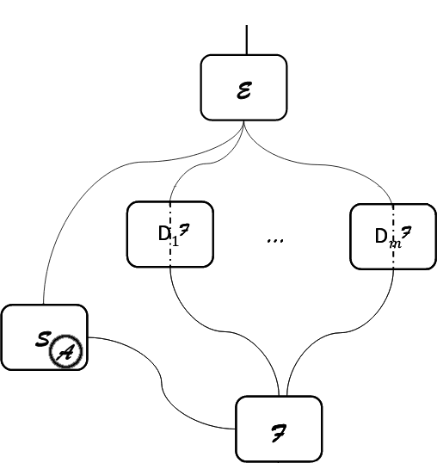
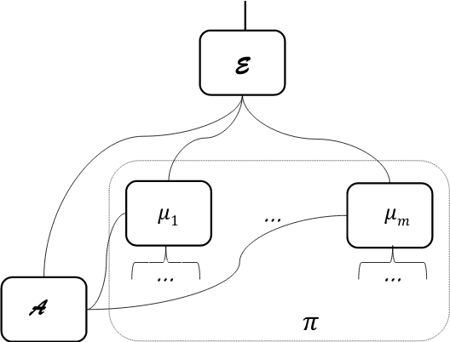
Simulation-based Security
Credits: “Universally Composable Security”, Ran Canetti https://eprint.iacr.org/2000/067

Slide 9
Our paper
a) Define functionality

Slide 10
Our paper
b) Implement specification
a) Define functionality

Slide 11
Our paper
b) Implement specification
a) Define functionality
c) Prove indistinguishability
Notes:
Proof of ind = def. simulator + follow every message seq from E and show that responses same in ideal & real
As secure as Bitcoin
Also
- prove revocation keys secure
- exact negligent behavior
TODOs:
- add fees
- prove actual commit secret generation secure

Slide 12
Our paper
d) Prove naive ledger unrealizable
b) Implement specification
a) Define functionality
c) Prove indistinguishability
Notes:
G_Ledger (Zikas et al) as hybrid
Very complex
Justification: G_Ledger (e.g. FairSwap) unrealizable

Slide 13
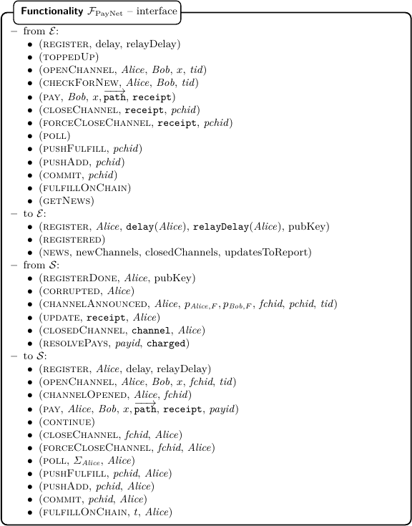
Functionality
Notes:
Complicated interface – match protocol messages with E
But abstracts protocol messages, no cryptographic primitives → much simpler
Think of Env as human user + polling daemon
Let’s look at subset

Slide 14
Functionality
Workhorse messages
  (open_channel, Alice, Bob, x)
  (pay, Bob, x, path, receipt)
  ({,force}_close_channel, receipt, id)
(poll) – sync and check for malicious closures
(resolve_pays, charged) – HTLC resolutions
check_closed(state)
(get_news)
Notes:
Poll – if defrauded player wasn’t negligent (polled in time), halt (ack of Func failure)
In proof we show that Prob[halt] < negl
Resolve_pays – also halts if non-negligent was defrauded
check_closed procedure after every sync – may halt
get_news returns opened, closed, updated channels

Slide 15
Thank you! Questions?
https://github.com/OrfeasLitos/PaymentChannels/
Image credits:
https://www.flaticon.com/authors/freepik
https://xkcd.com/

