Slide 1
A Composable Security Treatment of the Lightning Network
Aggelos Kiayias
Orfeas Stefanos Thyfronitis Litos
University of Edinburgh
24/6/2020

Slide 2



Part 1
The Lightning Network

Slide 3


20,000 tx/s
7 tx/s

Slide 4
Problem
All txs validated by all wallets
Solution
- Move most txs off-chain
- Resolve disputes on-chain

Slide 5


Alice
5

Slide 6
5
Com
0
5
0
Alice
5

Slide 7
Alice
& Bob
5
Com
0
5
0
Alice
5

Slide 8
Alice
& Bob
5
Com
0
5
Bob
0
Alice
5

Slide 9
Alice w/ Δt OR Bob_rev
Alice
& Bob
5
Com
0
5
Bob
0
Alice
5

Slide 10
Alice w/ Δt OR Bob_rev
Alice
Alice
& Bob
Alice
& Bob
5
5
Com
0
Com
0
5
5
Bob w/ Δt OR Alice_rev
Bob
0
0
Alice
5

Slide 11
Alice w/ Δt OR Bob_rev
Alice
Alice
& Bob
Alice
& Bob
5
5
Com
0
Com
0
5
5
Bob w/ Δt OR Alice_rev
Bob
0
0
Alice
& Bob
Alice
F
5
5

Slide 12
Alice w/ Δt OR Bob_rev
Alice
Alice
& Bob
Alice
& Bob
4
4
Com
1
1
Com
1
5
5
Bob w/ Δt OR Alice_rev
Bob
1
1
Alice
& Bob
Alice
F
5
5

Slide 13
Alice w/ Δt OR Bob_rev
Alice
Alice
& Bob
Alice
& Bob
4
4
Com
1
1
Com
1
5
5
Bob w/ Δt OR Alice_rev
Bob
1
1
Alice
& Bob
Alice
F
5
5

Slide 14
Alice w/ Δt OR Bob_rev
Alice
Alice
& Bob
Alice
& Bob
4.5
4.5
Com
2
0.5
Com
2
5
5
Bob w/ Δt OR Alice_rev
Bob
0.5
0.5
Alice
& Bob
Alice
F
5
5

Slide 15


Alice w/ Δt OR Bob_rev
Alice
& Bob
Alice
& Bob
Alice
4.5
F
Com
2
5
5
5
Bob
0.5
Alice
& Bob
F
Com
5
Dispute period t

Slide 16
Alice w/ Δt OR Bob_rev
Alice
& Bob
Alice
& Bob
Alice
5
F
Com
0
5
5
5
Bob
0
Alice
& Bob
F
Com
5
Dispute period t

Slide 17
Alice w/ Δt OR Bob_rev
Alice
& Bob
Bob
Alice
& Bob
Rev
Alice
5
F
Com
0
5
5
5
Bob
0
Alice
& Bob
F
Com
Rev
5
Dispute period t

Slide 18

Multi-hop payments
Alice
Charlie
Charlie
Bob
Give 1
to Bob
Take 1
from Alice

Slide 19
Part 2
Our contribution

Slide 20
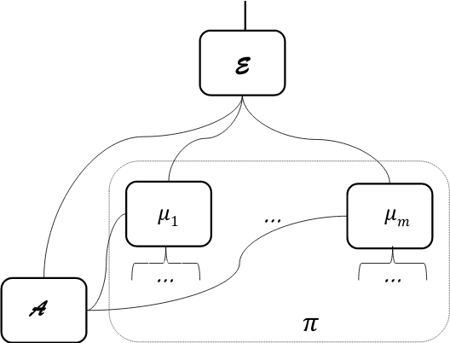
Simulation-based Security
Notes:
Every box 1 Turing machine
Environment can’t tell real from ideal world
Simulator weirdest part
Mu₁ – mu_n parties of LN protocol

Slide 21
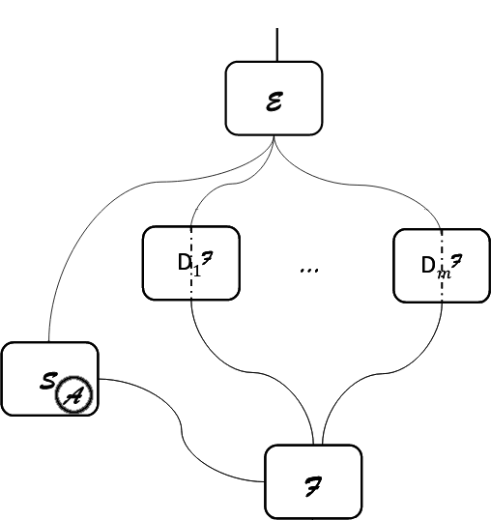
Simulation-based Security
Notes:
Every box 1 Turing machine
Environment can’t tell real from ideal world
Simulator weirdest part
Mu₁ – mu_n parties of LN protocol

Slide 22
Simulation-based Security
Credits: “Universally Composable Security”, Ran Canetti https://eprint.iacr.org/2000/067
Notes:
Every box 1 Turing machine
Environment can’t tell real from ideal world
Simulator weirdest part
Mu₁ – mu_n parties of LN protocol

Slide 23
Our paper
Prove indistinguishability
Define functionality
Notes:
Every box 1 Turing machine
Environment can’t tell real from ideal world
Simulator weirdest part
Mu₁ – mu_n parties of LN protocol

Slide 24
Universal Composition
If functionality F is UC-realized by protocol P, then a protocol R that internally uses F is indistinguishable from R’ that is like R but internally uses P
Notes:
Every box 1 Turing machine
Environment can’t tell real from ideal world
Simulator weirdest part
Mu₁ – mu_n parties of LN protocol

Slide 25
Universal Composition
[BMTZ’17, BGKRZ’18]
Notes:
Every box 1 Turing machine
Environment can’t tell real from ideal world
Simulator weirdest part
Mu₁ – mu_n parties of LN protocol

Slide 26
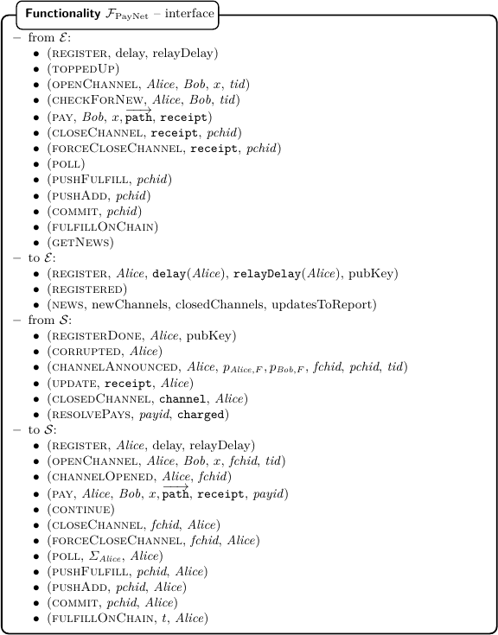
Notes:
Complicated interface – match protocol messages with E
But abstracts protocol messages, no cryptographic primitives → much simpler
Let’s look at subset

Slide 27
Our contributions
Prove Lightning Network security in UC framework
Derive exact time bounds for how often parties need to check the chain
Prove that a ledger with instant finality is unrealizable
Notes:
Every box 1 Turing machine
Environment can’t tell real from ideal world
Simulator weirdest part
Mu₁ – mu_n parties of LN protocol

Slide 28
Our contributions
Prove Lightning Network security in UC framework
Derive exact time bounds for how often parties need to check the chain
Prove that a ledger with instant finality is unrealizable
Thank you!
Notes:
Every box 1 Turing machine
Environment can’t tell real from ideal world
Simulator weirdest part
Mu₁ – mu_n parties of LN protocol

