Slide 1
Introduction to Blockchains
Orfeas Stefanos Thyfronitis Litos
PhD in Cryptography and Blockchains
University of Edinburgh
11/10/2019
Gentle

Slide 2








Outline
Why it works
Smart contracts
Types, ideas and the future

Slide 3
Part I
Why it works, or a Bitcoin primer

Slide 4
What is a Blockchain?
distributed,
append-only,
transaction ledger
Notes:
Useful for digital money
Bitcoin: the first blockchain

Slide 5
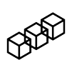
What is a Blockchain?

Slide 6
Transactions
Alice
Bob
tx
1 BTC
1 BTC

Slide 7
Transactions
Input
Output
Alice
Bob
tx
1 BTC
1 BTC

Slide 8
Transaction Graph

Slide 9
Many inputs

Slide 10
Many outputs

Slide 11
Unspent Transaction Outputs (UTXO)

Slide 12
Bob has 2 BTC
Bob
1 BTC
Bob
1 BTC

Slide 13
Bob pays 1 BTC to Alice
Bob
1 BTC
Bob
Bob
Alice
1 BTC
1 BTC
1 BTC
Notes:
Bob broadcasts new tx

Slide 14
New UTXO
Bob
1 BTC
Alice
1 BTC

Slide 15
Block
Contains
  transactions
  metadata
Has unique parent

Slide 16
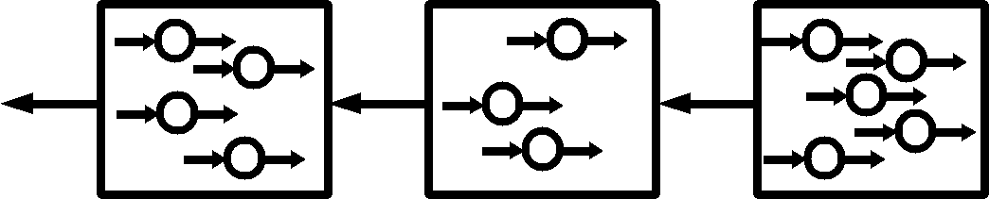
Blockchain
Notes:
Block Can have any number of txs (within limits)

Slide 17
Blockchain
History of all transactions
Notes:
Last block called … (next slide)

Slide 18
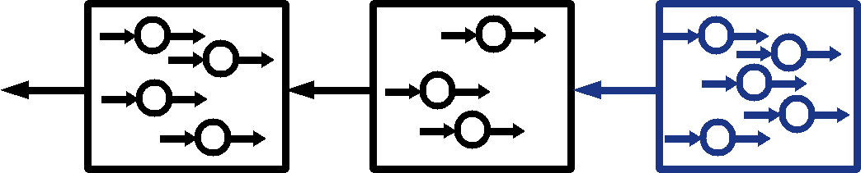
Blockchain
tip
Notes:
How are New blocks made? let’s make some space

Slide 19
Mining (a.k.a. writing history)
Only valid transactions?
Proof of Work?
Notes:
Received a new block from the network
- no spending previously spent outputs (double spend)
- no previously seen txs
- all txs must spend utxos
Block id hard to make, proves miner tried. Thus Blocks are relatively rare

Slide 20
Mining (a.k.a. writing history)
Only valid transactions!
Proof of Work!
new tip

Slide 21
Hash function
ε
01
ab
10
bb
11
baa
n-bit integers
strings
Notes:
H: infinite domain, finite range, a.k.a collisions

Slide 22
Hash function
easy
One way:
One way:
hard
ε
01
ab
10
bb
11
baa
n-bit integers
strings
Collision free:
rare
Notes:
Easy = polynomial (I can hash files easily)
Hard = exponential (I have to try random strings until I find correct)
Prob[collision] < Prob[meteorite]

Slide 23
Hash function
easy
One way:
Bitcoin uses SHA256, e.g.:
SHA256( ) =
0000000000000000000d7819fc59c65ca6f3e8f73c6eeadf538aa874a31341fb
One way:
hard
ε
01
598324
ab
10
bb
11
baa
n-bit integers
strings
Collision free:
rare
Notes:
Prob[collision] < Prob[meteorite] because many bits
Notice many zeroes

Slide 24
Proof of work
def hasProofOfWork(block):
return hasManyLeadingZeroes(SHA256(block))
Valid blocks need energy
→
can’t spam blocks
Notes:
Bitcoin secret sauce
How many zeroes? Adjusts automatically
Miners try random nonces until small hash

Slide 25

Forks
Notes:
Network latency may cause two miners to find a block at the same time

Slide 26
Forks
Protocol says:
Choose longest fork
If equal, choose random

Slide 27
Nice properties
if honest mining power > 50%,
Liveness: a new tx will enter the chain
Persistence: Old blocks won’t change
Garay, Kiayias, Leonardos. "The bitcoin backbone protocol: Analysis and applications." Annual International Conference on the Theory and Applications of Cryptographic Techniques. Springer, Berlin, Heidelberg, 2015.
Notes:
To trust a blockchain, ask for these two properties
Append-only ledger!
Bitcoin technical breakthrough: unauthenticated (~= decentralised ~= no single point of failure) AND resilient to bad actors

Slide 28
Part II
Smart Contracts: Programmable money

Slide 29
Remember transactions?
Alice
Bob
tx
1 coin
1 coin

Slide 30
Now add some code!
Alice
if (Alice gives 1 coin
and
block height > 10)
then
give Bob 1 coin
Bob
1 coin
1 coin
Notes:
Again, the basic operation is a transaction
Turing complete

Slide 31
Example 1: Flip a coin
Bob
1 coin
repeat no_operation
until
(Alice gives 1 coin
and
Bob gives 1 coin)
winner =
random(Alice, Bob)
give winner 2 coins
winner
2 coins
Alice
1 coin
Notes:
Careful...

Slide 32
Example 1: Flip a coin
Bob
1 coin
repeat no_operation
until
(Alice gives 1 coin
and
Bob gives 1 coin)
winner =
random(Alice, Bob)
give winner 2 coins
winner
2 coins
Alice
1 coin
Don’t use this contract in real life!
Notes:
Arrows unnecessary

Slide 33
Example 2: King of the Hill
top = 0
king = null
while (true)
if (user gives x coins
and
x > top)
give king top coins
king = user
top = x
Don’t use this contract in real life!
Notes:
Previous king gets refunded
New king can brag!

Slide 34
Still too hard
A fast way to lose your (and others’)
Smart Contracts: Programmable money
Very easy to make mistakes
  TheDAO
  Parity wallet
Smart contract languages not (yet) safe
Notes:
Discouraging? It’s a challenge!
Blockchain engineers really wanted

Slide 35



Part III
V
Types of blockchains, applications and the future
V
Xchain
V

Slide 36



Cryptokitties
Cute kitties that live on Ethereum!
Notes:
Tradeable, breedable
Smart contract success story
Drove ETH price up, almost filled blocks!
ERC721 token
Digital assets discussion

Slide 37
MakerDao
Decentralised stablecoin
  On Ethereum
1 Dai = 1 USD
Overcollateralised by floating “Maker”
Notes:
I am no economist, don’t really understand it – how does overcollateralisation work?
Success story: complex decentralised system without any successful attacks deployed so far, written in Solidity

Slide 38
Types of blockchains
Permissioned vs Permissionless
Proof of Work vs Proof of Stake
Private vs Transparent
V
V
V
Notes:
1) Who can create blocks, transactions
2) How do we agree on one history (2 ways really)
3) How much data on chain? (e.g. in zcash every tx is a proof that money is transferred, not created)

Slide 39

Scalability issue
: 7 txs/sec
: 20,000 txs/sec
Problem: too much redundancy
Notes:
Impossible to check every tx on every computer

Slide 40
Candidate Solution
Payment Channels! (e.g. Lightning, )
1 tx on-chain to open channel
Unlimited off-chain txs
1 tx on-chain to close channel
Notes:
Can also do multi-hop payments

Slide 41
Crosschain transactions
Move coins to another chain
E.g. use bitcoins in Ethereum contracts
Notes:
Sounds impossible, but it’s real

Slide 42
Interconnected blockchains
Specialised blockchains
Separation of duties
Related: Sharding

Slide 43
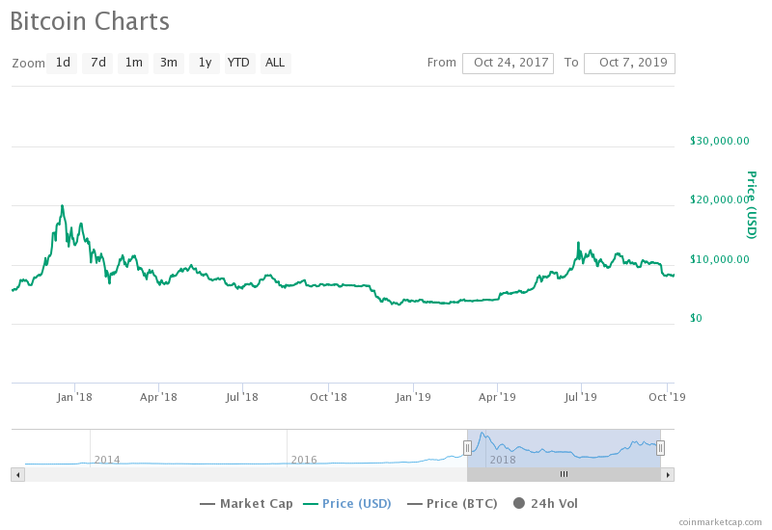
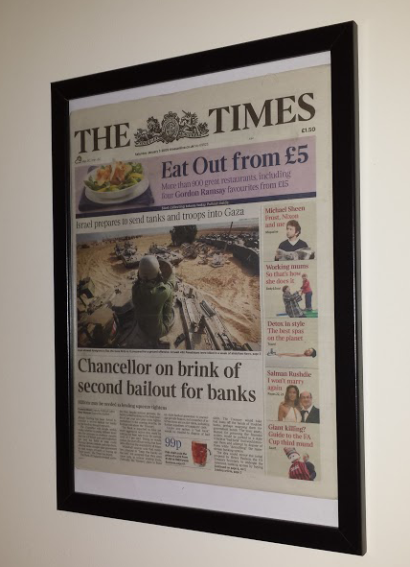
Questions?
Credits:
Blockchain by Pablo Rozenberg from the Noun Project

Slide 44
Blockchain
Notes:
Template with individual elements. Other slides contain a single metaelement built from the ones here.

