Slide 1
Lightning Network Analysis and Recursive Virtual Channels
Orfeas Stefanos Thyfronitis Litos
University of Edinburgh
8/2/2021

Slide 2


20,000 tx/s
7 tx/s

Slide 3
Problem
All txs validated by all wallets
Solution
- Move most txs off-chain
- Resolve disputes on-chain

Slide 4
Part 1
A Composable Security Treatment of the Lightning Network

Slide 5



Lightning Channels
Open
Alice: 1
Bob: 2
Alice: 1
Bob: 2
F
Alice & Bob: 3

Slide 6

Lightning Channels
Open
Pay
Alice: 1
Bob: 2
Alice: 1
Bob: 2
Alice: 1.3
Bob: 1.7
Alice: 1.3
Bob: 1.7
F
Alice & Bob: 3

Slide 7
Lightning Channels
Open
Pay
Alice: 1
Bob: 2
Alice: 1
Bob: 2
Alice: 1.3
Bob: 1.7
Alice: 1.3
Bob: 1.7
F
Alice & Bob: 3
Unlimited times
No touching blockchain

Slide 8
Lightning Channels
Open
Pay
Close
Alice: 1
Bob: 2
Alice: 1
Bob: 2
Alice: 1.3
Bob: 1.7
Alice: 1.3
Bob: 1.7
Alice: 1.3
Bob: 1.7
Alice: 1.3
Bob: 1.7
F
C
Alice & Bob: 3
Unlimited times
No touching blockchain
Alice: 1.3
Bob: 1.7

Slide 9
Lightning Channels
Open
Pay
Close
Unilateral
Alice: 1
Bob: 2
Alice: 1
Bob: 2
Alice: 1.3
Bob: 1.7
Alice: 1.3
Bob: 1.7
Alice: 1.3
Bob: 1.7
Alice: 1.3
Bob: 1.7
F
C
Alice & Bob: 3
Unlimited times
No touching blockchain
Alice: 1.3
Bob: 1.7

Slide 10

Multi-hop payments
From channels to network!
Alice
Charlie
Charlie
Bob
Give 1
to Bob
Take 1
from Alice

Slide 11
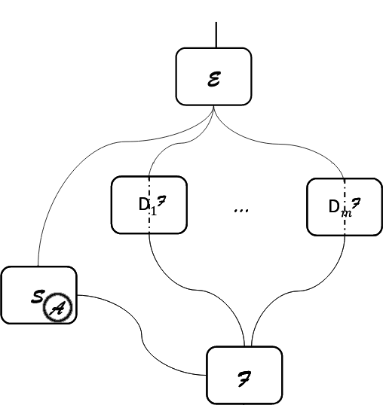
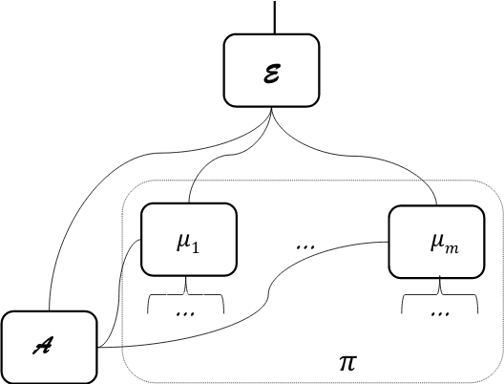
Simulation-based Security
Credits: “Universally Composable Security”, Ran Canetti https://eprint.iacr.org/2000/067

Slide 12
Our paper
a) Define functionality

Slide 13
Our paper
b) Implement specification
a) Define functionality

Slide 14
Our paper
b) Implement specification
c) Prove indistinguishability
a) Define functionality
Notes:
Proof of ind = def. simulator + follow every message seq from E and show that responses same in ideal & real
As secure as Bitcoin
Also
- prove revocation keys secure
- exact negligent behavior
TODOs:
- add fees
- prove actual commit secret generation secure

Slide 15
Blockchain Functionality
[BMTZ’17, BGKRZ’18]
Notes:
Every box 1 Turing machine
Environment can’t tell real from ideal world
Simulator weirdest part
Mu₁ – mu_n parties of LN protocol

Slide 16
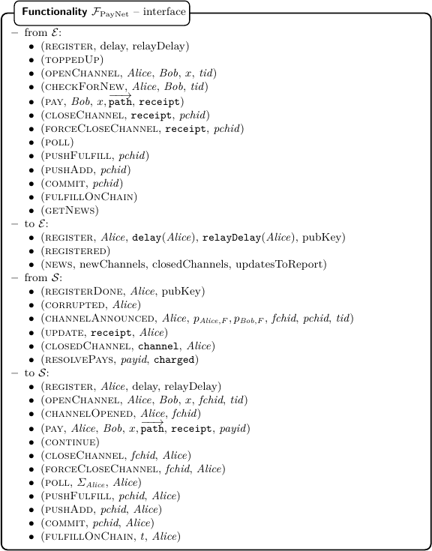
Functionality
Notes:
Complicated interface – match protocol messages with E
But abstracts protocol messages, no cryptographic primitives → much simpler
Think of Env as human user + polling daemon
Let’s look at subset

Slide 17
How often online?
No in-flight payments
  sync at least every to_self_delay blocks
In-flight HTLC – intermediary
  a = “max new blocks from tx bcast till settled”
  Sync during [out_cltv_exp, in_cltv_exp – 2a]
  try to publish HTLC-timeout
  Sync again after a
  If HTLC-success found, update or fulfill on-chain
In-flight HTLC – payee
  Fulfill on-chain until min_final_cltv_expiry – a
Notes:
Payee not analyzed in paper because equivalent to failed payment – can try again

Slide 18
Our contributions
Use a realistic ledger functionality
  Prove naive ledger unrealizable
Prove Lightning Network security in UC framework
Derive exact time bounds for how often parties need to check the chain
Notes:
Every box 1 Turing machine
Environment can’t tell real from ideal world
Simulator weirdest part
Mu₁ – mu_n parties of LN protocol

Slide 19
Part 2
Recursive Virtual Payment Channels for Bitcoin

Slide 20
Features
Enables long-lived “virtual” channels w/o an on-chain funding TX
Virtual channels built on top of a path of preexisting “base” channels – left endpoint funds the channel
Base channels may themselves be virtual!
Virtual channels can leverage a path of many base channels
Notes:
Parties w/ virtual channel pay each other fast, w/o comm. with intermediaries
3rd bullet: recursion

Slide 21
Construction
Intermediary i has 3 classes of TXs:
“Initiator” TX
  Spends left & right funding outputs
  Has virtual output with interval [i]
Notes:
Most details omitted

Slide 22
Construction
Intermediary i has 3 classes of TXs:
“Initiator” TX
  Spends left & right funding outputs
  Has virtual output with interval [i]
“Extend-interval” TXs
  Spends 1 funding output and 1 virtual output with interval [j, …, i-1] or [i+1, …, j]
  Has virtual output w/ interval [j, …, i] or [i, …, j]
Notes:
Most details omitted

Slide 23
Construction
Intermediary i has 3 classes of TXs:
“Initiator” TX
  Spends left & right funding outputs
  Has virtual output with interval [i]
“Extend-interval” TXs
  Spends 1 funding output and 1 virtual output with interval [j, …, i-1] or [i+1, …, j]
  Has virtual output w/ interval [j, …, i] or [i, …, j]
“Merge-intervals” TXs
  Spends 2 virtual outputs with intervals [j, …, i-1] and [i+1, …, k]
  Has virtual output with interval [j, …, k]
Notes:
Most details omitted

Slide 24
Example 1
Fundee wants to close

Slide 25
t=0
A & B
B & C
C & D
D & E
x_{AB}
x_{BC}
x_{CD}
x_{DE}

Slide 26
t=1
[E]
D–& E
x_{AE}
x_{DE}-x_{AE}
E
A & B
B & C
C & D
D & E
x_{AB}
x_{BC}
x_{CD}
x_{DE}

Slide 27
t=2
D
x_{AE}
[D,E]
C–& D
x_{AE}
x_{CD}-x_{AE}
D
[E]
D–& E
x_{AE}
x_{DE}-x_{AE}
E
A & B
B & C
C & D
D & E
x_{AB}
x_{BC}
x_{CD}
x_{DE}

Slide 28
t=3
C
x_{AE}
[C,D,E]
B–& C
x_{AE}
C
x_{BC}-x_{AE}
D
x_{AE}
[D,E]
C–& D
x_{AE}
x_{CD}-x_{AE}
D
[E]
D–& E
x_{AE}
x_{DE}-x_{AE}
E
A & B
B & C
C & D
D & E
x_{AB}
x_{BC}
x_{CD}
x_{DE}

Slide 29
B
x_{AE}
t=4
A–& E
A–& B
x_{AE}
B
x_{AB}-x_{AE}
C
x_{AE}
[C,D,E]
B–& C
x_{AE}
C
x_{BC}-x_{AE}
D
x_{AE}
[D,E]
C–& D
x_{AE}
x_{CD}-x_{AE}
D
[E]
D–& E
x_{AE}
x_{DE}-x_{AE}
E
A & B
B & C
C & D
D & E
x_{AB}
x_{BC}
x_{CD}
x_{DE}

Slide 30
Example 2
Simultaneous initiators

Slide 31
t=0
A & B
B & C
C & D
D & E
E & F
x_{AB}
x_{BC}
x_{CD}
x_{DE}
x_{EF}

Slide 32
t=1
C–& D
x_{CD}-x_{AF}
C
x_{AF}
[C]
B–& C
E–& F
x_{AF}
[F]
x_{BC}-x_{AF}
C
x_{EF}-x_{AF}
x_{AF}
F
A & B
B & C
C & D
D & E
E & F
x_{AB}
x_{BC}
x_{CD}
x_{DE}
x_{EF}

Slide 33
t=2
E
x_{AF}
C–& D
D–& E
[E,F]
x_{CD}-x_{AF}
C
x_{AF}
E
x_{DE}-x_{AF}
x_{AF}
[C]
B–& C
E–& F
x_{AF}
[F]
x_{BC}-x_{AF}
C
x_{EF}-x_{AF}
x_{AF}
F
A & B
B & C
C & D
D & E
E & F
x_{AB}
x_{BC}
x_{CD}
x_{DE}
x_{EF}

Slide 34
t=3
[C,D,E,F]
D
x_{AF}
x_{AF}
D
E
x_{AF}
C–& D
D–& E
[E,F]
x_{CD}-x_{AF}
C
x_{AF}
E
x_{DE}-x_{AF}
x_{AF}
[C]
B–& C
E–& F
x_{AF}
[F]
x_{BC}-x_{AF}
C
x_{EF}-x_{AF}
x_{AF}
F
A & B
B & C
C & D
D & E
E & F
x_{AB}
x_{BC}
x_{CD}
x_{DE}
x_{EF}

Slide 35
Example 3
Virtual base channel

Slide 36
t=0
A & C
C & D
D & E
x_{AC}
x_{CD}
x_{DE}
A & B
B & C
x_{AB}
x_{BC}

Slide 37
t=1
C–& D
x_{CD}-x_{AE}
D
[D]
x_{AE}
x_{AE}
D–& E
D
x_{DE}-x_{AE}
A & C
C & D
D & E
x_{AC}
x_{CD}
x_{DE}
A & B
B & C
x_{AB}
x_{BC}

Slide 38
t=2
C–& D
x_{CD}-x_{AE}
D
[D]
x_{AE}
x_{AE}
D–& E
D
x_{DE}-x_{AE}
A & C
C & D
D & E
x_{AC}
x_{CD}
x_{DE}
[C]
B–& C
x_{AC}
C
x_{BC}-x_{AC}
A & B
B & C
x_{AB}
x_{BC}

Slide 39
t=3
C–& D
x_{CD}-x_{AE}
D
[D]
x_{AE}
x_{AE}
D–& E
D
x_{DE}-x_{AE}
A & C
C & D
D & E
x_{AC}
x_{CD}
x_{DE}
B
A–& B
x_{AC}
B
x_{AB}-x_{AC}
[C]
B–& C
x_{AC}
C
x_{BC}-x_{AC}
A & B
B & C
x_{AB}
x_{BC}

Slide 40
A & E
t=4
C
x_{AE}
A–& C
C–& D
x_{AE}
x_{CD}-x_{AE}
C
x_{AC}-x_{AE}
D
[D]
x_{AE}
x_{AE}
D–& E
D
x_{DE}-x_{AE}
A & C
C & D
D & E
x_{AC}
x_{CD}
x_{DE}
B
A–& B
x_{AC}
B
x_{AB}-x_{AC}
[C]
B–& C
x_{AC}
C
x_{BC}-x_{AC}
A & B
B & C
x_{AB}
x_{BC}

Slide 41
Design decisions
UC secure
Intuitive functionality
State machine
Uses

Slide 42
Summary
Composable analysis of the Lightning Network
Construction and composable analysis of Recursive Virtual Channels for Bitcoin
Thank you!

