Slide 1
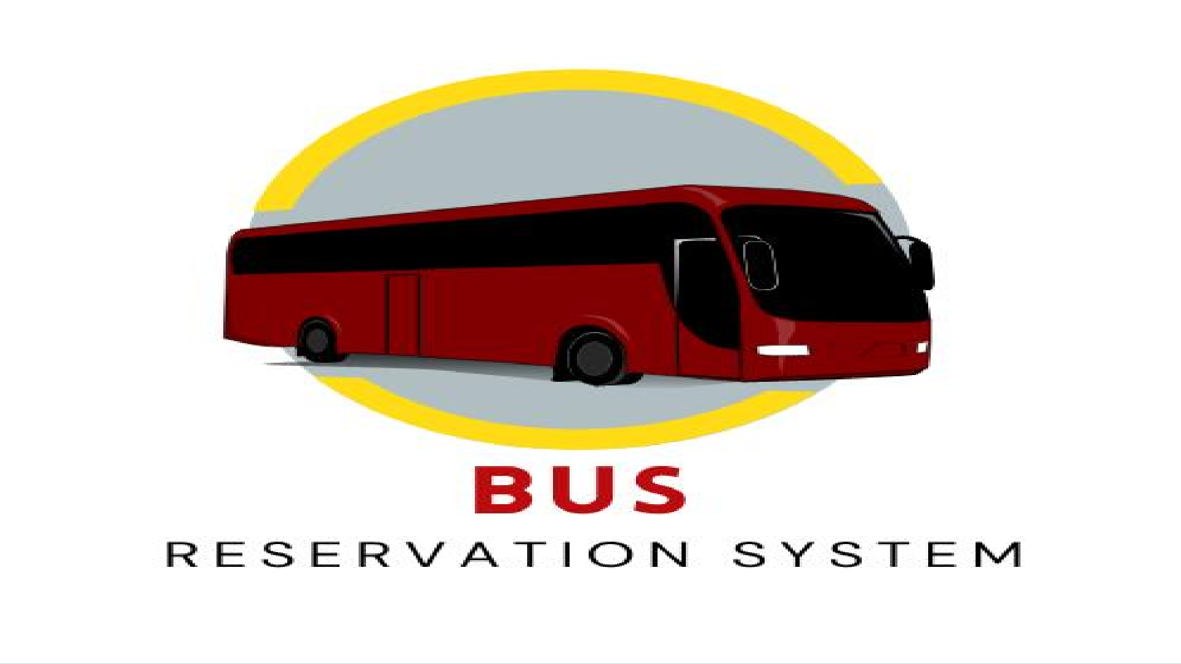
Bus reservation

Slide 2
Introduction
The bus reservation system is a simple yet practical application designed to streamline the process of booking bus seats and managing bus schedules. It provides functionalities for both bus companies and passengers, ensuring a smooth and efficient reservation experience.
Key features include:
Adding and managing bus details by the bus company.
Seat reservation by passengers.
Viewing reserved and available seats.
Authentication for administrative tasks.
This system leverages C++'s object-oriented programming features like classes and file handling to store and manage data persistently.

Slide 3
Motivation
The increasing demand for digital solutions in transportation motivated the development of this project. Traditional paper-based reservation systems are:
Prone to errors.
Time-consuming.
Inefficient for real-time updates.
By transitioning to a computerized system:
Passenger convenience is enhanced with quick bookings.
Bus operators can efficiently manage schedules and seat availability.
Data is stored and retrieved with accuracy, eliminating manual errors.

Slide 4
Statement of problem
The problem this project addresses can be summarized as follows:
Inefficient seat allocation: Manual systems often lead to overbooking or underutilization of available seats.
Data inconsistency: Traditional methods fail to provide a centralized
repository for bus schedules and reservations.
Lack of transparency: Passengers lack a clear view of available seats, causing confusion.
Difficulty in management: Bus companies face challenges in maintaining
records and updating schedules dynamically.

Slide 5
Objective
The primary objective of this project is to develop a meaningful real life usable program such as bus reservation system. Allows bus operators to manage their fleet and schedules effectively.
Enables passengers to book seats with ease and transparency.
Provides a secure, user-friendly, and error-free environment for reservations.
Ensures persistent storage of data, even after system restarts.

Slide 6
Methodology
Requirements Analysis: Defined roles (Admin, Passenger) and key features (Add bus, Reserve seats, View schedules).
Design:
Classes: Managed buses and reservations.
File Handling: For saving and loading data.
Implementation: C++ program with role-based menus and authentication.
Testing: Validated inputs, ensured functionality for all use cases.

Slide 7
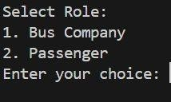
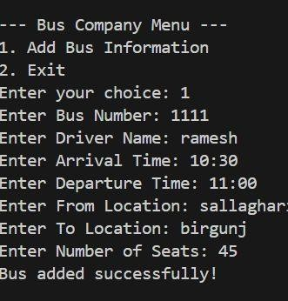
Result

Slide 8
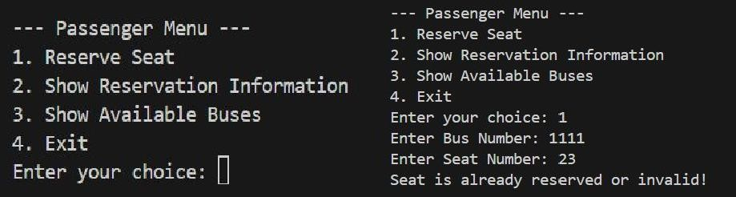

Slide 9
Conclusion
This Bus Reservation System simplifies seat booking and schedule management for bus companies and passengers. It bridges the gap between traditional manual processes and the need for efficient, error-free, and real-time operations in transportation management.

Slide 10
THANK YOU

