Slide 1
— LOCAL MODELS · A 201 FIELD GUIDE
Beyond the Data Center
When your own private API becomes an edge, and how to actually run it.
Peter Haubrich / Founder, Wayfinder Collective / 30-min talk + Q&A
LOCAL MODELS · FIELD GUIDE
01 / 22

Slide 2
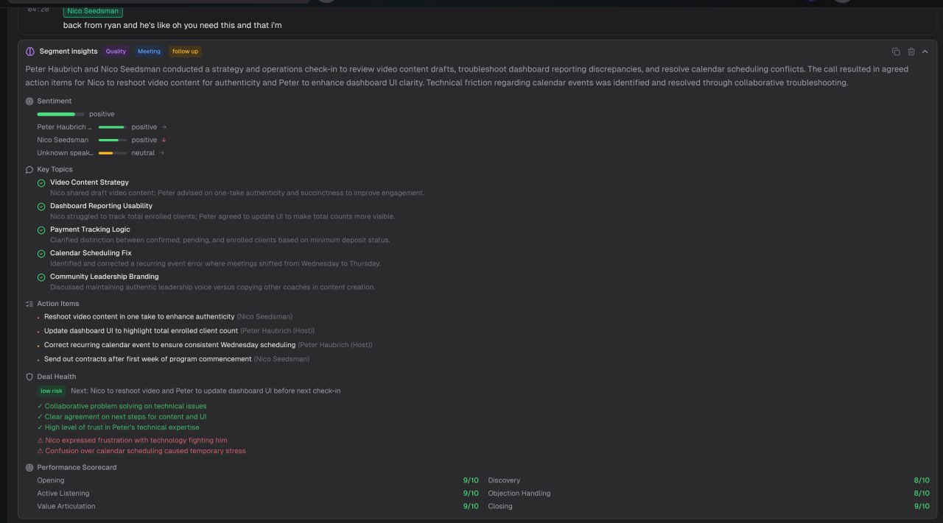
AI ANALYSIS · LOCAL MODEL · PRIVATE STACK
02 / 22

Slide 3
— WHO'S TALKING
Peter Haubrich
• Founder & CEO of Wayfinder Collective
• Builds Wayfinder OS, a 500K-line, AI-native platform for coaches and 7-figure high-ticket teams
• Runs a multi-node local inference cluster in production, every day
• Customer Service / Sales rep to 8 figure CEO of the same company in 3 years
home_cluster ● RUNNING
mac-studio (M3 Ultra · 256GB)
397B
gpu-node (RX 7900 XTX · 24GB)
27B Q4
edge-node (RX 9060 XT · 16GB)
WhisperX
LOCAL MODELS · FIELD GUIDE
03 / 22

Slide 4
— THE LINE
Local currently solves recurring non-instant medium reasoning at scale.
01
When it matters
Finding that line for your business, and what you gain by owning the stack and the data path.
02
How to run it
The setup, minus the tutorial. Hardware, models, and my real numbers.
LOCAL MODELS · FIELD GUIDE
04 / 22

Slide 5
— HOW I GOT HERE
The $900 day
$4-8K
per month · Opus credits on Cursor
$900
in a single day
I was renting intelligence from someone else's data center and burning through it across two devs. The $900 day was when it stopped being sustainable. I started asking what it would cost to own the compute instead of rent it. That question built the cluster, and a private API that never leaves my metal.
LOCAL MODELS · FIELD GUIDE
05 / 22

Slide 6
01
When local matters
The default is the data center. That's fine, until it isn't.
LOCAL MODELS · FIELD GUIDE
06 / 22

Slide 7
— START HONEST
The data center is the right default
One call, no GPUs, prototype in minutes. For most projects that's correct. Don't build a home lab to dodge a $12 bill.
THE REAL QUESTION
It isn't local vs. cloud. It's: when does owning your stack, and keeping the data path private, actually start to pay off?
LOCAL MODELS · FIELD GUIDE
07 / 22

Slide 8
— THE UNCOMFORTABLE PART
You don't care about local yet
01
The small models are narrow
Below ~128GB of memory you get a model that's good at one job, not a generalist. Useful general-purpose local starts around 128GB+.
02
Your tokens are subsidized
Frontier labs price plans to win the market, not earn margin. Huge quota for little cost. Why leave their data center?
NOTE
Both of those are temporary. Privacy pressure is not.
LOCAL MODELS · FIELD GUIDE
08 / 22

Slide 9
— WHERE THIS IS HEADED
The Uber playbook
THEN
$4
a ride
NOW
$60
to the airport
Subsidize hard to capture the market, then reprice once you depend on it. Cheap tokens are the cheap-Uber era. Post-IPO, the incentive flips from growth to margin.
HEDGE
Owning your inference, and your private API, is a hedge against the day the meter changes.
LOCAL MODELS · FIELD GUIDE
09 / 22

Slide 10
— WHEN LOCAL STARTS TO MATTER
Five triggers
01 Cost at volume
Data-center bills scale with usage. Local is a fixed cost after the hardware.
02 Data you can't send out
Client PII, health, financial, compliance. The 255K-contact problem. Privacy is the product.
03 Latency & reliability
No rate limits, no vendor outages, works offline. Your private API is always up when you are.
04 Control
No silent model swaps, no deprecations. Fine-tune on your own data, on your metal.
05 Independence
You don't bet the company on one vendor's pricing, terms, or data-retention policy.
LOCAL MODELS · FIELD GUIDE
10 / 22

Slide 11
— SAY IT OUT LOUD
The honest tradeoffs
Capability gap
The best frontier models still beat what you run at home on the hardest tasks.
Ops burden
You now run infrastructure: updates, uptime, drivers, quantization.
Upfront cost
Real money on the table before the first token.
THE FRAMING THAT KEEPS YOU HONEST
Local doesn't replace the data center. It takes the workloads where ownership and privacy beat rented capability.
LOCAL MODELS · FIELD GUIDE
11 / 22

Slide 12
— THE HEURISTIC
Use the data center by default. Go local when the work is high-volume, privacy-bound, or latency-sensitive, and doesn't need frontier-tier reasoning.
Shorter: frontier for the hard 10%. Private API for the recurring, sensitive 90%.
LOCAL MODELS · FIELD GUIDE
12 / 22

Slide 13
— PROOF · HOW I ROUTE IT AT WAYFINDER
It's a routing decision, not a religion
FRONTIER / DATA CENTER
• Architecture and system design
• Hard blockers, the genuinely difficult reasoning
• The 10% where capability is worth the bill
LOCAL / PRIVATE API
• Bulk classification and transcript analysis
• Anything touching client data
• High-volume, low-complexity work
• WhisperX on 9060 XT primary, Mac Studio CPU fallback
LOCAL MODELS · FIELD GUIDE
13 / 22

Slide 14
02
How to run it
The map and my real numbers, not a step-by-step install.
LOCAL MODELS · FIELD GUIDE
14 / 22

Slide 15
— THE WHOLE STACK
Every local setup is four layers
01 · HARDWARE
The metal that holds the weights
Memory decides the size of model you can run.
02 · RUNTIME
The engine that serves the model
Ease vs. throughput. Ollama through vLLM.
03 · MODEL
The weights you choose
Size to your memory first, task second.
04 · INTEGRATION
How it plugs into your product
An OpenAI-compatible private API on your metal.
LOCAL MODELS · FIELD GUIDE
15 / 22

Slide 16
— LAYER 01 · HARDWARE
Memory is the whole game
VRAM (or unified memory) sets the ceiling on model size. Rough tiers at Q4:
~8GB
ENTRY
7 to 8B models
~24GB
WORKHORSE
30B-class
40GB+
SERIOUS
70B territory
200B+
BIG MoE
multi-GPU or big Mac
TWO PATHS IN
A consumer GPU (a 24GB card), or Apple Silicon with large unified memory, more headroom per dollar once models get big.
LOCAL MODELS · FIELD GUIDE
16 / 22

Slide 17
— LAYER 02 · RUNTIME
Pick by ease vs. throughput
EASIEST
Ollama / LM Studio
One machine, one user, running in minutes. This is where you start.
THROUGHPUT
vLLM / SGLang
Serious concurrency, served behind an OpenAI-compatible private endpoint for real apps.
THE TRICK THAT MAKES BIG MODELS FIT
Quantization (Q4_K_M) roughly halves memory for minimal quality loss.
LOCAL MODELS · FIELD GUIDE
17 / 22

Slide 18
— LAYER 03 · MODEL
The 2026 field splits in two
WHERE YOUR INFERENCE LIVES
Big MoE track
GLM, DeepSeek, Kimi, Qwen 397B. Frontier-ish, needs a Mac Ultra, multi-GPU, or rented H100s.
WHAT YOUR DEVS RUN
Consumer track
Qwen 3.6 27B, Gemma 4. Fits a single GPU, the current local default.
START HERE
Don't start with the biggest model on the leaderboard. Start with the best one that runs smoothly on your machine.
LOCAL MODELS · FIELD GUIDE
18 / 22

Slide 19
— LAYER 04 · INTEGRATION
Your app barely changes
SWAP THE BASE URL
# before: someone else's data center
base_url = "https://api.provider.com/v1"
# after: your metal, same SDK, private API
base_url = "http://your-rig:11434/v1"
PRIVATE MESH
Local runtimes expose an OpenAI-compatible private API. Reach your rig from anywhere with Tailscale so it behaves like a cloud endpoint, but the data never leaves your metal.
LOCAL MODELS · FIELD GUIDE
19 / 22

Slide 20
— WHAT I ACTUALLY RUN · ONE TAILSCALE MESH
BIG-MODEL NODE
Mac Studio M3 Ultra
256 GB unified · 60-core GPU Qwen 3.5 · 397B A17B · 96k ctx
~35 tok/s · LiteLLM queue + routing
WORKHORSE
RX 7900 XTX
24 GB VRAM Qwen 3.6 · 27B Q4
~28 tok/s
EFFICIENCY NODE
RX 9060 XT · 16 GB
Custom Linux PC · always on Local transcription (primary)
WhisperX · private edge
A 400B-class model running in my house, reachable from my laptop like a private API, doing the work that used to be a bill that scaled with growth, with client data that never left the mesh.
LOCAL MODELS · FIELD GUIDE
20 / 22

Slide 21
— START THIS WEEK
If you take one thing: local isn't all-or-nothing. It's a routing decision.
1
Install Ollama, pull Qwen 3.6 (or Gemma 4), point your app's base URL at your private API.
2
Move one high-volume, privacy-sensitive, low-stakes workload off the data center.
3
Measure what it costs vs. what it replaced, and what never left your metal.
LOCAL MODELS · FIELD GUIDE
21 / 22

Slide 22

— YOUR TURN
Questions.
Peter Haubrich
Wayfinder Collective
peter@wayfindercollective.io
linkedin.com/in/peter-haubrich-d087
LOCAL MODELS · FIELD GUIDE
22 / 22

