Slide 1
Evolve the Harness,
Not (Just) the Model
Reinforcement learning on agent harnesses — reproduced locally on a frozen model
HarnessX · “Don't Train the Model, Evolve the Harness” · τ²-Bench retail · Claude Code as meta-agent

Slide 2
THE HOOK
“A frozen open model that solves 0% of a legal-agent benchmark end to end
is not as weak as that score looks. Zero model weights changed.”
Same model. Change the wrapper. Double-digit accuracy gains.
The question isn't “which model” — it's “which harness.”

Slide 3
What is a “harness”?
The runtime wrapper around the model.
• Context assembly · tools · memory · control flow · error recovery · evaluation
• agent = model.agentic(harness)
• Model = a fixed reasoning ceiling.
• Harness = how much of that ceiling you actually realize.

Slide 4
The thesis
Vanilla off-the-shelf harnesses are fine at baseline.
Vertical-specific use cases need the harness to evolve with them — or you design your own.
• Why? Each domain fails differently. One harness can't serve every vertical.

Slide 5
Two papers, one idea
• HarnessX (arXiv:2606.14249): MetaAgent.evolve() over trajectories — frozen Qwen3.5-9B / GPT-5.
• +14.5% avg, up to +44%. Weakest model gains most.
• “Evolve the Harness” (Niklaus): Meta-Harness proposer + gate — frozen DeepSeek-V4-Pro, legal vertical.
• 63.4% → 80.1% (+16.7pp).
Both: zero model-weight changes.

Slide 6
How harness evolution works
• R0: run tasks → LLM-judge each trajectory
• Meta-agent reads the failures → writes a new config.yaml (+ processors)
• Gate: keep if reward improves past tolerance, else revert to best-so-far
Repeat. It's harness-edit-as-MDP:
• state = config + traces · action = one edit · reward = gated pass-delta

Slide 7
Why it works — the core teaching
Most failures are NOT reasoning failures — they're harness failures:
• wrong file path · chunked-write corruption · malformed tool JSON
• context overflow · loop-without-progress · premature / wrong-context action
“For a weak agent, a lot of ‘capability’ is I/O discipline the scaffold can guarantee.”

Slide 8
The punchline: code beats prompts
“Five of the top six harnesses are deterministic code, not prompt edits.”
• Prompt edits: local, brittle, don't transfer across models.
• Code fixes: structural, portable, testable, versionable.

Slide 9
But it's not only code — 4 levers
The evolver edits the whole harness, not just processors:
• Instruction = prompts / guidance · Action = tools / skills
• Control = deterministic processors · Configuration = memory, compaction, knobs
Which lever wins depends on your model + your vertical's bottleneck:
• strong model → prompts · weak model → control code · long-context → memory/compaction · retrieval → tools

Slide 10
So: evolve the dimension your vertical is bottlenecked on
“Prompt dominance scales inversely with base-model strength.” — HarnessX paper
• Legal / retail reliability (frozen/weak model) → deterministic code dominates.
• LoCoMo long-context → memory + compaction. GAIA retrieval → tools. Sonnet → prompts.
This is the stronger thesis: not just a vertical-specific harness — the vertical-specific LEVER.

Slide 11
Inverse scaling
The weakest model gains the most.
• ALFWorld Qwen3.5-9B: 53 → 97 (+44) vs Sonnet: 83.6 → 94.8 (+11.2)
• Harness evolution makes small / cheap models punch up.
• Caveat: a capability floor exists — below it, evolution can't compound.

Slide 12
Vertical-specific harnesses
τ²-Bench = real business verticals: retail · airline · telecom.
• Evolve each independently — database tasks need different processors than pure-logic puzzles.
• Reference (retail, Qwen3.5-27B agent): 0.807 → 0.965, 18/22 badcases fixed.
• Elsewhere: Database domain 0% → 53.8%.

Slide 13
Our reproduction — a real lift (telecom)
same frozen model throughout · evolved the harness, not the weights
Frozen qwen3:32B (local, llama.cpp), τ²-Bench telecom, same 4 mobile_data_issue tasks.
• Vanilla harness (system prompt + token budget only): avg reward = 0.500
• + IRMA PolicyHint (telecom policy alerts): avg reward = 0.750
+0.25 absolute, +50% relative — zero model-weight changes, no regressions.
• Mechanism: [POLICY ALERT] injected → agent calls enable_roaming → rescues the abroad task 0.0 → 1.0.

Slide 14
Why telecom worked where retail didn't
• Retail = strict DB-equality grading → a Q4 local model scores ~0, nothing to lift.
• Telecom = lenient outcome-state grading → non-zero baseline the harness can move.
Cause ↔ lever alignment: vanilla fails the roaming task; IRMA's rule targets exactly that.
• Not at ceiling: 32B solves easy tasks (1.0), fails user_abroad (0.0) — room for the harness.
• A weaker 8B agent would show a BIGGER gap — inverse scaling.

Slide 15
Designing the vertical benchmark is HALF the work
The benchmark IS the reward function for agentic RL. No signal → no evolution.
• A benchmark you can evolve against needs:
• · a non-zero baseline (model not floored) · room (not at ceiling)
• · a failure mode that matches a lever · grading that gives a gradient (partial credit / enough tasks)
• Retail (strict DB) → 0.00 dead end. Telecom (lenient) → moves. GSM8K → clean gradient.
Vertical agents need vertical benchmarks — co-design the harness AND the benchmark together.

Slide 16
An honest note on reproducing the *number*
The METHOD reproduces on a laptop: diagnose trace → pick lever → author component → measure.
• The benchmark + grading choice matters: pick a domain where the model has a non-zero baseline.
• Small samples are noisy — one task hit an infra timeout; the paper uses 100+ tasks, pass^k, trials.
• Reference at scale (27B retail): 0.807 → 0.965. Our local telecom: 0.50 → 0.75.

Slide 17
How this workshop runs — you drive it
Not slide-watching. You run the loop on your laptop.
• 1. Run the vanilla baseline → watch a frozen model FAIL a real benchmark task.
• 2. Read the trace frontmatter → feel it's a harness failure, not a reasoning one.
• 3. Invoke the harness-evolver skill → YOUR Claude Code diagnoses + authors a fix.
• 4. make eval → see the number move. Loop until it lifts.
A reference solution is shipped — but try your own lever first.

Slide 18
The meta-agent is YOU (Claude Code)
evolve() = an agent that reads traces and writes config. We used Claude Code directly.
• read failure trajectories → diagnose the pattern → author a processor → re-eval → keep if it gates
• No RL training. No GPU. The loop runs on a laptop.

Slide 19
Reproduce it
uv + Ollama + one fork. make baseline → (Claude Code evolves) → make eval
• Gotcha we hit: LLAMA_API_KEY in your shell 401s all local inference — unset it.
• Fork: github.com/epuerta9/HarnessX (branch workshop/harness-evolution)

Slide 20
The technique is basic. The closed LOOP is the point.
Reflect, tools, retries, policy hints — all well-known. We're NOT teaching those.
• The skill is the loop: run → READ THE TRACE → the trace names the failure → pick the matching
• lever → evolve → re-run → new trace → repeat. Driven by evidence, not guesswork.
Every lever we pulled was chosen FROM a trace:
• telecom trace 'never called enable_roaming' → IRMA (0.50→0.75)
• GSM8K trace 'fast, wrong' → reflect (0.65→0.97) · KB trace 'hallucinated facts, no tool call' → kb_search (0→1.0)

Slide 21
Harness evolution IS reinforcement learning
The “operational mirror” — with the model FROZEN:
• State = the HarnessConfig · Action = pull one of the 4 levers
• Policy = a stronger model reading the traces (that's Claude Code)
• Reward = the benchmark score · Rollout = re-run the task set · Gate = keep if reward↑
Agentic RL = use a stronger model to read traces, pick the lever, re-run, keep what improves.

Slide 22
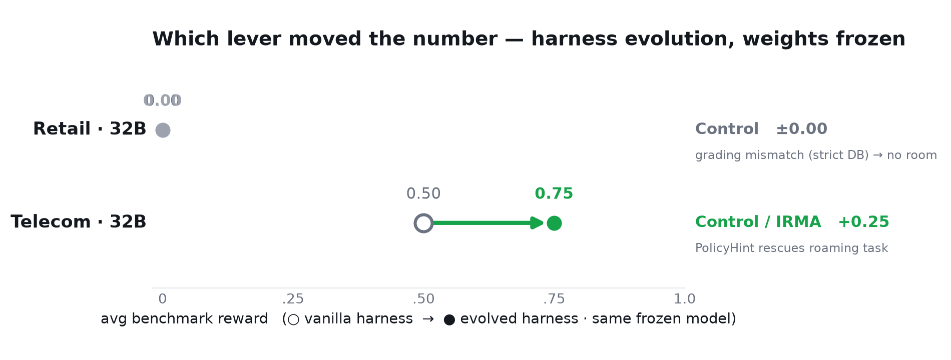
Which lever moved the number
Same frozen model. The lever lifts the score only when the benchmark gives a signal AND the failure matches the lever.

Slide 23
Which component makes the biggest difference?
Ablation: run vanilla / control-only / IRMA-only / full on the SAME tasks.
• Single-trial trap: variance (±0.25) is as big as the effect — the same config scores 0.50 OR 0.75 by luck.
• So you CANNOT rank components from one run. Attribution is statistical, not anecdotal.
• Fix: multiple trials (pass^k) + task-level check + leave-one-out to kill inert processors.
Task-level signal: IRMA's roaming alert rescues the roaming task; control processors are inert here.
• Reproducible in one command: bash workshop/ablate.sh

Slide 24
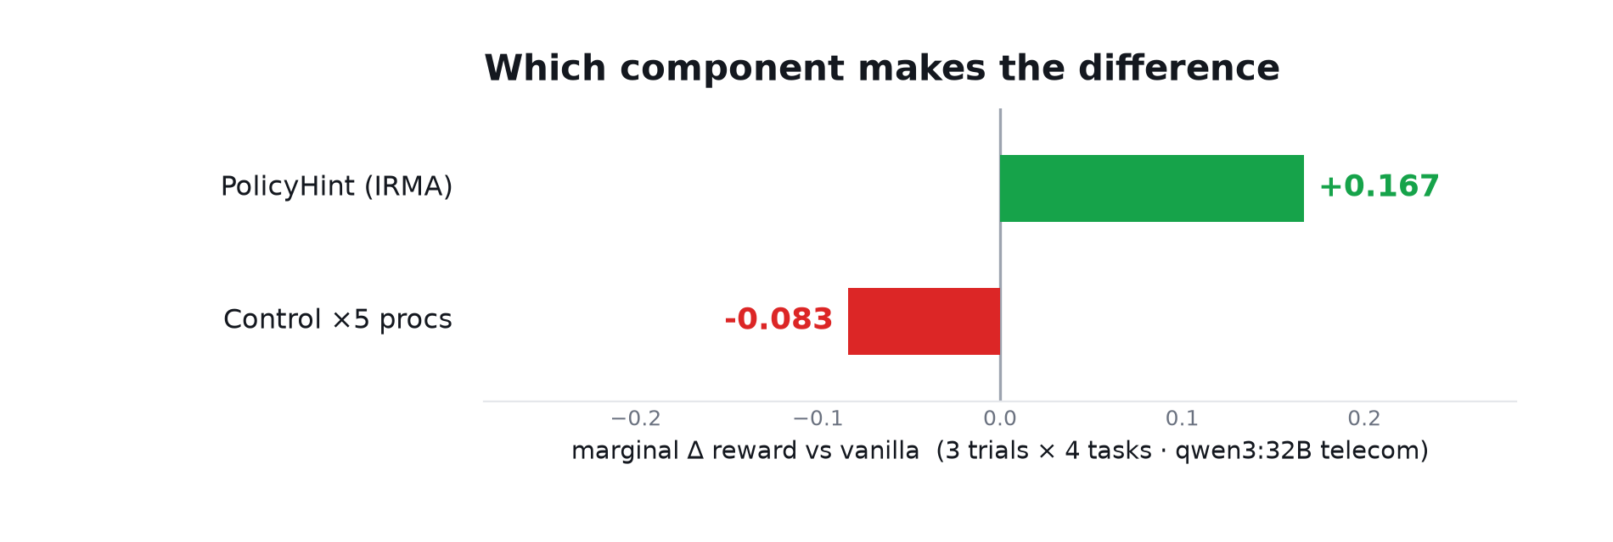
Attribution (3 trials): one component did the work
Multi-trial averaging clears the noise: IRMA (+0.167) drives the lift; the 5 control processors are inert (−0.083). Leave-one-out would drop them.

Slide 25
Did we prove the paper? (partly — yes)
• ✓ A FROZEN model's benchmark score rose via a harness edit alone (telecom 0.50 → 0.75).
• ✓ The moat is the infrastructure — we diagnosed + evolved purely off typed processors + structured traces.
• ✓ Lever mix is context-dependent — IRMA worked on telecom, did nothing on retail (grading mismatch).
• ✓ Ceiling/floor effects — 32B at ceiling on easy tasks; strict retail grading = effective floor.
Not reproduced (needs scale): +14.5% magnitudes, multi-round + the 3 RL pathologies, AEGIS, co-evolution.

Slide 26
Crutch or capability? Two value props
• Deterministic Control fixes (roaming alert, ParseRetry) are a CRUTCH — they recover latent
• capability a frozen model failed to apply. Real, but capped at the model's ceiling.
Instruction (reasoning scaffolds) + Action (tools/skills) ADD realized capability — not plumbing.
• To raise the ceiling itself, you need loop 2: RL on the weights (co-evolution). Different game.
On a frozen model, the most capability-like levers are reasoning scaffolds + new tools.

Slide 27
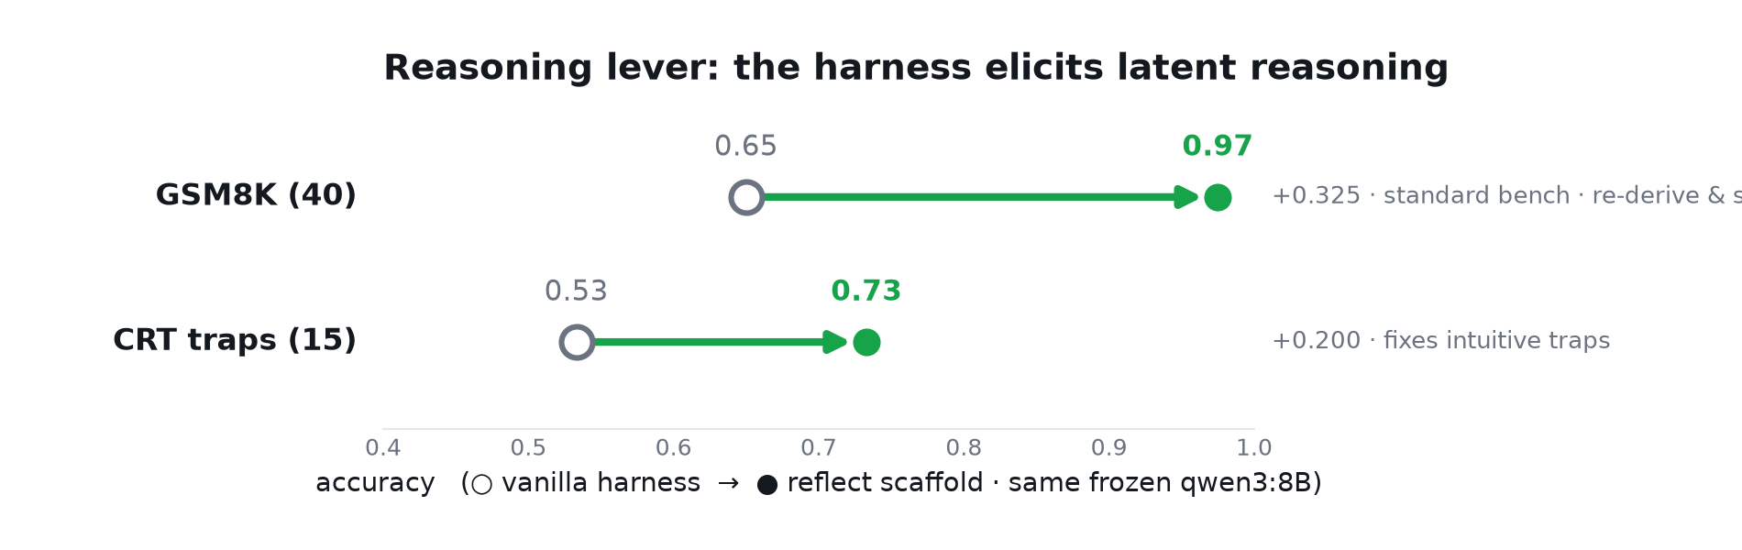
The harness elicits latent reasoning (GSM8K)
Same frozen qwen3:8B. A reflect scaffold (re-derive + self-check) lifts GSM8K 0.65 → 0.97 and CRT 0.53 → 0.73. Realized reasoning, not I/O.

Slide 28
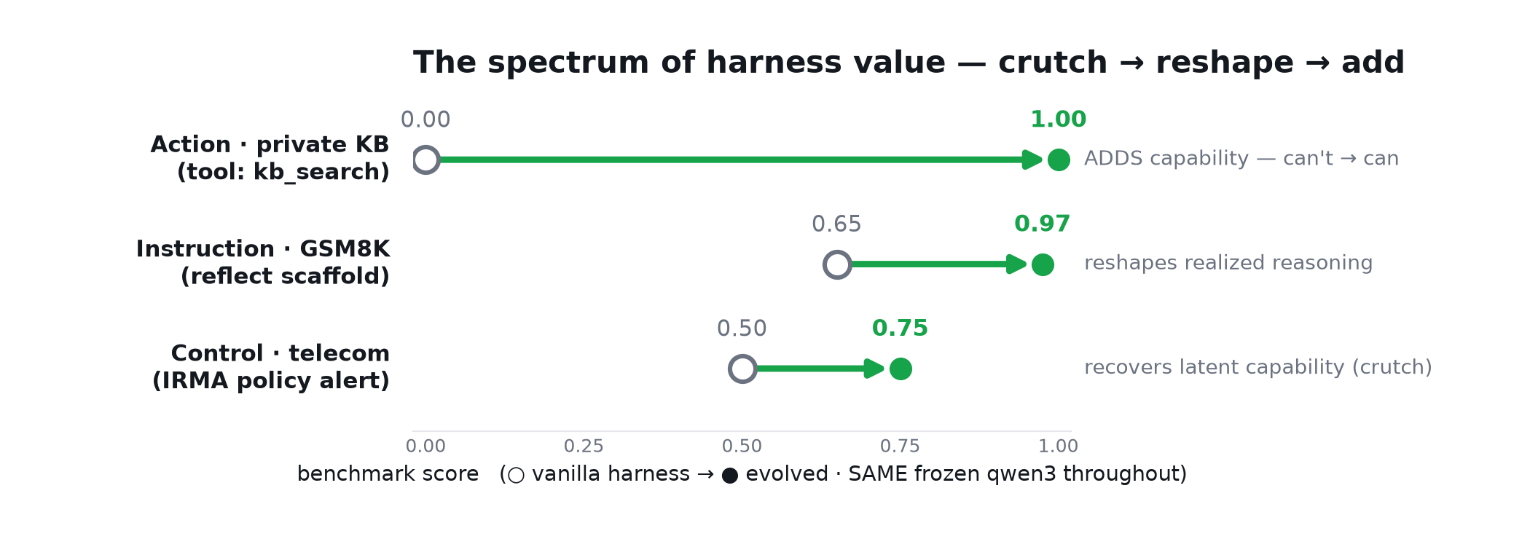
The spectrum of harness value (all 3 levers, real numbers)
Action ADDS capability (private KB 0.00 → 1.00, can't → can). Instruction reshapes reasoning (GSM8K 0.65 → 0.97). Control recovers latent (telecom 0.50 → 0.75, a crutch). Same frozen model throughout.

Slide 29
The Action lever — genuine capability (can't → can)
A frozen model CANNOT know your private data — it's not in the weights.
• Vanilla on a private company KB: 0/12 — every fact hallucinated (Sentinel Arm → $12,500, not $8,450).
• Add a kb_search tool (Action lever): 12/12 — it retrieves the fact and answers.
That's NEW capability, not a crutch — and it's the whole reason vertical agents exist:
• proprietary knowledge, tools, and APIs the base model will never have.

Slide 30
Takeaways
1. The deliverable is the LOOP: run → read traces → pick the lever → evolve → re-run. Not the technique.
2. Every lever is chosen FROM a trace — the trace names the failure; you match a lever to it.
3. The harness, not the weights, sets REALIZED performance — proven across 3 levers, frozen model.
4. Vertical agents need a STRONG BENCHMARK to evolve against — it's the reward signal in the loop.
5. Off-the-shelf model + off-the-shelf harness plateaus: no trace signal → nothing to evolve on.
6. This is how you squeeze a cheap, frozen model to punch up on YOUR vertical.

