Slide 1
pXp analysis
Luiz Emediato (Sao Paulo)
Tom McDowell, Cory Rude, Jane Nachtman (Iowa)
Mike Albrow (FNAL)
<number>

Slide 2
Overview
- 4 pions mass distributions
- 4-track 2015 sample
<number>

Slide 3
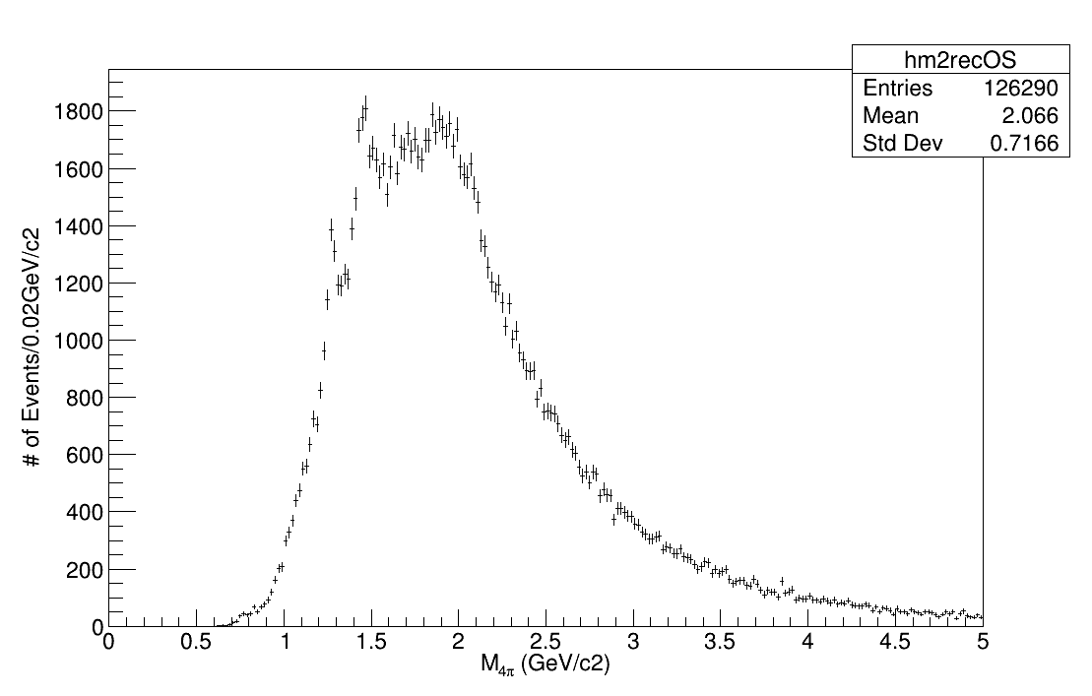
cut 1, Q=0
M 4 pions
ptCut > 0.1
etaCut < 2.5
1 or 2 vertices
fiducial
<number>

Slide 4
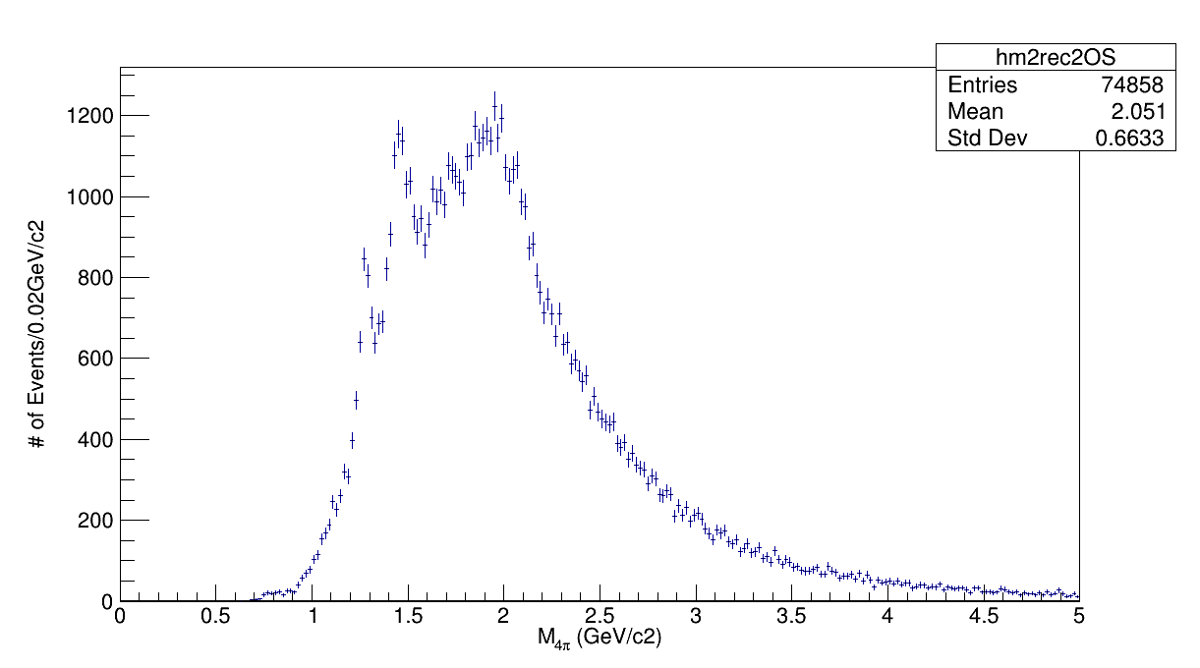
M 4 pions
cut 2, Q=0
ptCut > 0.1
etaCut < 2.5
1 or 2 vertices
RPvertex
CTpxcut
CTvertex
fiducial
<number>

Slide 5
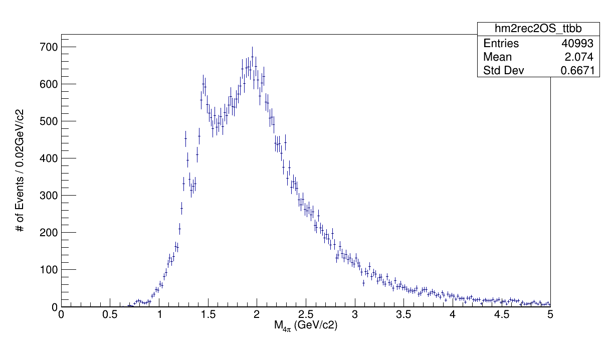
M 4 pions TTBB
cut 2, Q=0
ptCut > 0.1
etaCut < 2.5
1 or 2 vertices
RPvertex
CTpxcut
CTvertex
fiducial
<number>

Slide 6
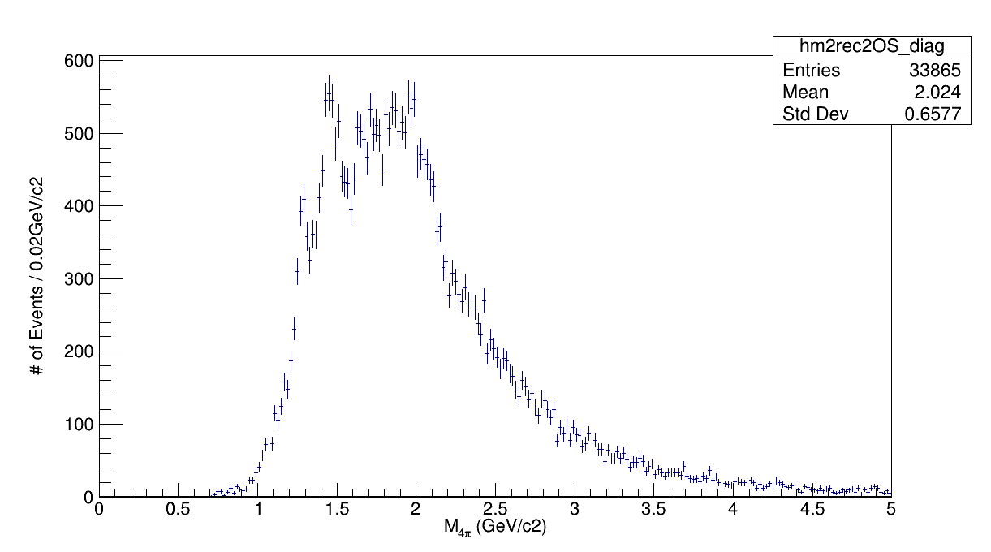
M 4 pions TB/BT
cut 2, Q=0
ptCut > 0.1
etaCut < 2.5
1 or 2 vertices
RPvertex
CTpxcut
CTvertex
fiducial
<number>

Slide 7
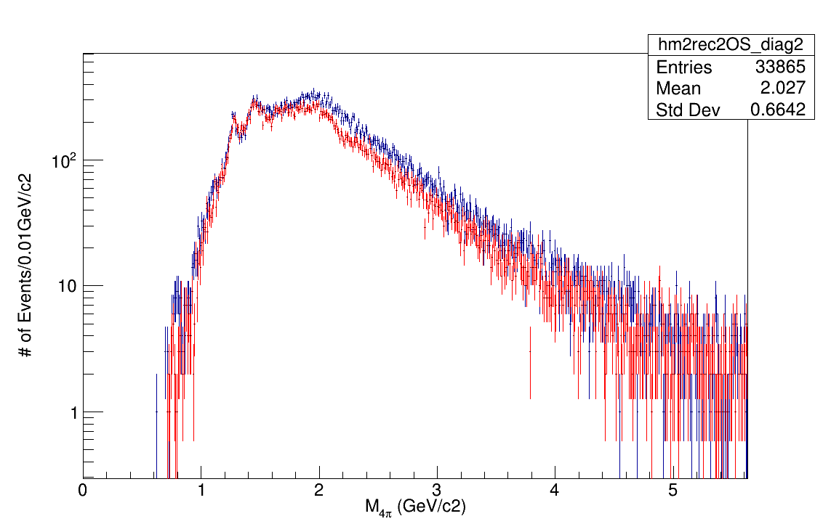
M 4 pions TTBB + TBBT
cut 2, Q=0
TTBB
TBBT
<number>

Slide 8
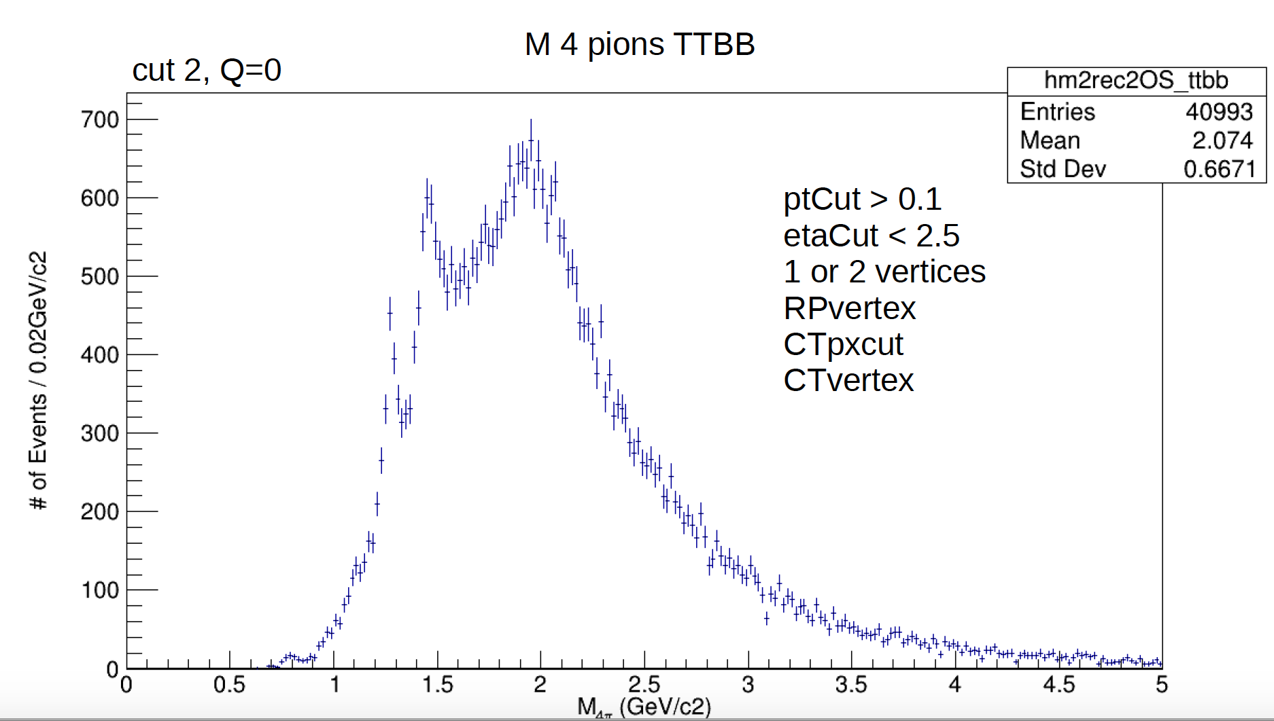
f₀(1500)? Low!
Γ = 109 MeV
4π BR (49.5±3.3) %
f₂(1270)
Γ = 187 MeV
BR (2.8±0.4) %
f₀(1710)?
?
<number>

Slide 9
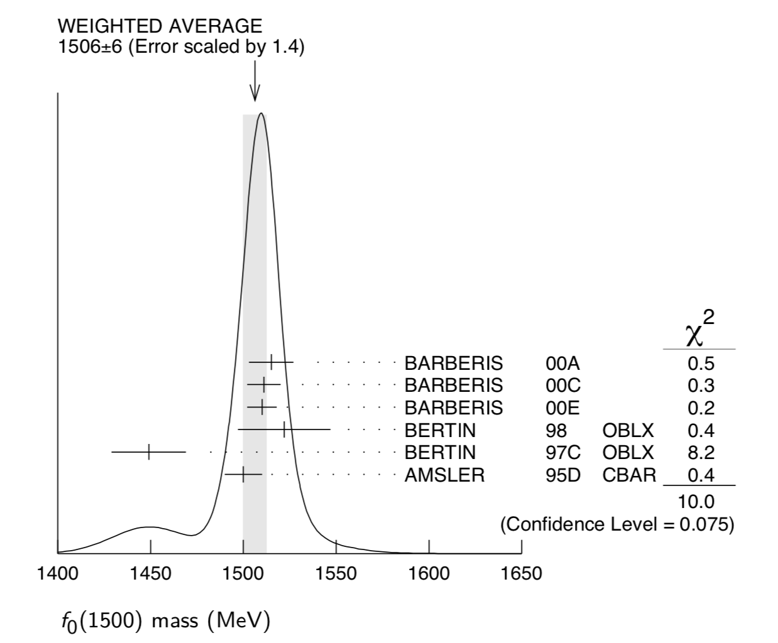
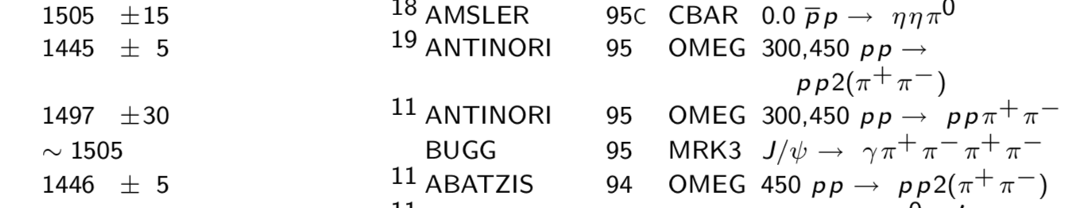
From PDG 2018 big book on f0(1500)
Is this a bad measurement
or a different state?
Superceded by Antinori’s later paper
<number>

Slide 10
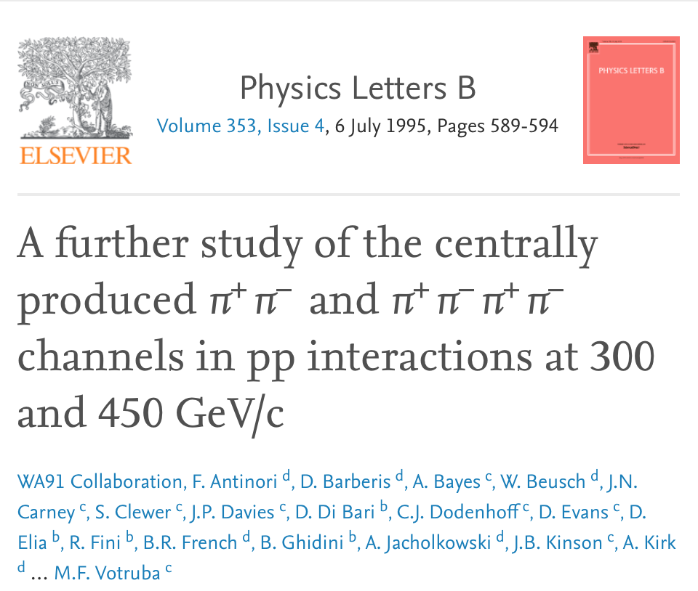
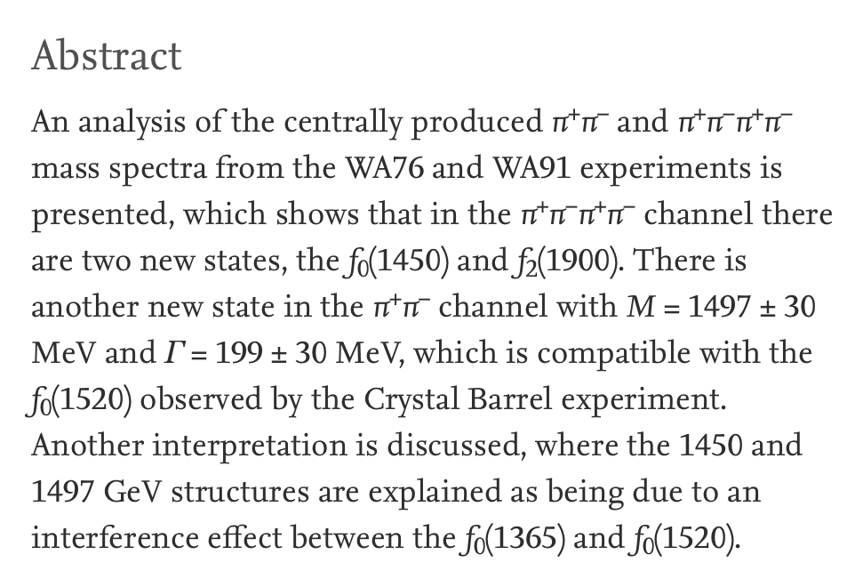
<number>

Slide 11
for the simulation: GRANIITTI is working fine on my Fedora 29
Thanks for your kind help and attention !
<number>

