Slide 1
pXp analysis
Luiz Emediato (Sao Paulo)
Tom McDowell, Cory Rude, Jane Nachtman (Iowa)
Mike Albrow (FNAL)
1

Slide 2
Overview
1. 4-track code: luianaRP4.cc (github)
important: make -f LUMakefile4 to compile the code
- for now 4 pions per event only
- 4-track 2015 data
2. Hand notes: luianaRP-scheme.pdf (140MB google drive only)
- helps to understand the logic
- not in github, it allows only 25MB/file
- “pula” is the portuguese for skip or jump
- if you want to print the code in syntax-oriented colors use emacs:
C-u M(ESC)-x ps-print-buffer-with-faces
- for2 loop: tracks per event
- for3 loop: vertices per event
1

Slide 3
- main loops:
- loop over data files
- loop over events
- sub loop over tracks
- sub loop over vertices
3. number of vertices nvtx : now 1 or 2 (originally 1)

Slide 4
5. cuts:
a- fiducialRegion: 4 tracks, each pion eta < etaCut=2.5
b- fiducialRegionPt: 4 tracks, each pion pt > ptCut=0.2GeV/c (changed to 0.1)
definition:
CTpycut = | CMSpy + TOTEMpy | < 0.06 (applied to all cuts)
CTpxcut = | CMSpx + TOTEMpx | < 0.15
RPvertex = | xVtxL – xVtxR | < 3e-5
CTvertex = -0.04 < (xvtx - xvtxT*100) .AND. (xvtx - xvtxT*100) < 0.18
- cut 1: a, b → hm2rec
a, b, Q=0 → hm2recOS (hm4recOS)
a, b, Q!=0 → hm2recSS
- cut 2: a, b, Q=0, RPvertex, CTpxcut, CTvertex → hm2rec2OS (hm4rec2OS)
a, b, Q!=0, RPvertex, CTpxcut, CTvertex → hm2rec2SS
need to be fixed

Slide 5
- cut 3: a, b, Q=0, RPvertex, CTpxcut → hm2rec3OS (hm4rec3OS)
a, b, Q!=0, RPvertex, CTpxcut → hm2rec3SS
- cut 4: a, b, Q=0, RPvertex, CTpxcut, CTvertex, |zvtx|<5.0 → hm4rec4OS
a, b, Q!=0, RPvertex, CTpxcut, CTvertex, |zvtx|<5.0 → hm4rec4SS
- cut 5: a, b, Q=0, Rpvertex, CTvertex → hm4rec5OS
a, b, Q!=0, RPvertex, CTvertex → hm4rec5SS
- cut 6: a, b, Q=0, RPvertex, CTpxcut, CTvertex, etaCut2
each pion |eta| < etaCut2=1.5 → hm4rec6OS
a, b, Q!=0, RPvertex, CTpxcut, CTvertex, etaCut2
each pion |eta| < etaCut2=1.5 → hm4rec6SS
- cut 7: a, b, Q=0, diag, RPvertex, CTpxcut → hm4recHFvetoOS
a, b, Q!=0, diag, RPvertex, CTpxcut → hm4recHFvetoOS

Slide 6
events in the 4-track sample
eta distribution: -3.0 < eta < 3.0 ~ 5,300,000 events
sequence of processing:
CMSpy+TOTEMpy histogram ~ 1,000,000 events
if CTpycut < 0.06 then (from here we have a big reduction of data)
CMSpx+TOTEMpx histogram ~ 160,000 events
cut 1: fiducialRegion, fiducialRegionPt, Q=0 histograms ~ 140,000 events

Slide 7
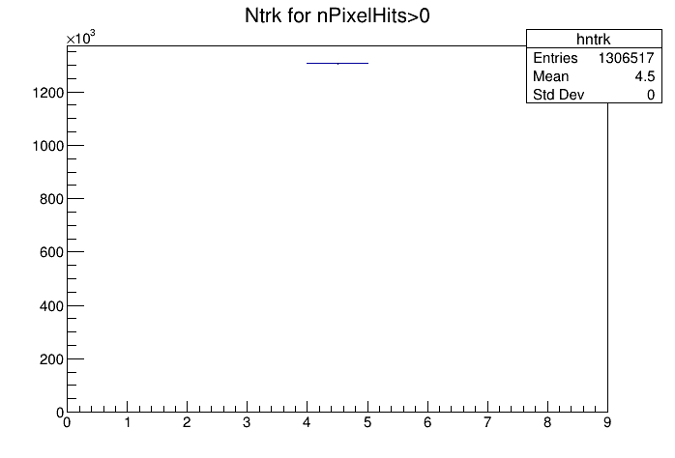
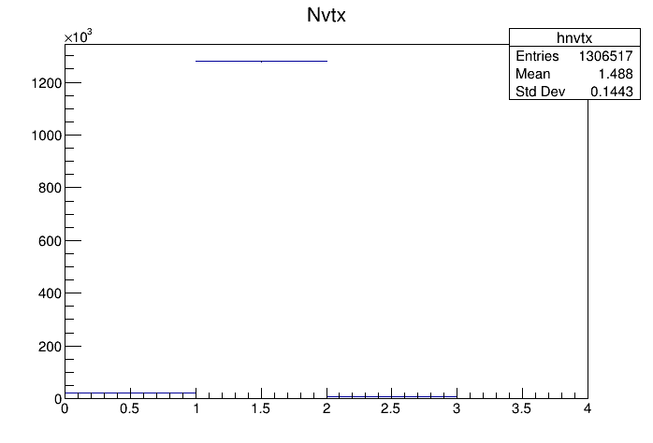
4-track sample job#81
number of good 4-tracks
number of vertices

Slide 8
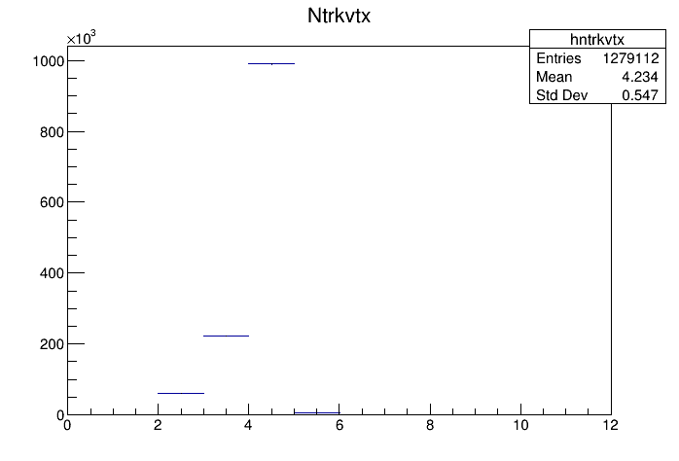
number of tracks with 1 vertex only

Slide 9
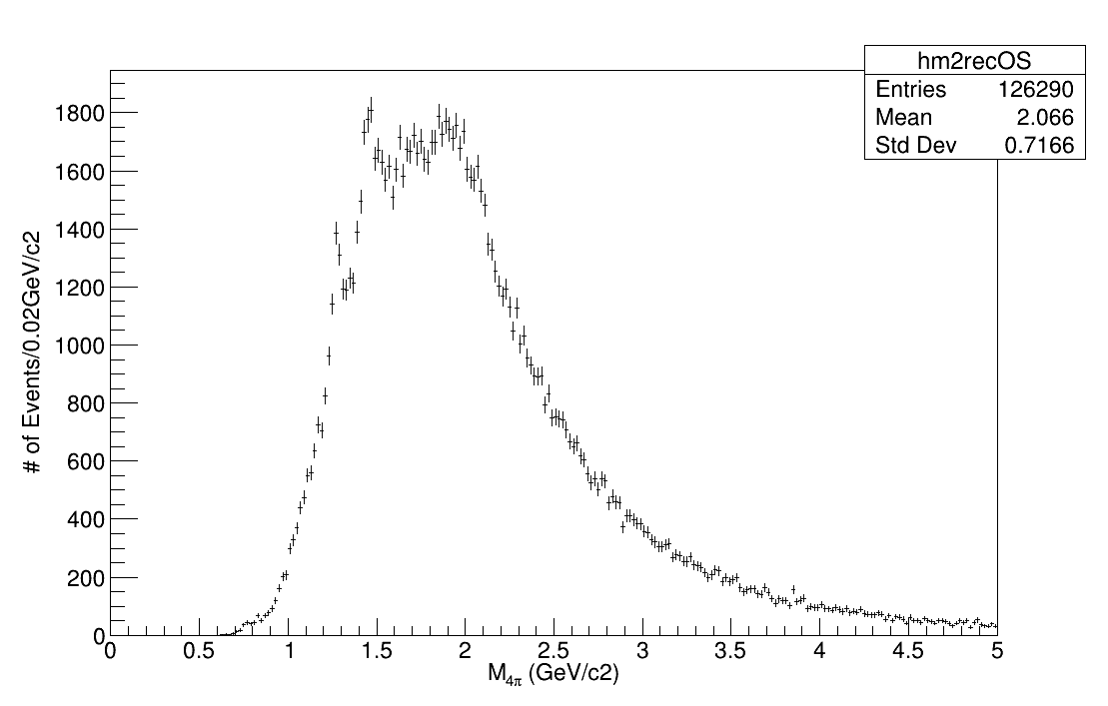
cut 1, Q=0
M 4 pions
ptCut > 0.1
etaCut < 2.5
1 or 2 vertices

Slide 10
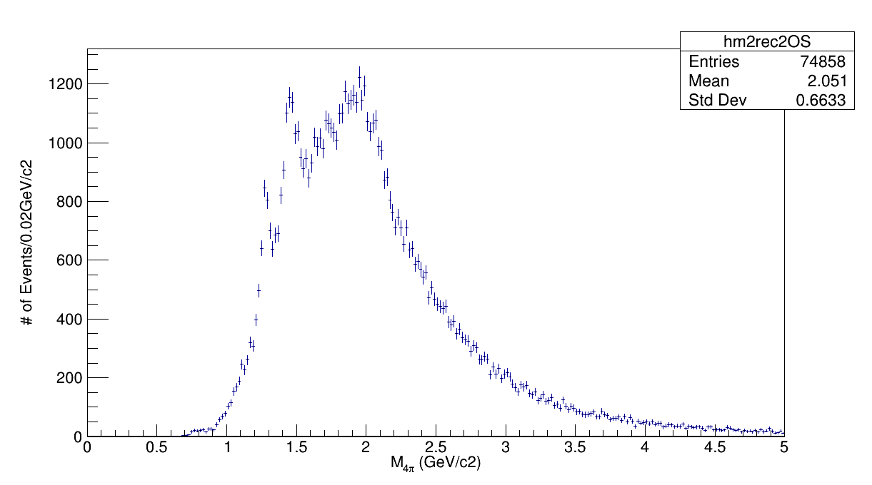
M 4 pions
cut 2, Q=0
ptCut > 0.1
etaCut < 2.5
1 or 2 vertices
RPvertex
CTpxcut
CTvertex

Slide 11
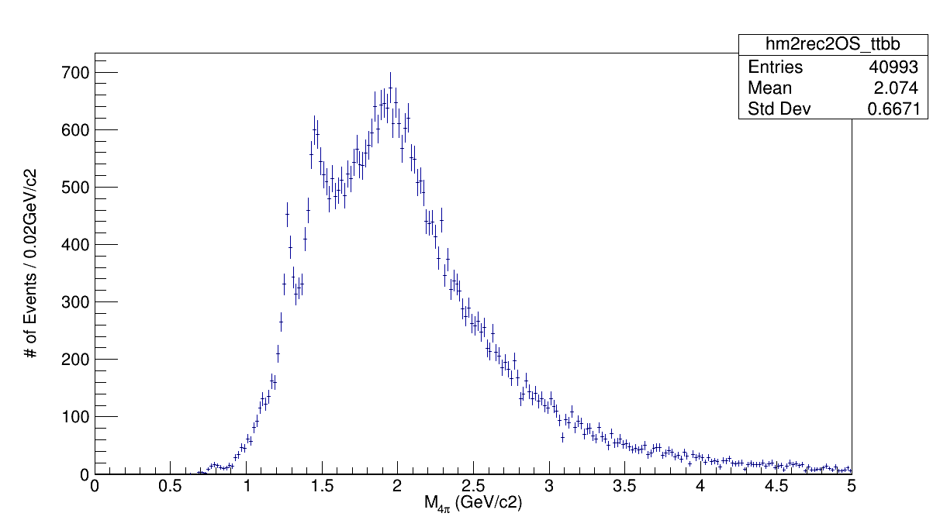
M 4 pions TTBB
cut 2, Q=0
ptCut > 0.1
etaCut < 2.5
1 or 2 vertices
RPvertex
CTpxcut
CTvertex

Slide 12
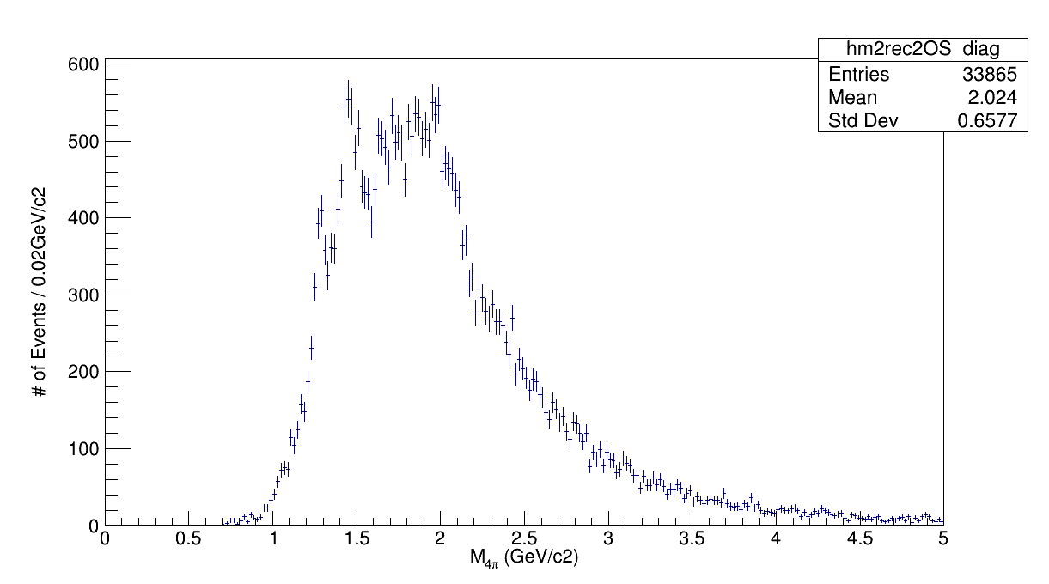
M 4 pions TB/BT
cut 2, Q=0
ptCut > 0.1
etaCut < 2.5
1 or 2 vertices
RPvertex
CTpxcut
CTvertex

Slide 13
Question: What does Simone mean in the code ?
simulation: GRANIITTI is working fine on my Fedora 29
Thanks for your kind help and attention !

