Slide 1
Rock Paper Scissors Tournament
Kyle Haustein
Python Analytics Quest: Week 1 Project

Slide 2
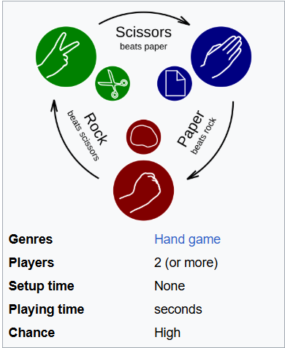
Game Overview
Objective:
Win condition:
The player reaches the required number of wins first.
Lose condition:
The computer reaches the required number of wins first.
Extra feature:
The player can replay the game after the tournament ends. The number of rounds can be customized within limits

Slide 3
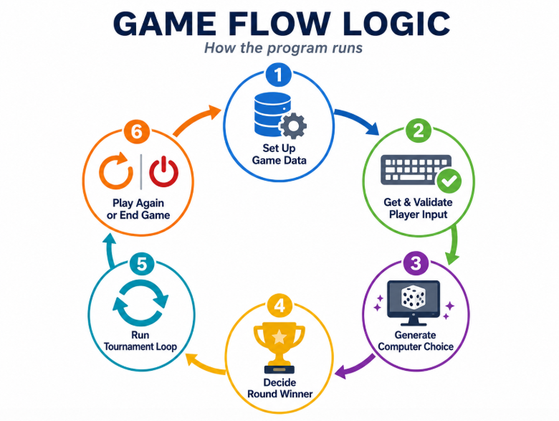
Technical Design

Slide 4
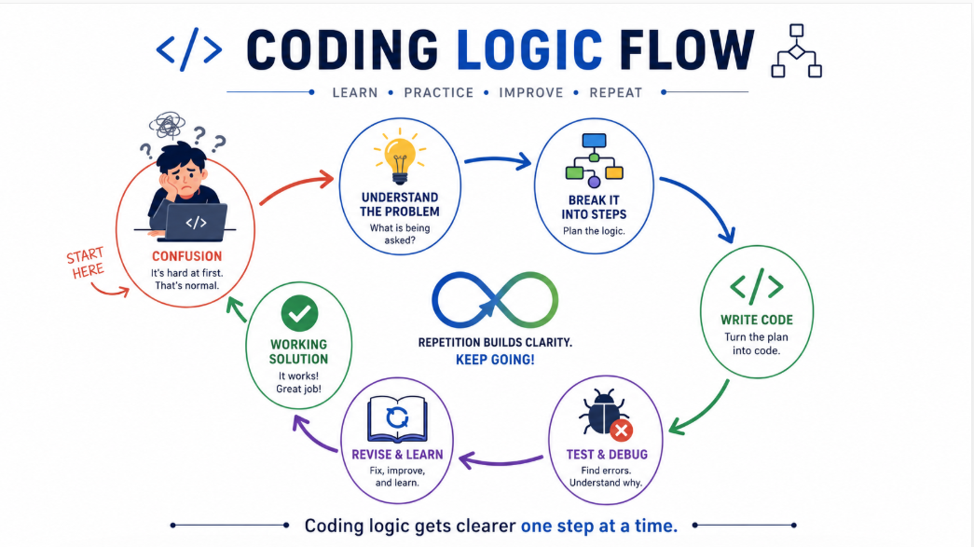


Struggles

Slide 5
Demo
Who wants to play?

Slide 6
?
Questions?

