Slide 1


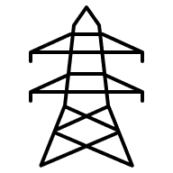


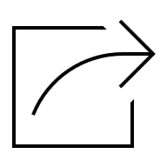



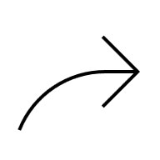
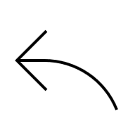
Search Location…

Slide 2
PV Area
Manual Draw
Draw
PV Area
Obstacle
Object
PV Area By Coordinates
Latitude; longitude
Draw PV Area
Setbacks
Area Setbacks (m)
Object N (m)

Slide 3
PV Design
Orientation
Tilt Angle (°)
Azimuth Angle (°)
Auto fill Azimuth Align To Area Edge
PV Module
Select from Library
Power (Wp)
Long Edge (mm)
Short Edge (mm)
Mounting Structure
Layout Options

Slide 4
PV Design
Orientation
PV Module
Mounting Structure
Select Type
Portrait
Landscape
Y
X
PV-PV space (X)
PV-PV space (Y)
PV/Table (X)
PV/Table (Y)
Table Distance (x)
Table Distance (y)
Detailed Table configuration
Table/ Block (X)
Table/ Block (Y)
Block Distance (x)
Block Distance (y)
Layout Options

Slide 5
PV Design
Orientation
PV Module
Mounting Structure
Layout Options
Desired Capacity (kWp)
Fill Maximum
Area
Fill Desired Capacity
Adaptive Layout
Block Design
Show Only Table
Show PV Modules
Show PV Modules option is not applicable for Systems >5000 kWp
Fill Area Start Point

Slide 6
Electrical Configuration
General Scheme
Inverter Capacity (kW)
DC/AC Ratio
Central
String
Detailed Inverter Sizing
Detailed Inverter sizing is Considered
Systems

Slide 7

Electrical Configuration
Overall System
String Inverter
Central Inverter
DC Combiner
AC Combiner
Transformer Station
Delivery Station
Inverter Capacity (kW)
General Scheme Inputs
DC/AC Ratio
Add Delivery Station
on Map
Add Point of Connection on Map
Draw Main Cable Routs
Auto fill from initial layout
Central
String
Area | Initial DC Capacity [kWp] | Inverter Capacity [kVA] | Desired DC/AC Ratio | PV Module/String | MV Transformer Station [kVA] | Delivery Station | POC
Area 1 |  | Enter kVA | Enter Number | Enter Number | Enter kVA | DS 1 | POC 1
Area 2 |  | Enter kVA | Enter Number | Enter Number | Enter kVA | DS 1 | POC 1
Area 3 |  | Enter kVA | Enter Number | Enter Number | Enter kVA | DS 2 | POC 2
Detailed Inverter Sizing
Detailed Inverter sizing is Considered
Systems

Slide 8
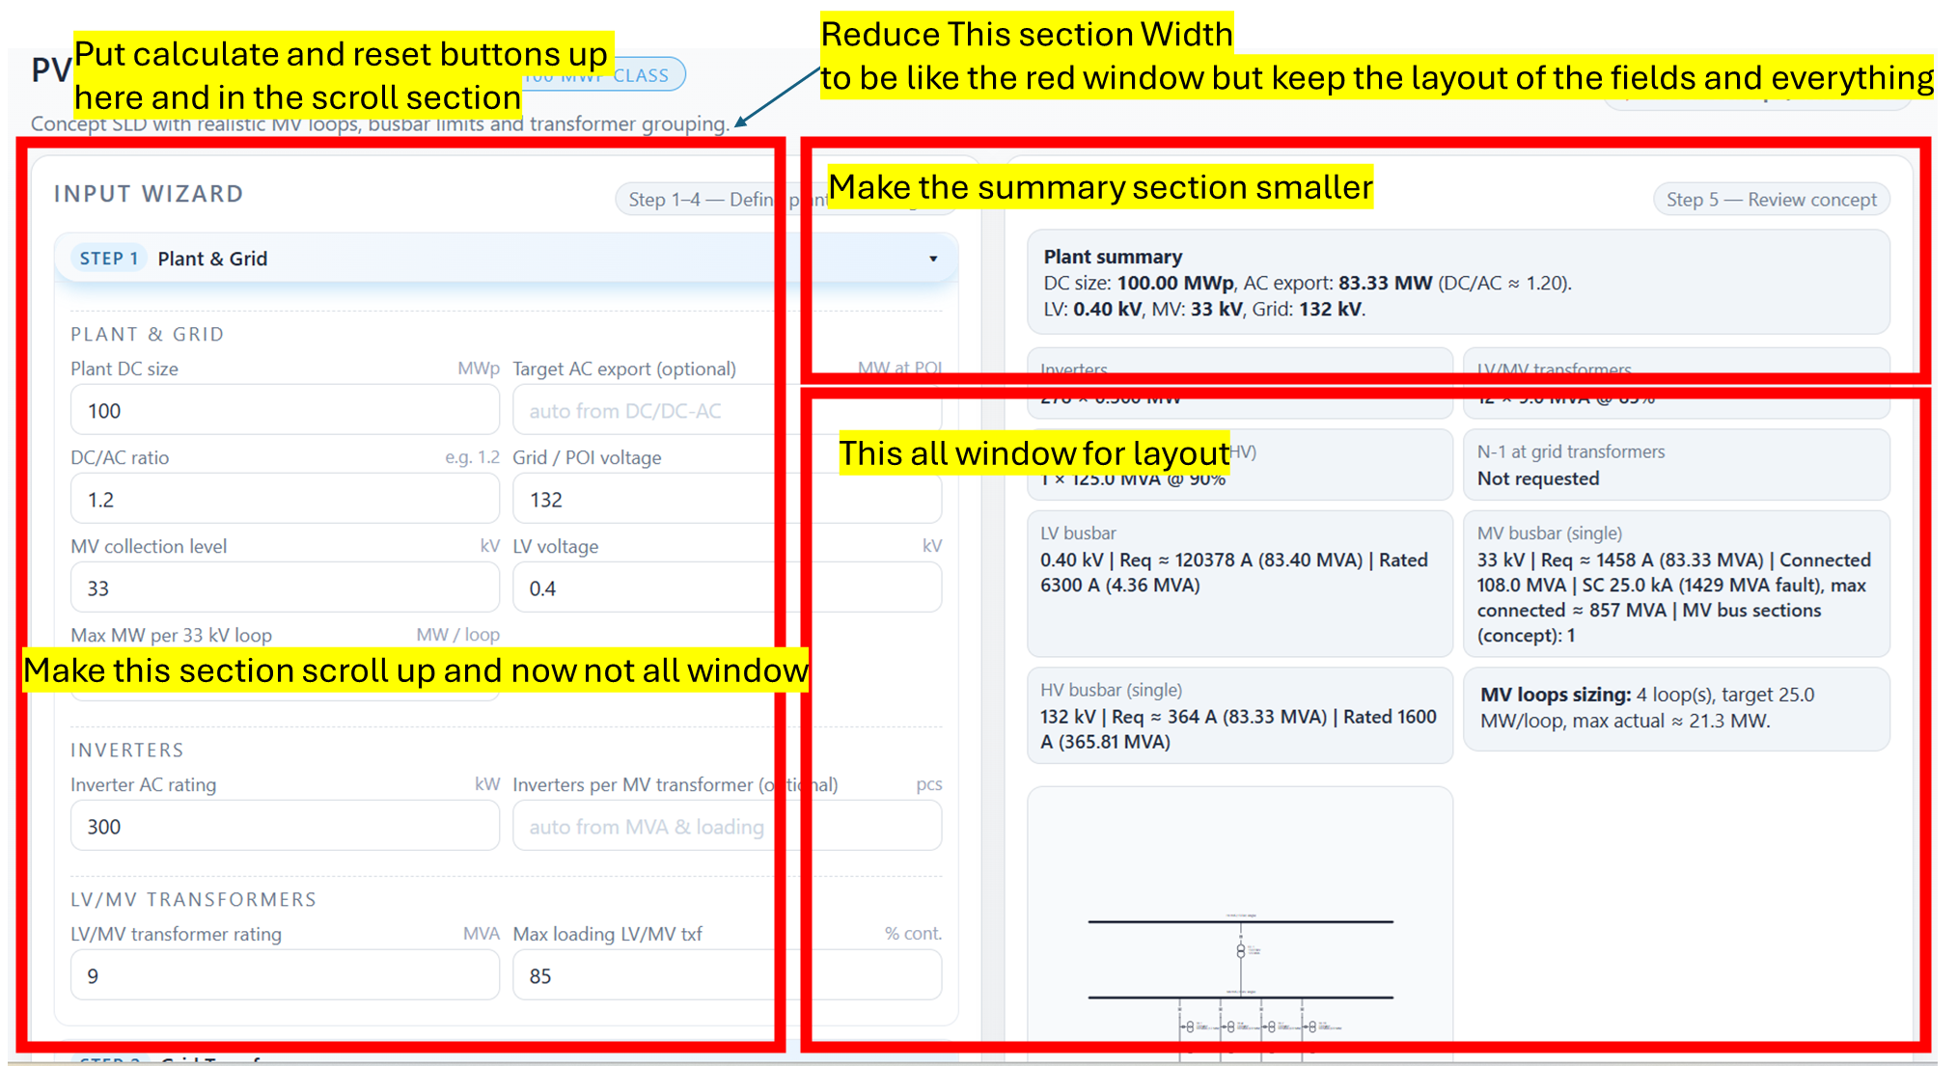
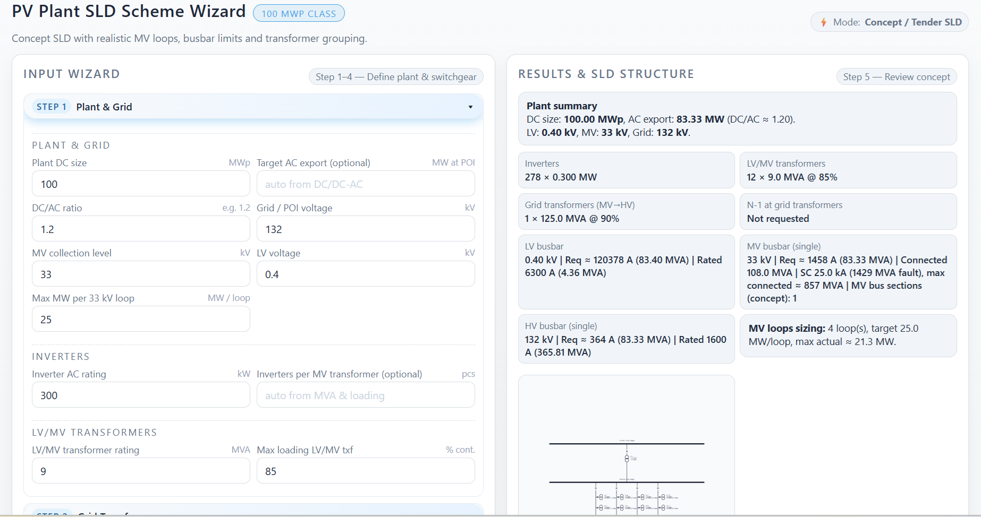
Put calculate and reset buttons up here and in the scroll section
Reduce This section Width to be like the red window but keep the layout of the fields and everything
Make the summary section smaller
This all window for layout
Make this section scroll up and now not all window

