Slide 1


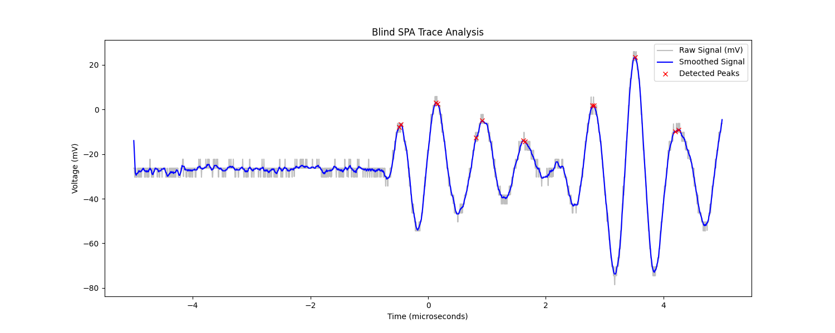
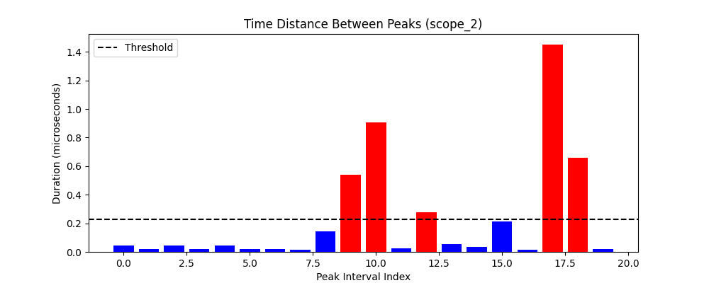
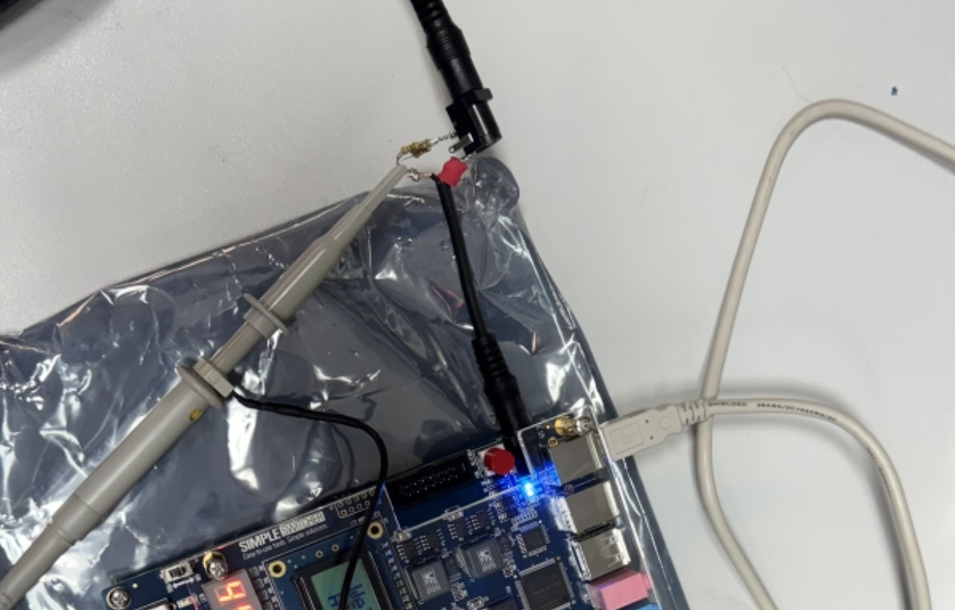
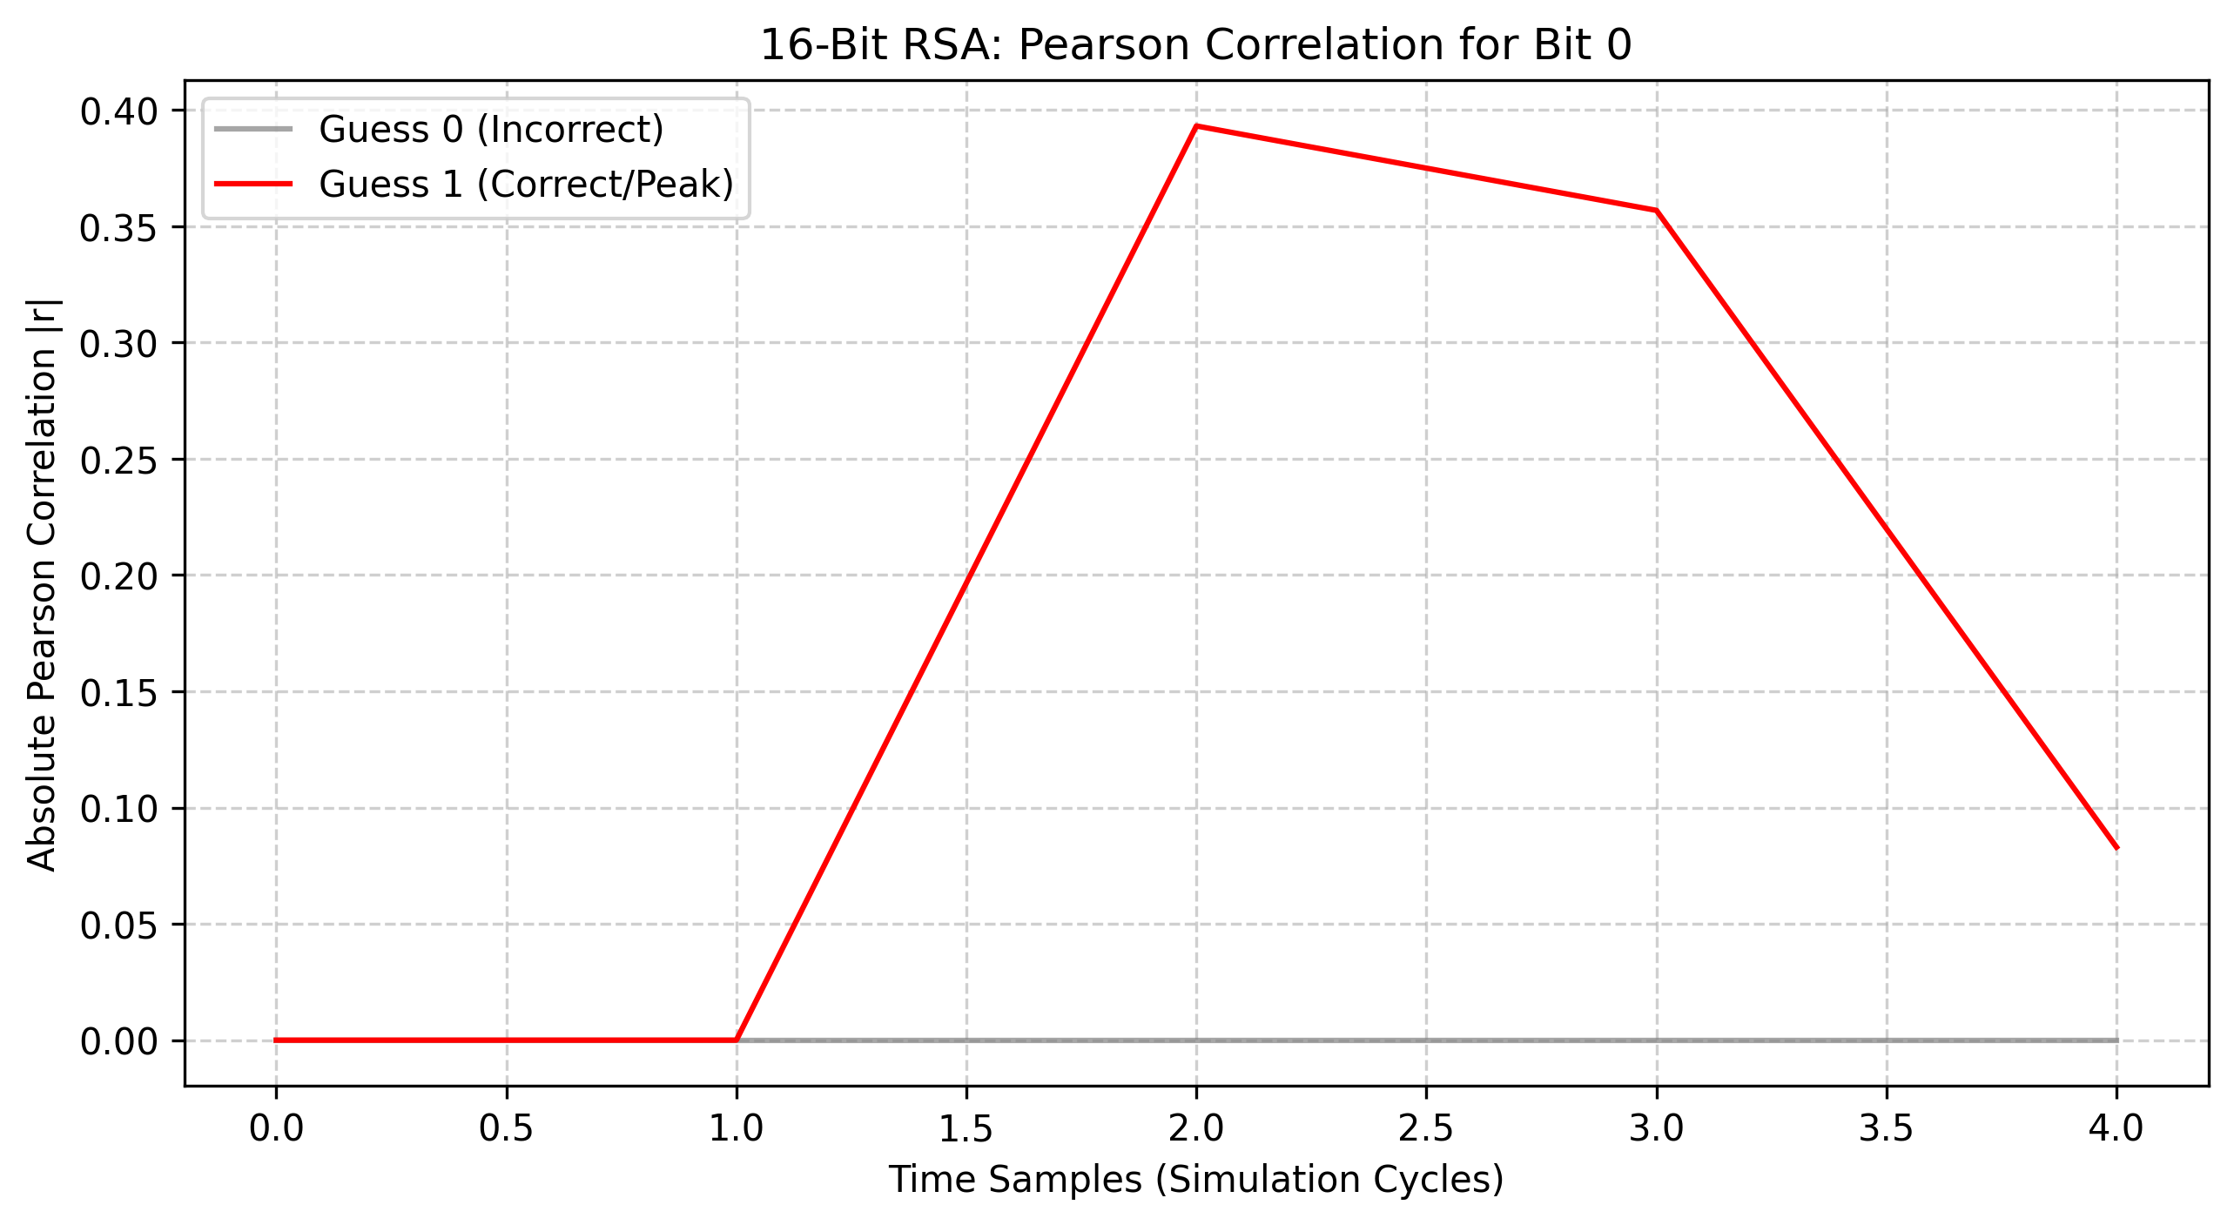
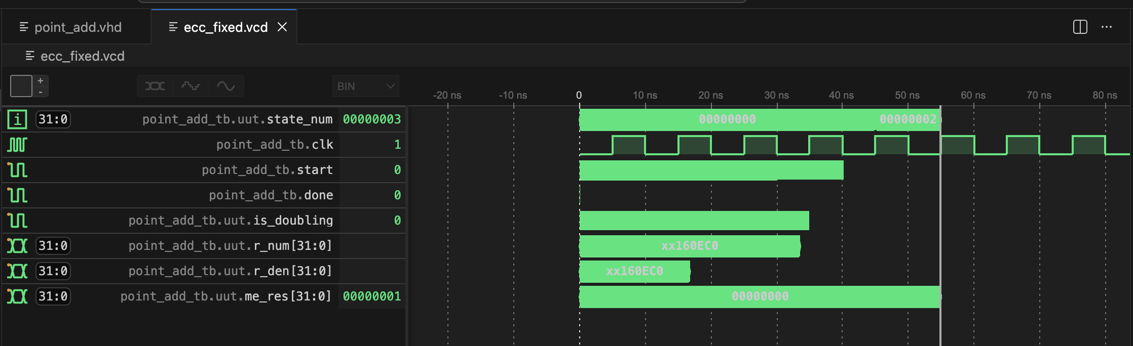
Architectural Construction and Physical Exploitation of Cryptographic Hardware Orhun Boydak
2026 /
Abstract
Methodology
Results and Dıscussıon
This year-long project investigates the dual nature of hardware security: architectural construction and physical exploitation. In Phase 1, cryptographic primitives were implemented in VHDL: an LFSR-based Shrinking Generator stream cipher, 16/32-bit RSA engines using Montgomery Multiplication, and Elliptic Curve Cryptography (ECC) foundations over prime fields GF(p). In Phase 2, these architectures were attacked. A simulated Correlation Power Analysis (CPA) recovered the full 16-bit RSA private key in 50 traces (|r| ≈ 0.98), while failing against 32-bit due to algorithmic noise. A physical Simple Power Analysis (SPA) on a real Altera DE2-115 FPGA then recovered key segments from a single noisy oscilloscope trace — proving that mathematically correct hardware is not physically secure without countermeasures.
To physically exploit the RSA Square-and-Multiply architecture, a deterministic Simple Power Analysis (SPA) timing attack was mounted against an Altera DE2-115 FPGA.
Hardware Instrumentation Setup: The FPGA's PLL was reprogrammed to 2 MHz (from 50 MHz) to make each Montgomery operation last ~8 μs — measurable on a standard oscilloscope. A 0.5 Ω shunt resistor was placed in series on the low-side power supply. By Ohm's Law (V = I × R), the voltage drop directly reflects instantaneous current draw.
Blind Signal Processing Pipeline: A custom Python engine extracts the key without prior knowledge:
Noise Filtering: A moving-average filter smoothed environmental white noise from raw CSV oscilloscope data.
Peak Detection: scipy.signal.find_peaks identified peaks corresponding to Montgomery operation boundaries.
Dynamic Thresholding: Inter-peak distances (Δt) were measured. The statistical mean of all Δt values served as the adaptive separator: short Δt → '0' bit (Square only); long Δt → '1' bit (Square + Multiply).
Simulated CPA vs. Algorithmic Noise: Simulated attacks using the Pearson Correlation Coefficient successfully extracted the full 16-bit RSA private key using only 50 simulation traces, achieving a peak correlation of |r| ≈ 0.98 at the exact Montgomery register update cycle.
32-bit CPA Failure: Applying the same attack to the 32-bit architecture dropped the peak correlation to |r| ≈ 0.25 — below the extraction threshold. The 31 additional uncorrelated bits transitioning each cycle constitute algorithmic noise, requiring ~4x more traces to overcome.
Background
Figure 5: Blind SPA — smoothed FPGA power trace. Red X markers identify Montgomery operation peaks.
Cryptographic security relies on two pillars: the mathematical algorithm and its physical hardware execution.
Stream & Public-Key Ciphers: LFSRs generate pseudo-random sequences efficiently but are broken by the Berlekamp-Massey algorithm using only 2N output bits. The Shrinking Generator introduces non-linearity via irregular decimation, achieving a combined period of ~2¹²⁷ clock cycles. RSA relies on modular exponentiation (C = Mᵉ mod N) using the Square-and-Multiply algorithm and Montgomery Multiplication to eliminate hardware-prohibitive integer division.
Side-Channel Leakage: In standard CMOS, dynamic power P = α·C·V²·f is proportional to switching activity α — which depends directly on processed data. The Hamming Distance HD(V₀, V₁) = HW(V₀ XOR V₁) models register power leakage per clock cycle, enabling statistical key extraction without breaking the underlying mathematics.
Figure 6: Inter-peak interval analysis — scope_2.csv. Dynamic 0.23 μs threshold separates '0'/'1' key bits.
Physical Blind SPA Success: The SPA attack exploited timing differences in Square-and-Multiply: '1' bits produce SQUARE+MULTIPLY (long burst); '0' bits produce SQUARE only (short burst).
Results: scope_0.csv → 13 peaks → 12-bit key: 010101010110. scope_2.csv → 22 peaks → 20-bit key: 00000000011010000110. Single trace, zero prior knowledge.
Conclusion
Figure 2: Altera DE2-115 FPGA instrumented with 0.5 Ω low-side shunt resistor for power measurement.
This study definitively proves that implementing mathematically robust cryptography (like RSA and ECC) in hardware is insufficient for security. Standard architectural optimizations, such as naive Square-and-Multiply algorithms, embed control-flow timing vulnerabilities directly into the silicon. These flaws render wide-data path architectures completely defenseless against deterministic physical SPA attacks, even in highly uncalibrated, noisy environments.
Future Work
Figure 3: CPA Pearson correlation for 16-bit RSA Bit 0. Correct key (red) peaks at |r| ≈ 0.98 with 50 traces.
To secure modern physical hardware against the timing vulnerabilities demonstrated in this project, future architectures must mandate constant-time algorithms across all execution paths. Replacing standard algorithms with the Montgomery Ladder ensures uniform execution time regardless of the key bits. Additionally, implementing rigorous Hardware Masking (boolean or multiplicative) is essential to mathematically decouple the physical power consumption from the secret data.
Figure 1: ECC Point Doubling (2P = P+P) — tangent line intersection geometry used in ECC scalar multiplication.
Figure 4: GHDL simulation — Shrinking Generator. Irregular valid_out pulses confirm non-linear output.
Funding Information
Acknowledgments
Sponsors

