Slide 1


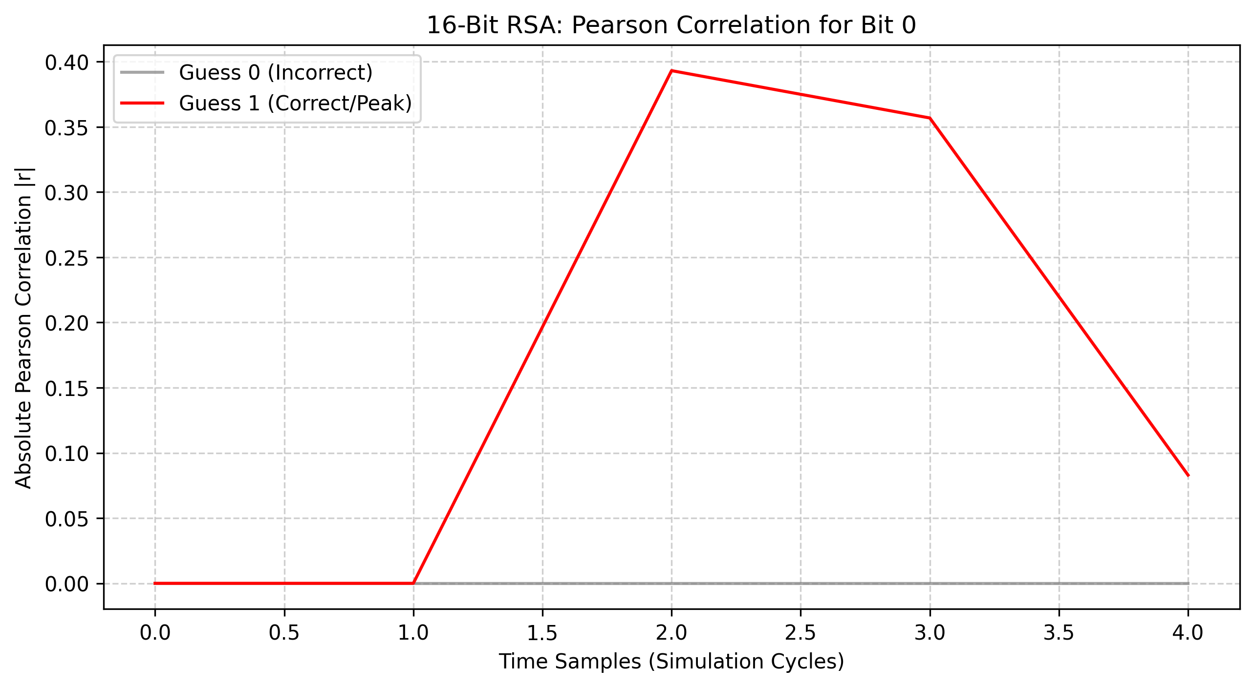
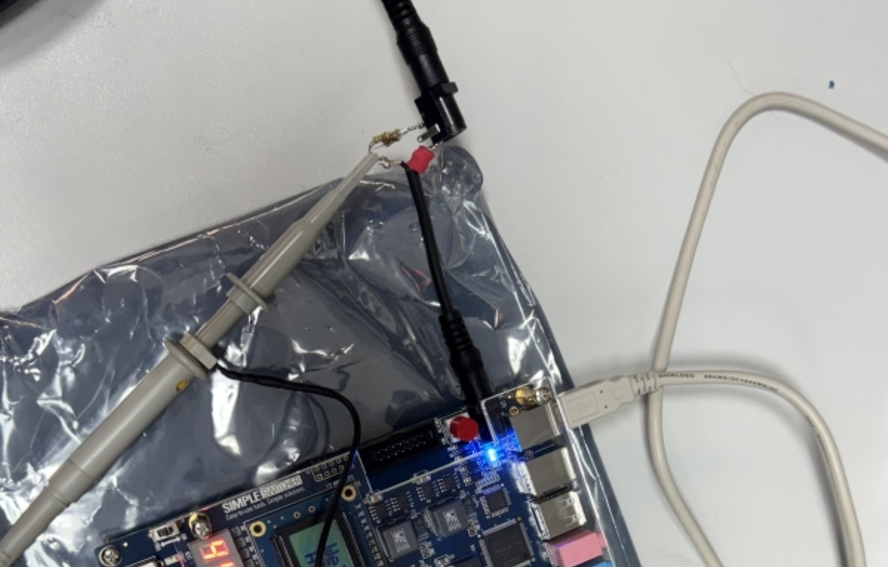
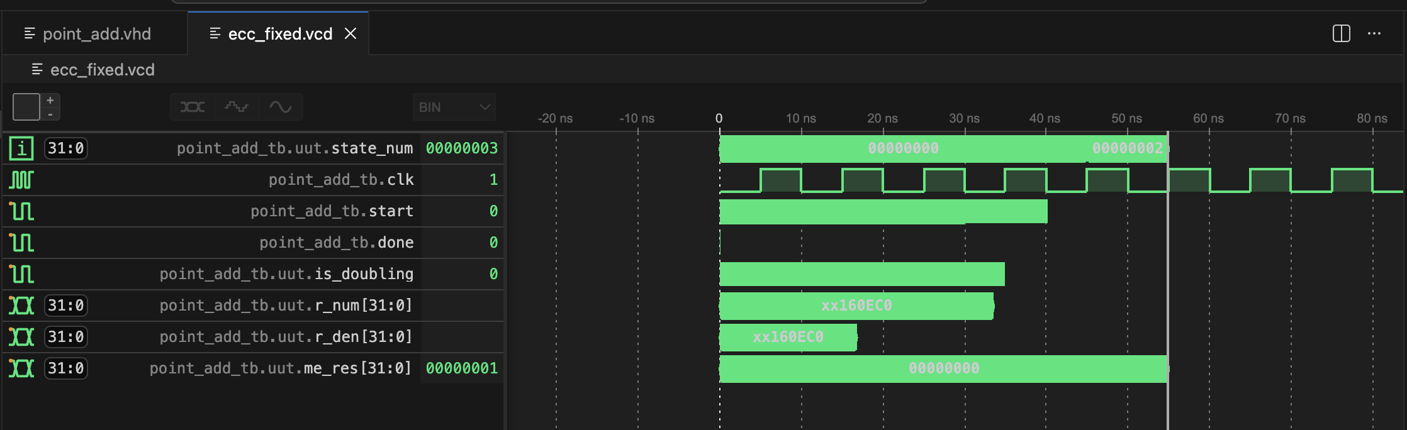
Architectural Construction and Physical Exploitation of Cryptographic Hardware Orhun Boydak
2026 /GN
“Funding Information”
Information”
Information”
Abstract
Methodology
Results and Dıscussıon
This comprehensive year-long project investigates the dual nature of hardware security: architectural construction and physical exploitation. In the first phase, highly efficient cryptographic algorithms—including LFSR Shrinking Generators, 16/32-bit RSA using Montgomery Multiplication, and Elliptic Curve Cryptography (ECC) over prime fields—were successfully engineered at the RTL level. However, robust mathematics does not guarantee physical security. In the second phase, these architectures were subjected to devastating Side-Channel Analyses (SCA). While 32-bit systems naturally masked statistical Correlation Power Analysis (CPA) via "Algorithmic Noise", physical implementations on an Altera DE2-115 FPGA were entirely broken using a blind Simple Power Analysis (SPA) timing attack, proving that naive control-flow logic is fundamentally insecure in physical environments.
To physically exploit the RSA Square-and-Multiply architecture, a deterministic Simple Power Analysis (SPA) timing attack was mounted against an Altera DE2-115 FPGA.
Hardware Instrumentation Setup: To capture instantaneous power variations without extreme noise, the FPGA's internal PLL was reprogrammed to scale the core clock down to 2 MHz, preventing signal aliasing on standard oscilloscopes. A 0.5 $\Omega$ shunt resistor was placed in series on the low-side of the power supply. According to Ohm's Law ($V = I \times R$), measuring the voltage drop ($V_{shunt}$) directly correlates to the instantaneous current drawn by the logical gates.
Blind Signal Processing Pipeline: A custom Python engine was developed to extract the key without prior knowledge:
Noise Filtering: A Savitzky-Golay digital filter smoothed environmental white noise.
Peak Detection: scipy.signal.find_peaks algorithms identified Montgomery operations.
Dynamic Thresholding: The time distance ($\Delta t$) between peaks was measured. The algorithm dynamically computed the statistical mean of $\Delta t$ to blindly separate short operations ('0' bit, Square only) from long operations ('1' bit, Square+Multiply).
Simulated CPA vs. Algorithmic Noise: Simulated attacks using the Pearson Correlation Coefficient successfully extracted a 16-bit RSA key using merely 50 traces ($|r| \approx 0.98$). However, applying identical methodology to the 32-bit architecture failed. Because 32-bit registers flip twice as many bits per cycle, the targeted bit leakage was overshadowed by the 31 other bits transitioning simultaneously—a protective phenomenon known as Algorithmic Noise.
Background
Cryptographic security relies on two pillars: the mathematical algorithm and its physical hardware execution.
Stream & Public-Key Ciphers: LFSRs provide high-speed sequence generation but suffer from absolute mathematical linearity, vulnerable to Berlekamp-Massey attacks. RSA relies on massive modular exponentiation ($C = M^e \pmod N$), utilizing the Square-and-Multiply algorithm and Montgomery Mathematics to avoid hardware division. ECC provides equivalent security to RSA at drastically smaller key sizes (256-bit vs 2048-bit) by relying on the Elliptic Curve Discrete Logarithm Problem (ECDLP) over the Weierstrass Equation ($y^2 = x^3 + ax + b$).
Side-Channel Leakage: In standard CMOS digital logic, a gate only consumes dynamic power ($P_{dynamic} = \alpha C V^2 f$) when transistors switch states. Because switching activity ($\alpha$) is proportional to the data bits being processed, the instantaneous power consumption of the microchip mathematically leaks information about the secret key, modeled via the Hamming Distance: $HD(V_0, V_1) = HW(V_0 \oplus V_1)$.
Physical Blind SPA Success: Bypassing algorithmic noise entirely, the physical SPA timing attack exploited the control-flow variations in the Square-and-Multiply state machine. Applied to the noisy physical trace scope_2.csv, the Python pipeline dynamically set a 0.23 $\mu$s threshold, identified 21 execution peaks, and perfectly reconstructed the 20-bit sequence: 00000000011010000110.
Conclusion
This study definitively proves that implementing mathematically robust cryptography (like RSA and ECC) in hardware is insufficient for security. Standard architectural optimizations, such as naive Square-and-Multiply algorithms, embed control-flow timing vulnerabilities directly into the silicon. These flaws render wide-data path architectures completely defenseless against deterministic physical SPA attacks, even in highly uncalibrated, noisy environments.
Future Work
To secure modern physical hardware against the timing vulnerabilities demonstrated in this project, future architectures must mandate constant-time algorithms across all execution paths. Replacing standard algorithms with the Montgomery Ladder ensures uniform execution time regardless of the key bits. Additionally, implementing rigorous Hardware Masking (boolean or multiplicative) is essential to mathematically decouple the physical power consumption from the secret data.
Figure 1: Geometric representation of Point Doubling ($P+P=2P$) utilized in ECC scalar multiplication.
“Funding Information”
“Acknowledgments”
“Sponsors”

