Slide 1
WhatsAppBot
Notes:
This template can be used as a starter file for presenting training materials in a group setting.
Sections
Right-click on a slide to add sections. Sections can help to organize your slides or facilitate collaboration between multiple authors.
Notes
Use the Notes section for delivery notes or to provide additional details for the audience. View these notes in Presentation View during your presentation.
Keep in mind the font size (important for accessibility, visibility, videotaping, and online production)
Coordinated colors
Pay particular attention to the graphs, charts, and text boxes.
Consider that attendees will print in black and white or grayscale. Run a test print to make sure your colors work when printed in pure black and white and grayscale.
Graphics, tables, and graphs
Keep it simple: If possible, use consistent, non-distracting styles and colors.
Label all graphs and tables.

Slide 2
Motivation
WhatsApp is a widely used social networking app
Has no open API for out side control
Supports group chats that tends to be long and lose its focus
Automatic respond when you are away or busy

Slide 3
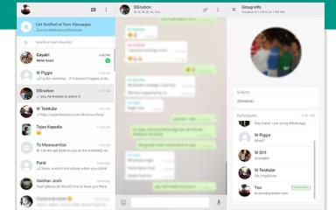
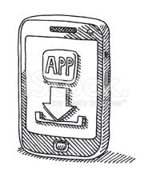


Slide 4
Summarize a conversation
Coordinate events
Monitor conversation mood
Automatic reply
Pre planed or periodic messages

Slide 5
WhatsApp web running on Chrome browser
Bot use Selenium engine to access the chats
Bot listen to selected chats
Bot process the chat content and respond
Notify on alerting content
Automatically reply on specify messages
Monitor event status and send summary

