Slide 1


Workshop in Information Security - Firewall
Ori Glassman

Slide 2

IPS: CVE-2019-17662
Ori Glassman

Slide 3
Preparing the environment - ThinVNC
ThinVNC is x86 .exe file that is designed for Windows.
It uses Basic Authentication to authenticate a user to access the web VNC interface.
It can run on our ubuntu distributions using 32 bit “wine”. Once running with wine, you set the credentials (also port), and the server is up waiting for http requests.
The client side doesn’t need to install anything, he can use a browser and point it to the ip and port of the ThinVNC server. The whole communication between the vnc client and server is on top HTTP. Upon surfing to the ThinVNC ip:port, you are asked to fill in the credentials. Let’s say we don’t know the credentials. Can we somehow find them out anyway?

Slide 4
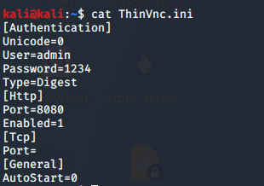
Finding out the credentials
Turns out it is possible to find the credentials
When the username and password are configured on the server side, a ThinVnc.ini file is created, which has the following format:
These are the valid user credentials that were configured by the user

Slide 5
Finding out the credentials – Cont.
As we saw, the valid credentials are written in plaintext inside that file. All we have to do is somehow read this file. But how can we read a file remotely without access to the OS?

Slide 6
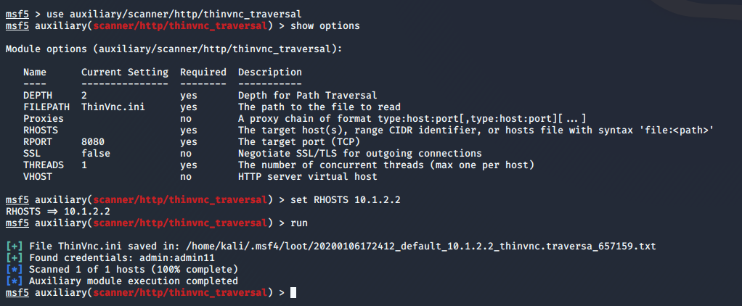
Finding out the credentials – using Metasploit

Slide 7
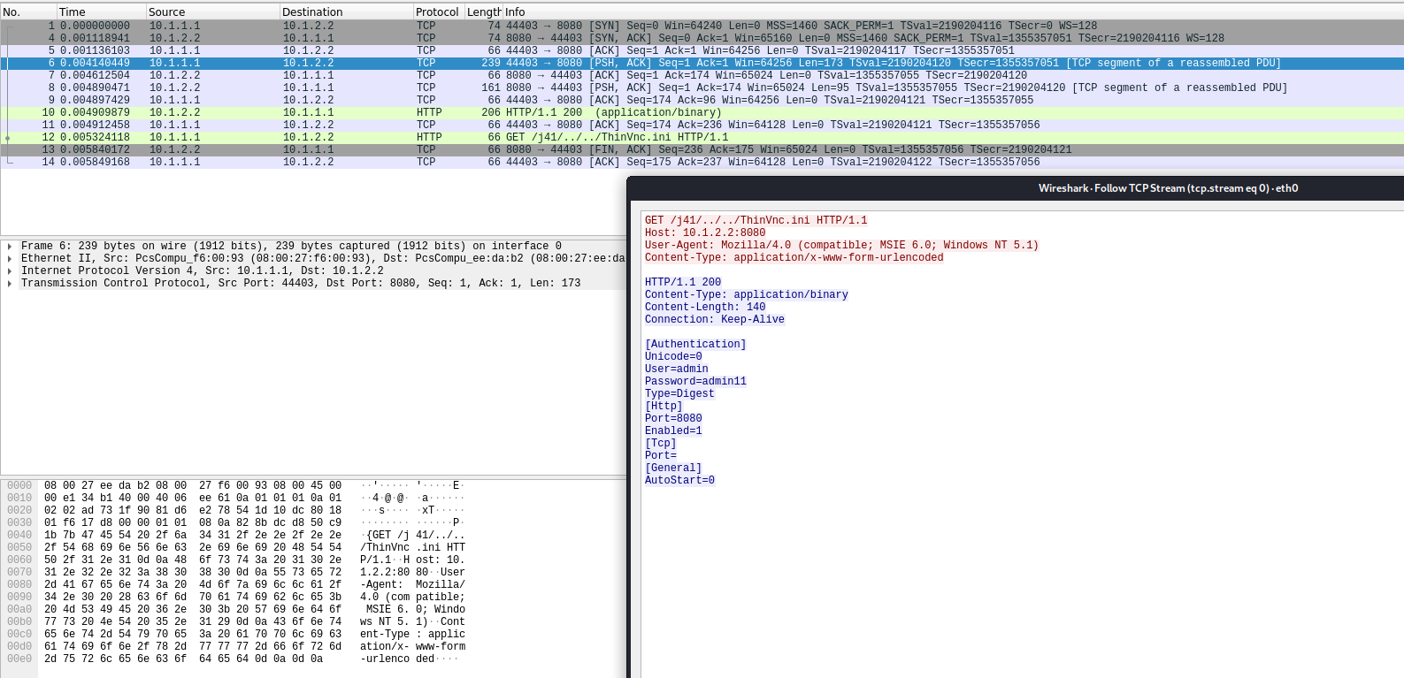
Network Level – Finding out the bad request
Let’s analyze what happened in the background
Request
Response

Slide 8
Blocking the attack
Searching for directory traversal (“..”) in the GET URL request, and dropping the request if it exists.
Since no reasonable URL has “..” in it, we block it and there is no false positive.
Note: With the directory traversal you may get any file in the OS. By blocking directory traversal (other method of blocking the attack would be to search for “ThinVnc.ini” in the URL), not only we prevent the attacker from getting the ThinVnc.ini file, we prevent from him getting any other relevant files.

Slide 9
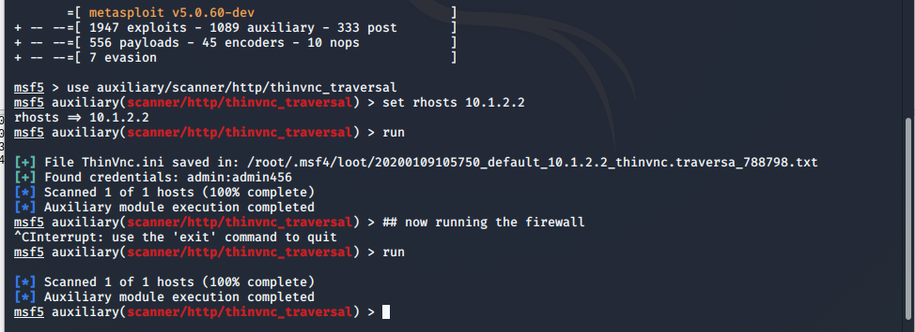
Blocking the attack – in action
Credentials found
No credentials found

Slide 10
DLP – Data Leak Prevention

Slide 11
How to prevent C code from leaking out
Inspect every line and see for common C words and phrases.
The initial score is set to zero.
Each finding increments the score by the likelihood that it corresponds with C code. For example, finding “int main()” is very likely that this is C code, thus returns high score.
At the end, if the score is above or equal to some predefined threshold, we drop the connection.
The chosen threshold was 100 points.

Slide 12
List of C indicators
Starts with “#define” – 100 points
Has C main function: “int main(” or “void main(“ – 100 points
Has function calls to basic common string libraries such as: strcpy, strcmp – 100 points
Has calls to C memory allocation function such as: malloc, realloc, calloc – 100 points
Has function calls to printf or fprintf – 100 points
Starts with #include – 90 points
Function calls: “some_func()” – 20 points
Comments: “//” or “/*” or “*/” – 20 points
Ends with “;” – 10 points

Slide 13

Getting False Positive
Java and C has syntax in common: semi-colons and line comments
A large Java file will get high score due to semi-colons.
What about C and python syntax?
Normal function calls

Slide 14
Reducing False Positive without reducing accuracy
If some line starts with package declaration, its Java.
If some line starts with import: with semi colons its Java, without it’s python
If we see a Java or python indicator, we immediately return that it is not C code. Thus, we still have common C indicators such as line comments to increase accuracy, without dropping Java or python files unintended.

