Slide 1
Severity Code on car accidents Analysis
The IBM Professional Data Science Capstone Project
by Oriol Jorba Ferro

Slide 2
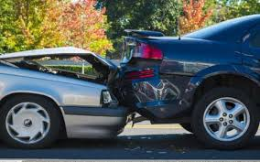
Introduction
The world suffers due to car accidents, including the USA. National Highway Traffic Safety Administration of the USA suggests that the economical and societal harm from car accidents can cost up to $871 billion in a single year. The project aims to understand, study and predict the severity of accidents and the external factors that can play a role such as the weather, the road and light conditions.
This model can be used for alerting drivers when the probability of having a severe accident is high, due to weather and other external conditions.

Slide 3
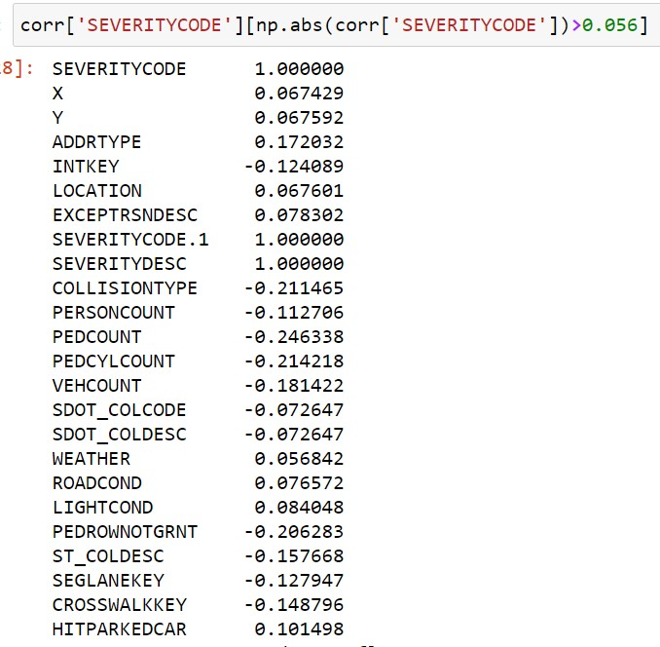
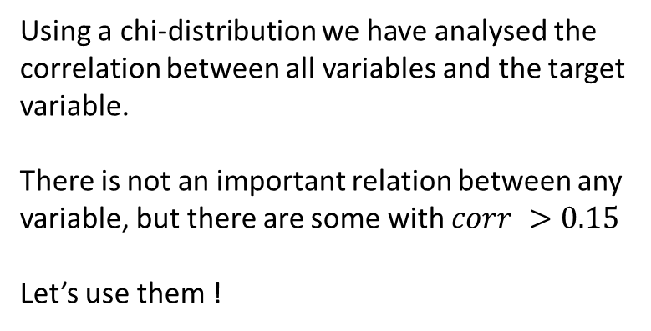
Data Understanding : Raw data / Target var.
The raw data consist on all type of collisions on the city of Seattle from 2004 to present. It has 194673 observations (collisions).
Target variable : Severity Code (binary variable)
Property damage only : y = 0*
Some type of injury : y = 1*
Which predictor variables use?
Using a chi-distribution we have analysed the correlation between all variables and the target variable.
There is not an important relation between any variable, but there are some with $corr >0.15$
Let’s use them !
* In the raw data are prop. Dmg. 0, and inj. dmg. 1. We modified them for simplicity.

Slide 4
Data Understanding: Predictor Variables (I)
Root variables (factors that can lead to an accident):
Weather
Road conditions
Light conditions,
Speeding,
Other variables:
Address type
Collision type
Person count
Pedestrian count
Vehicle count
Number of Bicycles involved.
Under influence of drugs/alcohol
Innatention to the road
Whether the pedestrian right of way was not granted.

Slide 5
Data Understanding: Predictor Variables (II)
We simplify most categorical variables into binary variables, e.g. Weather:
We do the same with all categorical variables but Collision Type.
Good weather
Bad weather

Slide 6
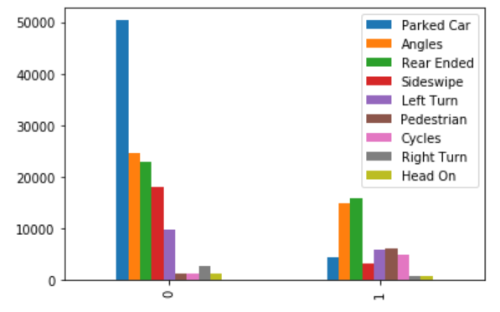
Data Understanding: Predictor Variables (IV)
Collision Type can be an important factor determining the types of accidents that can lead into a car accident with injures:

Slide 7
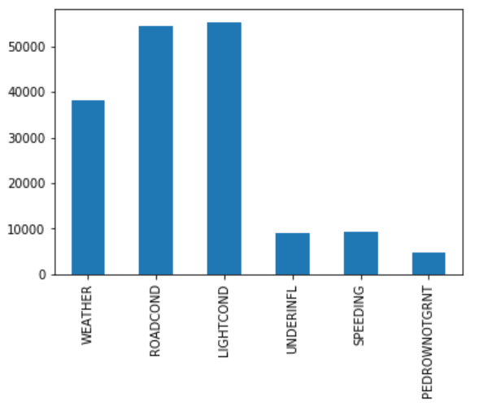
Data Understanding: Predictor Variables (V)
Frequency of the factors that can lead into an accident:

Slide 8
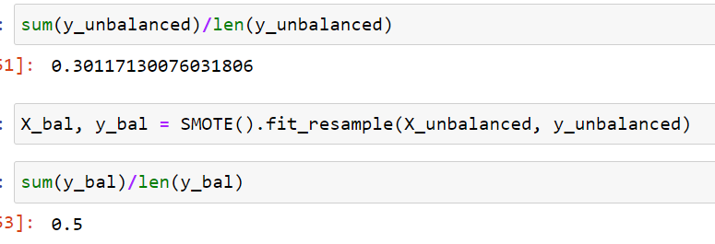
Data Preparation: Data unbalance
Data in unbalanced ! The target variable has two times more property damage accidents (0) than injure accidents (1). Two options to balanced it :
We erase randomly half of the prop. damage accidents (y= 0)
Problem: We are loosing a lot of data
We insert synthetically the double of values of injure accidents (y = 1)
Problem: We are generating a bias and over-valuating the under-represented class and increasing the computational resources.
We choose the second option ! We use a library called SMOTE()

Slide 9

Modeling: Overview
Data is normalized
Data is split into two groups:
70% train set
30% test set
Machine Learning Models used:
Decision Tree Analysis
Logistic Regression
K-Nearest Neighbor

Slide 10
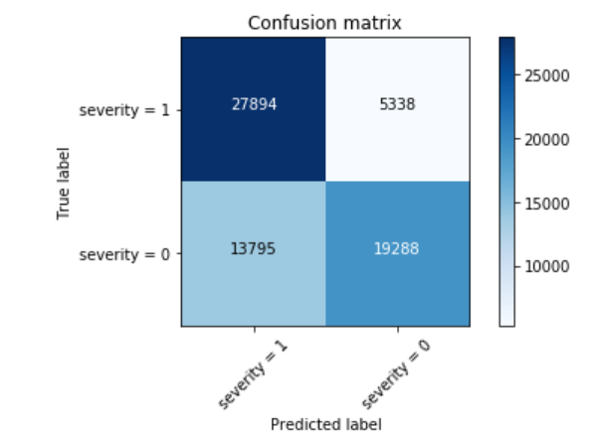
Modeling: Decision Tree Analysis
Manually tuning.
Max depth = 10
Both accuracy and f1-score around 0.70

Slide 11
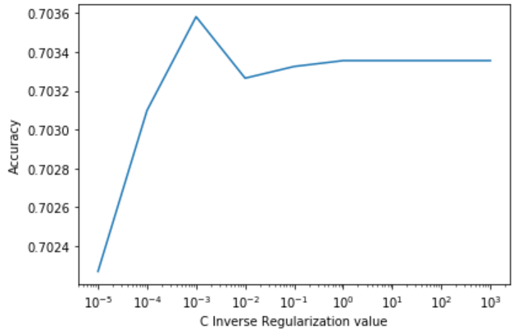
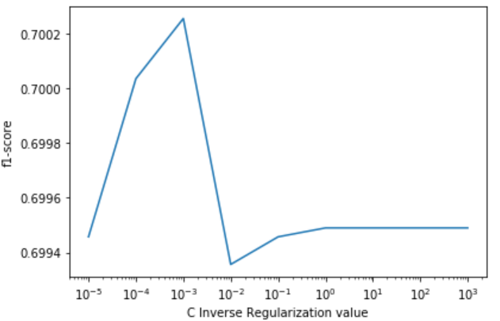
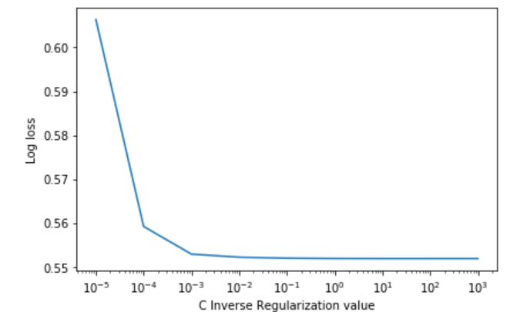

Modeling: Logistic Regression
Tuning: Regularization inverse constant c.
Optimal $c≈0.001$

Slide 12
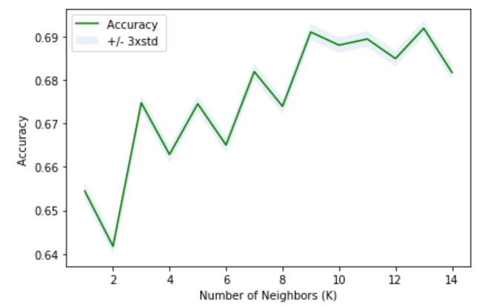
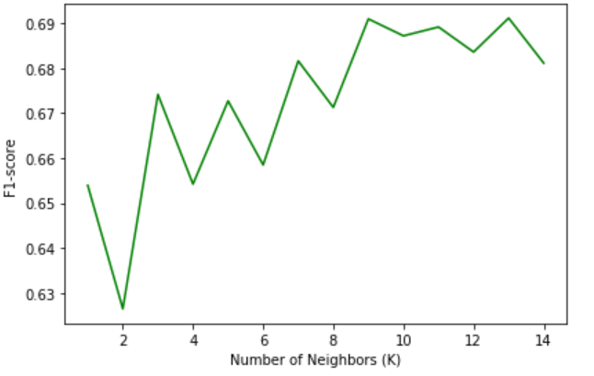

Modeling: k-Nearest Neightbors
Optimal number neighbours $n ≈9$.
Both accuracy and f1-score around 0.66-0.9
Very slow method !

Slide 13
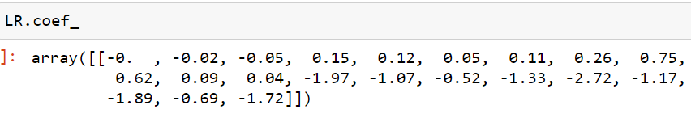
Evaluation and results
Coeficients values (LR):
 | Tree Decision Analysis |  |  | Logistic Regression |  |  | K-Nearest Neighbors
Severity Code | Precision | Recall | F1-score | Precision | Recall | F1-score | Precision | Recall | F1-score
0 | 0.78 | 0.58 | 0.67 | 0.76 | 0.60 | 0.67 | 0.69 | 0.69 | 0.69
1 | 0.67 | 0.84 | 0.74 | 0.67 | 0.81 | 0.73 | 0.69 | 0.69 | 0.69
Weighted | 0.73 | 0.71 | 0.71 | 0.71 | 0.70 | 0.70 | 0.69 | 0.69 | 0.69
Accuracy | 0.71 |  |  | 0.70 |  |  | 0.69
Best model :
Tree Decision Analysis
The weather, road and light conditions are not a good estimator for knowing the severity of an accident.
At least with our DATA !

Slide 14
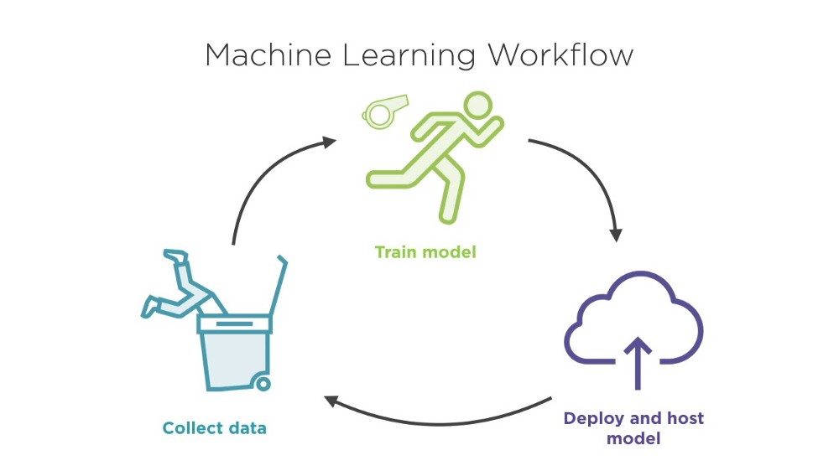
Questions?

