Slide 1
Wasserstein Distributionally Robust Kalman Filtering
Ori Meiraz

Slide 2
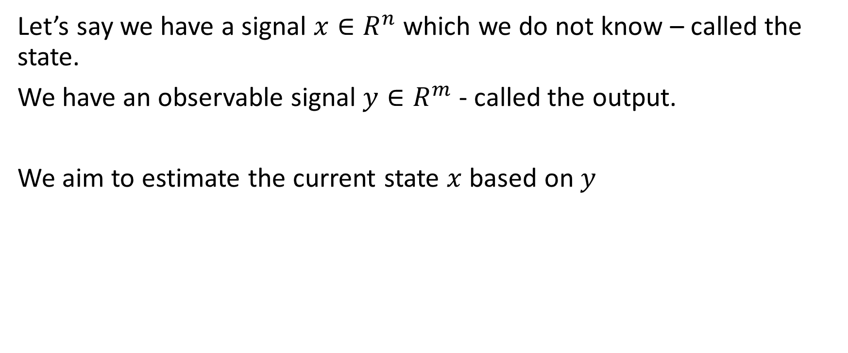
Background
Let’s say we have a signal $x∈R^{n}$ which we do not know – called the state.
We have an observable signal $y∈R^{m}$ - called the output.
We aim to estimate the current state $x$ based on$y$

Slide 3
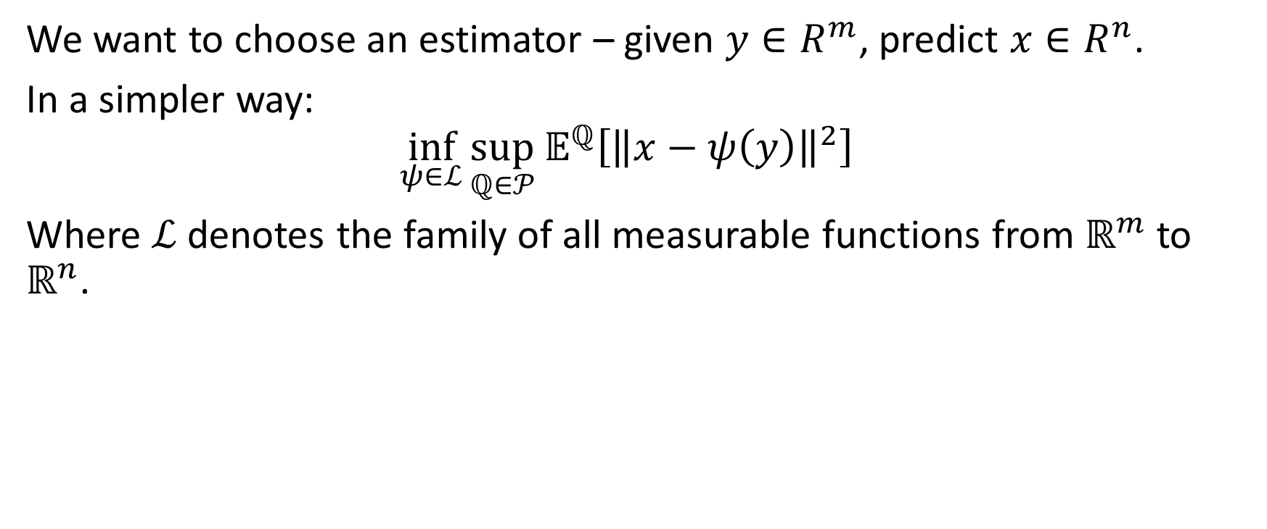
Goal
We want to choose an estimator – given $y∈R^{m}$, predict $x∈R^{n}$.
In a simpler way:
$$\inf_{ψ∈ℒ}{\sup_{ℚ∈𝒫}{𝔼^{ℚ}\left[{\left\|x−ψ\left(y\right)\right\|}^{2}\right] } }$$
Where $ℒ$ denotes the family of all measurable functions from $ℝ^{m}$ to $ℝ^{n}$.

Slide 4
Overview of the paper

Slide 5
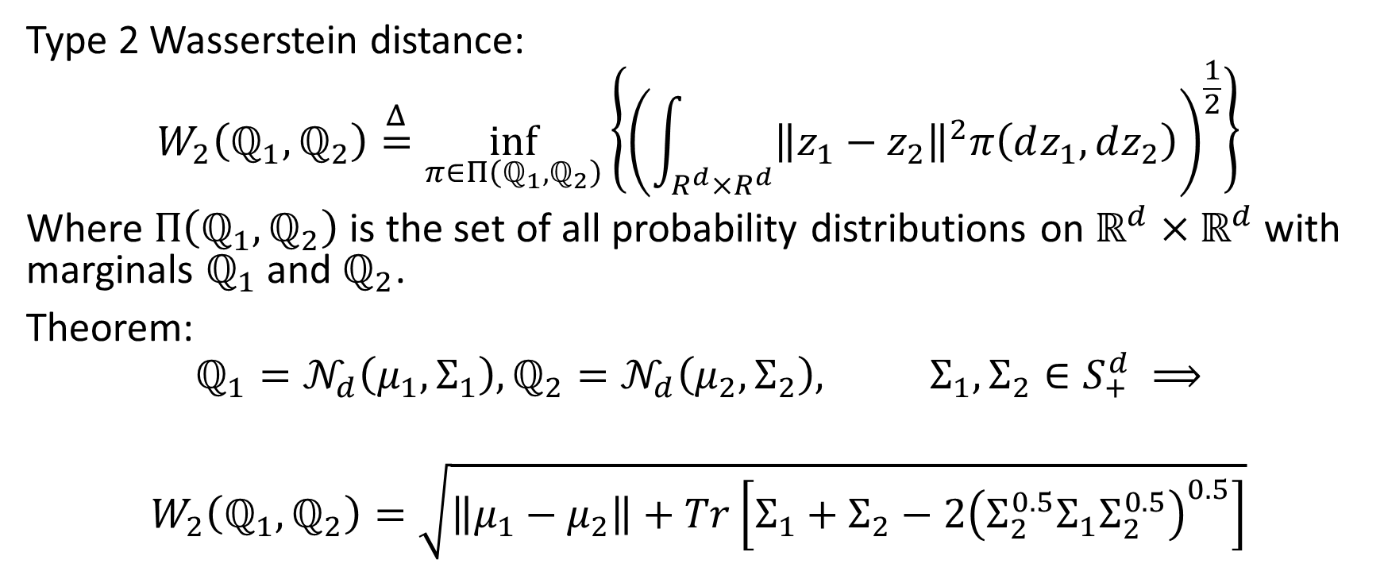
Reminders:
Type 2 Wasserstein distance:
$$W_{2}\left(ℚ_{1}, ℚ_{2}\right)\overset{Δ}{=}\inf_{π∈Π\left(ℚ_{1}, ℚ_{2}\right)}\left\{{\left(\int_{R^{d}×R^{d}}{{\left\|z_{1}−z_{2}\right\|}^{2}π\left(dz_{1}, dz_{2}\right)}\right)}^{\frac{1}{2}}\right\}$$
Where $Π\left(ℚ_{1}, ℚ_{2}\right)$ is the set of all probability distributions on $ℝ^{d}×ℝ^{d}$ with marginals $ℚ_{1}$ and $ℚ_{2}$.
Theorem:
$$ℚ_{1}=𝒩_{d}\left(μ_{1}, Σ_{1}\right),ℚ_{2}=𝒩_{d}\left(μ_{2}, Σ_{2}\right), Σ_{1},Σ_{2}∈S_{+}^{d} ⟹$$ $$W_{2}\left(ℚ_{1}, ℚ_{2}\right)=\sqrt{\left\|μ_{1}−μ_{2}\right\|+Tr\left[Σ_{1}+Σ_{2}−2{\left(Σ_{2}^{0.5}Σ_{1}Σ_{2}^{0.5}\right)}^{0.5}\right]}$$

Slide 6
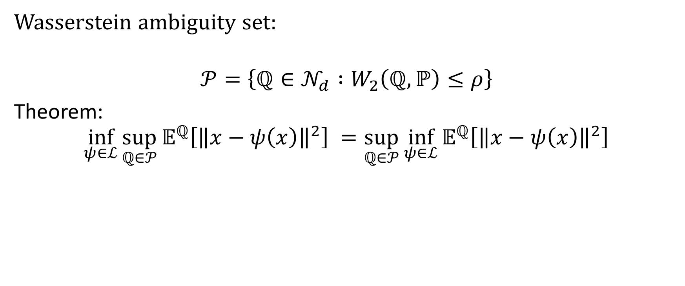
Reminders
Wasserstein ambiguity set:
$$𝒫=\left\{ℚ∈𝒩_{d} :W_{2}\left(ℚ, ℙ\right)≤ρ\right\}$$
Theorem:
$$\inf_{ψ∈ℒ}{\sup_{ℚ∈𝒫}{𝔼^{ℚ}\left[{\left\|x−ψ\left(x\right)\right\|}^{2}\right] }}=\sup_{ℚ∈𝒫}{\inf_{ψ∈ℒ}{𝔼^{ℚ}\left[{\left\|x−ψ\left(x\right)\right\|}^{2}\right]}}$$

Slide 7
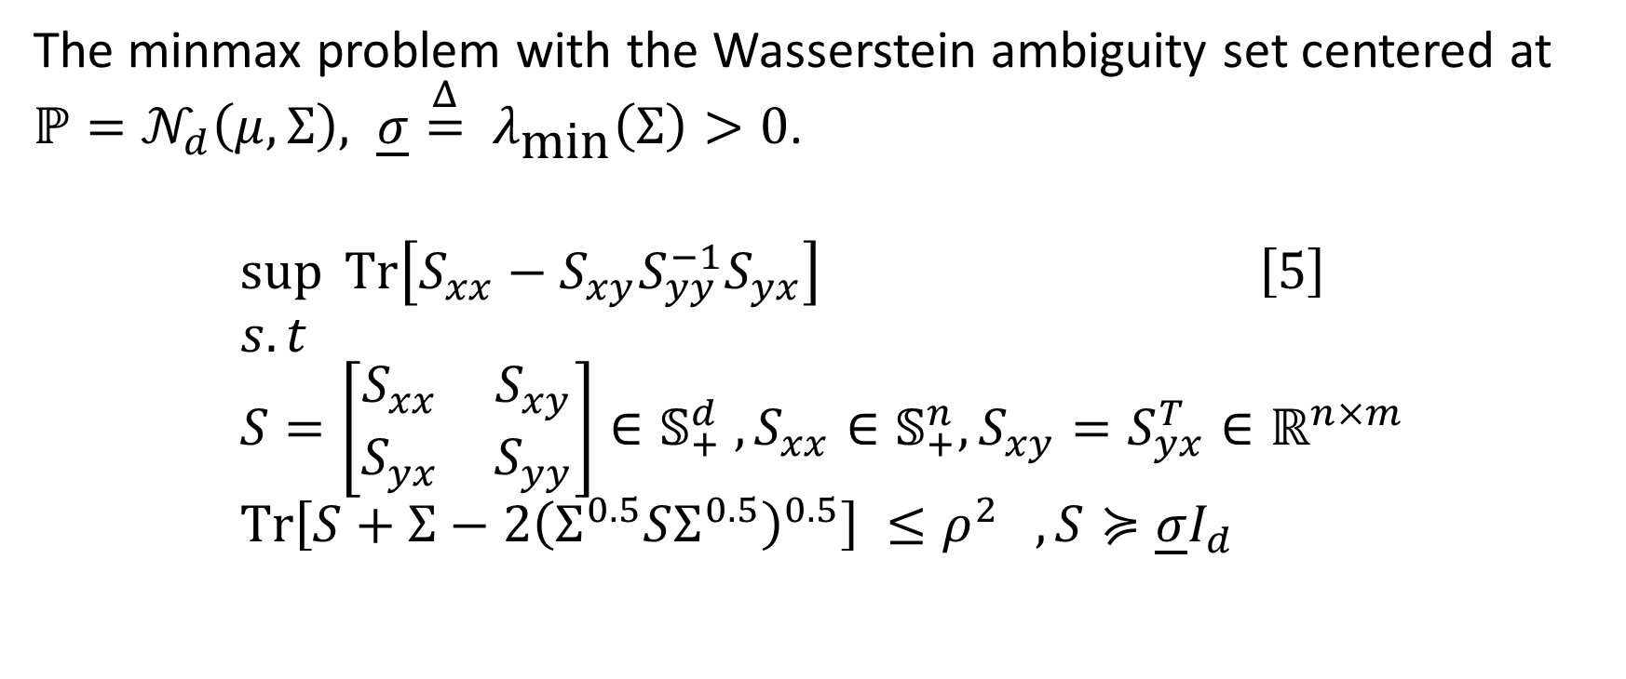
Reformulation
The minmax problem with the Wasserstein ambiguity set centered at $ℙ=𝒩_{d}\left(μ, Σ\right), \underline{σ}\overset{Δ}{=} λ_{\text{min}}\left(Σ\right)>0$.
$$\sup{Tr\left[S_{xx}−S_{xy}S_{yy}^{−1}S_{yx}\right]} \left[5\right] \\ s.t \\ S=\left[\begin{matrix}S_{xx} & S_{xy} \\ S_{yx} & S_{yy}\end{matrix}\right]∈𝕊_{+}^{d} , S_{xx}∈𝕊_{+}^{n}, S_{xy}=S_{yx}^{T}∈ℝ^{n×m} \\ Tr\left[S+Σ−2{\left(Σ^{0.5}SΣ^{0.5}\right)}^{0.5}\right] ≤ρ^{2} , S≽\underline{σ}I_{d}$$

Slide 8

How does it help me?

Slide 9
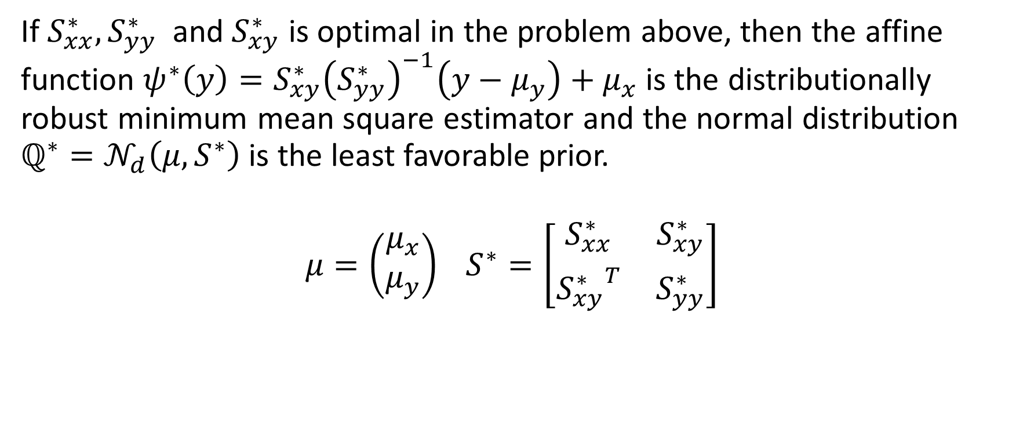
Using the solution:
If $S_{xx}^{∗}, S_{yy}^{∗}$ and $S_{xy}^{∗}$ is optimal in the problem above, then the affine function $ψ^{∗}\left(y\right)=S_{xy}^{∗}{\left(S_{yy}^{∗}\right)}^{−1}\left(y−μ_{y}\right)+μ_{x}$ is the distributionally robust minimum mean square estimator and the normal distribution $ℚ^{∗}=𝒩_{d}\left(μ, S^{∗}\right)$ is the least favorable prior.
$$μ=\left(\begin{aligned}μ_{x} \\ μ_{y}\end{aligned}\right) S^{∗}=\left[\begin{matrix}S_{xx}^{∗} & S_{xy}^{∗} \\ {S_{xy}^{∗}}^{T} & S_{yy}^{∗}\end{matrix}\right]$$

Slide 10

So now we know what to do

Slide 11

But there is a long way

Slide 12

Definitions
Denote
$$f\left(S\right)\overset{Δ}{=}Tr\left[S_{xx}−S_{xy}S_{yy}^{−1}S_{yx}\right]$$

Slide 13

Definitions
A function $φ:S_{+}^{d}→R_{+}$ has a unit total elasticity if
$$φ\left(S\right)= \left\langle S, ∇φ\left(S\right)\right\rangle ∀S∈S_{+}^{d}$$
Turns out that $f\left(S\right)$ has a unit total elasticity.

Slide 14
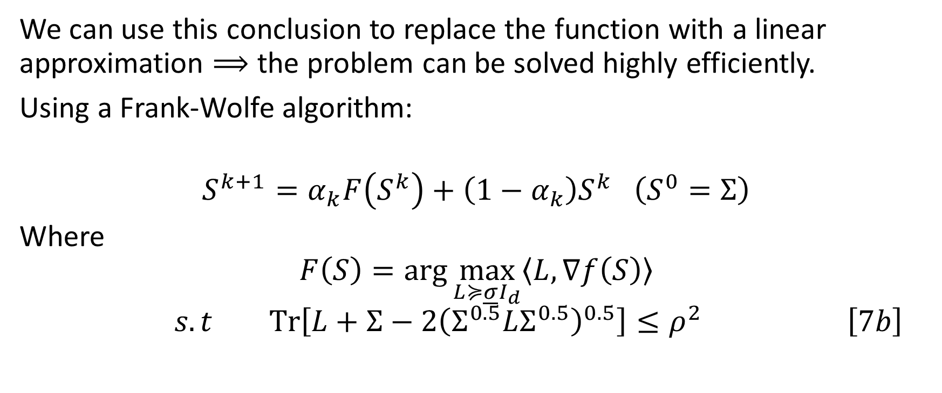
Uses
We can use this conclusion to replace the function with a linear approximation $⟹$ the problem can be solved highly efficiently.
Using a Frank-Wolfe algorithm:
$$S^{k+1}=α_{k}F\left(S^{k}\right)+\left(1−α_{k}\right)S^{k} \left(S^{0}=Σ\right)$$
Where
$$F\left(S\right)=\arg{\max_{L≽\underline{σ}I_{d}}\left\langle L, ∇f\left(S\right)\right\rangle }$$
$$s.t Tr\left[L+Σ−2{\left(Σ^{0.5}LΣ^{0.5}\right)}^{0.5}\right]≤ρ^{2} \left[7b\right]$$

Slide 15
In simple words
In each iteration, the Frank-Wolfe algorithm thus maximizes a linearized objective function over the original feasible set.
In contrast to other commonly used first-order methods, the Frank-Wolfe
algorithm thus obviates the need for a potentially expensive projection step to recover feasibility.

Slide 16
In simpler words
To make the frank – wolfe algorithm work in practice, one needs:
an efficient routine for solving the direction-finding subproblem (7b)
a step-size rule that offers rigorous guarantees on the algorithm’s convergence rat

Slide 17
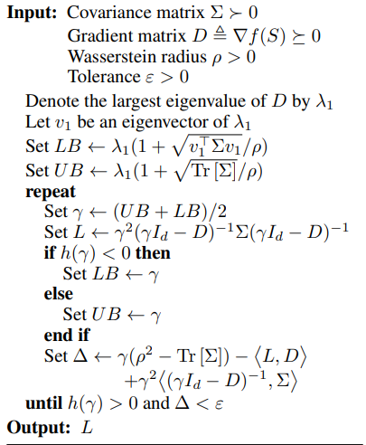

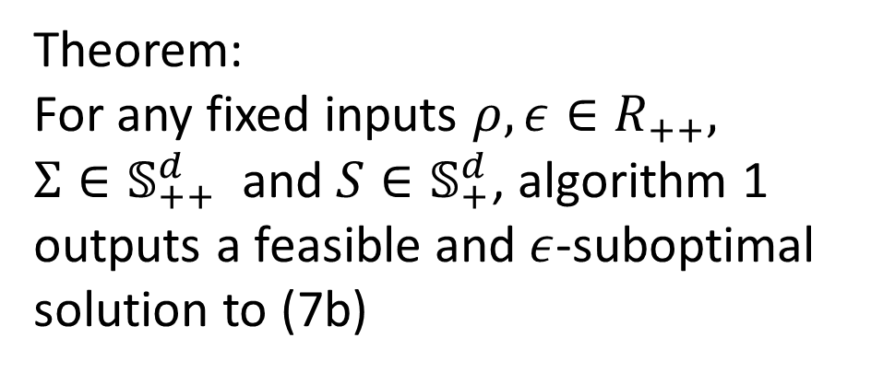
Algorithm 1 – Bisection algorithm to solve 7b
Theorem:
For any fixed inputs $ρ, ε∈R_{++},$ $Σ∈𝕊_{++}^{d}$ and $S∈𝕊_{+}^{d}$, algorithm 1 outputs a feasible and $ε$-suboptimal solution to (7b)

Slide 18
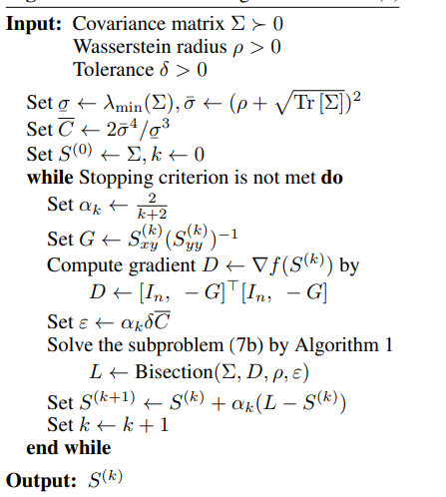
Algorithm 2 – Frank-Wolfe algorithm to solve 5

Slide 19
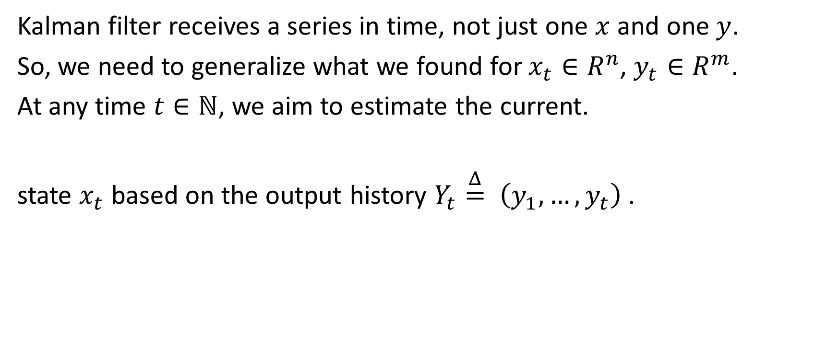
What is a Kalman filter?
Kalman filter receives a series in time, not just one $x$ and one $y$.
So, we need to generalize what we found for $x_{t}∈R^{n}$, $y_{t}∈R^{m}$.
At any time $t∈ℕ$, we aim to estimate the current.
state $x_{t}$ based on the output history $Y_{t}\overset{Δ}{=} \left(y_{1},…,y_{t}\right)$.

Slide 20
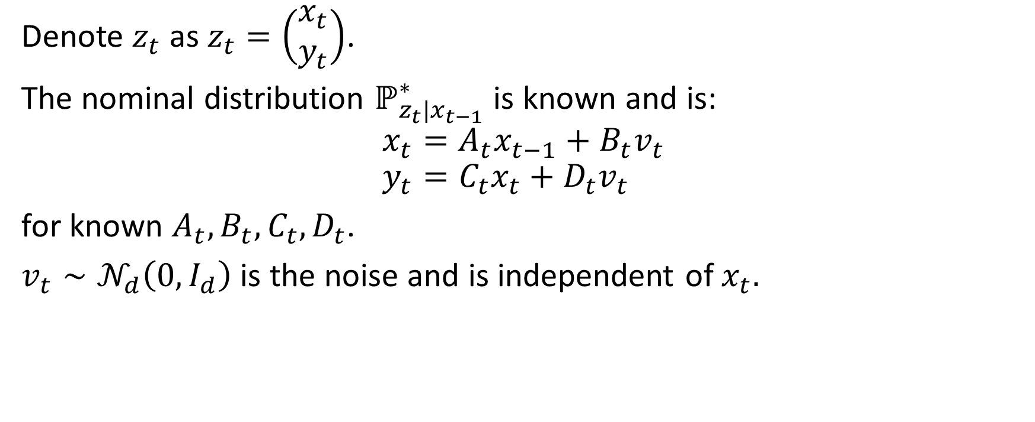
What is a Kalman filter?
Denote $z_{t}$ as $z_{t}=\left(\begin{aligned}x_{t} \\ y_{t}\end{aligned}\right)$.
The nominal distribution $ℙ_{z_{t}|x_{t−1}}^{∗}$ is known and is:
$$x_{t}=A_{t}x_{t−1}+B_{t}v_{t} \\ y_{t}=C_{t}x_{t}+D_{t}v_{t}$$
for known $A_{t}, B_{t}, C_{t}, D_{t}$.
$v_{t}∼𝒩_{d}\left(0, I_{d}\right)$ is the noise and is independent of $x_{t}.$

Slide 21

What is a Kalman filter
So,
$$P_{z_{t}|x_{t−1}}^{∗}=𝒩_{d}\left(\left[\begin{aligned}A_{t} \\ C_{t}A_{t}\end{aligned}\right]x_{t−1}, \left[\begin{aligned}B_{t} \\ C_{t}B_{t}+D_{t}\end{aligned}\right]{\left[\begin{aligned}B_{t} \\ C_{t}B_{t}+D_{t}\end{aligned}\right]}^{T}\right)$$
$$∀t∈ℕ$$
Unlike $P^{∗}$, the true distribution $ℚ$ is unknown.

Slide 22
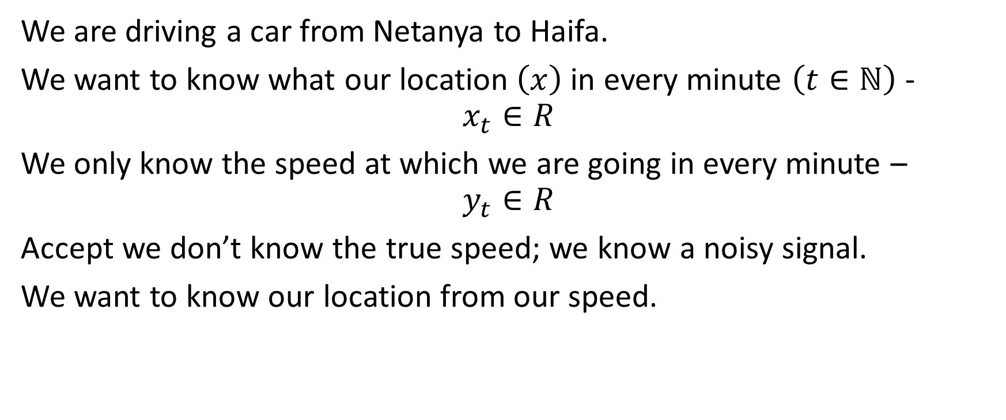
Example
We are driving a car from Netanya to Haifa.
We want to know what our location $\left(x\right)$ in every minute $\left(t∈ℕ\right)$ - $$x_{t}∈R$$
We only know the speed at which we are going in every minute –
$$y_{t}∈R$$
Accept we don’t know the true speed; we know a noisy signal.
We want to know our location from our speed.

Slide 23
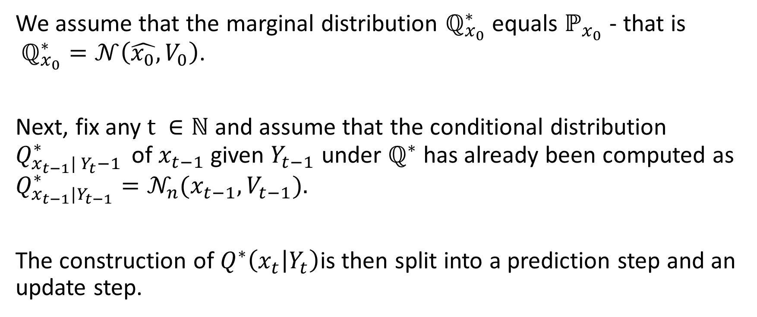
Algorithm
We assume that the marginal distribution $ℚ_{x_{0}}^{∗}$ equals $ℙ_{x_{0}}$ - that is $ℚ_{x_{0}}^{∗}=𝒩\left(\hat{x_{0}}, V_{0}\right)$.
Next, fix any $t ∈ℕ$ and assume that the conditional distribution $Q_{x_{t−1}| Y_{t}−1 }^{∗}$ of$x_{t−1}$ given $Y_{t−1}$ under $ℚ^{∗}$ has already been computed as $Q_{x_{t−1}|Y_{t−1}}^{∗}=𝒩_{n}(x_{t−1}, V_{t−1}).$
The construction of $Q^{∗}\left(x_{t} | Y_{t}\right)$is then split into a prediction step and an update step.

Slide 24
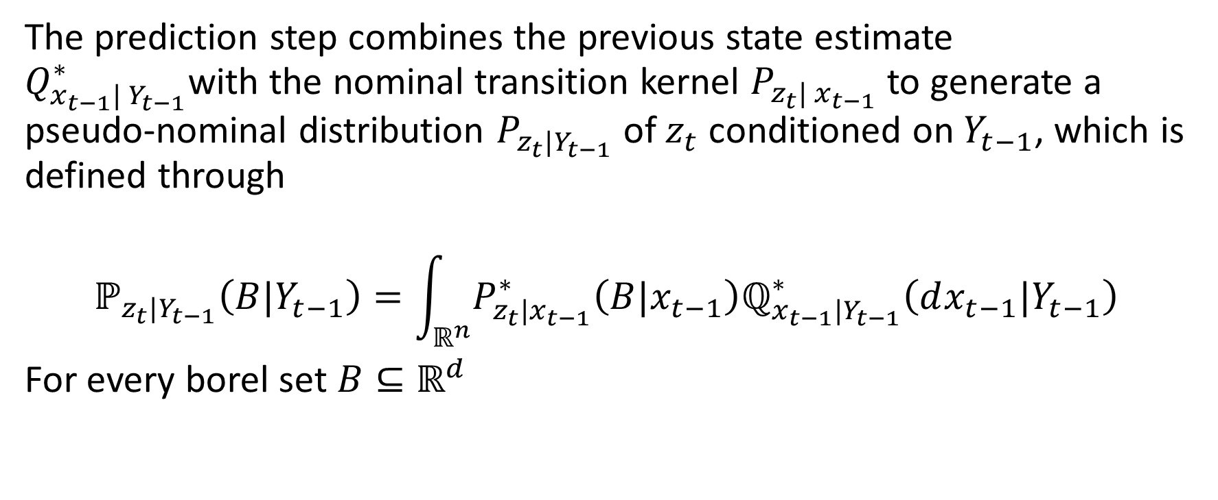
Prediction step
The prediction step combines the previous state estimate $Q_{x_{t−1}| Y_{t−1}}^{∗}$with the nominal transition kernel $P_{z_{t}| x_{t−1}}$ to generate a pseudo-nominal distribution $P_{z_{t}|Y_{t−1}}$ of $z_{t}$ conditioned on $Y_{t−1}$, which is defined through
$$ℙ_{z_{t}|Y_{t−1}}\left(B|Y_{t−1}\right)=\int_{ℝ^{n}}{P_{z_{t}|x_{t−1}}^{∗}\left(B|x_{t−1}\right)ℚ_{x_{t−1}|Y_{t−1}}^{∗}\left(dx_{t−1}|Y_{t−1}\right)}$$
For every borel set $B⊆ℝ^{d}$

Slide 25


memes

Slide 26
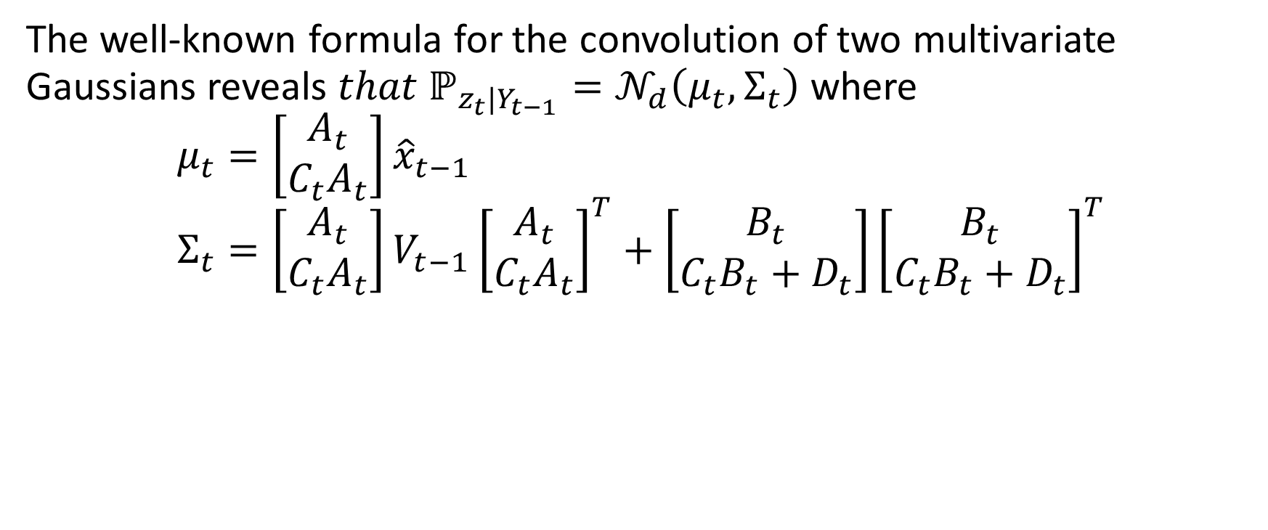
Prediction step
The well-known formula for the convolution of two multivariate Gaussians reveals $that ℙ_{z_{t}|Y_{t−1}}=𝒩_{d}\left(μ_{t}, Σ_{t}\right)$ where
$$μ_{t}=\left[\begin{aligned}A_{t} \\ C_{t}A_{t}\end{aligned}\right]{\hat{x}}_{t−1} \\ Σ_{t}=\left[\begin{aligned}A_{t} \\ C_{t}A_{t}\end{aligned}\right]V_{t−1}{\left[\begin{aligned}A_{t} \\ C_{t}A_{t}\end{aligned}\right]}^{T}+\left[\begin{aligned}B_{t} \\ C_{t}B_{t}+D_{t}\end{aligned}\right]{\left[\begin{aligned}B_{t} \\ C_{t}B_{t}+D_{t}\end{aligned}\right]}^{T}$$

Slide 27
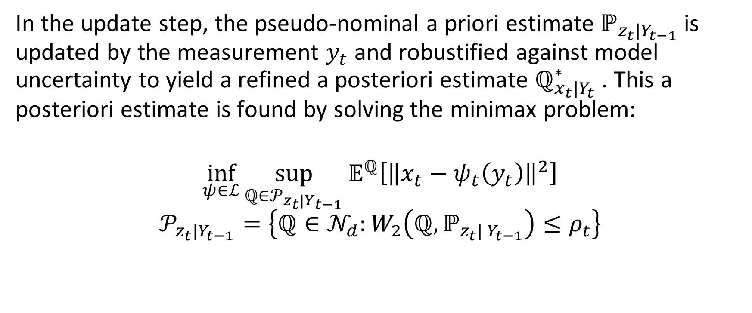
Update step
In the update step, the pseudo-nominal a priori estimate $ℙ_{z_{t}|Y_{t−1}}$is updated by the measurement $y_{t}$ and robustified against model uncertainty to yield a refined a posteriori estimate $ℚ_{x_{t}|Y_{t}}^{∗}$. This a posteriori estimate is found by solving the minimax problem:
$$\inf_{ψ∈ℒ}{\sup_{ℚ∈𝒫_{z_{t}|Y_{t−1}}}{𝔼^{ℚ}\left[{\left\|x_{t}−ψ_{t}\left(y_{t}\right)\right\|}^{2}\right]}}$$
$$𝒫_{z_{t}|Y_{t−1}}=\left\{ℚ∈𝒩_{d}:W_{2}\left(ℚ, ℙ_{z_{t}| Y_{t−1}}\right)≤ρ_{t}\right\}$$

Slide 28

Update step
Finally,
We obtain that the least favorable distribution is:
$$ℚ_{x_{t}|Y_{t}}=𝒩_{n}\left(\hat{x_{t}}, V_{t}\right)$$
$$\hat{x_{t}}=S_{t, xy}^{∗}{\left(S_{t, yy}^{∗}\right)}^{−1}\left(y_{t}−μ_{t, y}\right)+μ_{t,x}$$
$$V_{t}=S_{t, xx}−S_{t, xy}^{∗}{\left(S_{t, yy}^{∗}\right)}^{−1}S_{t, yx}^{∗}$$

Slide 29
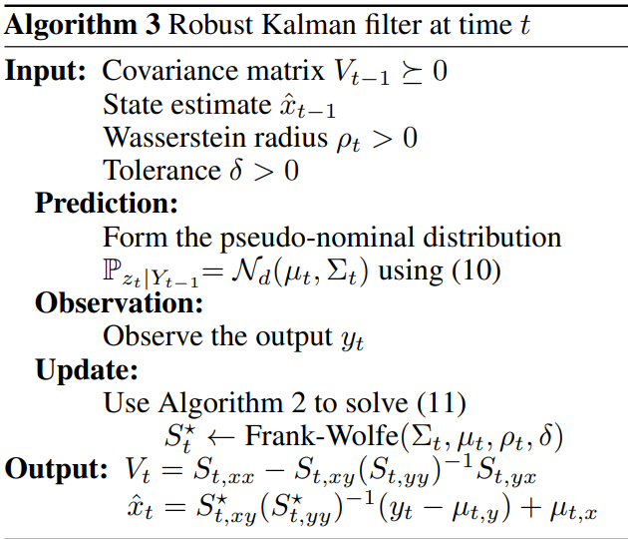
Sum it all up

Slide 30
Connected literature

Slide 31
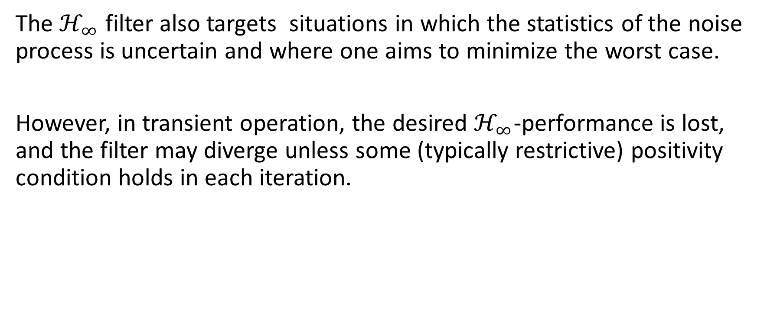
Connected literature
The $ℋ_{∞}$ filter also targets situations in which the statistics of the noise process is uncertain and where one aims to minimize the worst case.
However, in transient operation, the desired $ℋ_{∞}$-performance is lost, and the filter may diverge unless some (typically restrictive) positivity condition holds in each iteration.

Slide 32
Connected literature
A risk-sensitive Kalman filter is obtained by minimizing the moment-generating function instead of the mean of the squared estimation error.
This risk-sensitive Kalman filter minimizes the worst-case mean square error across all joint state-output distributions in a Kullback-Leibler (KL) ball around a nominal distribution.

Slide 33
Paper contribution

Slide 34
Paper contribution
The paper focuses on a (nonconvex) Wasserstein ambiguity set containing only normal distributions.
Shows that the optimal estimator and the least favorable distribution form a Nash equilibrium.
Proves that the estimation problem is equivalent to a tractable convex program. Devises a Frank-Wolfe algorithm for this convex program.

Slide 35
Assessment of strength and weakness

Slide 36

Strength
The paper solves gives an efficient way to solve the optimization problem.
Given the solution, $S^{∗}$, we know exactly the worst-case distribution.

Slide 37
Weakness
Only considers type-2 Wasserstein distance.
Only considers normal distributions.

