Slide 1
Wasserstein Distributionally Robust Kalman Filtering
Ori Meiraz

Slide 2
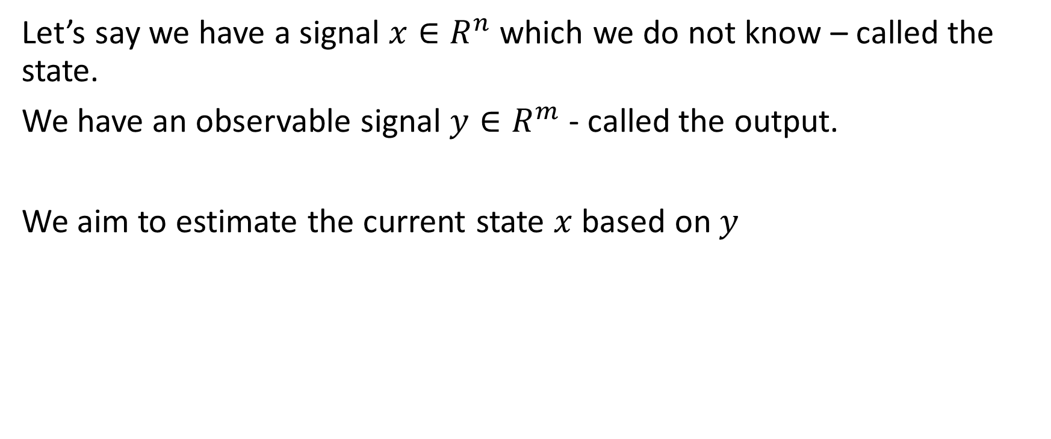
Background
Let’s say we have a signal $x∈R^{n}$ which we do not know – called the state.
We have an observable signal $y∈R^{m}$ - called the output.
We aim to estimate the current state $x$ based on$y$

Slide 3
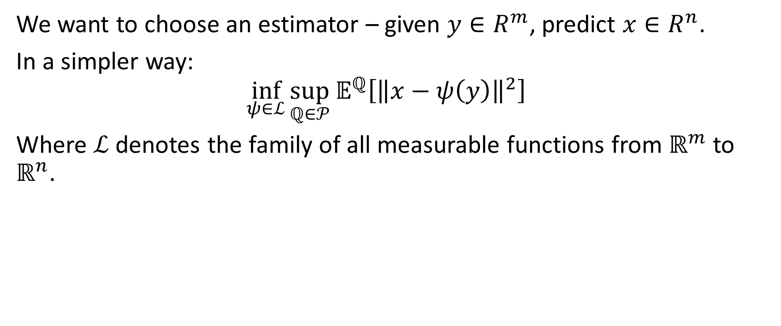
Goal
We want to choose an estimator – given $y∈R^{m}$, predict $x∈R^{n}$.
In a simpler way:
$$\inf_{ψ∈ℒ}{\sup_{ℚ∈𝒫}{𝔼^{ℚ}\left[{\left\|x−ψ\left(y\right)\right\|}^{2}\right] } }$$
Where $ℒ$ denotes the family of all measurable functions from $ℝ^{m}$ to $ℝ^{n}$.

Slide 4
Overview of the paper

Slide 5
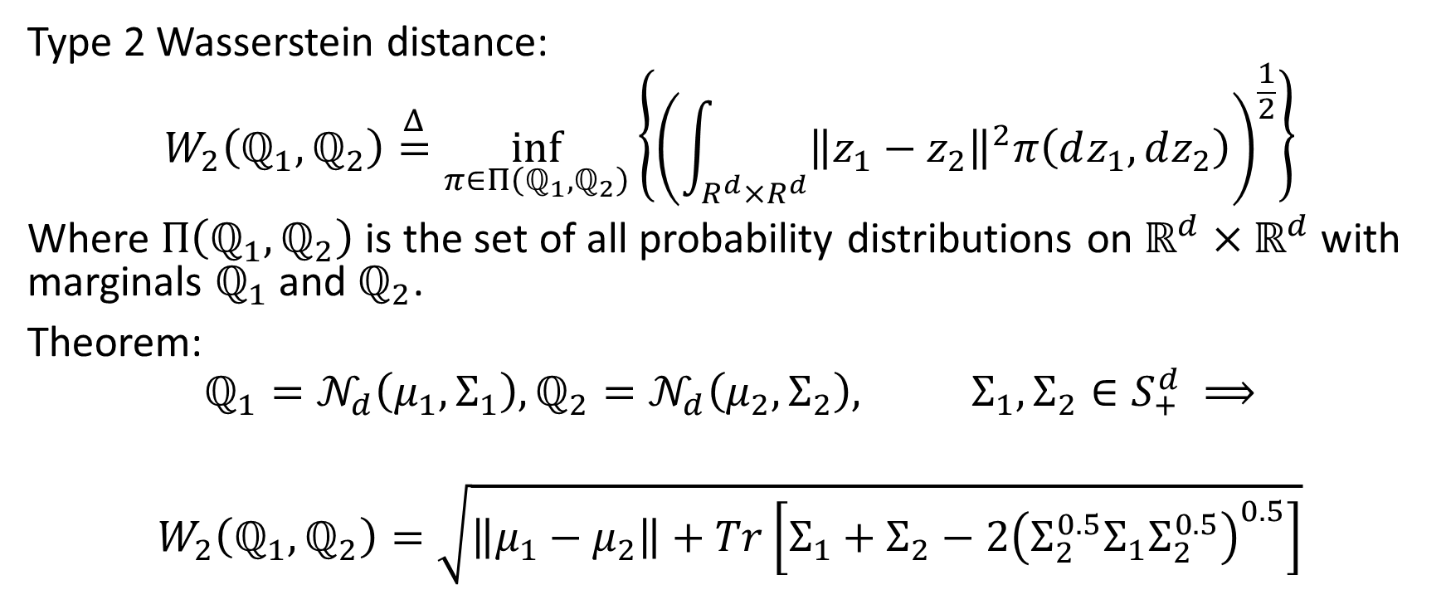
Reminders:
Type 2 Wasserstein distance:
$$W_{2}\left(ℚ_{1}, ℚ_{2}\right)\overset{Δ}{=}\inf_{π∈Π\left(ℚ_{1}, ℚ_{2}\right)}\left\{{\left(\int_{R^{d}×R^{d}}{{\left\|z_{1}−z_{2}\right\|}^{2}π\left(dz_{1}, dz_{2}\right)}\right)}^{\frac{1}{2}}\right\}$$
Where $Π\left(ℚ_{1}, ℚ_{2}\right)$ is the set of all probability distributions on $ℝ^{d}×ℝ^{d}$ with marginals $ℚ_{1}$ and $ℚ_{2}$.
Theorem:
$$ℚ_{1}=𝒩_{d}\left(μ_{1}, Σ_{1}\right),ℚ_{2}=𝒩_{d}\left(μ_{2}, Σ_{2}\right), Σ_{1},Σ_{2}∈S_{+}^{d} ⟹$$ $$W_{2}\left(ℚ_{1}, ℚ_{2}\right)=\sqrt{\left\|μ_{1}−μ_{2}\right\|+Tr\left[Σ_{1}+Σ_{2}−2{\left(Σ_{2}^{0.5}Σ_{1}Σ_{2}^{0.5}\right)}^{0.5}\right]}$$

Slide 6
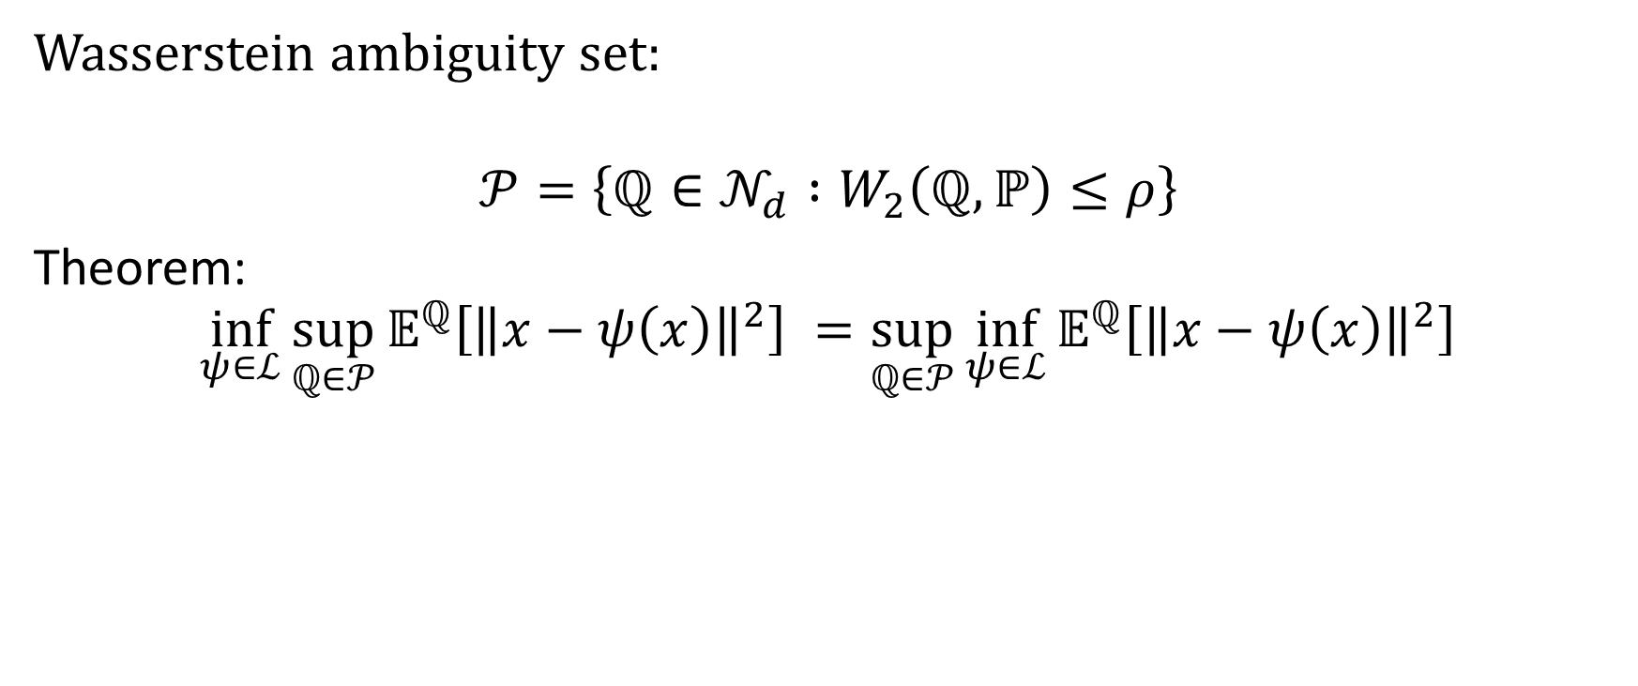
Reminders
Wasserstein ambiguity set:
$$𝒫=\left\{ℚ∈𝒩_{d} :W_{2}\left(ℚ, ℙ\right)≤ρ\right\}$$
Theorem:
$$\inf_{ψ∈ℒ}{\sup_{ℚ∈𝒫}{𝔼^{ℚ}\left[{\left\|x−ψ\left(x\right)\right\|}^{2}\right] }}=\sup_{ℚ∈𝒫}{\inf_{ψ∈ℒ}{𝔼^{ℚ}\left[{\left\|x−ψ\left(x\right)\right\|}^{2}\right]}}$$

Slide 7
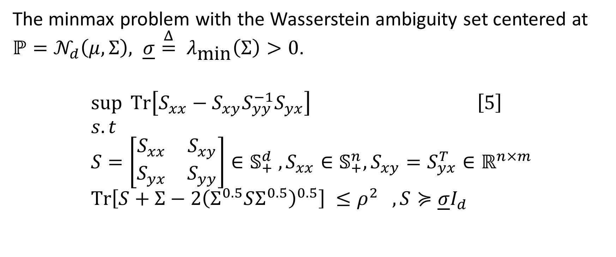
Reformulation
The minmax problem with the Wasserstein ambiguity set centered at $ℙ=𝒩_{d}\left(μ, Σ\right), \underline{σ}\overset{Δ}{=} λ_{\text{min}}\left(Σ\right)>0$.
$$\sup{Tr\left[S_{xx}−S_{xy}S_{yy}^{−1}S_{yx}\right]} \left[5\right] \\ s.t \\ S=\left[\begin{matrix}S_{xx} & S_{xy} \\ S_{yx} & S_{yy}\end{matrix}\right]∈𝕊_{+}^{d} , S_{xx}∈𝕊_{+}^{n}, S_{xy}=S_{yx}^{T}∈ℝ^{n×m} \\ Tr\left[S+Σ−2{\left(Σ^{0.5}SΣ^{0.5}\right)}^{0.5}\right] ≤ρ^{2} , S≽\underline{σ}I_{d}$$

Slide 8

How does it help me?

Slide 9
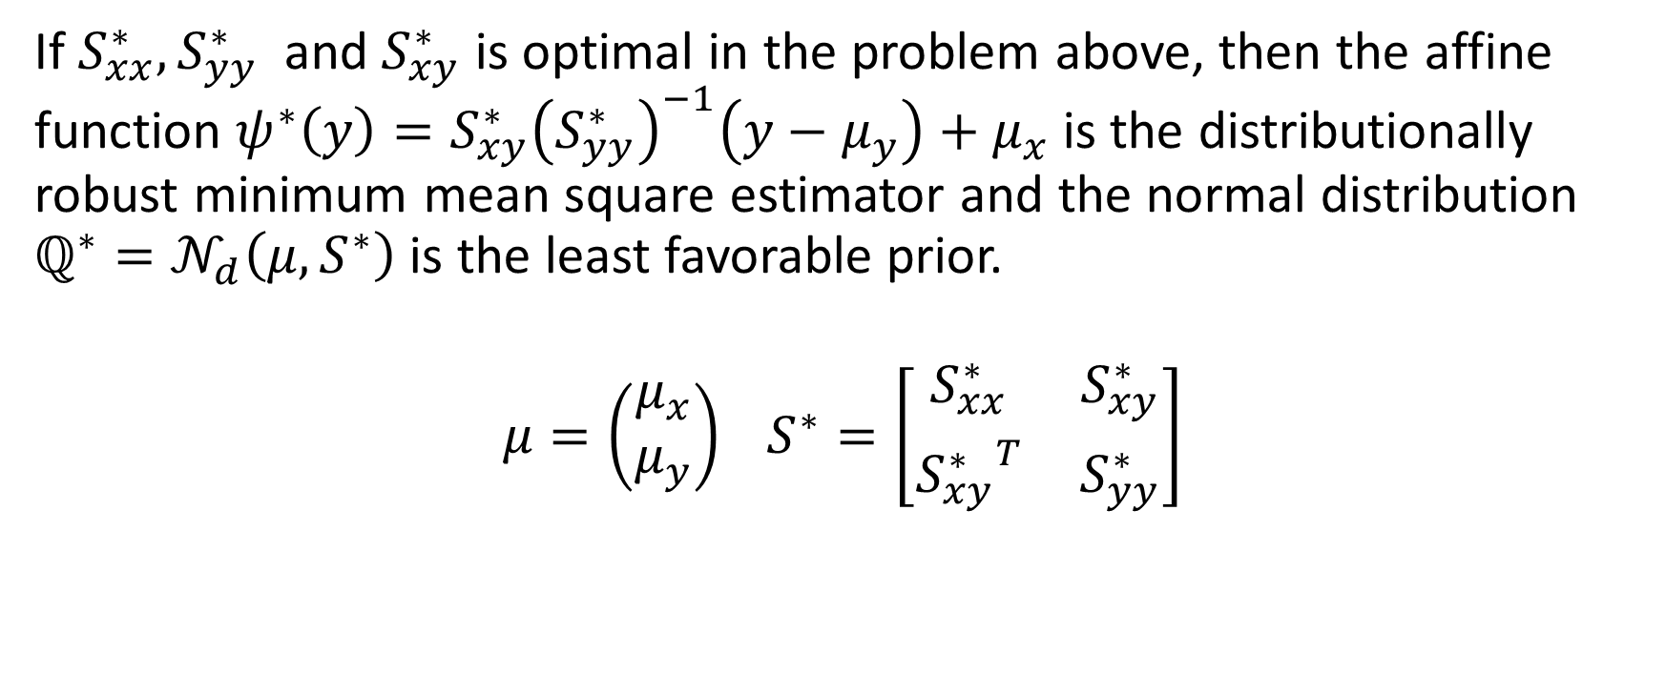
Using the solution:
If $S_{xx}^{∗}, S_{yy}^{∗}$ and $S_{xy}^{∗}$ is optimal in the problem above, then the affine function $ψ^{∗}\left(y\right)=S_{xy}^{∗}{\left(S_{yy}^{∗}\right)}^{−1}\left(y−μ_{y}\right)+μ_{x}$ is the distributionally robust minimum mean square estimator and the normal distribution $ℚ^{∗}=𝒩_{d}\left(μ, S^{∗}\right)$ is the least favorable prior.
$$μ=\left(\begin{aligned}μ_{x} \\ μ_{y}\end{aligned}\right) S^{∗}=\left[\begin{matrix}S_{xx}^{∗} & S_{xy}^{∗} \\ {S_{xy}^{∗}}^{T} & S_{yy}^{∗}\end{matrix}\right]$$

Slide 10

So now we know what to do

Slide 11

But there is a long way

Slide 12

Definitions
Denote
$$f\left(S\right)\overset{Δ}{=}Tr\left[S_{xx}−S_{xy}S_{yy}^{−1}S_{yx}\right]$$

Slide 13

Definitions
A function $φ:S_{+}^{d}→R_{+}$ has a unit total elasticity if
$$φ\left(S\right)= \left\langle S, ∇φ\left(S\right)\right\rangle ∀S∈S_{+}^{d}$$
Turns out that $f\left(S\right)$ has a unit total elasticity.

Slide 14
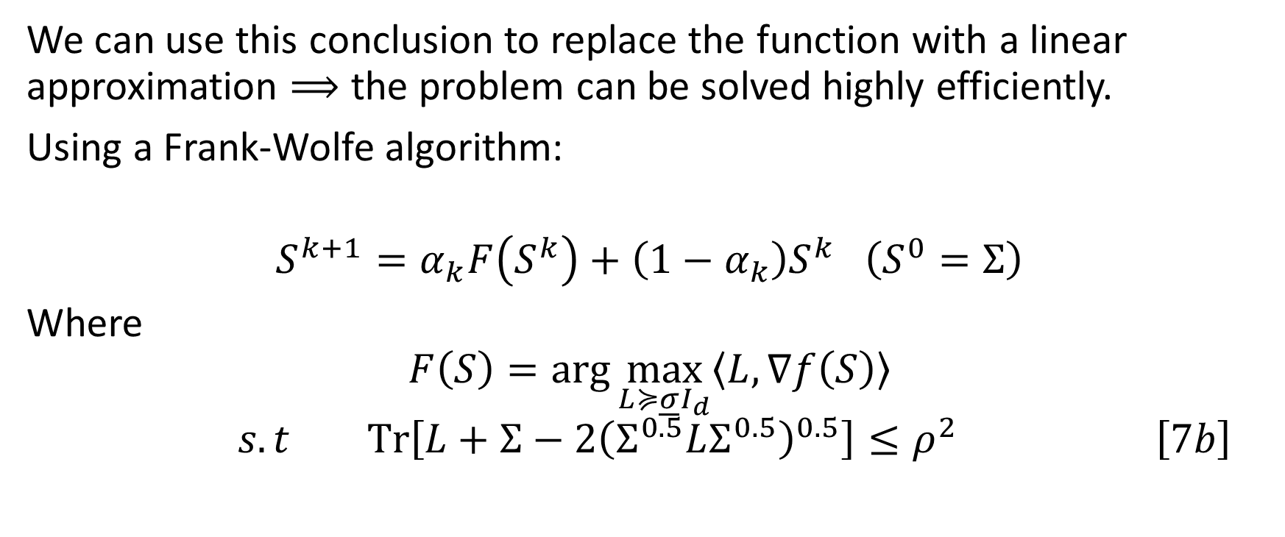
Uses
We can use this conclusion to replace the function with a linear approximation $⟹$ the problem can be solved highly efficiently.
Using a Frank-Wolfe algorithm:
$$S^{k+1}=α_{k}F\left(S^{k}\right)+\left(1−α_{k}\right)S^{k} \left(S^{0}=Σ\right)$$
Where
$$F\left(S\right)=\arg{\max_{L≽\underline{σ}I_{d}}\left\langle L, ∇f\left(S\right)\right\rangle }$$
$$s.t Tr\left[L+Σ−2{\left(Σ^{0.5}LΣ^{0.5}\right)}^{0.5}\right]≤ρ^{2} \left[7b\right]$$

Slide 15
In simple words
In each iteration, the Frank-Wolfe algorithm thus maximizes a linearized objective function over the original feasible set.
In contrast to other commonly used first-order methods, the Frank-Wolfe
algorithm thus obviates the need for a potentially expensive projection step to recover feasibility.

Slide 16
In simpler words
To make the frank – wolfe algorithm work in practice, one needs:
an efficient routine for solving the direction-finding subproblem (7b)
a step-size rule that offers rigorous guarantees on the algorithm’s convergence rat

Slide 17
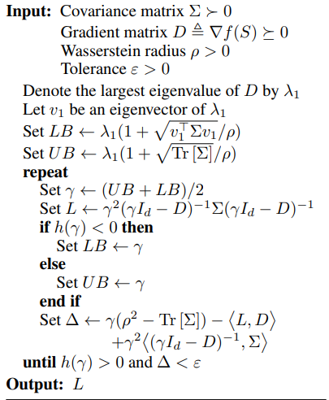

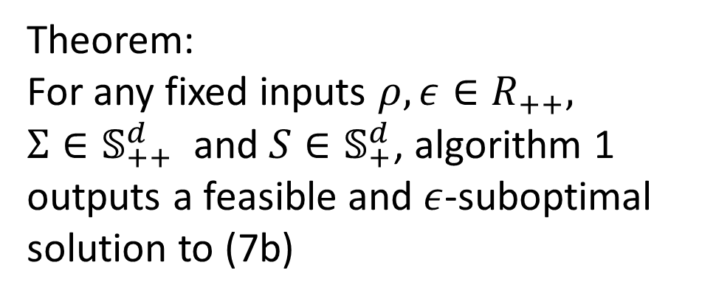
Algorithm 1 – Bisection algorithm to solve 7b
Theorem:
For any fixed inputs $ρ, ε∈R_{++},$ $Σ∈𝕊_{++}^{d}$ and $S∈𝕊_{+}^{d}$, algorithm 1 outputs a feasible and $ε$-suboptimal solution to (7b)

Slide 18
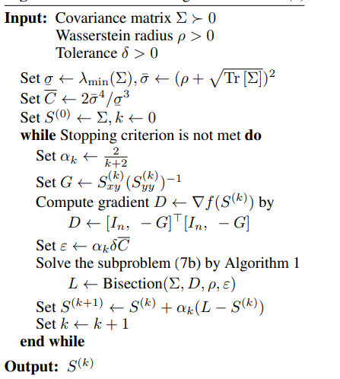
Algorithm 2 – Frank-Wolfe algorithm to solve 5

Slide 19
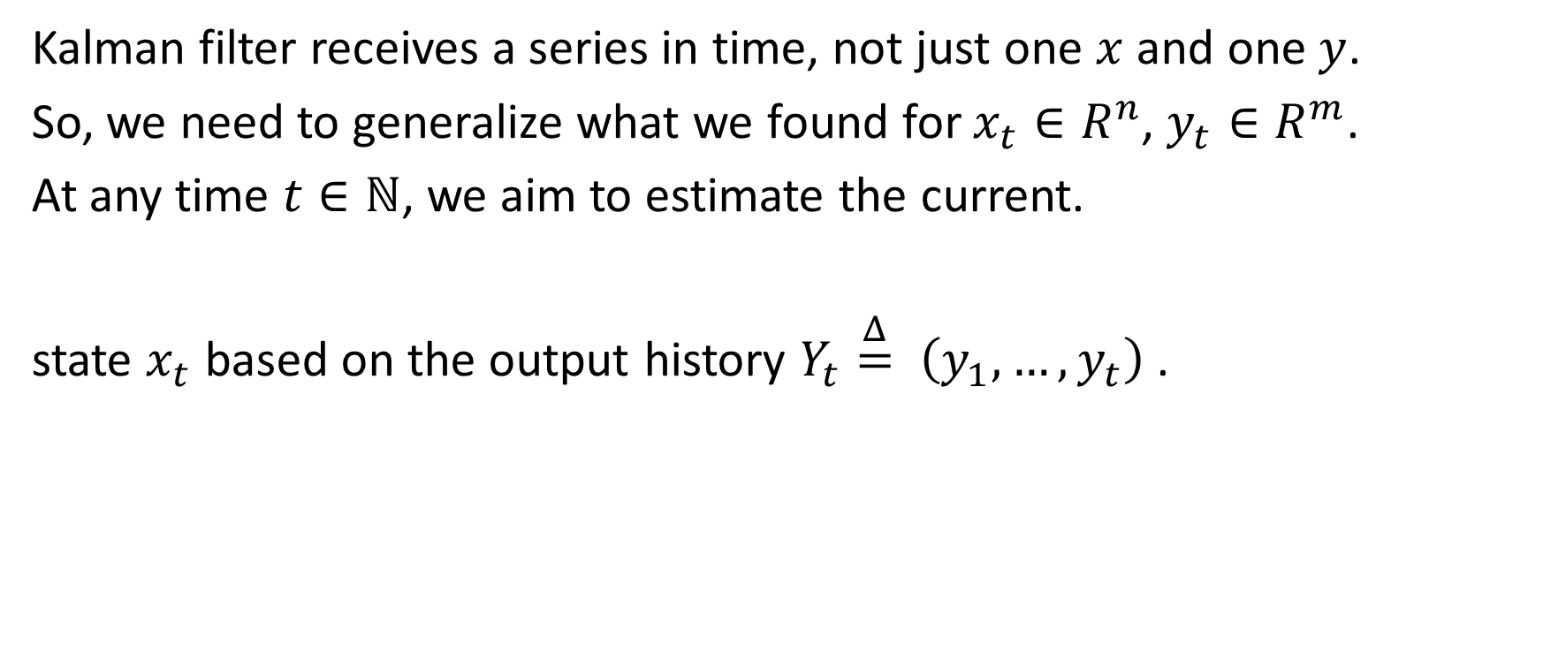
What is a Kalman filter?
Kalman filter receives a series in time, not just one $x$ and one $y$.
So, we need to generalize what we found for $x_{t}∈R^{n}$, $y_{t}∈R^{m}$.
At any time $t∈ℕ$, we aim to estimate the current.
state $x_{t}$ based on the output history $Y_{t}\overset{Δ}{=} \left(y_{1},…,y_{t}\right)$.

Slide 20
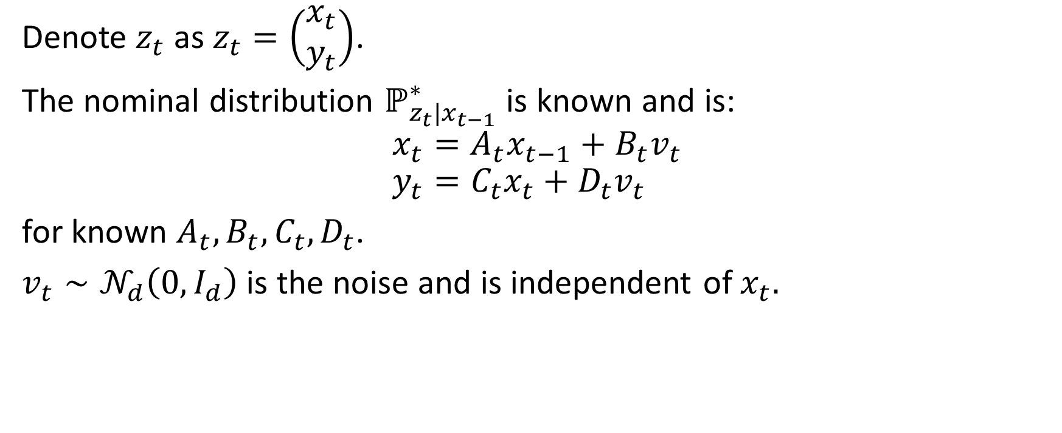
What is a Kalman filter?
Denote $z_{t}$ as $z_{t}=\left(\begin{aligned}x_{t} \\ y_{t}\end{aligned}\right)$.
The nominal distribution $ℙ_{z_{t}|x_{t−1}}^{∗}$ is known and is:
$$x_{t}=A_{t}x_{t−1}+B_{t}v_{t} \\ y_{t}=C_{t}x_{t}+D_{t}v_{t}$$
for known $A_{t}, B_{t}, C_{t}, D_{t}$.
$v_{t}∼𝒩_{d}\left(0, I_{d}\right)$ is the noise and is independent of $x_{t}.$

Slide 21

What is a Kalman filter
So,
$$P_{z_{t}|x_{t−1}}^{∗}=𝒩_{d}\left(\left[\begin{aligned}A_{t} \\ C_{t}A_{t}\end{aligned}\right]x_{t−1}, \left[\begin{aligned}B_{t} \\ C_{t}B_{t}+D_{t}\end{aligned}\right]{\left[\begin{aligned}B_{t} \\ C_{t}B_{t}+D_{t}\end{aligned}\right]}^{T}\right)$$
$$∀t∈ℕ$$
Unlike $P^{∗}$, the true distribution $ℚ$ is unknown.

Slide 22
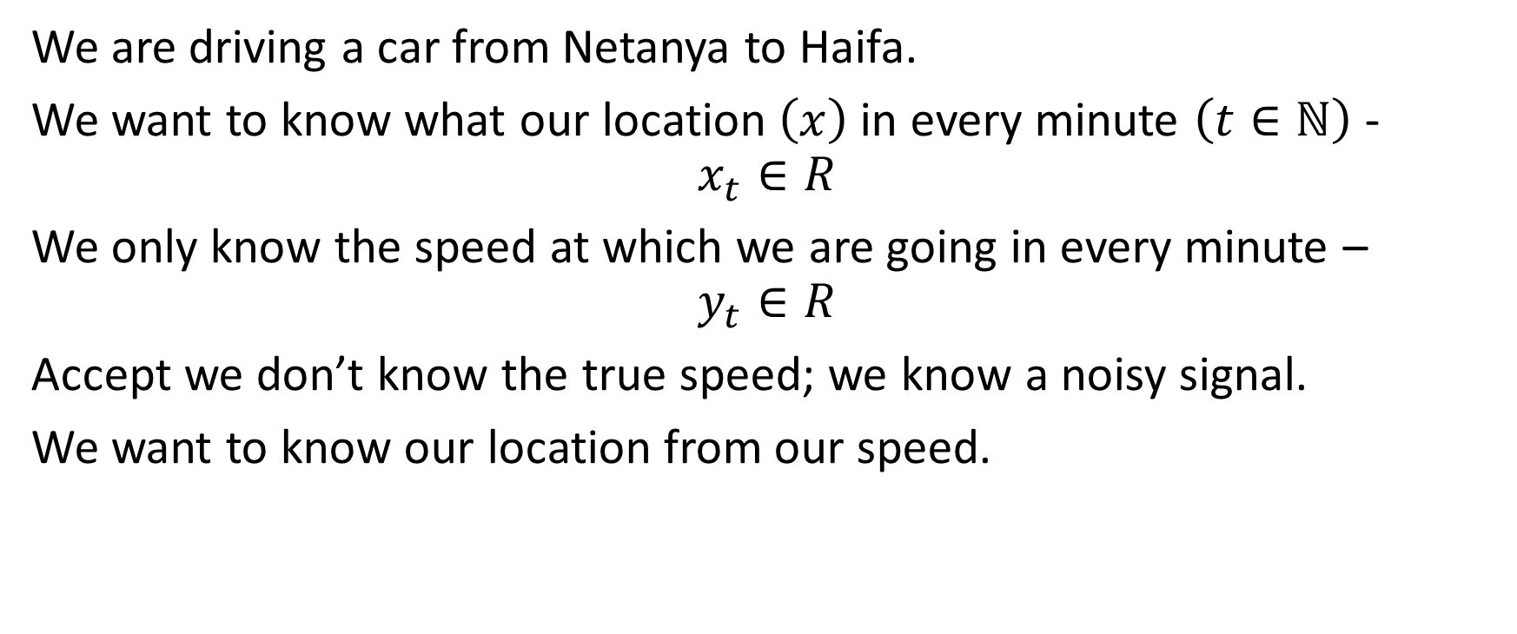
Example
We are driving a car from Netanya to Haifa.
We want to know what our location $\left(x\right)$ in every minute $\left(t∈ℕ\right)$ - $$x_{t}∈R$$
We only know the speed at which we are going in every minute –
$$y_{t}∈R$$
Accept we don’t know the true speed; we know a noisy signal.
We want to know our location from our speed.

Slide 23
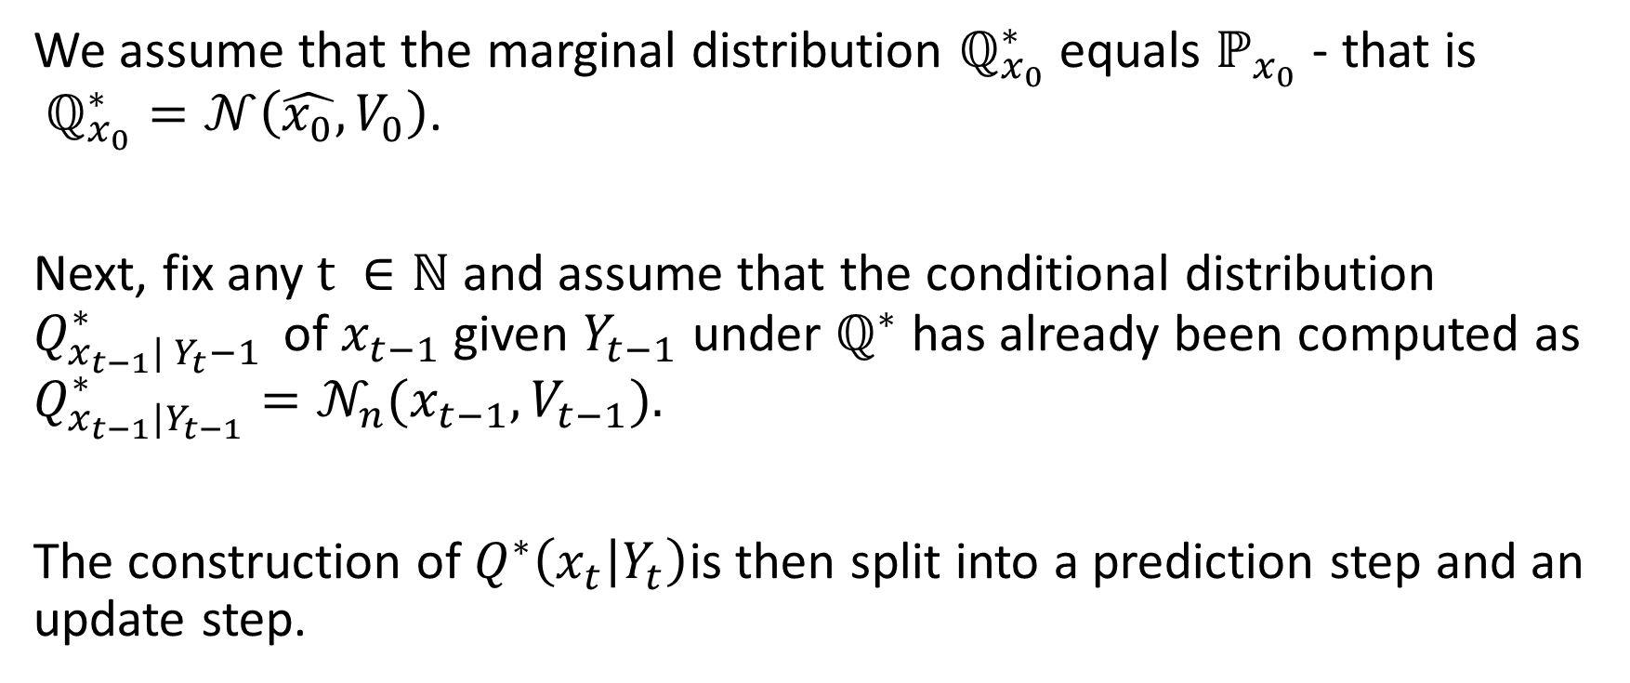
Algorithm
We assume that the marginal distribution $ℚ_{x_{0}}^{∗}$ equals $ℙ_{x_{0}}$ - that is $ℚ_{x_{0}}^{∗}=𝒩\left(\hat{x_{0}}, V_{0}\right)$.
Next, fix any $t ∈ℕ$ and assume that the conditional distribution $Q_{x_{t−1}| Y_{t}−1 }^{∗}$ of$x_{t−1}$ given $Y_{t−1}$ under $ℚ^{∗}$ has already been computed as $Q_{x_{t−1}|Y_{t−1}}^{∗}=𝒩_{n}(x_{t−1}, V_{t−1}).$
The construction of $Q^{∗}\left(x_{t} | Y_{t}\right)$is then split into a prediction step and an update step.

Slide 24
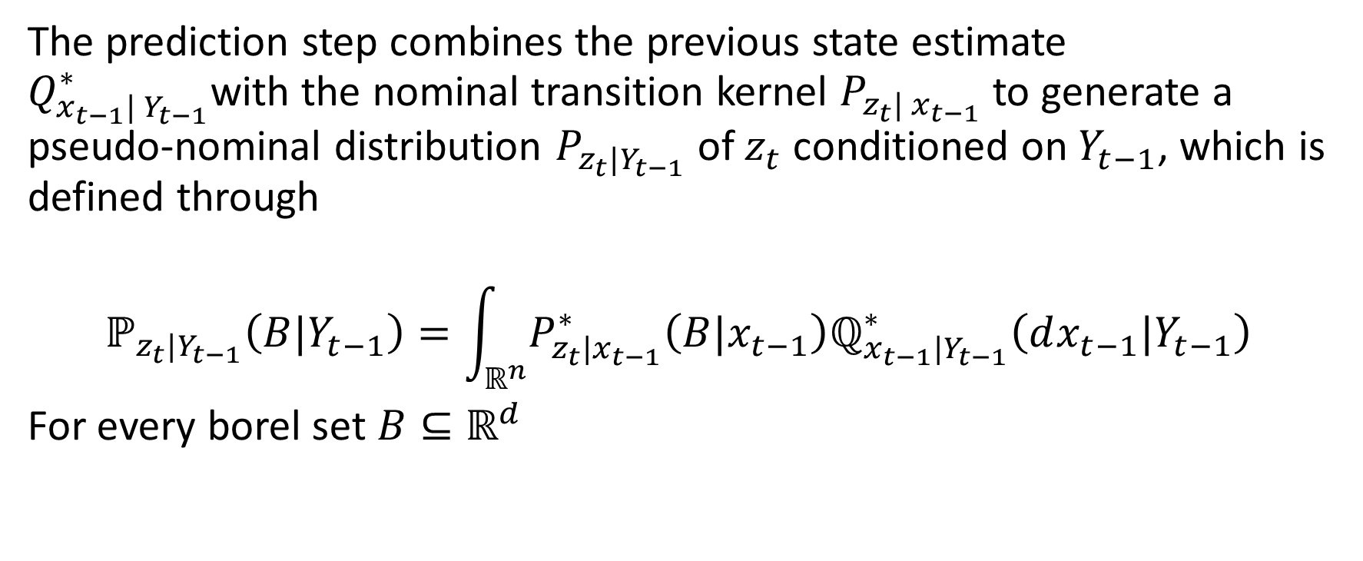
Prediction step
The prediction step combines the previous state estimate $Q_{x_{t−1}| Y_{t−1}}^{∗}$with the nominal transition kernel $P_{z_{t}| x_{t−1}}$ to generate a pseudo-nominal distribution $P_{z_{t}|Y_{t−1}}$ of $z_{t}$ conditioned on $Y_{t−1}$, which is defined through
$$ℙ_{z_{t}|Y_{t−1}}\left(B|Y_{t−1}\right)=\int_{ℝ^{n}}{P_{z_{t}|x_{t−1}}^{∗}\left(B|x_{t−1}\right)ℚ_{x_{t−1}|Y_{t−1}}^{∗}\left(dx_{t−1}|Y_{t−1}\right)}$$
For every borel set $B⊆ℝ^{d}$

Slide 25


memes

Slide 26
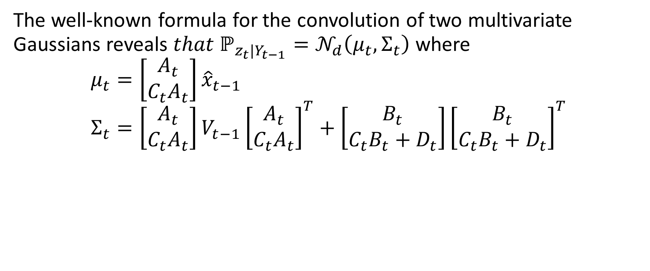
Prediction step
The well-known formula for the convolution of two multivariate Gaussians reveals $that ℙ_{z_{t}|Y_{t−1}}=𝒩_{d}\left(μ_{t}, Σ_{t}\right)$ where
$$μ_{t}=\left[\begin{aligned}A_{t} \\ C_{t}A_{t}\end{aligned}\right]{\hat{x}}_{t−1} \\ Σ_{t}=\left[\begin{aligned}A_{t} \\ C_{t}A_{t}\end{aligned}\right]V_{t−1}{\left[\begin{aligned}A_{t} \\ C_{t}A_{t}\end{aligned}\right]}^{T}+\left[\begin{aligned}B_{t} \\ C_{t}B_{t}+D_{t}\end{aligned}\right]{\left[\begin{aligned}B_{t} \\ C_{t}B_{t}+D_{t}\end{aligned}\right]}^{T}$$

Slide 27
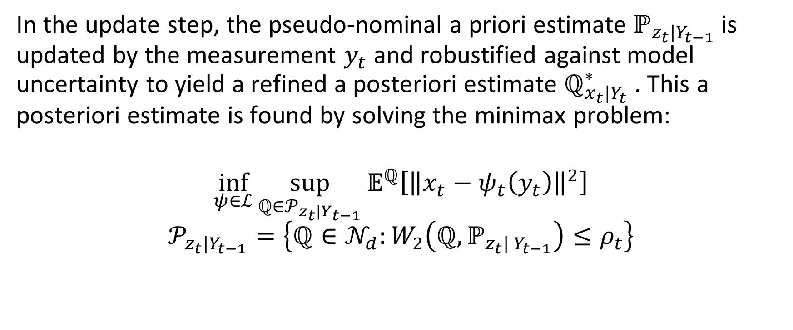
Update step
In the update step, the pseudo-nominal a priori estimate $ℙ_{z_{t}|Y_{t−1}}$is updated by the measurement $y_{t}$ and robustified against model uncertainty to yield a refined a posteriori estimate $ℚ_{x_{t}|Y_{t}}^{∗}$. This a posteriori estimate is found by solving the minimax problem:
$$\inf_{ψ∈ℒ}{\sup_{ℚ∈𝒫_{z_{t}|Y_{t−1}}}{𝔼^{ℚ}\left[{\left\|x_{t}−ψ_{t}\left(y_{t}\right)\right\|}^{2}\right]}}$$
$$𝒫_{z_{t}|Y_{t−1}}=\left\{ℚ∈𝒩_{d}:W_{2}\left(ℚ, ℙ_{z_{t}| Y_{t−1}}\right)≤ρ_{t}\right\}$$

Slide 28

Update step
Finally,
We obtain that the least favorable distribution is:
$$ℚ_{x_{t}|Y_{t}}=𝒩_{n}\left(\hat{x_{t}}, V_{t}\right)$$
$$\hat{x_{t}}=S_{t, xy}^{∗}{\left(S_{t, yy}^{∗}\right)}^{−1}\left(y_{t}−μ_{t, y}\right)+μ_{t,x}$$
$$V_{t}=S_{t, xx}−S_{t, xy}^{∗}{\left(S_{t, yy}^{∗}\right)}^{−1}S_{t, yx}^{∗}$$

Slide 29
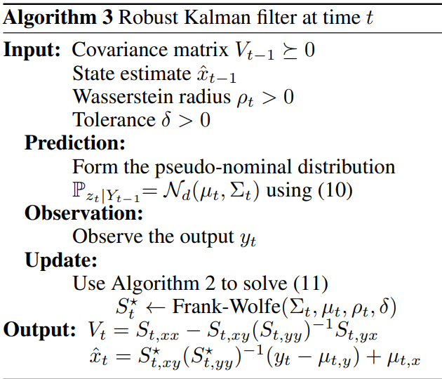
Sum it all up

