Slide 1
Detect Abnormal User Activity

Slide 2
What is abnormal activity
One might think of several different definitions of abnormal activity. The diversion in which abnormal activity might appear makes it harder for detection.
In order to stay agile and avoid a strict definition of abnormality, we will leverage ML algorithms and techniques to mark the abnormalities without specifically defined it.

Slide 3
The intuition behind the abnormality we look for
The abnormality we are looking for rely on the frequency in which a specific user generates a request to a specific route.
Note: we do not set thresholds for the “normal” frequency, we expect the algorithm to do it for us
Abnormality might appear due to high/low number of requests generated by a user
Abnormality might appear due to significant different in the number of requests a user generates in comparison to previous periods
Note: other types of abnormalities might rely on cookies, headers, user-agents, etc...

Slide 4
Cold Start
2 weeks events data
2020 time windows of 600 seconds
1.4M events
Single event includes the following attributes: timestamp, user, route

Slide 5
Abnormalities Found statistics
Number of abnormalities: 436 (0.2%)
Number of users for which abnormal activity detected: 12 (80%)
Number of routes for which abnormal activity detected: 5 (100%)

Slide 6
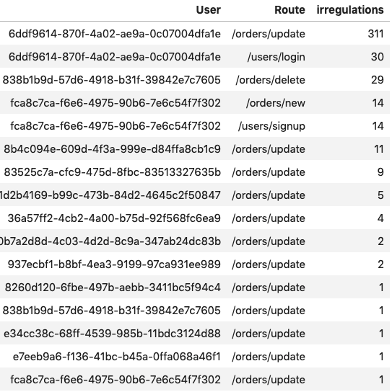
Abnormalities Distributed

Slide 7
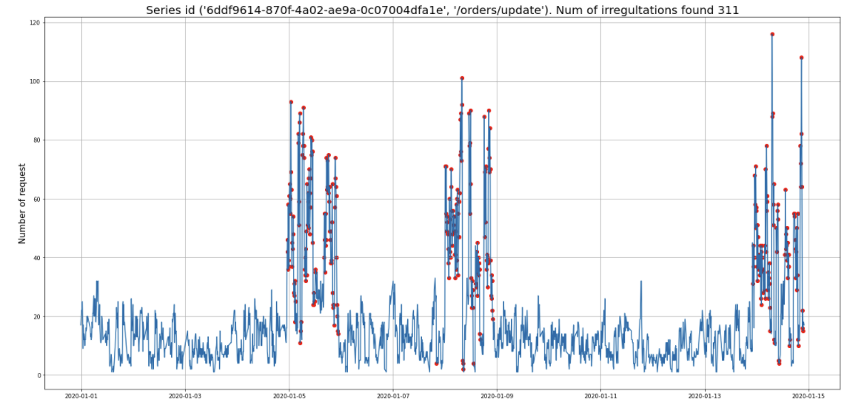
Abnormalities Visualization

Slide 8
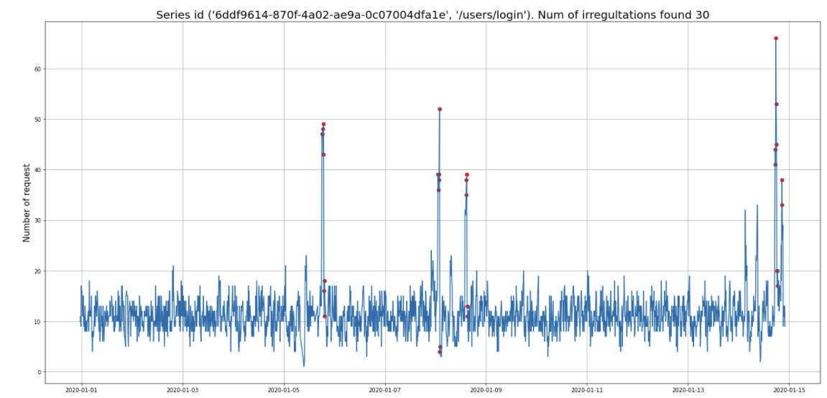
Abnormalities Visualization

Slide 9
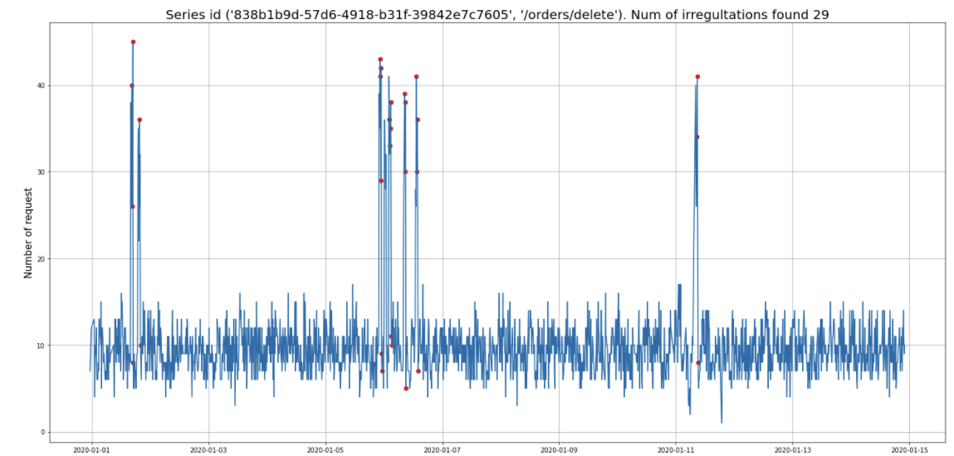
Abnormalities Visualization

Slide 10
Methodology Review
Extract difference features
Set 600 sec time windows
Aggregate events by time, user and route
Extract lag features
Training dataset
Train Isolation Forest
Inference
Extract moving averages

Slide 11
Methodology Review
Things I would add with no time constraints:
Trend related features
Seasonality related features
Difference between prediction and actual
Change in percentage with lags
Add distance related features (euclidian, mahalanobis)
Other algorithms
Extract difference features
Set 600 sec time windows
Aggregate events by time, user and route
Extract lag features
Training dataset
Train Isolation Forest
Inference
Extract moving averages

Slide 12
Demo
GitHub:
https://github.com/OriMorahim/home_assignments/blob/master/anomaly_detection/detection_model.ipynb

