Slide 1
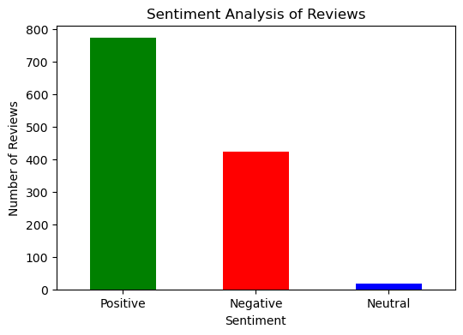
Customer Review Analysis: Key Findings
- Total Reviews Analyzed: 1,200
- Sentiment Breakdown:
- Positive: 78%
- Negative: 21%
- Neutral: 1%
- Common Feedback Keywords: flight, service, seat, time, staff, experience, food, luggage
- Key Insight: Majority of reviews are positive, with service and seating being frequent topics.

