Slide 1
Digital Behavior
The Effects of Technology on Everyday Life
Presented by Orianny Medina Jimenez

Slide 2
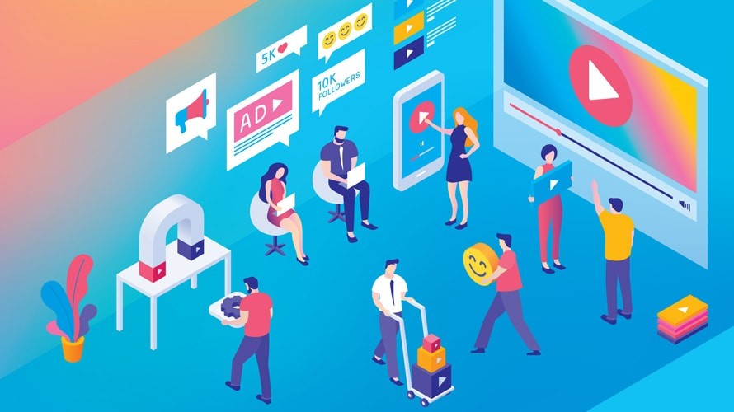
What is Digital Behavior?
Digital behaviors refer to the attitudes and actions of individuals as they interact with technology like
Internet
Phones and other devices
Social media
Notes:
“Digital behavior refers to everything people do online—scrolling, searching, buying, communicating, and participating in online communities.”

Slide 3
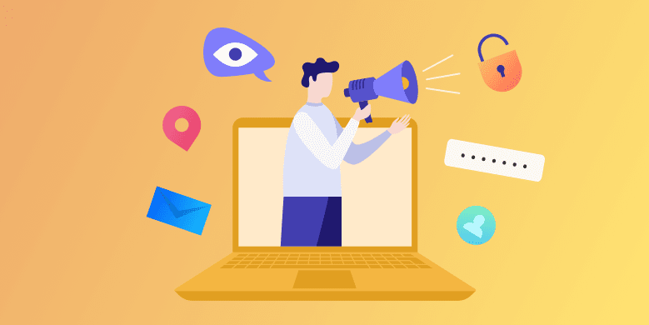
Positive Online Behaviors
1)
Think before you post
2)
Set boundaries online
Manage your privacy with privacy settings
3)
4)
Set boundaries online
5)
Treat others with respect
6)
Practice accountability
There are many benefits online like having access to healthy online communities and support groups, getting online educational services, getting digital literacy services, and more.

Slide 4


Negative Online Behaviors
Being online can also be harmful as it can be an environment that fosters cyberbullying, online harassment, misinformation, social media addictions, depression, and more.
According to the Pew Research Center in 2023 26.5% of teenagers in the US ranging from 13 to 17 were victims of cyberbullying

Slide 5
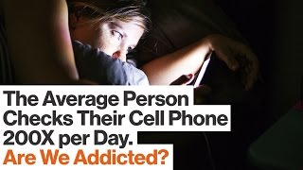

Slide 6
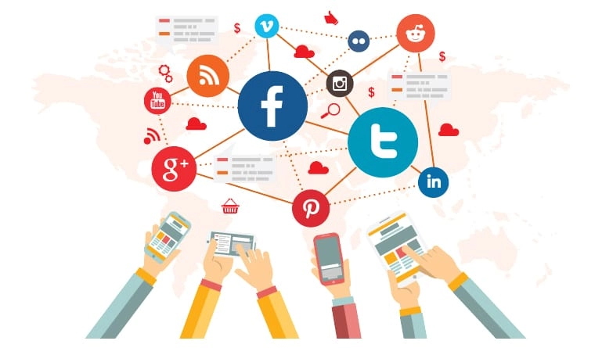
Social Media Use
According to the Pew Research Center in 2022 9 in 10 teenagers reported to be using Youtube in a survey
6 in 10 teenager reported to use TikTok, Instagram, and Snapchat
Only 32% of teens reported to use facebook and 17% reported to use X (Twitter)

Slide 7
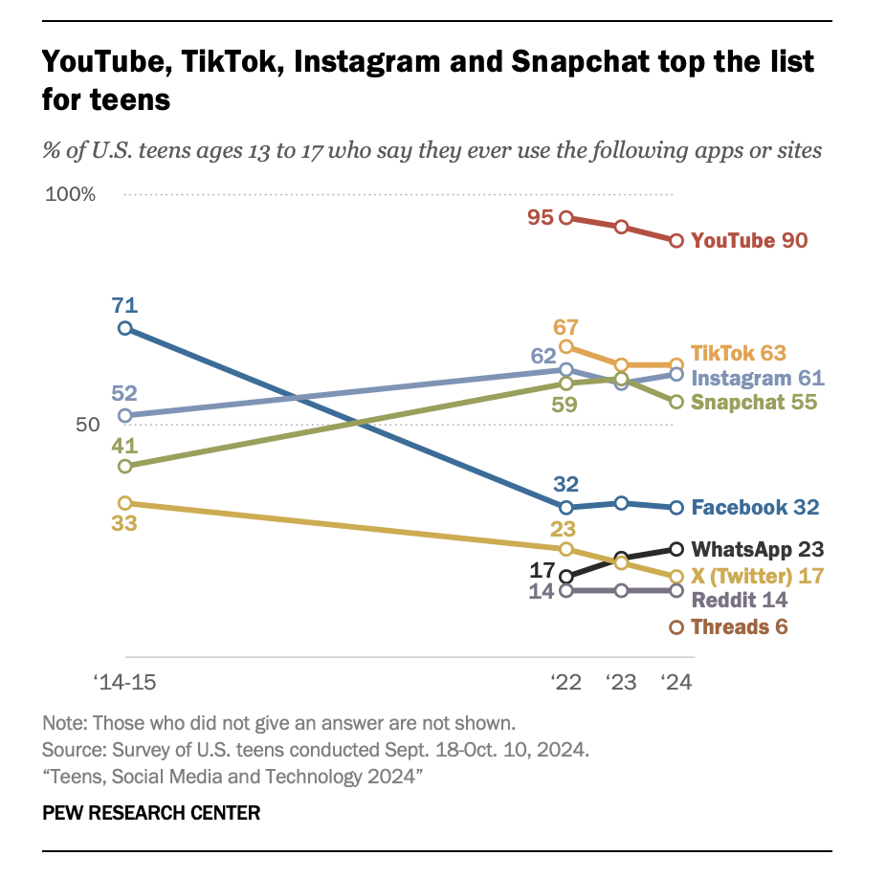
Social Media Use

Slide 8
Algorithms and Personalization
In social media algorithms are used a rules or signals that impact the operation of each platform. Algorithms determine what content is filtered, recommended, and selected for each user. Algorithms also influence what users see on their social media and possibly their choices both online and offline.

Slide 9
Algorithms and Personalization
There are various factors that impact social media algorithms including
User engagement such as likes, comments, shares
Timing and frequency like media that was posted at the prime time and are more likely to reach a target audience
Location → Content can be filtered by location
Watch time → Based on your watch time some videos will be more recommended than others

Slide 10
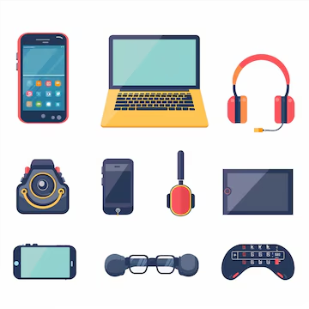
Behavior Across Screens
Digital behaviors will vary across devices due to accessibility and comfortability
Smartphones → Used for many things in all aspects of life including work, school, home time
Tablets → Similar accessibility to smartphones but differing comfortability
TV’s → Has less accessibility to the internet than smartphones and tablets which can lessen screen time on this device
Consoles → Mostly used for gaming

Slide 11
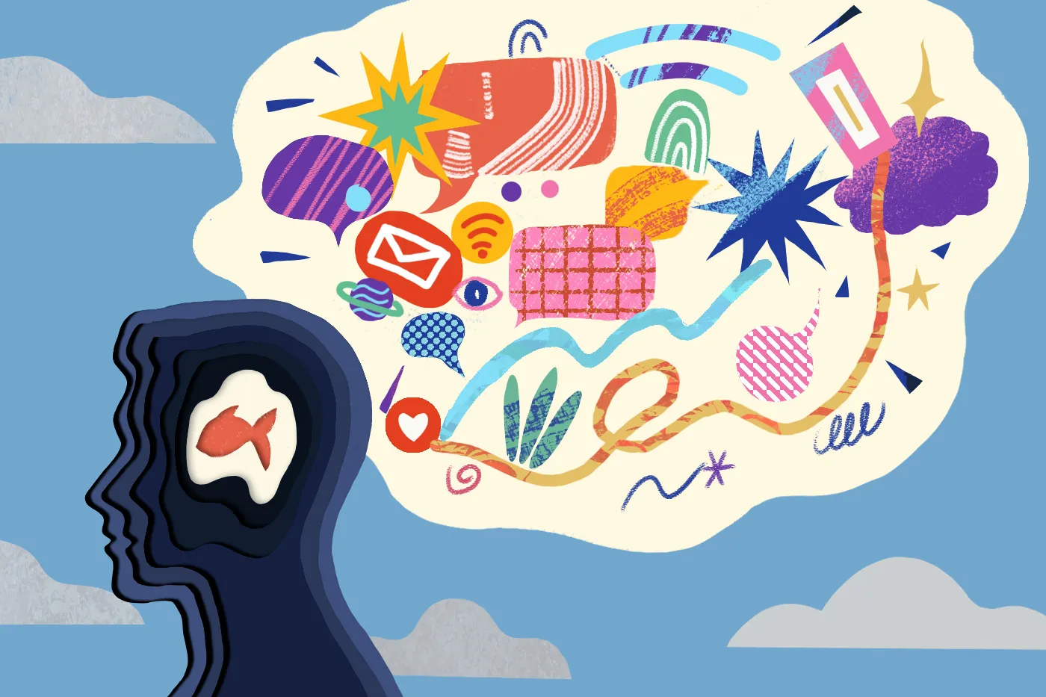
Effect on Attention
Your digital behavior can impact your attention span
Multitasking
Notifications
Short form and rapid fire content
Cognitive overload
Dopamine reward loops
As we get used to constant stimulation and constantly having our focus broken our attention span weakens

Slide 12
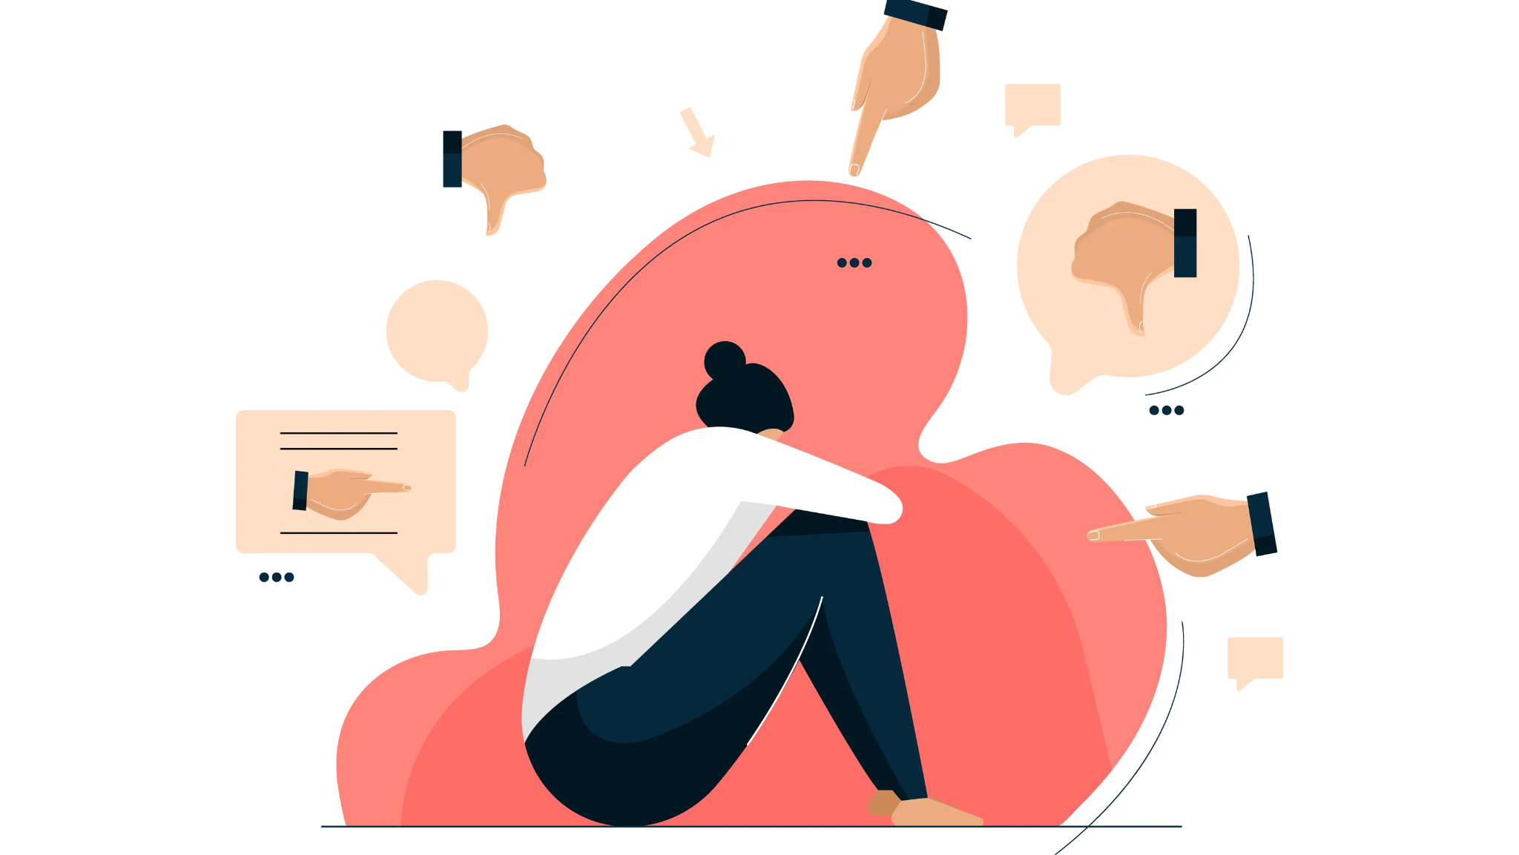
Impact on Mental Health
Studies show that as screen time increases especially social media time negative impacts on your mental health increases as well.
You can be more susceptible to
Anxiety
Depression
Addictive Nature
Sleep Disruption

Slide 13
Works Cited
Alhabash, Saleh, and Mengyan Hsu. “Use of Social Media Platforms among Adults in the United States—Behavior on Social Media.” Societies, vol. 10, no. 1, 2020, pp. 1–14.
Adebayo, Johnson, et al. “How We Browse: Measurement and Analysis of Digital Behavior.” arXiv, 2021, arxiv.org/abs/2108.06745.
Ali, Muhammad, et al. “Digital Consumer Behavior: A Systematic Literature Review.” ResearchGate, 2024, www.researchgate.net/publication/380283060.
Big Think. (2016, April 25). The science of compulsive online behavior | Mary Aiken | Big Think [Video]. YouTube. https://www.youtube.com/watch?v=edaDZIffizI
Muller, Samuel A., et al. “The Potential Stickiness of Pandemic-Induced Behavior Changes in the United States.” arXiv, 2021, arxiv.org/abs/2104.14708.

