Slide 1
Arrays
Chapter 2

Slide 2
Objectives
The Basics of Arrays
An Ordered Array
Big O Notation

Slide 3
The Basics of Arrays in Java
Creating an Array
Arrays in Java are objects, created with the new operator.
int[] intArray; // defines a reference to an array
intArray = new int[100]; // creates the array, and // sets intArray to refer to it
int intArray[] = new int[100]; // alternative syntax
Arrays have a length field, which you can use to find the size (the number of elements) of an array:
int arrayLength = intArray.length; // find array size

Slide 4
The Basics of Arrays in Java
Accessing Array Elements
Array elements are accessed using an index number in square brackets.
temp = intArray[3]; // get contents of fourth element of array
intArray[7] = 66; // insert 66 into the eighth cell.
Initialization
initialize an array of a primitive type to something besides 0 using this syntax:
int[] intArray = { 0, 3, 6, 9, 12, 15, 18, 21, 24, 27 };

Slide 5
Advantages of Ordered Arrays
The major advantage is that search times are much faster than in an unordered array.
The disadvantage is that insertion takes longer because all the data items with a higher key value must be moved up to make room.
Deletions are slow in both ordered and unordered arrays because items must be moved down to fill the hole left by the deleted item.

Slide 6
Logarithm (cont’d)
The Opposite of Raising Two to a Power
The inverse of raising something to a power is called a logarithm.
s = log2(r)
the number of steps (comparisons) is equal to the logarithm to the base 2 of the range.
What’s a logarithm? The base 2 logarithm of a number r is the number of times you must multiply two by itself to get r.

Slide 7
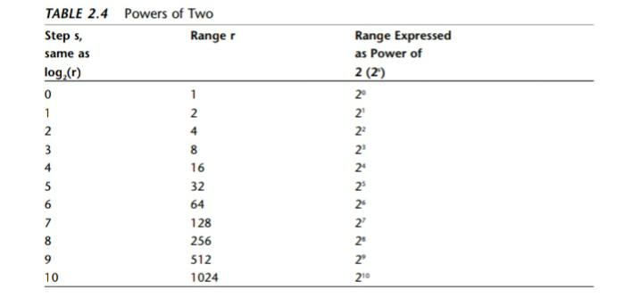
Logarithm (cont’d)

Slide 8
Logarithm (cont’d)
r = 2s
s, the number of steps, r, the range. For example, if s is 6, the range is 26, or 64.

Slide 9
Big O Notation
Big O notation provides a convenient way to compare the speed of algorithms.
Big O notation uses the uppercase letter O.
An algorithm that runs in O(1) time is the best, O(log N) is good, O(N) is fair,and O(N2) is pretty bad.

Slide 10
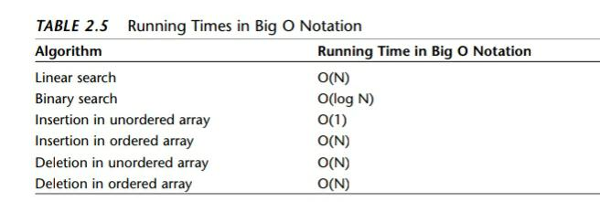
Big O Notation (cont’d)

Slide 11
Why Not Use Arrays for Everything?
Disadvantages: In an unordered array you can insert items quickly, in O(1) time, but searching takes slow O(N) time.
In an ordered array you can search quickly, in O(logN) time, but insertion takes O(N) time. For both kinds of arrays, deletion takes O(N) time because half the items (on the average) must be moved to fill in the hole.
Arrays is that their size is fixed when they are first created with new. Usually, when the program first starts, you don’t know exactly how many items will be placed in the array later, so you guess how big it should be.
If your guess is too large, you’ll waste memory by having cells in the array that are never filled.
If your guess is too small, you’ll overflow the array, causing at best a message to the program’s user, and at worst a program crash.

Slide 12
Reference
Data Structures and Algorithms in Java, Second Edition
Copyright © 2003 by Sams Publishing

