Slide 1
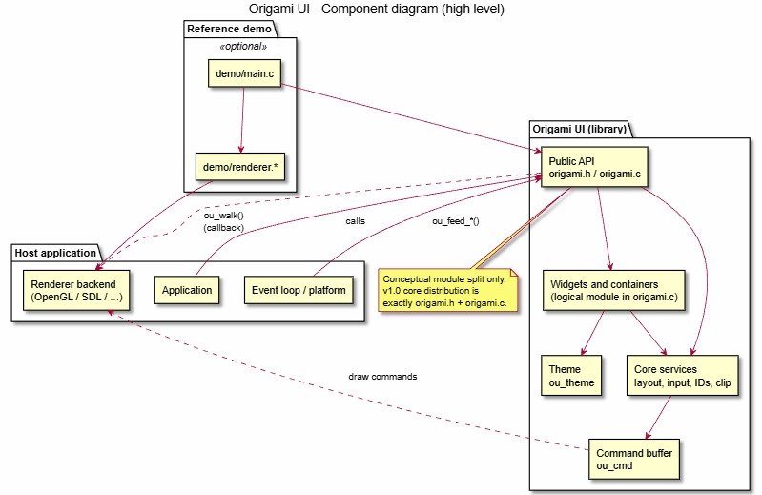
Origami UI
Demo presentation
Architecture • UML • quality factors • evidence logs • live scenario
• Portable ANSI C immediate-mode GUI library • Host application owns input, window, and renderer • Origami emits abstract draw commands via ou_walk()
Assignment 3 walkthrough
15-minute demo flow
High-level component view: host app → Origami API → widgets/core → command buffer → renderer

Slide 2
Demo roadmap
The deck is structured to match the instructor checklist and the live recording flow.
What we cover before the live run
Live demo path
• Planning, requirements, design, implementation, deployment, and test artifacts • Top-level architecture plus UML class and sequence views • Quality factors with metric, target, measured value, and linked tests • Recorded evidence: build/run smoke, strict compile, Unity suite, documentation checks • Traceability from scoped use cases to sprint tasks and test cases • Delta report: implemented feedback, effort, cost, and deferred items
Show build command and launch the SDL2 demo
01
02
Run one command-pipeline render flow (UC-2)
03
Interact with controls: button, input, slider, toggle (UC-3)
04
Change theme values and show next-frame effect (UC-4)
05
Open test logs / report / traceability / delta docs
Recording requirement: show at least one flow for each scoped use-case family (UC-2, UC-3, UC-4).

Slide 3
Lifecycle traceability and team ownership
The project is presented as a full SDLC story, not only a code demo.
Traceable lifecycle
Scoped demo scenarios
Planning
Requirements
Design
Implementation
Test
UC-2
build UI → command buffer → renderer callback
UC-3
interactive controls and returned signal flags
Project plan, backlog, sprint goal
SRS use cases and NFR constraints
Architecture + UML + SDD
ANSI C core + SDL2 demo
Report, logs, quality matrix, traceability
UC-4
runtime theme mutation reflected next frame
Team contribution view (from task matrices)
Ahmet Batuhan Günal
Archyn Mikhailov
Tuna Kömürcü
System overview, system context, runtime theme test, commit/cancel evidence.
Architecture, component/data design, traceability focus, keyboard & command-pipeline evidence.
Implementation notes, UI/deployment/testability sections, demo build evidence, strict compile checks.
During the live demo, open git history separately to show per-member commits; this deck only summarizes the documented task split.

Slide 4
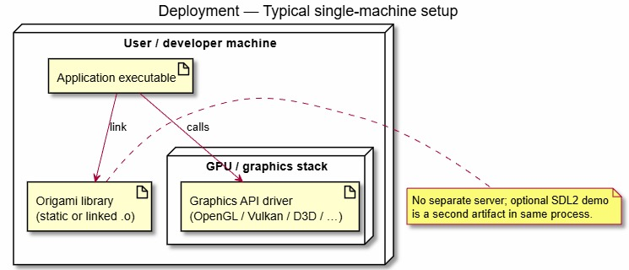
Top-level architecture and deployment
Layered architecture + modular monolith + immediate-mode pipeline.
Architecture takeaways
• Public API → widgets/layout → core services → command buffer → host renderer • Exactly two distributed core files: origami.h + origami.c • No dynamic allocation inside the library context
Typical deployment
Host application feeds input and owns the renderer; Origami stays embeddable and dependency-free in the core.
Single-machine setup: application binary links the Origami library and calls the graphics API through its host renderer.

Slide 5
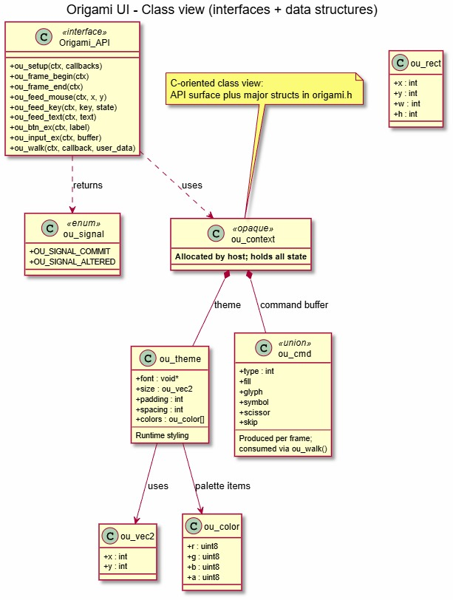
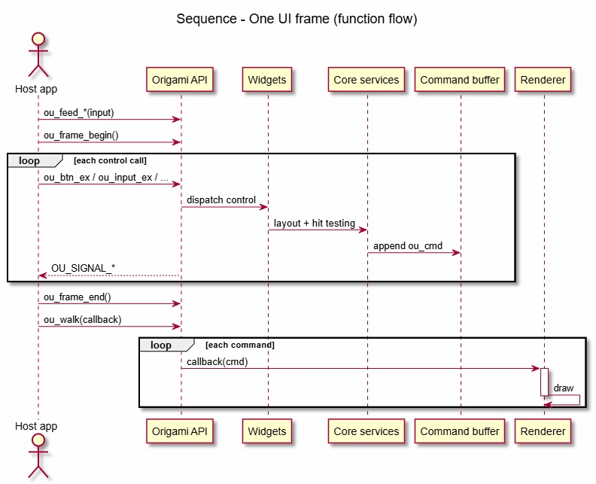
Design pattern views: class + sequence UML
The diagrams explain the API surface, data structures, and one-frame execution flow.
Class view: API surface, ou_context, theme, command union, and key data structures.
Sequence view: input feed → frame begin → control calls → append commands → walk callback → draw.

Slide 6
Quality factors and measurable criteria
Each factor is tied to a target value, measured snapshot, requirement reference, and executed test.
Quality factor
Metric + target
Measured snapshot
Req / test
Status
Functional correctness
Demo build + launch smoke
Target: build succeeds and app launches
Build passed; launch started
(STARTED_AND_KILLED)
UC-2, E-1
TC-01
Pass
Interaction correctness
Keyboard traversal
Target: implemented and testable
Tab/Shift+Tab not implemented
in current code path
UC-3
TC-02
Pass*
Interaction correctness
Commit / cancel keys
Target: Enter + Escape verified
Enter present; Escape dismissal
not explicit
UC-3
TC-03
Pass*
Rendering reliability
ou_walk() integration
Target: pass
Pass
UC-2
TC-04
Pass
Build quality
Strict GCC + Clang compile
Target: both compilers
GCC pass; Clang unavailable
NFR
TC-05
Blocked
Runtime configurability
Theme mutation next frame
Target: pass
Pass
UC-4
TC-06
Pass
Documentation consistency
Doc check script
Target: DOC_CHECKS_OK
DOC_CHECKS_OK
F-3 / SB-08
TC-07
Pass
* In the quality matrix snapshot the evidence line is recorded, but the traceability matrix still keeps UC-3 completeness as open because traversal / Escape are not fully closed.

Slide 7
Recorded test results and report evidence
The assignment requires screenshots / logs, test report metadata, and reproducible evidence logs.
Execution summary
Evidence log excerpts
Scenario-level report table
32
Unity tests executed
TC
Focus
Status
32 Tests 0 Failures 0 Ignored
OK
GCC Result: STRICT_COMPILE_OK
clang_not_available
Build ExitCode: 0
Launch Result: STARTED_AND_KILLED
DOC_CHECKS_OK
TC-01
Demo smoke
Pass
0
Failures / ignored
TC-02
Keyboard traversal
Pass*
TC-03
Commit / cancel
Pass*
TC-04
Command walk
Pass
6 / 1
Pass / blocked scenario tests
TC-05
Strict compile
Blocked
TC-06
Theme update
Pass
2026-04-02 → 04-09
Execution window
TC-07
Doc consistency
Pass
Test report fields captured: tester, date, steps, expected result, environment, log path, status, notes.
Environment: Windows PowerShell, GCC 15.2.0, Unity framework, SDL2 demo dependency.
* The evidence exists, but functional completeness remains open in traceability for UC-3.

Slide 8
Traceability from requirement to test case
Traceability shows that the selected demo scenario is linked to backlog, sprint task, and executed evidence.
What the matrix tells us
Requirement / objective
Sprint task
Test
Current status
• UC-2 and UC-4 are demo-ready with passing evidence. • UC-3 is demonstrable, but full keyboard completeness is still open. • Portability evidence is honest: GCC pass, Clang blocked by environment.
UC-2 command pipeline walk/render validity
SB-04
TC-04
Pass
UC-2 demo deliverable build/run closure
SB-03
TC-01
Pass
UC-3 keyboard and focus completeness
SB-02
TC-02, TC-03
Pass
UC-4 runtime theme update behavior
SB-01
TC-06
Pass
NFR strict compile portability
SB-05
TC-05
Blocked
Scenario coverage to show live
• 1) Build + open demo window • 2) Click / type / drag to show returned signals • 3) Walk through draw-command interpretation • 4) Mutate theme and show next-frame visual change • 5) Close with test evidence + open issues
Documentation completeness and consistency
SB-07 / SB-08
TC-07
Pass
IDs stay stable across report, CSV, logs, and traceability matrix.

Slide 9
Feedback implemented: delta design & implementation report
The closeout sprint focused on evidence depth, report compliance, and reproducible validation.
Selected feedback → implemented delta
Deferred follow-up items
• Complete Tab / Shift+Tab traversal and close TC-02. • Implement Escape cancellation / dismissal coverage and close TC-03. • Run strict compile under Clang or add CI job to close TC-05.
Automated test evidence
Submission-format alignment
Reproducible build / validation
Added Unity suite with 29 component tests + 3 integration tests, plus inventory and centralized runner.
Standardized report columns, synchronized Markdown + CSV, tightened naming and traceability rules.
Stabilized SDL2 smoke build path, logged strict compile evidence, documented blocked Clang path honestly.
Design impact
• Stronger audit trail and more transparent reviewer story. • Not all status cells are green—but the report is more honest and reproducible.
Actual effort snapshot: 13.0 hours total across test harness, integration tests, demo compatibility, document alignment, and evidence cleanup.

Slide 10
Live demo script
Use this slide as the handoff from slides to the running application and evidence documents.
What we do on screen
Suggested speaking cues
• Open the repo / terminal and run the demo build command. • Launch the SDL2 window and briefly point at the architecture mapping: input, widgets, command buffer, renderer. • Interact with a button, input field, checkbox/slider/toggle; mention returned signal flags and focus/hover behavior. • Change a theme parameter and show the next-frame visual update. • Open test logs, test report, traceability matrix, and delta report to close the loop.
• “This build/run step corresponds to TC-01 and the demo deliverable closure.” • “This interaction is our UC-3 scenario; signals come back immediately each frame.” • “Here the renderer consumes commands emitted by the library through ou_walk().” • “This color change demonstrates UC-4: theme mutation affects the next frame output.” • “Finally, we link the scenario back to logs, report rows, and traceability.”
Keep the live section short and observable: the goal is to prove the scenario, then prove the evidence.
If asked about remaining gaps: keyboard traversal and Escape dismissal are documented as open; Clang validation is environment-blocked.

