Slide 1
3-D localisation using ultra-wideband technology
By Marcus Utter

Slide 2
Research questions
Are UWB-based positioning systems suitable for 3-D localisation of objects in furnished rooms?
How accurately can a UWB-based positioning system localise an object in 3-D?
How sensitive is a UWB-based positioning system to interference?

Slide 3
Positioning
Important for centuries
Stars, compass and now GPS
GPS is sufficient for positioning outdoors but not indoors

Slide 4
Indoor Positioning
Several nodes with known location (anchor nodes)
Measure distance to the object being localised from each node
Use the distances to calculate the position of the object

Slide 5
Indoor Positioning using RSSI
Received signal strength indication
Sensitive to obstacles and interference
Often needs calibration for the current environment
Line-of-sight is almost required
Around 2m accuracy at best
Average ceiling height at around 2.4m

Slide 6
Indoor Positioning using ultra-wideband
Low energy consumption
Time of arrival (ToA)
Trilateration
Similar to GPS
Have shown cm (and even mm) precision
Promising candidate for indoor 3D-localisation

Slide 7
Time of Arrival
Travel time between transmitter and receiver
Distance = Rate x Time
Rate is known (speed of light)
Requires transmitter and receiver to have well-synchronized clocks to work
Unless some smart alghorithm is used

Slide 8
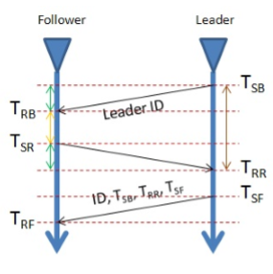
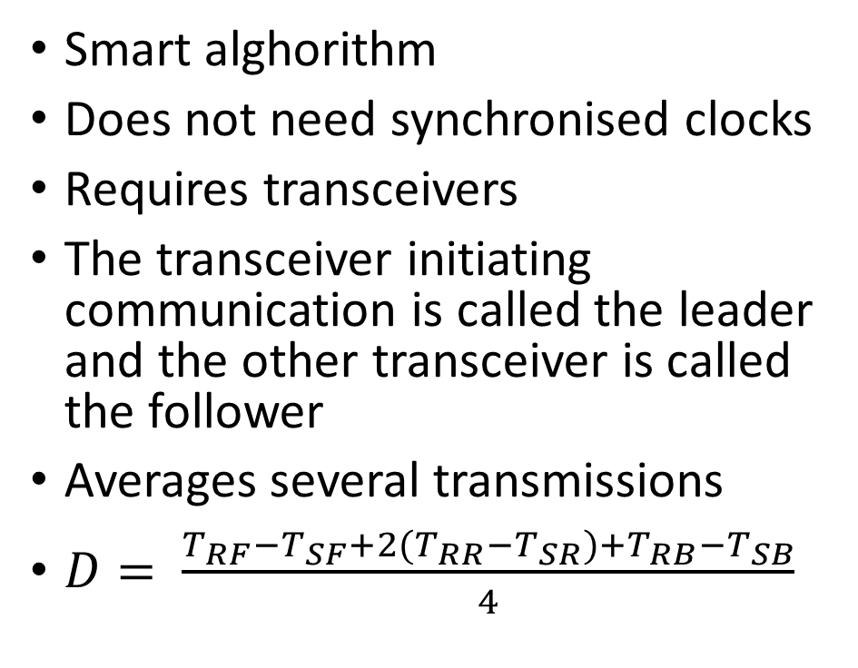
Two-way ranging
Smart alghorithm
Does not need synchronised clocks
Requires transceivers
The transceiver initiating communication is called the leader and the other transceiver is called the follower
Averages several transmissions
$D= \frac{T_{RF}{−T}_{SF}+{2(T}_{RR}−T_{SR})+T_{RB}−T_{SB}}{4}$

Slide 9
Trilateration
Process to localise a node
Similar to triangulation but doesn’t use angles
Uses measured distances to anchor nodes

Slide 10
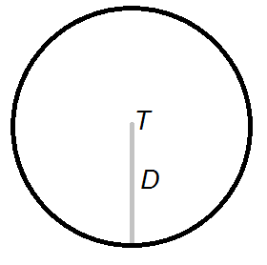
Trilateration in 2-D
Using one transmitter T as an anchor node
Has measured the distance D between transmitter and receiver
The receiver is known to be located somewhere on the perimeter of the circle centered around T with radius D

Slide 11
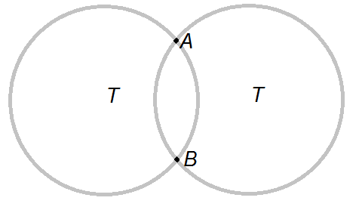
Trilateration in 2-D
Using two transmitters
The receiver is known to be located in some of the intersections (A or B) of the circles

Slide 12
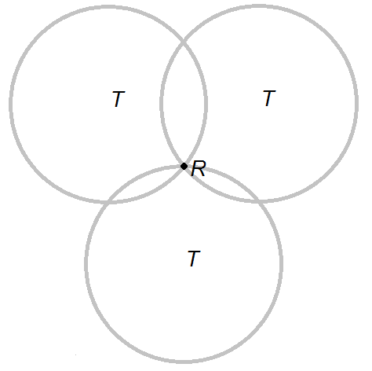
Trilateration in 2-D
Using three transmitters
The receiver R is known to be located at the intersection

Slide 13
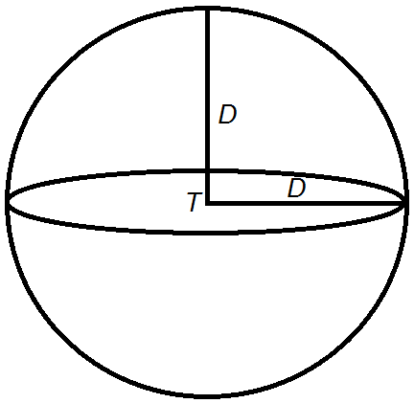
Trilateration in 3-D
Using one transmitter T
Has measured the distance D between transmitter and receiver
The receiver is known to be located somewhere on the peripheral of the sphere centered around T with a radius of D

Slide 14
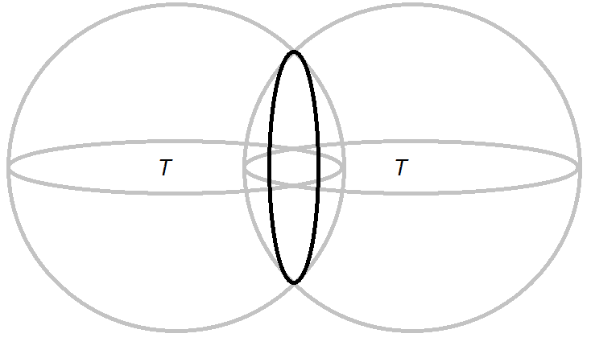
Trilateration in 3-D
Using one transmitter T
The receiver is known to be located somewhere on the perimeter of the circular intersection of the spheres

Slide 15
Trilateration in 3-D
2 Transmitters 3-D
1 Transmitter 2-D
Using two transmitters
Similar to using one transmitter for 2-D localisation
Adding more transmitters progress in the same way as in the 2-D example
Enough with 3 transmitters in some cases (e.g. GPS)
3 Transmitters 3-D
2 Transmitters 2-D
4 Transmitters 3-D
3 Transmitters 3-D

Slide 16
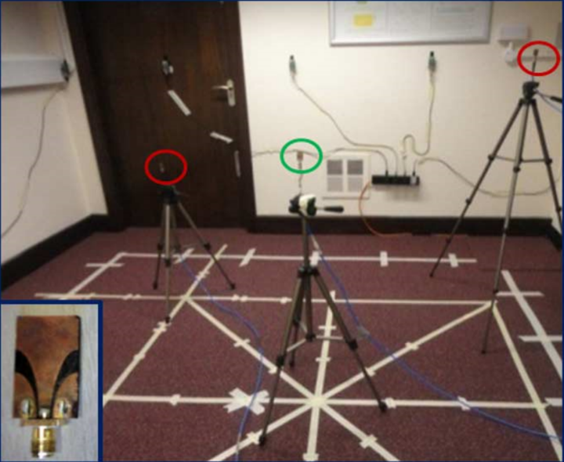
Method
UWB transceivers from DecaWave will be used (DWM1000)
Connect each transceiver to a wireless sensor module (Tmote Sky) through SPI
The sensor modules will run the Contiki OS (created at SICS)
The transceivers will be used both for the anchor nodes and the object to be localised
Data from the transceivers will be sent through the sensor modules to an API where all calculations will be handled

Slide 17
Extensions (if time allows)
Testing interference sensitivity further
Locating objects in real time

Slide 18
Questions?

