Slide 1
3D Localisation using ultra-wideband technology
By Marcus Utter

Slide 2
Research questions
Are UWB-based positioning systems suitable for 3-D localisation of objects in furnished rooms?
How accurately can a UWB-based positioning system localise an object in 3-D?
How sensitive is a UWB-based positioning system to interference?

Slide 3
Positioning
Important for centuries
Stars, compass and now GPS
GPS is sufficient outdoors
How to locate an object indoors?

Slide 4
Indoor Positioning using RSSI
Received signal strength indication
Sensitive to obstacles and interference
Line-of-sight is almost required
Around 2m accuracy at best
Average ceiling height at around 2.4m

Slide 5
Indoor Positioning using UWB
Ultra-wideband
Time of arrival (ToA)
Trilateration
Similar to GPS
Have shown cm (and even mm) precision
Promising candidate for 3D-localisation indoors

Slide 6
Time of Arrival
Travel time between transmitter and receiver
Distance = Rate x Time
Rate is known (speed of light)
Requires transmitter and receiver to have well-synchronized clocks to work
Unless some smart alghorithm is used

Slide 7
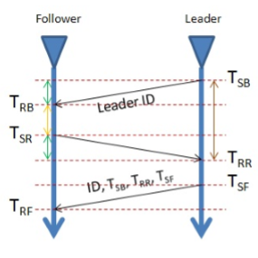
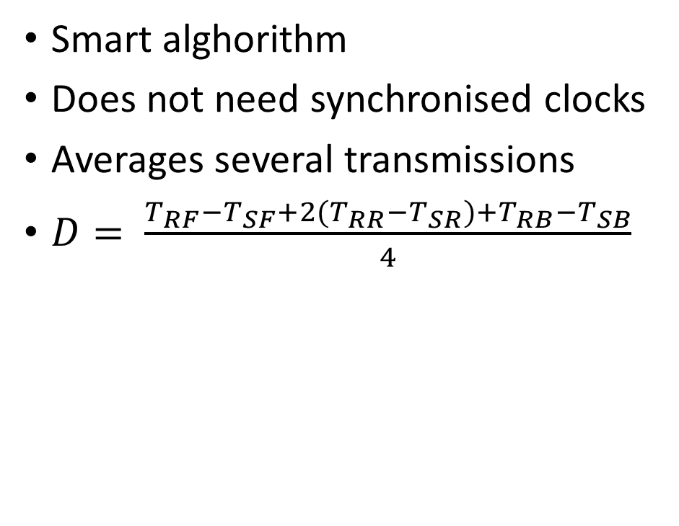
Two-way ranging
Smart alghorithm
Does not need synchronised clocks
Averages several transmissions
$D= \frac{T_{RF}{−T}_{SF}+{2(T}_{RR}−T_{SR})+T_{RB}−T_{SB}}{4}$

Slide 8
Trilateration
Similar to triangulation but without using angles
Used in GPS
Measures distance to nodes with known location
Combines the distances to locate the object

Slide 9
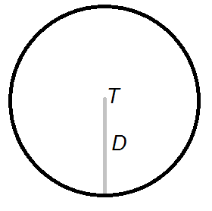
Trilateration in 2-D
Using one transmitter T
Has measured the distance D between transmitter and receiver
The receiver is known to be located somewhere on the perimeter of the circle

Slide 10
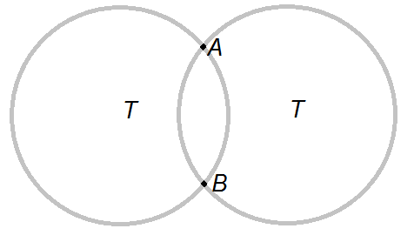
Trilateration in 2-D
Using two transmitters
The receiver is known to be located in some of the intersections (A or B) of the circles

Slide 11
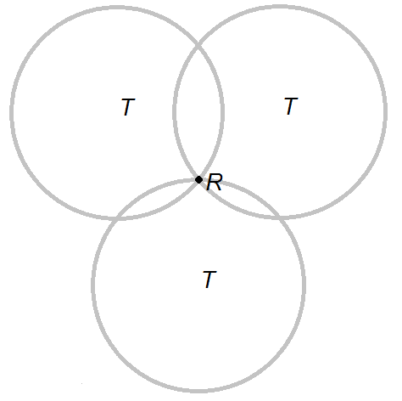
Trilateration in 2-D
Using three transmitters
The receiver is known to be located somewhere on the perimeter of the circle

Slide 12
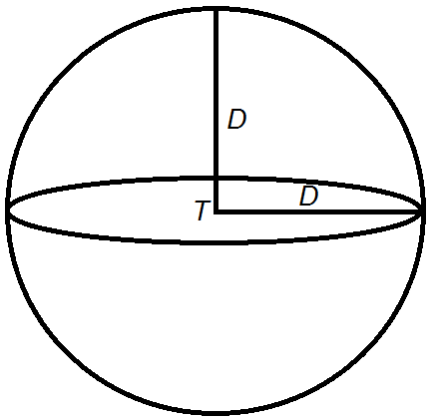
Trilateration in 3-D
Using one transmitter T
Has measured the distance D between transmitter and receiver
The receiver is known to be located somewhere on the peripheral of the sphere

Slide 13
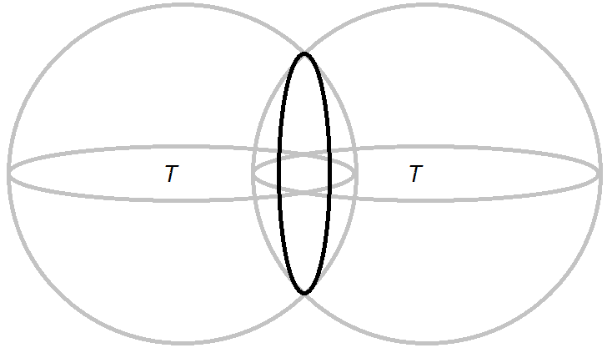
Trilateration in 3-D
Using one transmitter T
The receiver is known to be located somewhere on the circular intersection of the spheres

Slide 14
Trilateration in 3-D
2 Transmitters 3-D
1 Transmitter 3-D
Using two transmitters
Similar to using one transmitter for 2-D localisation
Adding more transmitters progress in the same way as in the 2-D example
Enough with 3 transmitters in some cases (e.g. GPS)
3 Transmitters 3-D
2 Transmitters 2-D
4 Transmitters 3-D
3 Transmitters 3-D

Slide 15
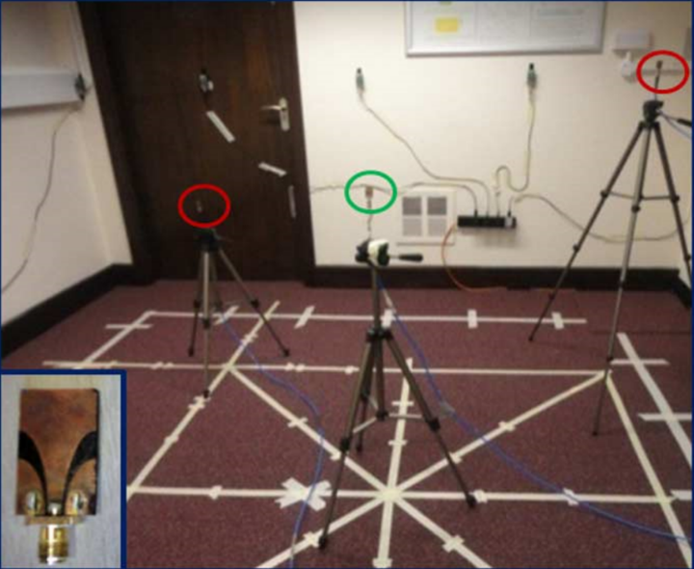
Method
UWB transceivers from DecaWave will be used (DWM1000)
Connected through SPI to wireless sensor modules (Tmote Sky)
The sensor modules will run the Contiki OS
The transceivers will be used both for the anchor nodes and the object to be localised
Data from the transceivers will be sent through the sensor modules to an API where all calculations will be handled

Slide 16
Extensions (if time allows)
Testing interference sensitivity
Locating objects in real time

Slide 17
Questions?

