Slide 1
Playing with Corners
Detecting corners for QR-code rectification

Slide 2
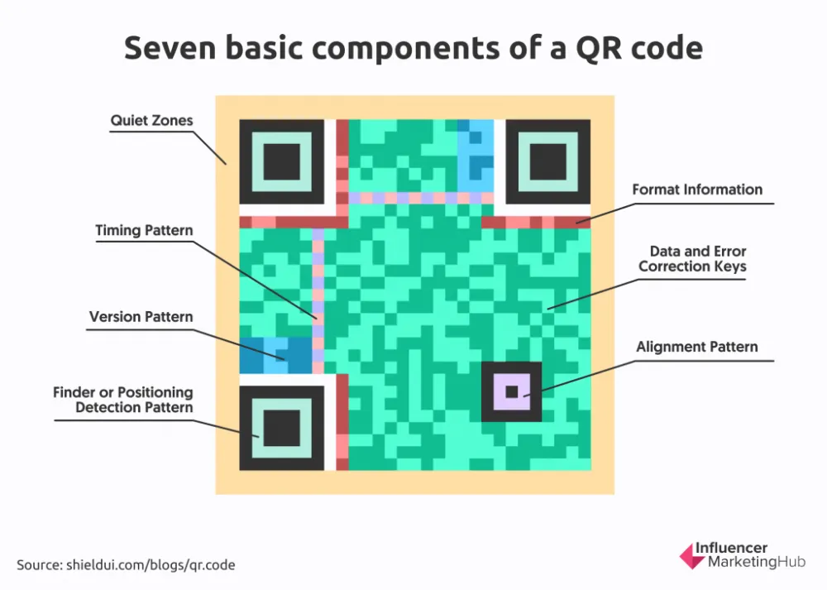
QR Code Anatomy
The QR code is built up of data and metadata.
Three finder patterns, plus zero or several alignment patterns.
Divided into modules, where the number of modules depends on the code version 1 – 40.
Num modules = 4 * version + 17
  Version 1: 21x21
  Version 40: 177x177
Data can be coded with redundancy for robustness.

Slide 3
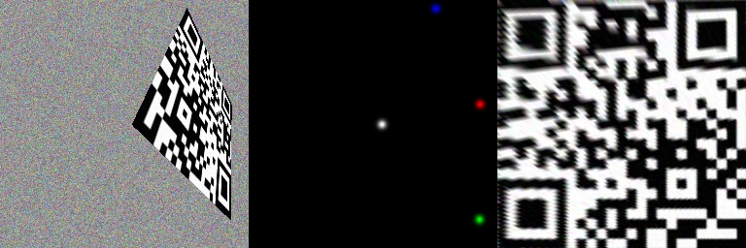
Catching Codes in the Wild
Often codes are transformed when attempting to read them:
  From rotations to projective transforms.
Reading codes are divided in three main steps:
  Identify the corners in correct order (”red”, ”green”, ”blue”, ”white”).
  Rectify the code (plus filtering).
  Read and decode the bitmap.
This playground focus only on the first step.

Slide 4
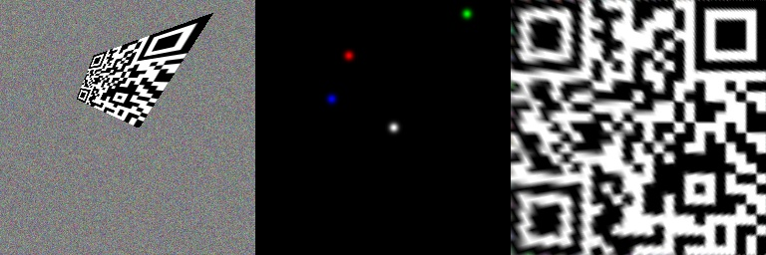
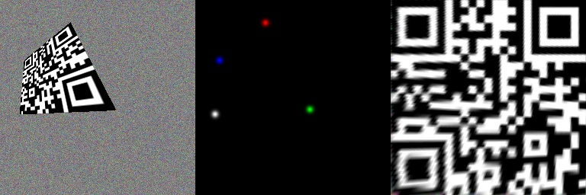
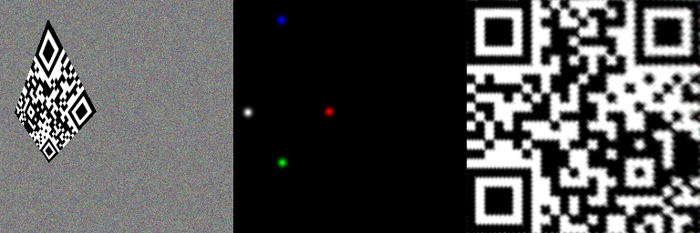
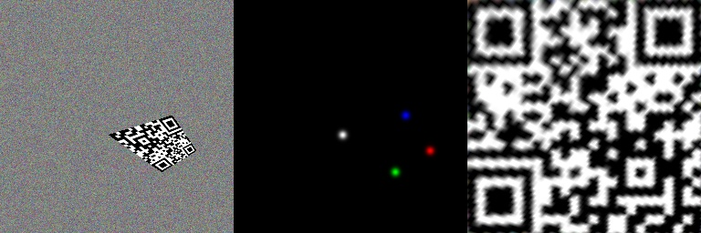
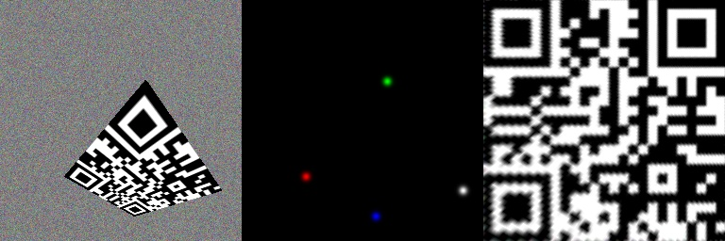
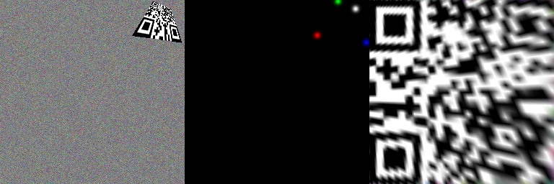
Learning Based Approach for Corner Detection
Generate random training and validation datasets. Each sample:
  Random version 2 QR code.
  Random noise background.
  Random homography for warping the QR code onto the background.
  Save the RGB image, one ground truth heatmap per corner, and the numeric points.
The task is to learn to predict the corner heatmaps.

Slide 5
Network Architecture – Tiny U-Net
(1.1 Mparams)
3x256x256
16x256x256
4x256x256
16x128x128
32x128x128
32x64x64
64x64x64
2 * CBR
2 * CBR + concat
64x32x32
128x32x32
Max Pool 2x2
Transpose conv
Skip connection

