Slide 1
Hardening your Windows Server Environment
Orin Thomas
@orinthomas
Principal Cloud Operations Advocate
orin.thomas@microsoft.com

Slide 2
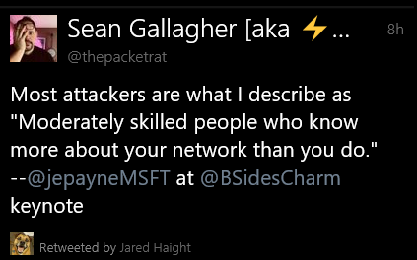

Slide 3
Caveats
There is no perfect security solution
You can harden your systems so that casual attackers move on to easier targets
If you are being attacked by a nation state or an insanely competent attacker then you are $#$%#^!!d
Aim to systematically do your best with the resources you have
Server hardening is a journey …

Slide 4
Aim of the Session
Provide you with the information about your options for securing Windows Server environments
Focus on Server 2016 & 2019
Running the latest OS with all updates applied is more secure than running a 10 year old OS with all updates applied
Keep turning the security dial setting by setting as your extingencies allow

Slide 5
Domain Dominance
Ultimate aim of attackers of Windows based networks is to get domain admin privileges
Pwn a DC and you have access to every system in the network

Slide 6
Baselines and Hardening
Windows Server ships in a “moderately hardened” configuration
There is more that you can do, but the more you do, the more you risk introducing problems into your environment

Slide 7
Important Baselines
Microsoft only publishes general baselines as part of the SCT
National Checklist Repository
https://nvd.nist.gov/ncp/repository
Detailed low level guidelines
Center for Internet Security
https://www.cisecurity.org/cis-benchmarks
IASE Windows Server 2016 (Defense Information Systems Agency Security Technical Implementation Guide)(DISA STIG)
https://public.cyber.mil/stigs/downloads/
Noted by MS as a top-level security posture for Windows Server

Slide 8
Challenges of Server Hardening
Harden the servers too much and things stop working
Harden servers in a manner commensurate with your organization’s risk profile
Harden incrementally
Tighten, test, tighten rather than starting with a fully hardened configuration and then trying to debug it to make stuff work.
Don’t invest in a $10,000 safe to protect a $1000 diamond

Slide 9
Minimizing chance of log compromise
Event Log Forwarding
Forward events from servers to a central location for collection and storage
If attacker compromises server and clears logs, events are still stored in an alternate location
Can also use Azure Monitoring to collect event data from on-prem/IaaS servers

Slide 10
DC configuration
DCs should always run most recent version of Windows Server
Should be Server Core
Should have device guard enabled
Should be blocked from directly communicating with hosts on the internet
Admin sessions (RDP/PowerShell) only from known PAW/Jump Server IP addresses

Slide 11
Admin Accounts
Lock down when and where an account can be used
Specify restricted logon times
Specify restricted logon locations
Specify account expiration
Ensure that password policies are enforced

Slide 12
DEMO: LOGON RESTRICTIONS

Slide 13
Protected Users
Special group in Server 2016 & 2019
Members of this group
No cached credentials
Cannot use NTLM authentication
Cannot use older cipher suites for Kerberos pre-authentication
Add all privileged accounts to this group to minimize chances of cached credential harvesting

Slide 14
DEMO: PROTECTED USERS

Slide 15
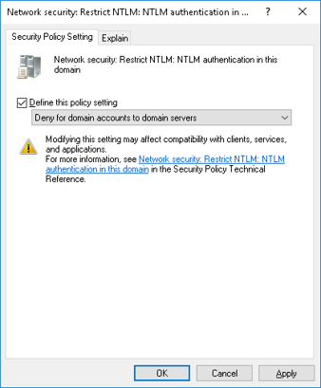
Disabling NTLM
Prior to disabling, audit current use of NTLM
Configure Network Security: Restrict NTLM authentication in this domain policy

Slide 16
Credential Guard
Uses virtualization based security to protect cached account credentials
Used to mitigate pass-the-hash & pass-the-ticket attacks
Does not allow
Unconstrained Keberos delegation
NTLMv1
MS-CHAPv2
Digest Authentication
CredSSP
Kerberos DES encryption

Slide 17
ESAE Forests
Admin forest is trusted in one way relationship by Production forest
All admin accounts in Production forest are standard user accounts in Admin forest
If admin account is compromised, it can’t be used to compromise other accounts in admin forest
Any accounts that have admin privileges that aren’t hosted in Admin forest are suspect

Slide 18
Principle of Least Privilege
Assign minimum required rights to an account
If account is compromised, attacker will only be able to perform limited set of tasks
Create accounts to perform specific administrative tasks
Avoid swiss army knife accounts

Slide 19
PAWs and Jump Servers
Locked down workstation that can only be used for administrative tasks
Blocked from accessing internet
Servers only accept admin connections from PAWs or Jump Servers
Jump Server
Connection made to jump server
Admin connection made from jump server to target system to be managed

Slide 20
Good Admin Habits
Daily driver account used to read email, generate TPS reports should be standard user account
Should not be member of local Admins group
Only use privileged accounts from PAWs to perform administrative tasks

Slide 21
Just Enough Administration
RBAC for Windows PowerShell remoting
Specially configured endpoints limit access so that user can only use a defined set of PowerShell cmdlets, parameters, and parameter values
Actions are performed using a special machine local virtual account

Slide 22
Just Enough Administration
Not appropriate where problem and solution are not clearly defined
Requires that you understand exactly which cmdlets, parameters, aliases, and values are needed to perform specific tasks
Only works with PowerShell sessions

Slide 23
JEA Endpoint
Connect to a specific endpoint to access JEA session
A server can have multiple endpoints
Account does not have to be privileged, only authorized to connect to a JEA endpoint

Slide 24
DEMO: DNS & JEA

Slide 25
Windows Admin Center
Web based console for the remote administration of Windows Server
Existing admin tools will be supported, but new admin functionality will be placed in Windows Admin Center
Eventually will replicate functionality of all existing RSAT tools & MMCs
Not any time soon, you know, eventually

Slide 26
Privileged Access Management
Also known as Just in Time Administration
Request privileged access using PowerShell or Web Interface
Granted administrative privileges for a limited duration of time (by default 60 minutes)
After 60 minutes expires, returned to normal unprivileged user configuration
Requires
ESAE Forest to host admin accounts
Microsoft Identity Manager 2016

Slide 27
PAM/JIT Administration
Can specify which users are able to request privileges
Can automatically allow some privileges whilst requiring approval for others
Approver does not need to be a privileged account
Can require MFA
Approver and requestor may be required to provide reason for request/approval
Can be combined with Just Enough Administration

Slide 28
Local Administrator Password Solution (LAPS)
Local administrator passwords are unique on each computer that LAPs manages
LAPS randomizes and changes local administrator passwords every 30 days
LAPS stores local admin passwords and secrets within AD
Configurable permissions
Retrieved passwords transmitted in encrypted manner

Slide 29
LAPS
Works only with domain joined computers
Requires only Server 2003 or higher AD functional level
Does require schema extension
Add computer accounts to an OU and then enable the OU to use LAPs
Configure password policies in group policy
View passwords in PowerShell, ADUC or the LAPS UI

Slide 30
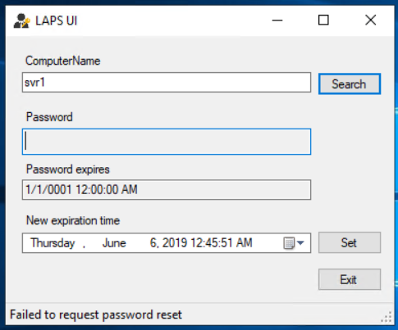

Slide 31
Server Core
Smaller attack surface than Server with a GUI
Requires fewer software updates and reboots
Can be managed using Windows Admin Center
Use sconfig.cmd to perform basic configuration tasks
Windows Server 2019 has improved Server Core functionality

Slide 32
2019 Server Core App Compatibility
Improves app compatibility for Server Core by including set of binaries and packages from Server with GUI without adding Server with GUI experience
Performance Monitor (PerfMon.exe)
Resource Monitor
Device Manager
MMC
PowerShell ISE
Failover Cluster Manager
ProcMon & other Sysinternals

Slide 33
DEMO: 2019 Server Core

Slide 34
BitLocker
Provides boot environment protection
Provides encrypted storage protection
MBAM tool allows you to integrate BitLocker management for domain joined devices into AD
Simplifies the process of BitLocker recovery

Slide 35
Network Isolation Policies
Use IPsec policies to restrict which hosts are able to communicate with servers
For example, block a file server from communicating with any computer that is not a member of the domain
Block sensitive servers from communicating with hosts that don’t have a computer certificate from a specific CA installed

Slide 36
Group Managed Service Accounts
Special type of account that can be used for services
AD DS manages the service account password
Requires Server 2012 or higher functional level
Virtual accounts are local equivalent of GMSA

Slide 37
Anti-Malware Configuration
Windows Defender ATP is available in Server 2019
Integrates with Microsoft Security Graph for behavior based detection of attacks
Can also use Azure Security Center to manage security configuration of on-prem and IaaS servers
View issues such as lack of firewall configuration & missing updates

Slide 38
Windows Defender Exploit Guard
Exploit protection
Blocks malicious files, scripts, lateral movement, ransomware behavior
Attack surface reduction rules
Brining EMET into the operating system
Network protection
Block apps from communicating with untrusted network locations
Leverages SmartScreen
Controlled folder access
Block untrusted apps
Mitigates Ransomware

Slide 39
DEMO: Exploit Guard

Slide 40
Security Compliance Toolkit
Allows you to analyze and configure systems against security baselines
Replacement for Security Compliance Manager

Slide 41
Virtualization Dominance
Virtualization fabric administrators can
Export VMs and exfiltrate their contents
Perform offline attacks against VMs
Offline dictionary attack against NTDS.dit on virtualized domain controller

Slide 42
Shielded VMs
Shielded VMs: Like “BitLocker” for VMs
VM is encrypted
VM will only boot if the virtualization fabric passes attestation integrity check
VM cannot be run on unapproved Hyper-V host
No local console connections, debuggers, access only using remote network administration tools

Slide 43
Guarded Fabrics
VM will only run on specific “pre-authorized” virtualization host
Each virtualization host must pass
Verified TPM identity
Code integrity check
Measured boot sequence
VM will only run when Host Guardian Service attests to health & identity of VM host

Slide 44
Shielded VM Templates
VM owner can publish signed template and encrypted settings file to guarded fabric
Encrypted settings file includes all VM secrets such as local admin password
Inaccessible to virtualization fabric admnistrator
VM template cannot be modified because of signature

Slide 45
Windows Defender Application Guard
When user visits untrusted site in Edge or Chrome, browser opens in isolated Hyper-V container
This makes it difficult for malware that may be dropped using the browser to interact with the operating system
Requires Enterprise/Pro edition of Windows 10
64 bit CPU with virtualization extensions & 8 GB of RAM
Can block cut/paste from untrusted sites

Slide 46
Windows Defender Device Guard
Hardware based code integrity policies
Uses Virtual Secure Mode blocks interaction of apps with sensitive parts of the operating system via virtualization
Kernel mode code integrity
User mode code integrity
Requires TPM, Secure Boot, UEFI, and Virtualization Extensions

Slide 47
Securing AD
ESAE Forest
Use RODC in locations where security is not assured
Run virtualized DC as shielded VMs
Use Security Configuration Manager to apply configuration baselines
Use AppLocker and Device Guard to control execution of application and scripts
Limit inbound RDP/PowerShell connection to known PAWs/Jump Servers
Block traffic from domain controllers to and from Internet

Slide 48
Securing DNS
Configure DNS policies to mediate how queries are handled on the basis of the characteristics of the DNS request
Configure DNSSEC and NRPT so that all internal DNS records are digitally signed and authenticated

Slide 49
Securing DHCP
Configure MAC address filtering so that only known MAC addresses can request IP addresses
Configure secure dynamic DNS update settings
Restrict updates to static records
Restrict updates to records marked as sensitive
Block dynamic updates based on record type (MX, SRV, PTR, TXT etc)

Slide 50
Securing File Servers
Disable SMB1
File Server Resource Manager File Screens
Exploit Guard Controlled Folder Access to minimize chance of Ransomware encryption of sensitive files

Slide 51
Securing IIS
Deploy IIS on standalone server
Avoid deploying on a DC
Only install required modules, don’t install every IIS option
Run SQL and other servers on separate hosts
Move INETPUB to separate volume instead of on OS volume
Isolate web applications
Separate sites & application pools
Isolate ASP.NET temp folders

Slide 52
Securing IIS
If using Windows Auth, turn on extended protection
Do not allow anonymous writes to the server
Enable request filtering rules
Configure request limits based on how the IIS server is used
Don’t use built in accounts for Application Pool identities
Virtual accounts are a good idea
Enforce use of SSL/TLS and disable non TLS where possible
Turn off debug mode for classic ASP application

Slide 53
Containerizing Applications
Where possible, shift applications into Server Core / Nano Server containers
Easier to blow away a container that has become corrupted than it is to blow away a server that has become corrupted

Slide 54
Easy Wins
Upgrade your domain controllers to Server 2019
Disable NTLM in your domain
Implement privileged access workstations & limit where admin accounts can be used
Add admin accounts to protected users group
Deploy Local Administrator Password Solution

Slide 55
Easy Wins
Configure Domain Isolation Policies
Deploy Group Managed Service Accounts
Place unsupported operating systems on air-gapped/isolated “life support” networks that are inaccessible from the internet
Deploy ATA/Azure ATP

Slide 56
Q&A

