Slide 1
Confirmation
Exploration
Parametric Statistics
specify predictors
specify functional forms (e.g., straight line, quadratic line, categories)
Machine Learning
analysis finds important predictors
analysis finds functional forms
Abundant Prior Knowledge
Minimal Prior Knowledge

Slide 2
Parametric Statistics
Machine Learning
AIC-based Model Selection
need to identify important predictors
prior knowledge of functional forms

Slide 3
Generalized Additive Models
need to identify functional forms
prior knowledge of important predictors
Parametric Statistics
Machine Learning
AIC-based Model Selection
need to identify important predictors
prior knowledge of functional forms

Slide 4
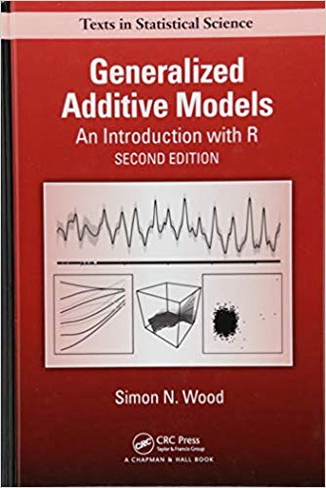
Generalized Additive (Mixed) Model basic characteristics
GAMs are regressions of arbitrary shapes, with shape determined by data
very roughly speaking, GAMs are a type of segmented regression
segments connect at “knot points”
the number of knot points affects how wiggly the line will be
across these knot points, first and second derivatives (i.e. slope and rate of change of slope) are smooth
For a real explanation see Simon Wood’s book
library mgcv (part of the base R installation) is described in this book, and likely would serve most peoples’ requirements
even the built-in documentation for mgcv is above average in usefulness and clarity

