Slide 1
Naive Bayes model to classify tissue types and brain regions using splicing patterns
Oriol Gracia, Júlia Mir, Helena Rodríguez

Slide 2
Introduction
Exon-skipping events.
Proportion of RNA molecules that include the exon from all RNA molecules.
Per tissue - per splicing site
Brain samples
Tissue samples
Gtex format:
columns → tissues
rows → splicing sites

Slide 3
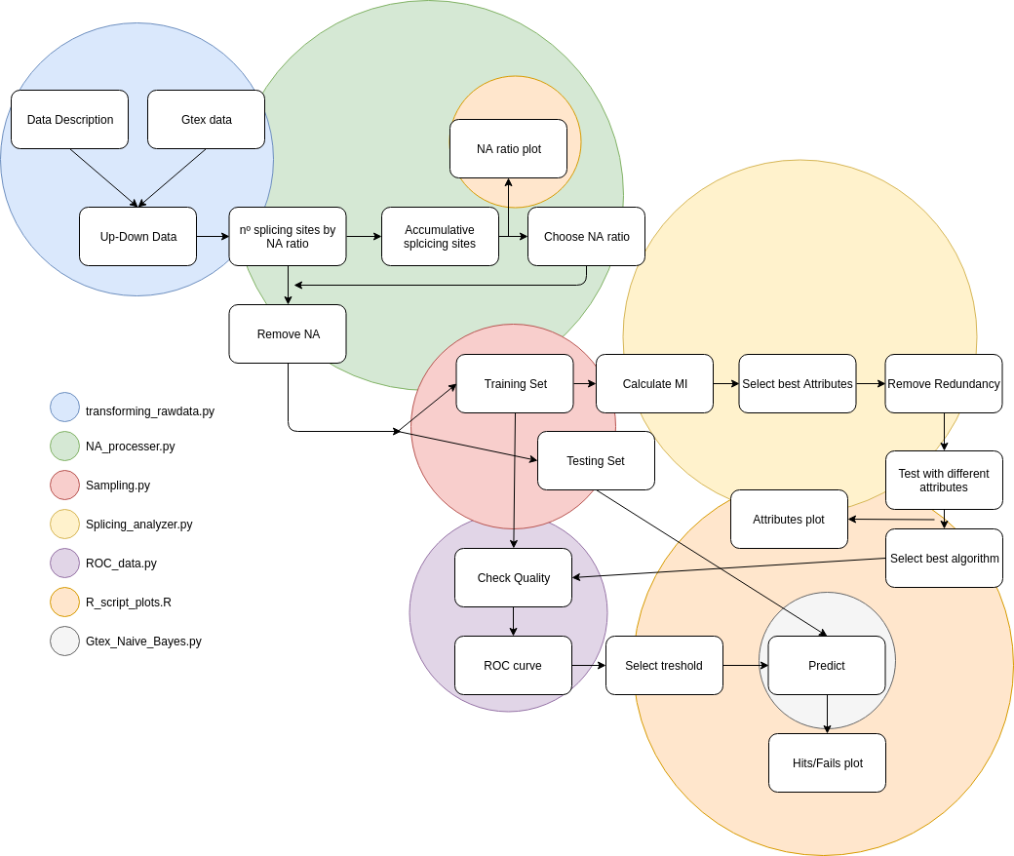
Pipeline

Slide 4
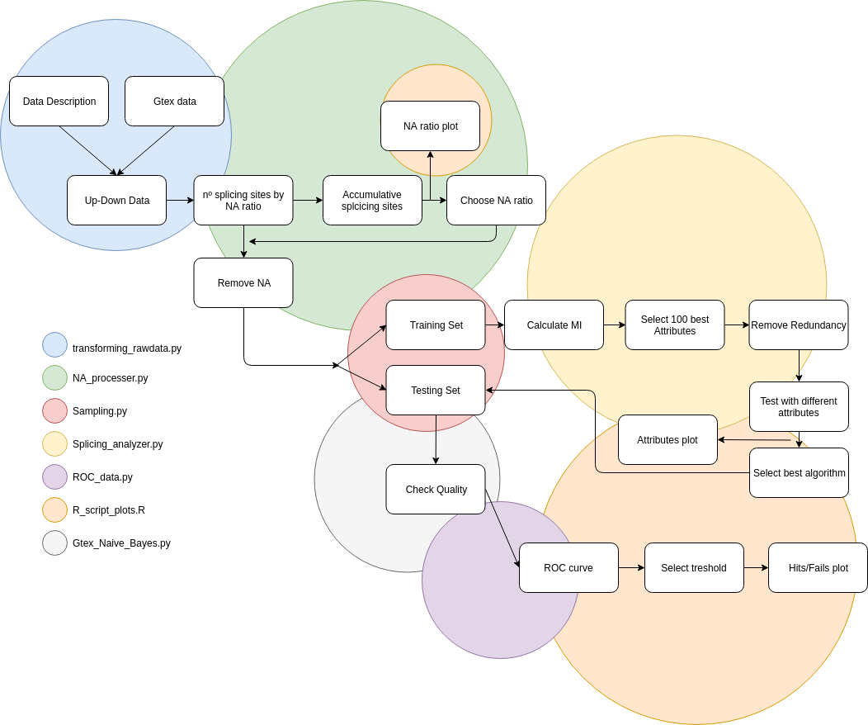

Slide 5
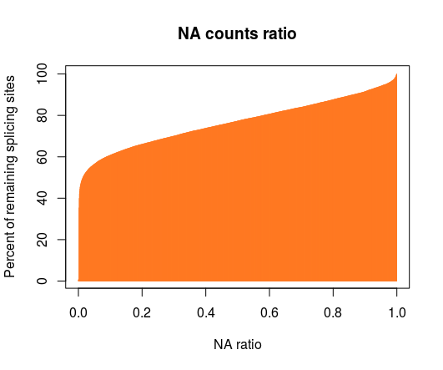
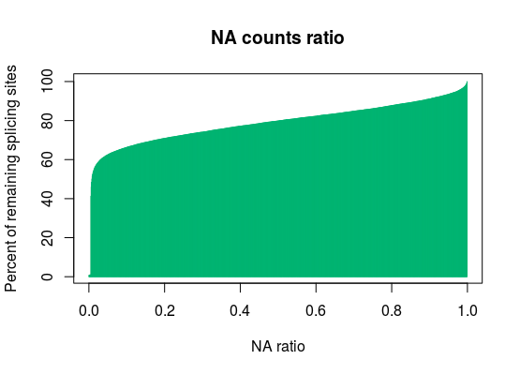
NA ratio
Brain
Other tissues

Slide 6
Training and Testing sets
BRAIN
69 Amygdala 83 Anterior_Cingulate_Cortex_(Ba24) 109 Caudate_(Basal_Ganglia) 97 Cerebellar_Hemisphere 119 Cerebellum 105 Cortex 102 Frontal_Cortex_(Ba9) 84 Hippocampus 82 Hypothalamus 104 Nucleus_Accumbens_(Basal_Ganglia) 81 Putamen_(Basal_Ganglia) 60 Spinal_Cord_(Cervical_C-1) 57 Substantia_Nigra
TISSUES
377 Heart 28 Kidney 110 Liver 288 Lung 396 Muscle 278 Nerve
80% → training
20% → testing
55 → training
2 → testing

Slide 8



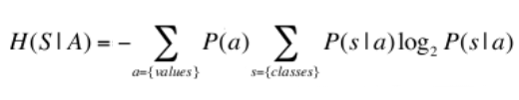
Calculate MI

Slide 9
Avoiding Redundancy
 | Tissue A | Tissue A | Tissue B | MI
splicing A | up | down | up | 0.02
splicing B | up | up | up | 0.01
nº up
nº down
nº up
nº down
if nºup splicingA == nº up splicingB → +1 hit

Slide 10
Avoiding Redundancy
 | splicing A | splicing B | splicing C | splicing D
splicing A
splicing B | 3
splicing C | 1 | 1
splicing D | 2 | 2 | 2
MI A > MI B
 | splicing A | splicing C | splicing D
splicing A
splicing C | 2
splicing D | 1 | 2

Slide 11
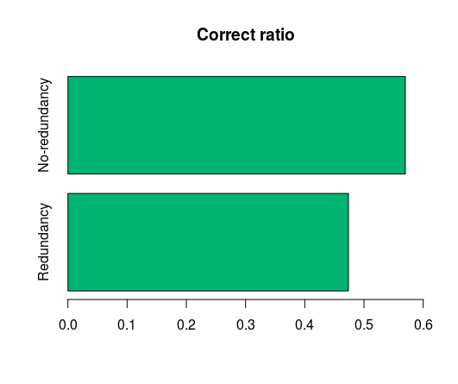
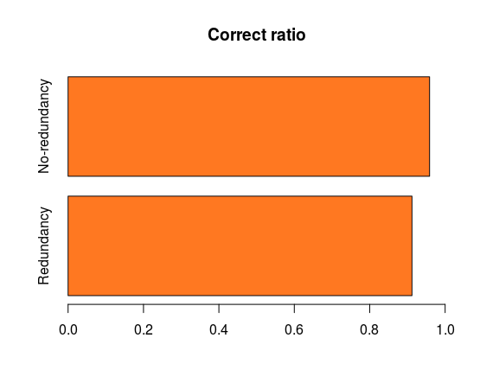
Redundancy
Brain
Other tissues

Slide 12
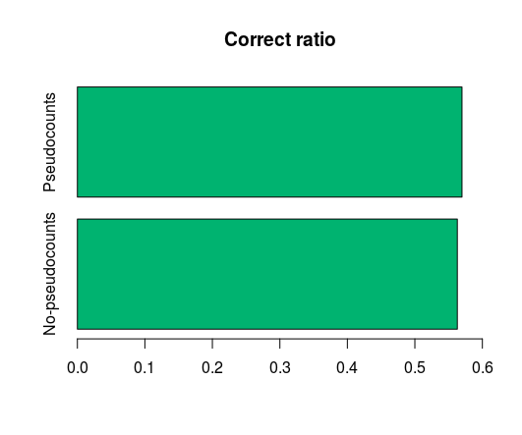
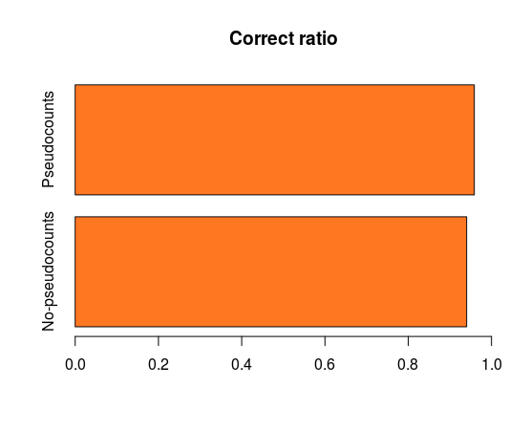
Pseudocounts
Brain
Other tissues

Slide 13
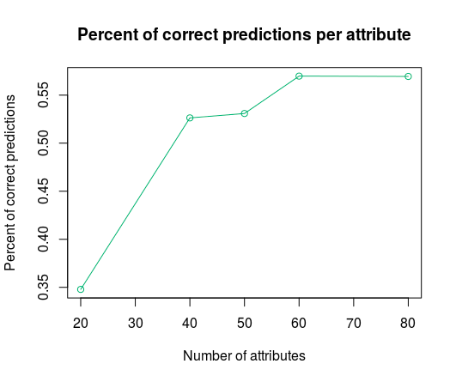
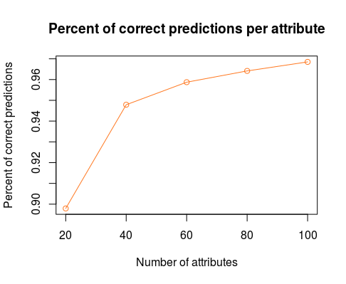
Correct predictions per attribute
Brain
Other tissues

Slide 15
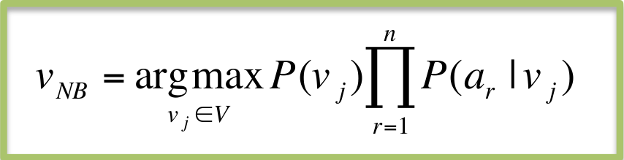
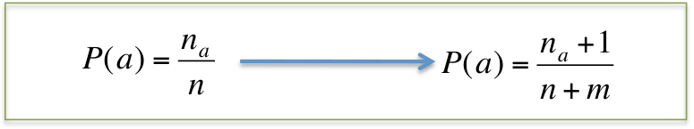
Naive Bayes
Pseudocounts

Slide 16
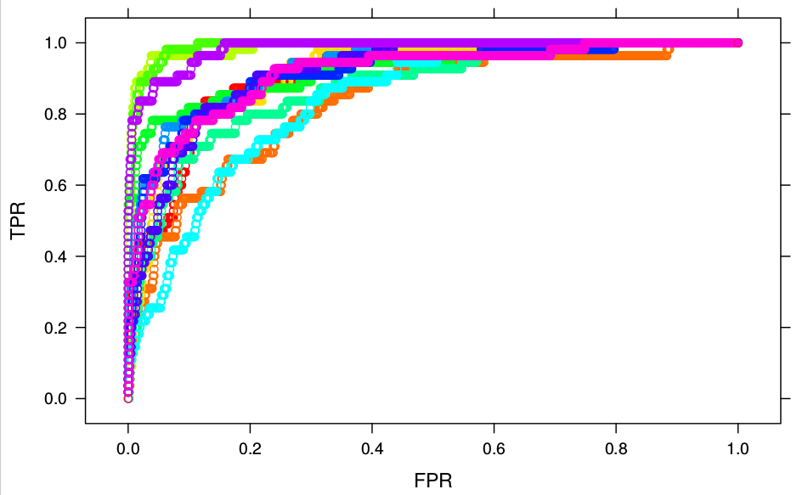
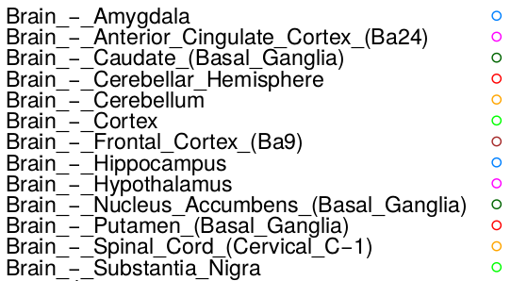
ROC curves (brain)

Slide 17
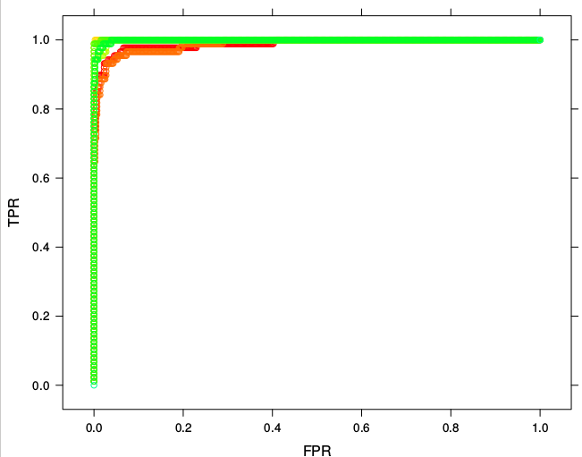
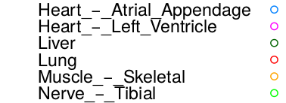
ROC curves(other tissues)

Slide 18
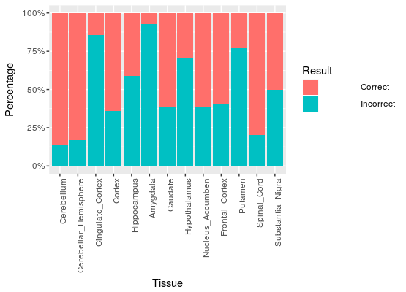
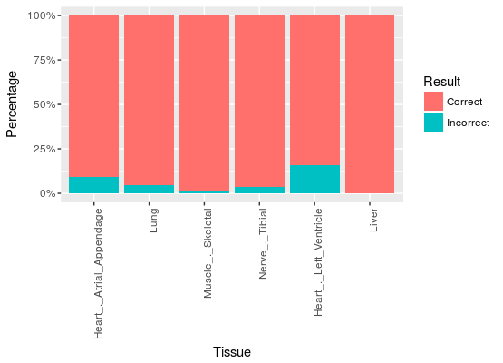
Correct versus incorrect predictions
Brain
Other tissues

Slide 19
Final Results
BRAIN
The Number of correct guesses are: 249
The Number of incorrect guesses are: 188
The correct ratio is 0.57
OTHER TISSUES
The Number of correct guesses are: 498
The Number of incorrect guesses are: 30
The correct ratio is 0.94

Slide 20
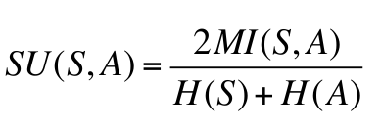
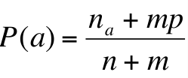
Possible improvements
Symmetrical uncertainty
K-fold cross-validation
Different approaches for pseudocounts
Prior estimate
Remove tissues with lower prediction accuracy: amygdala, cingulate cortex and putamen

Slide 21
Thank you

