Slide 2
What is machine learning ?
Traditional programming
Data
Computer
Output
Algorithm

Slide 3
What is machine learning ?
Machine learning
Data
Computer
Algorithm
Output

Slide 4
Machine learning techniques
We can separate learning problems into:
Supervised learning: Data is labeled and the algorithms learn to predict the output from the input data.
Classification: samples belong to two or more classes (discrete values) and we want to learn from already labeled data how to predict the class of unlabeled data.
Regression: Desired output consists of one or more continuous variables. We want to predict a specific continuous value.
Unsupervised learning: All data is unlabeled and the algorithms learn to inherent structure from the input data.
Clustering: A clustering problem is where you want to discover the inherent groupings in the data, such as grouping customers by purchasing behavior.
Association: An association rule learning problem is where you want to discover rules that describe large portions of your data, such as people that buy X also tend to buy Y.
Semi-supervised: Some data is labeled but most of it is unlabeled and a mixture of supervised and unsupervised techniques can be used.
Notes:
You are a kid, you see different types of animals, your father tells you that this particular animal is a dog…after him giving you tips few times, you see a new type of dog that you never saw before - you identify it as a dog and not as a cat or a monkey or a potato.
You go bag-packing to a new country, you did know much about it - their food, culture, language etc. However from day 1, you start making sense there, learning to eat new cuisines including what not to eat, find a way to that beach etc.
Example, semi supervised: photo archive where only some of the images are labeled, (e.g. dog, cat, person) and the majority are unlabeled. Many real world machine learning problems fall into this area. This is because it can be expensive or time-consuming to label data as it may require access to domain experts. Whereas unlabeled data is cheap and easy to collect and store.
You can use unsupervised learning techniques to discover and learn the structure in the input variables.

Slide 5
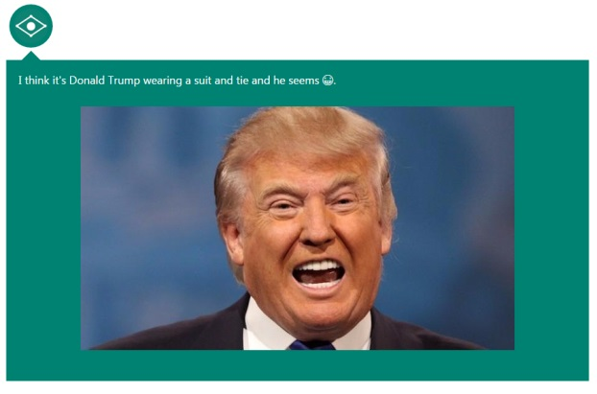
Captionbot.ai

Slide 6
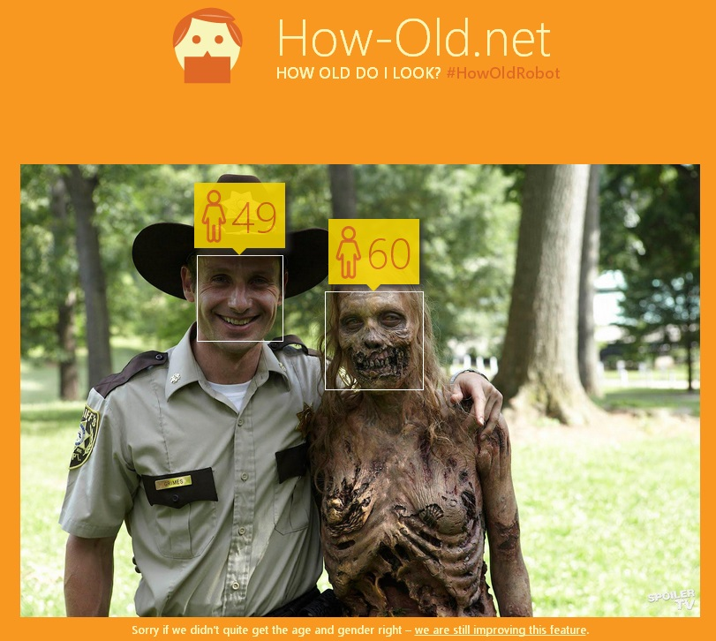
Howold.net

Slide 7
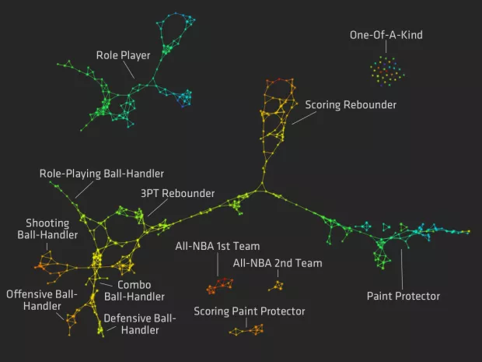
Notes:
https://flowingdata.com/2012/03/21/redefining-nba-basketball-positions/

