Slide 1
Introduction to Networking

Slide 2


Slide 3

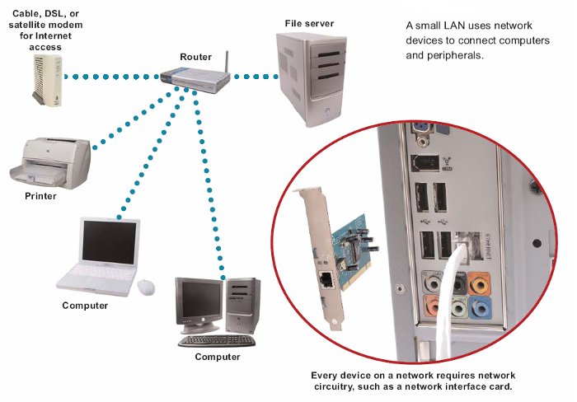
A system of computers and peripherals that are linked together
Purpose is usually to share files, resources, and peripherals

Slide 4
Parts of a Network
Clients
  Computers that request or order information from a server
  Usually desktop computers with their own local storage and processing power
  Thin client – network computer with no local storage

Slide 5
Servers
  Computers that work behind the scenes to provide (serve) the resources requested by the clients
  Two types
    Non-dedicated – provides many different services to its client computers such as file retrieval, printing, and emailing
    Dedicated – provides only one type of resource to its clients, such as printing

Slide 6
Other network components
Shared peripherals – a device that is connected to a computer and controlled by its microprocessor
Media – physical pieces used to transport data from one computer to another computer or peripheral on the network
Data - packets

Slide 7
Specialized Servers
File Servers
Print Servers
Application Servers
Mail Servers
Communication Servers
Directory Services Servers
Backup Servers

Slide 8

Advantages:
  Enable people to work together
  Reduce costs from sharing networked hardware and software
  Increase productivity by sharing data
  Provide access to a wide range of services and specialized peripheral devices
Disadvantages:
  Unavailable resources when network malfunctions
  More vulnerable to unauthorized access than stand alone computers
  Susceptible to an increased number of worms, Trojan horses, and blended threats

Slide 9

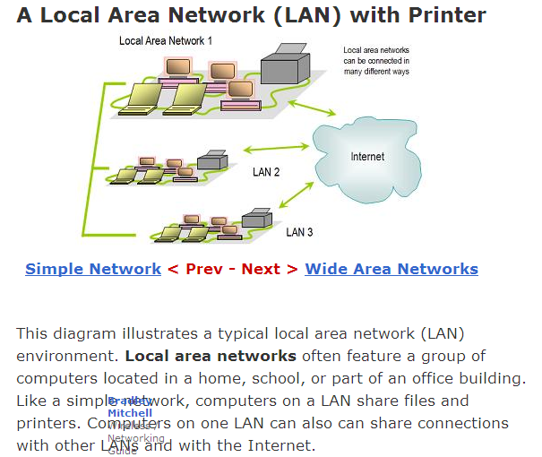
Network of computers located in a single location, like a home, school, or office building
Can share connection with other LANS and with the internet

Slide 10
Characteristics of a LAN?
Local area network
Relatively limited in size
Computers connected in small areas
Same office
True peer-to-peer
Can support limited number of nodes

Slide 11

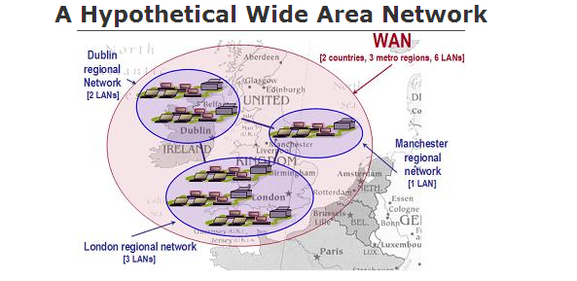
Network over a large area like a city, a country, or multiple countries
  Connects multiple LANs together
Generally utilizes different and much more expensive networking equipment than LANs
The internet is
the most
popular WAN

Slide 12
Types of WANs
Campus Area Network – limited geographic area
Metropolitan Area Network – towns and cities
Home Area Network – home setups
Global Area Network – uses satellites to link networks
Storage Area Network – stores large amounts of data

Slide 13

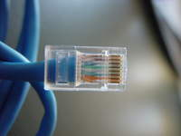
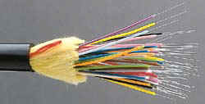
There are many different wires and cables that are used to create a network
Ethernet cable - often used to connect computers
Phone or cable TV lines – connect LAN to an internet service provider (ISP)
Fiber optic cable – used by much of the internet to send data quickly over long distances underground

Slide 14

A wired network uses cables to connect network devices
Wired networks are fast, secure, and simple to configure
Devices tethered to cables
have limited mobility

Slide 15

A network is considered wireless when data is transmitted from one device to another without cables or wires
Tend to be slower than wired networks
Have more security issues
Common wireless terms:
  Wi-Fi - common standard technology for building home networks and other LANs
  Hotspots – many businesses use Wi-Fi technology to allow the public an access point to a wireless network
  Bluetooth – allows handhelds, cell phones, and other peripherals to communicate over short ranges

Slide 16

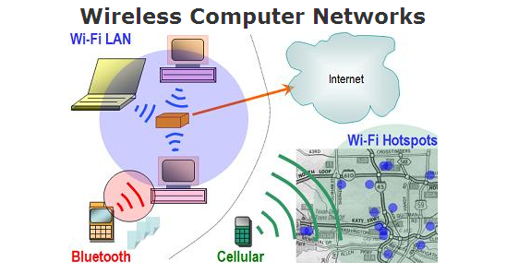

Slide 17

Network devices can function as clients or servers
Server - computer that performs administration or coordination functions within a network
Types: (1)application server, (2) file server, (3) print server
Client – regular workstation that performs applications

Slide 18
Client/Server Network

Slide 19

A network of personal computers, each of which acts as both client and sever, so that each can exchange files directly with every other computer on the network
Each computer can access any of the others, although access can be restricted to those files that a computer's user chooses to make available
Less expensive than client/server networks but less efficient when large amounts of data need to be exchanged

Slide 20
Peer-to-peer

Slide 21

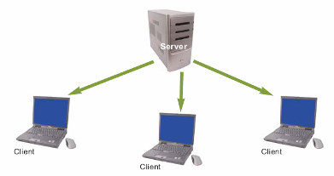
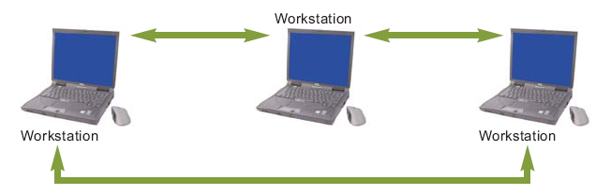

Slide 22
Comparison of …
 | Peer-to-peer | Client/Server
Type of user | Homes and small businesses | Large corporations, schools, and hospitals
Size of organization | Limited number of workstations | Large number of workstations
Administration | User | Central administrator
Security | Individual users | Network administrator
Network traffic | Limited number of users | Large number of users
Cost | Inexpensive to implement | Usually more expensive than peer-to-peer
Scalability | Limited growth | High growth projected

Slide 23
How do we choose the architecture?
Type of user
Size of the organization
Administration
Security
Network traffic
Cost
Scalability

Slide 24


Slide 25

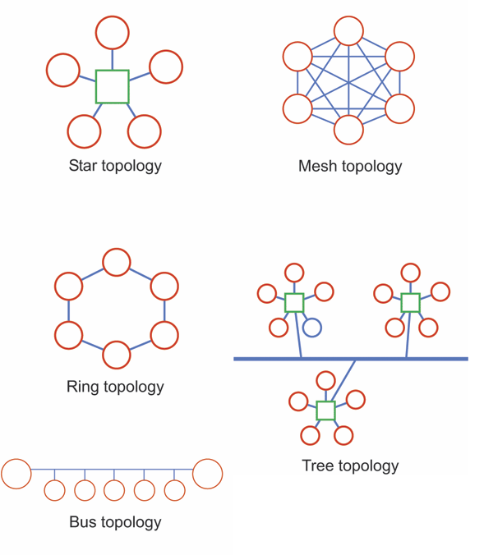
Physical arrangement of devices in a network
Common types:
  Star
  Ring
  Bus
  Tree

Slide 26

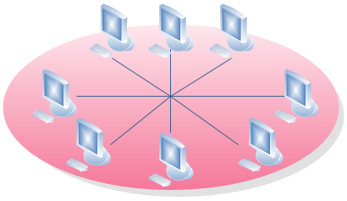
Features a central connection point called a "hub“; that may be a hub, switch or router
Advantages:
  Easy to install
  Failure in any cable will only take down one computer's network access and not the entire LAN
  Easy to detect faults and to remove parts
Disadvantages:
  Requires more cable than linear topology
  If the hub fails, the entire network also fails
Often used in home networks

Slide 27

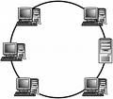
Every device has exactly two neighbors for communication purposes
All messages travel through a ring in the same direction (either "clockwise" or "counterclockwise")
A failure in any cable or device breaks the loop and can take down the entire network
Found in some office buildings or school campuses

Slide 28

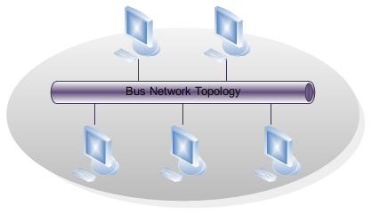
A common backbone (a single cable) to connects all devices and devices attach, or tap into, the cable with an interface connector
Devices wanting to communicate with other devices on the network send a broadcast message onto the wire that all other devices see, but only the intended recipient actually accepts and processes the message
Advantages:
  Easy to connect a computer or peripheral to a linear bus
  Requires less cable length than a star topology
Disadvantages
  Entire network shuts down if there is a break in the main cable
  Terminators are required at both ends of the backbone cable
  Difficult to identify the problem if the entire network shuts down
Work best in networks with just a few computers

Slide 29

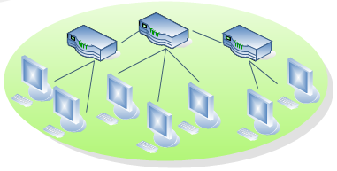
Integrates multiple star topologies together onto a bus
In its simplest form, only hub devices connect directly to the tree bus, and each hub functions as the "root" of the tree
Advantages
  Point-to-point wiring for individual segments
  Supported by several hardware and software venders
  Easier to expand than bus or star
Disadvantages
  Overall length of each segment is limited by the type of cabling used
  If the backbone line breaks, the entire segment goes down
  More difficult to configure and wire than other topologies

Slide 30

Combination of any two or more network topologies
  Note 1: Two of the same topologies, when connected together, may still retain the basic network character, and therefore not be a hybrid network
    For example, a tree network connected to a tree network is still a tree network, but two star networks connected together exhibit hybrid network topologies
  Note 2: A hybrid topology always accrues when two different basic network topologies are connected

Slide 31

Money
Length of cable needed
Future growth
Cable type

Slide 32


Slide 33

A protocol is a set of rules that govern the connection, communication, and data transfer between computers on a network
These rules include guidelines that regulate the following characteristics of a network: access method, allowed physical topologies, types of cabling, and speed of data transfer

Slide 34

There are hundreds of internet protocols
Protocols to be discussed further:
  http
  https
  ftp

Slide 35

HTTP is a protocol used by the World Wide Web that defines how messages are formatted and transmitted, and what actions Web servers and browsers should take in response to various commands
Protocol built on top of TCP
The three main HTTP message types are GET, POST, and HEAD

Slide 36

Combination of normal HTTP interactions, but with a different default TCP port and an additional encryption/authentication layer between the HTTP and TCP
Widely used on the World Wide Web for security-sensitive communication such as payment transactions and corporate logons
Ensures reasonable protection from eavesdroppers and man-in-the-middle attacks

Slide 37

Network protocol used to transfer data from one computer to another through a network, such as the Internet
Protocol for exchanging and manipulating files over any TCP-based computer network
A FTP client may connect to a FTP server to manipulate files on that server.
Since there are many FTP client and server programs available for different operating systems, FTP is a popular choice for exchanging files independent of the operating systems involved

Slide 38

Defines rules and conventions for communication between network devices
Protocols for computer networking all generally use packet switching techniques to send and receive messages in the form of packets
Network protocols include mechanisms for:
  Devices to identify and make connections with each other
  Formatting rules that specify how data is packaged into messages sent and received
  Message acknowledgement
  Data compression designed for reliable and/or high-performance network communication
Hundreds of different computer network protocols have been developed each designed for specific purposes and environments

Slide 39

The most common protocols are:
Ethernet
LocalTalk
Token Ring
FDDI

Slide 40

Most widely used protocol
Uses an access method called CSMA/CD (Carrier Sense Multiple Access/Collision Detection) where each computer listens to the cable before sending anything through the network
  If the network is clear, the computer will transmit, but if some other node is already transmitting on the cable, the computer will wait and try again when the line is clear.
  When two computers attempt to transmit at the same time, a collision occurs, and each computer then backs off and waits a random amount of time before attempting to retransmit
  Delay caused by collisions and retransmitting is very small and does not normally effect the speed of transmission on the network
Allows for linear bus, star, or tree topologies
Transmission speed of 10 Mbps

Slide 41

To allow for an increased speed of transmission, the Fast Ethernet protocol has developed a new standard that supports 100 Mbps
Requires the use of different, more expensive network devices and cables

Slide 42

Developed by Apple for Macintosh computers
Method used by LocalTalk is called CSMA/CA (Carrier Sense Multiple Access with Collision Avoidance), which is similar to CSMA/CD except that a computer signals its intent to transmit before it actually does so
  The Macintosh operating system allows the establishment of a peer-to-peer network without the need for additional software
  With the addition of the server version of AppleShare software, a client/server network can be established
Allows for linear bus, star, or tree topologies
Transmission speed is only 230 Kbps

Slide 43

Protocol developed by IBM in the mid-1980s.
Access method used involves token-passing where computers are connected so that the signal travels around the network from one computer to another in a logical ring.
  A single electronic token moves around the ring from one computer to the next and if a computer does not have information to transmit, it simply passes the token on to the next workstation
  If a computer wishes to transmit and receives an empty token, it attaches data to the token and the token then proceeds around the ring until it comes to the computer for which the data is meant
Requires a star-wired ring
Transmission speeds of 4 Mbps or 16 Mbps

Slide 44

Used primarily to interconnect two or more local area networks, often over large distances
Access method used by FDDI involves token-passing
  Transmission normally occurs on one of the rings; however, if a break occurs, the system keeps information moving by automatically using portions of the second ring to create a new complete ring
Requires a dual ring topology
Transmission speed of100 Mbps

Slide 45

Protocol | Cable | Speed | Topology
Ethernet | Twisted Pair, Coaxial, Fiber | 10 Mbps | Linear Bus, Star, or Tree
Fast Ethernet | Twisted Pair | 100 Mbps | Star
Local Talk | Twisted Pair | 23 Kbps | Linear Bus, or Star
Token Ring | Twisted Pair | 4 Mbps – 16 Mbps | Star-wired Ring
FDDI | Fiber | 100 Mbps | Dual Ring

Slide 46

Rules for efficiently transmitting data from one network node to another
  Divide messages into packets
  Affix addresses to packets
  Initiate transmission
  Regulate flow of data
  Check for transmission errors
  Acknowledge receipt of transmitted data

Slide 47


Slide 48

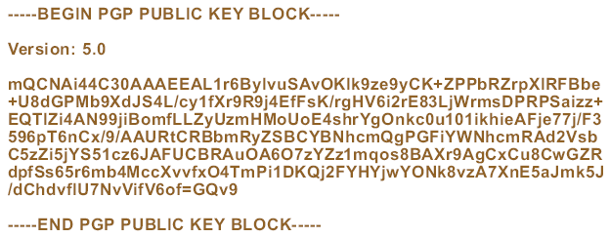
When personal computer users want to encrypt e-mail or other documents, they turn to public key encryption software called PGP (Pretty Good Privacy) software
Notes:
Figure 3-36

Slide 49
Encryption transforms a message so that its contents are hidden from unauthorized readers
  Plaintext has not yet been encrypted
  An encrypted message is referred to as cipher text
Decryption is the opposite of encryption
  Cryptographic algorithm
  Cryptographic key

Slide 50

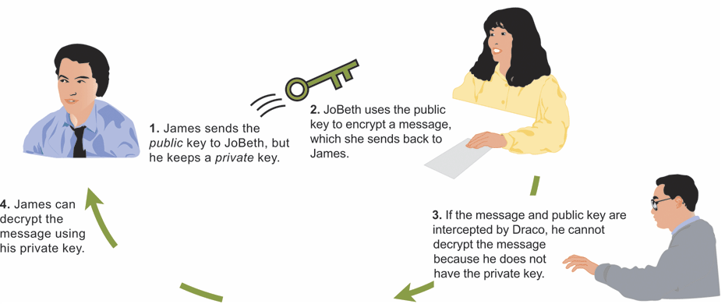
Encryption methods can be broken by the use of expensive, specialized, code-breaking computers
Public key encryption (PKE) eliminates key-distribution problem, by using one key to encrypt a message and another key to decrypt the message

Slide 51

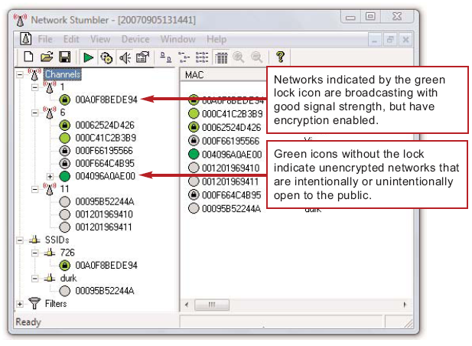
Wireless networks are much more susceptible to unauthorized access and use than wired networks
LAN jacking, or war driving, is the practice of intercepting wireless signals by cruising through an area
Notes:
Figure 3-30

Slide 52

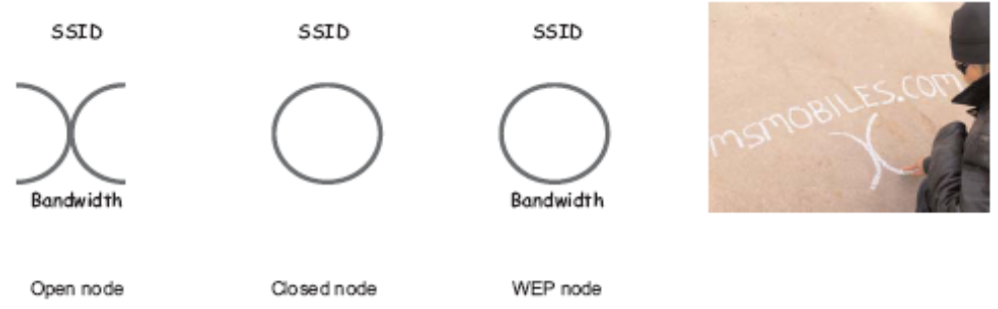
An offshoot of war driving is a gambit called war chalking
Chalkers make chalk marks on outdoor surfaces to indicate wireless networks
  They use symbols to indicate passwords for WEPs
Notes:
Figure 3-31

Slide 53
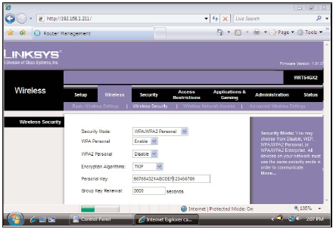
Wireless encryption scrambles data transmitted between wireless devices and then unscrambles the data only on devices that have a valid encryption key
Activate encryption by using a wireless network key

Slide 54


