Slide 1
IP and Networking Basics

Slide 2
Outline
Origins of TCP/IP
OSI Stack & TCP/IP Architecture
Client Server Architecture
IP Addressing & Numbering Rules
IP Forwarding and default route
Network Troubleshooting Tools

Slide 3
Origins of TCP/IP
1950’s – 1960’s – US Govt. requirement for “rugged” network that would continue to work in case of a nuclear attack
RAND Corporation (America’s leading think thank) & DoD formed ARPA (Advanced Research Project Agency)
1968 – ARPA engineers proposed Distributed network design for ARPANET Network

Slide 4
Distributed Network Design
Pre-ARPANET networks
  “connection oriented”
  Management & control was centralized
“New” Network – ARPANET
  Connectionless
  Decentralised
Modern Internet has evolved from the ARPANET

Slide 5
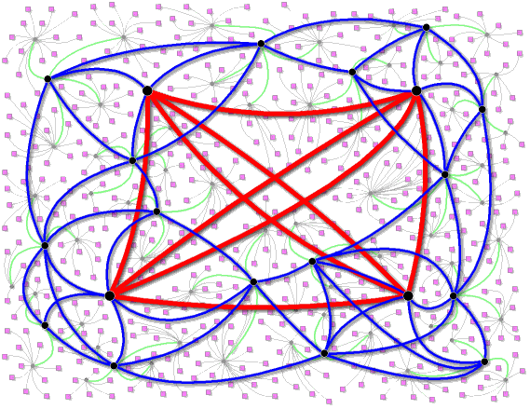
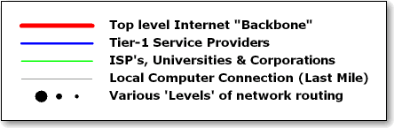
Simplified view of the Internet

Slide 6
Internetworks
Start with lots of little networks
Many different types
  Ethernet, dedicated leased lines, dialup, ATM, Frame Relay, FDDI
Each type has its own idea of addressing and protocols
Want to connect them all together and provide a unified view of the whole lot (i.e. act as a single large network)

Slide 7
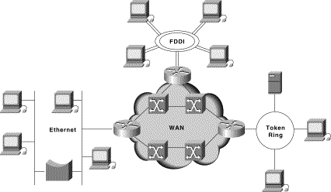
A small internetwork or “Internet”

Slide 8
The unifying effect of the network layer
Define a protocol that works in the same way with any underlying network
Call it the network layer (IP)
IP routers operate at the network layer
There are defined ways of using:
    IP over Ethernet
    IP over ATM
    IP over FDDI
    IP over serial lines (PPP)
    IP over almost anything

Slide 9
OSI Stack & TCP/IP Architecture

Slide 10
What is TCP/IP?
In simple terms is a language that enables communication between computers
A set of rules (protocol) that defines how two computers address each other and send data to each other
Is a suite of protocols named after the two most important protocols TCP and IP but includes other protocols such as UDP, RTP, etc

Slide 11
Open Systems & TCP/IP
TCP/IP formed from standardized communications procedures that were platform independent and open
Open systems
  open architecture - readily available to all
What is open system networking?
  network based on well known and standardized protocols
  standards readily available
  networking open systems using a network protocol
Notes:
When we talk about open systems networking, we mean a network protocol that is based on well known and standardized protocols and is readily available

Slide 12
OSI - Layered Model Concept
Divide-and-conquer approach
Dividing requirements into groups, e.g transporting of data, packaging of messages, end user applications
Each group can be referred to as a layer
  Upper layers are logically closer to the user and deal with more abstract data, relying on lower layer protocols to translate data into forms that can eventually be physically transmitted.
Open Systems Interconnection Reference Model (OSI-RM) adopted as a standard for networking
Notes:
The OSI model whichas been widely adopted as a standard for networking closely resembles the TCP/IP model and uses the underlying principle of divide-and conquer.

Slide 13
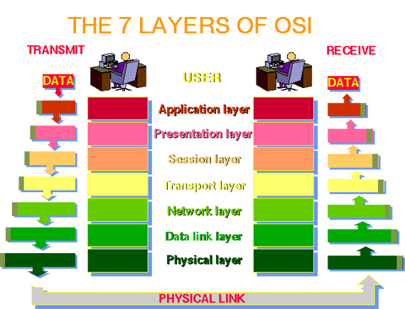
OSI Model

Slide 14
OSI Model
Application
7
Presentation
APPLICATION
Upper Layers
Application oriented
Independent of layers below
6
Session
5
Transport
4
Network
3
TRANSPORT
Lower Layers
Transmission of data
No differentiation of upper layers
Data Link
2
Physical
1

Slide 15
Layers 7, 6, 5
7: Application layer
  Provides different services to the applications
  Uses the underlying layers to carry out work
    e.g. SMTP (mail), HTTP (web), Telnet, FTP, DNS
6: Presentation layer
  Converts data from applications into common format and vice versa
5: Session layer
  organizes and synchronizes the exchange of data between application processes

Slide 16
Layer 4
4: Transport layer
  Provides end to end transportation of segments
  E.g. TCP
    encapsulates TCP segments in network layer packets
    adds reliability by detecting and retransmitting lost packets
    uses acknowledgements and sequence numbers to keep track of successful, out-of-order, and lost packets
    timers help differentiate between loss and delay
  UDP is much simpler: no reliability features

Slide 17
Layer 3
3: Network layer
  Routes the information in the network
  E.g. IP is a network layer implementation which defines addresses in such a way that route selection can be determined.
    Single address space for the entire internetwork
    adds an additional layer of addressing, e.g. IP address, which is different from MAC address.

Slide 18
Layer 3
3: Network layer (e.g. IP)
  Unreliable (best effort)
    if packet gets lost, network layer doesn’t care for higher layers can resend lost packets
  Forwards packets hop by hop
    encapsulates network layer packet inside data link layer frame
    different framing on different underlying network types
    receive from one link, forward to another link
    There can be many hops from source to destination

Slide 19
Layer 3
3: Network layer (e.g. IP)
  Makes routing decisions
    how can the packet be sent closer to its destination?
    forwarding and routing tables embody “knowledge” of network topology
    routers can talk to each other to exchange information about network topology

Slide 20
Layer 2
2: Data Link layer
  Provides reliable transit of data across a physical network link
  bundles bits into frames and moves frames between hosts on the same link
  a frame has a definite start, end, size
  often also a definite source and destination link-layer address (e.g. Ethernet MAC address)
  some link layers detect corrupted frames while other layers re-send corrupted frames (NOT Ethernet)

Slide 21
Layer 1
1: Physical layer
  moves bits using voltage, light, radio, etc.
  no concept of bytes or frames
  bits are defined by voltage levels, or similar physical properties
1101001000

Slide 22
OSI and TCP/IP
7
Application
Application
6
Presentation
Mail, Web, etc.
5
Session
4
Transport
Transport
TCP/UDP – end to end reliability
3
Network
Network
IP - Forwarding (best-effort)
2
Data Link
Data Link &
Physical
Framing, delivery
1
Physical
Raw signal
OSI
TCP/IP
Notes:
This diagram shows the mapping between the OSI and the TCP/IP model. The OSI models further divides the application layer in the TCP/IP into separate layers, each with its own function

Slide 23
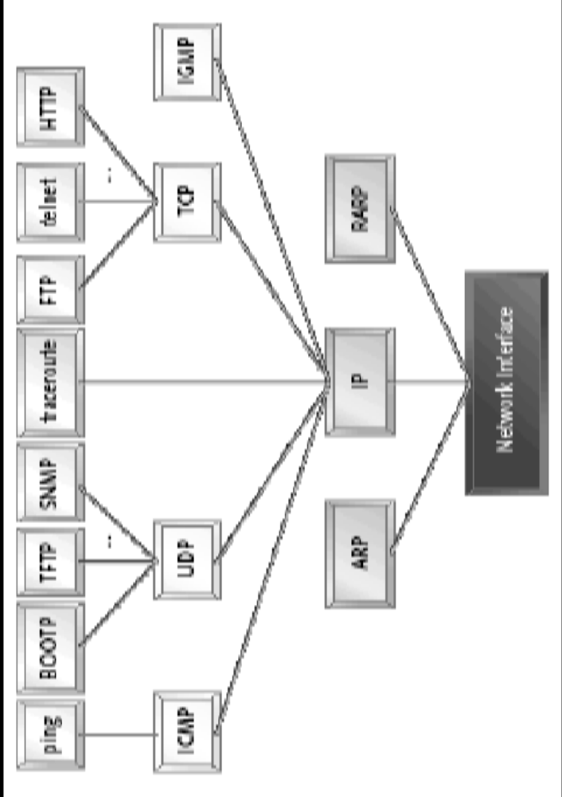
TCP/IP Layer Model

Slide 24
Protocol Layers:
The TCP/IP Hourglass Model
Application layer
SMTP
HTTP
FTP
Telnet
DNS
Audio
Video
TCP
UDP
RTP
Transport layer
IP
Network layer
Token Ring
Frame Relay
Ethernet
ATM
X.25
PPP
HDLC
Data link layer

Slide 25
Layer Interaction
Application, Presentation and Session protocols are end-to-end
Transport protocol is end-to-end
  encapsulation/decapsulation over network protocol on end systems
Network protocol is throughout the internetwork
  encapsulation/decapsulation over data link protocol at each hop
Link and physical layers may be different on each hop

Slide 26
Layer Interaction:
OSI 7-Layer Model
Application
Application
End to end
Presentation
Presentation
Session
Session
Transport
Transport
Network
Network
Network
Network
Hop by hop
Link
Link
Link
Link
Link
Link
Physical
Physical
Physical
Host
Router
Router
Host

Slide 27
Layer Interaction:
TCP/IP Model
No session or presentation layers in TCP/IP model
End to end
Application
Application
TCP or UDP
TCP or UDP
IP
IP
IP
IP
Hop by hop
Link
Link
Link
Link
Link
Link
Physical
Physical
Physical
Host
Router
Router
Host

Slide 28
Encapsulation & Decapsulation
Lower layers add headers (and sometimes trailers) to data from higher layers
Application
Data
Transport
Header
Transport Layer Data
Network
Header
Network Layer Data
Network
Header
Header
Data
Data Link
Header
Link Layer Data
Trailer
Data Link
Header
Header
Header
Data
Trailer

Slide 29
Frame, Datagram, Segment, Packet
Different names for packets at different layers
  Ethernet (link layer) frame
  IP (network layer) datagram
  TCP (transport layer) segment
Terminology is not strictly followed
  we often just use the term “packet” at any layer

Slide 30
Layer 2 - Ethernet frame
Destination and source are 48-bit MAC addresses
Type 0x0800 means that the data portion of the Ethernet frame contains an IP datagram. Type 0x0806 for ARP.
Preamble
Dest
Source
Length
Type
Data
CRC
6 bytes
6 bytes
2 bytes
2 bytes
46 to 1500 bytes
4 bytes

Slide 31
Layer 3 - IP datagram
Version
IHL
Type of Service
Total Length
Version = 4
If no options, IHL = 5
Source and Destination are 32-bit IP addresses
Protocol = 6 means data portion contains a TCP segment. Protocol = 17 means UDP.
Identification
Flags
Fragment Offset
Time to Live
Protocol
Header Checksum
Source Address
Destination Address
Options
Padding
Data

Slide 32
Layer 4 - TCP segment
Source Port
Destination Port
Sequence Number
Acknowledgement Number
Data Offset
Reserved
URG
ACK
EOL
RST
SYN
FIN
Window
Checksum
Urgent Pointer
Options
Padding
Data
Source and Destination are 16-bit TCP port numbers (IP addresses are implied by the IP header)
If no options, Data Offset = 5 (which means 20 octets)

Slide 33
Client Server Architecture
simple example layer 7 protocol: HTTP
Client makes requests, Server serves requests – e.g HTTP for transferring “websites”. This is the easiest way to provide services on demand and provides a means of sharing resources more effectively.
Example: Mimicking the browser with telnet (client) talking to a web server (server)
  telnet www.google.com 80
  GET / HTTP/1.1
  Host: www.google.com

Slide 34
IP Addressing

Slide 35
Purpose of an IP address
Unique Identification of
  Source
  Sometimes used for security or policy-based filtering of data
  Destination
  So the networks know where to send the data
Network Independent Format
  IP over anything

Slide 36
Purpose of an IP Address
Identifies a machine’s connection to a network
Physically moving a machine from one network to another requires changing the IP address
TCP/IP uses unique 32-bit addresses

Slide 37
Basic Structure of an IP Address
32 bit number (4 octet number):
(e.g. 133.27.162.125)
Decimal Representation:
133
27
162
125
Binary Representation:
10000101
00011011
10100010
01111101
Hexadecimal Representation:
85
1B
A2
7D

Slide 38
IP Address Allocation
Private IP address ranges:
  10/8 (10.0.0.0 – 10.255.255.255)
  192.168/16 (192.168.0.0 – 192.168.255.255)
  172.16/12 (172.16.0.0 – 172.31.255.255)
Public IP address space
  Assigned by an appropriate authority such as RIPE, ARIN, AFRINIC, etc. or Local Internet Registries (LIRs)
  Public Address space for the Africa Region available from AfriNIC
Choose a small block from whatever range you have, and subnet your networks (to avoid problems with broadcasts)

Slide 39
Addressing in Internetworks
The problem we have
  More than one physical network
  Different Locations
  Larger number of computers
Need structure in IP addresses
  network part identifies which network in the internetwork (e.g. the Internet)
  host part identifies host on that network

Slide 40
Address Structure Revisited
Hierarchical Division in IP Address:
  Network Part (Prefix)
    describes which physical network
  Host Part (Host Address)
    describes which host on that network
  Boundary can be anywhere
    very often NOT at a multiple of 8 bits
205 . 154 . 8
1
11001101 10011010 00001000 00000001
Network
Host

Slide 41
Network Masks
Network Masks help define which bits are used to describe the Network Part and which for hosts
Different Representations:
  decimal dot notation: 255.255.224.0
  binary: 11111111 11111111 11100000 00000000
  hexadecimal: 0xFFFFE000
  number of network bits: /19
Binary AND of 32 bit IP address with 32 bit netmask yields network part of address

Slide 42
Classless Addressing
IP address with the subnet mask defines the range of addresses in the block
  E.g 10.1.1.32/28 (subnet mask 255.255.255.240) defines the range 10.1.1.32 to 10.1.1.47
  10.1.1.32 is the network address
  10.1.1.47 is the broadcast address
  10.1.1.33 ->46 assignable addresses

Slide 43
Forwarding
Computers can only send packets directly to other computers on their subnet
If the destination computer is not on the same subnet, packets are sent via a “gateway”
defaultrouter option in /etc/rc.conf sets the default gateway for this system.
IP forwarding on a FreeBSD box
  turned on with the gateway_enable option in /etc/rc.conf otherwise the box will not forward packets from one interface to another.

Slide 44
How DNS fits
Computers use IP Addresses but Humans find names easier to remember
DNS provides a mapping of IP Addresses to names and vice versa
Computers may be moved between networks, in which case their IP address will change BUT their names can remain the same

Slide 45
Network Troubleshooting Tools
ping
traceroute
tcpdump

