Slide 1

FLIGHT PRICE PREDICTION PROJECT PRESENTATION
Submitted by:
Priyanka Saikia
Data Science Intern
Flip Robo Technologies

Slide 2
INTRODUCTION
Problem Statement
The airline industry is considered as one of the most sophisticated industry in using complex pricing strategies. Nowadays, ticket prices can vary dynamically and significantly for the same flight, even for nearby seats. Anyone who has booked a flight ticket knows how unexpectedly the prices vary. The cheapest available ticket on a given flight gets more and less expensive over time. This usually happens as an attempt to maximize revenue based on
1. Time of purchase patterns (making sure last-minute purchases are expensive)
2. Keeping the flight as full as they want it (raising prices on a flight which is filling up in order to reduce sales and hold back inventory for those expensive last-minute expensive purchases)

Slide 3
PROJECT PHASES :
This project is done in three phases:
- Data Collection
- Data Analysis
- Model Building
I created two different Jupyter Notebook files to performed the required actions.
As per the requirement of client, I have scrapped the data from online sites and based on that data I have performed analysis like based on which feature of my data does flight prices change and checked the relationship of flight prices with all the other features to get a gist on what flight a passenger should choose.

Slide 4
MODEL BUILDING PHASE
After collecting the data, you need to build a machine learning model. Before model building do all data pre-processing steps. Try different models with different hyper parameters and select the best model. Follow the complete life cycle of data science. Include all the steps mentioned below:
Data Cleaning
Exploratory Data Analysis and Visualization
Data Pre-processing
Model Building
Model Evaluation
Selecting the Best model

Slide 5
PROJECT LIFE CYCLE
Data Cleaning
Import the collected data from web scraping
Exploratory Data Analysis
Check through all the dataset information like datatype, missing value, duplicate value etc.
Visualization and Data Preprocessing
Use various visualization methods to check the data distribution identify presence of outliers and skewness
Clean and format the records as per usage by using various imputation techniques
Analyze each and every data record to ensure we have usable information
Perform encoding and scaling methods
Model Building
Create appropriate Regression Machine Learning model function
Model Evaluation
Usage of evaluation metrics to check the accuracy of the models over trained and test data inputs
Hyperparameter Tuning Best Model
Choosing the appropriate Regression Machine Learning model to check various parameter permutation and combinations
Need to ensure that whenever the regression function is called it is able to process all the necessary parameters
Ensure the cross validation techniques helps in reducing over fitting and under fitting data
Using Grid Search CV to obtain the best parameters that can be plugged into the selected model

Slide 6
DATA PREPROCESSING
Importing the necessary dependencies and libraries.
Reading the EXCEL file and loading into dataframe.
Checking the data dimensions for the original dataset.
Looking for null values and accordingly renaming the values.
Checking the summary of the dataset.
Checking unique values.
Checking all the categorical columns in the dataset.
Ensuring that the values are good to use and discarding junk data..
Visualizing each features using matplotlib and seaborn.
Performing encoding using the ordinal encoder on categorical features.
Checking for co-relation/multi-collinearity in a heatmap.
Checking for Outliers/Skewness using distribution plot.
Checking for the final dimension of dataset to confirm the input details.
Creating train test split and the best random state found in the range 1-1000.

Slide 7
TECHNOLOGY USED
Hardware technology used-
RAM: 8 GB
CPU: AMD A8 Quad Core 2.2 Ghz
GPU: AMD Redon R5 Graphics
Software technology used-
Programming language : Python
Distribution : Anaconda Navigator
Browser based language shell : Jupyter Notebook
Libraries/Packages specifically being used.
Pandas, NumPy, matplotlib, seaborn, scikit-learn

Slide 8
EXPLORATORY DATA ANALYSIS (EDA) AND VISUALIZATION
01. Univariate Analysis
02. Multivariate Analysis
03. Correlation of Dataset
Univariate analysis is the simplest form of analyzing data. “Uni” means “one”, so in other words your data has only one variable.
Multivariate analysis is a set of statistical techniques used for analysis of data that contain more than one variable.
Correlation is used to test relationships between quantitative variables or categorical variables.
04. Correlation with Target variable
05. Conclusion
Correlation with the target variable to know how the data is related.
Summary with the conclusion of all the analysis

Slide 9
EXPLORATORY DATA ANALYSIS (EDA)
First I have imported the necessary libraries and loaded the entire dataset in our Jupyter Notebook and renamed the project file.
Then I checked the shape of our dataset and found that we have a total of 3365 rows and 10 different columns.
We don’t have any null values or missing values present in our dataset from the web scraping.
By checking the data types I came to know that our data set consists of columns having only object datatype even those there were numeric information present.

Slide 10
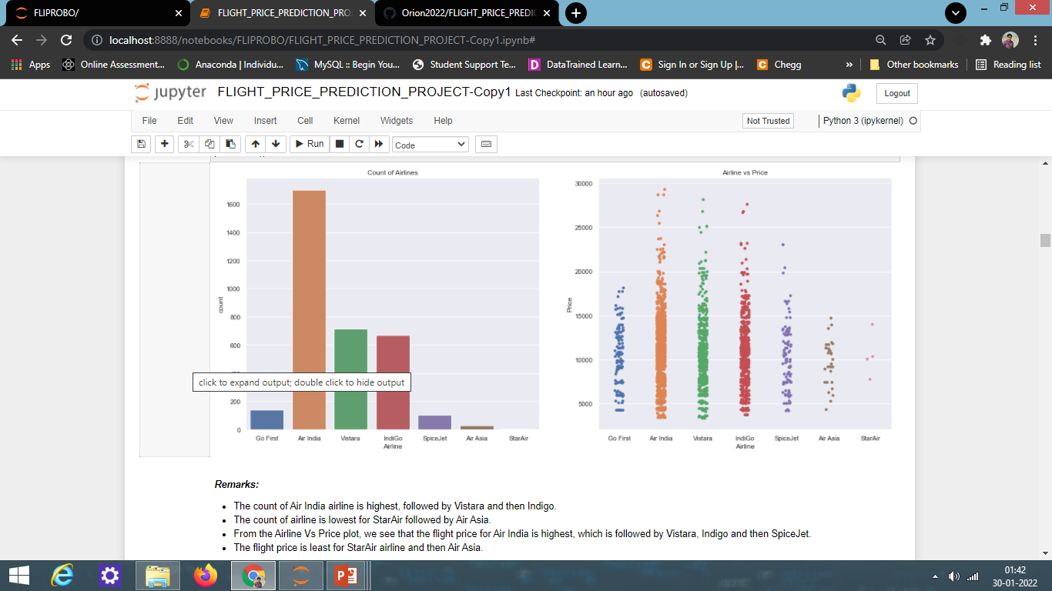
COUNT PLOTS
Observations:
The count of Air India airline is highest, followed by Vistara and then Indigo.
The count of airline is lowest for StarAir followed by Air Asia.
From the Airline Vs Price plot, we see that the flight price for Air India is highest, which is followed by Vistara, Indigo and then SpiceJet.
The flight price is least for StarAir airline and then Air Asia.

Slide 11
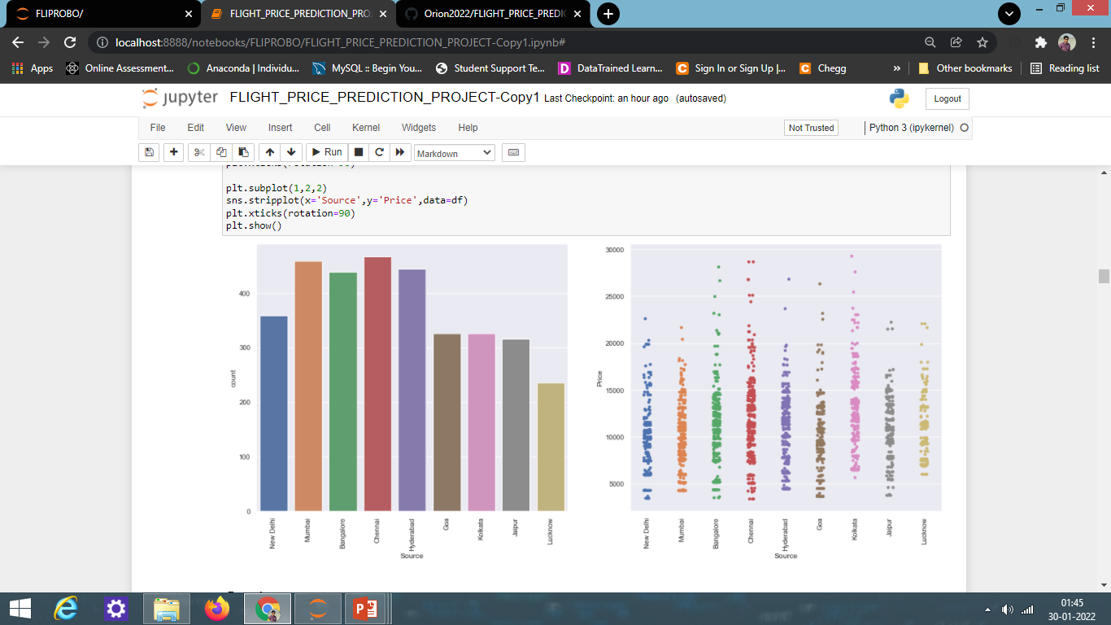
COUNT PLOTS
Observations:
Majority of flights travel from source Chennai which is followed by Mumbai, Hyderabad and then Bangalore.
Other locations from which people like to fly are New Delhi, Goa, Kolkata and Jaipur.
From the count plot, it seems that less people fly from Lucknow.
From the source vs price plot, we can see that flight price is the highest from Kolkata, which is followed by Chennai, Bangalore, and then Hyderabad.
The flight prices from New Delhi, Lucknow and Jaipur is almost similar.
The least flight price is from Chennai, Bangalore ,Delhi, Goa and Jaipur.

Slide 12
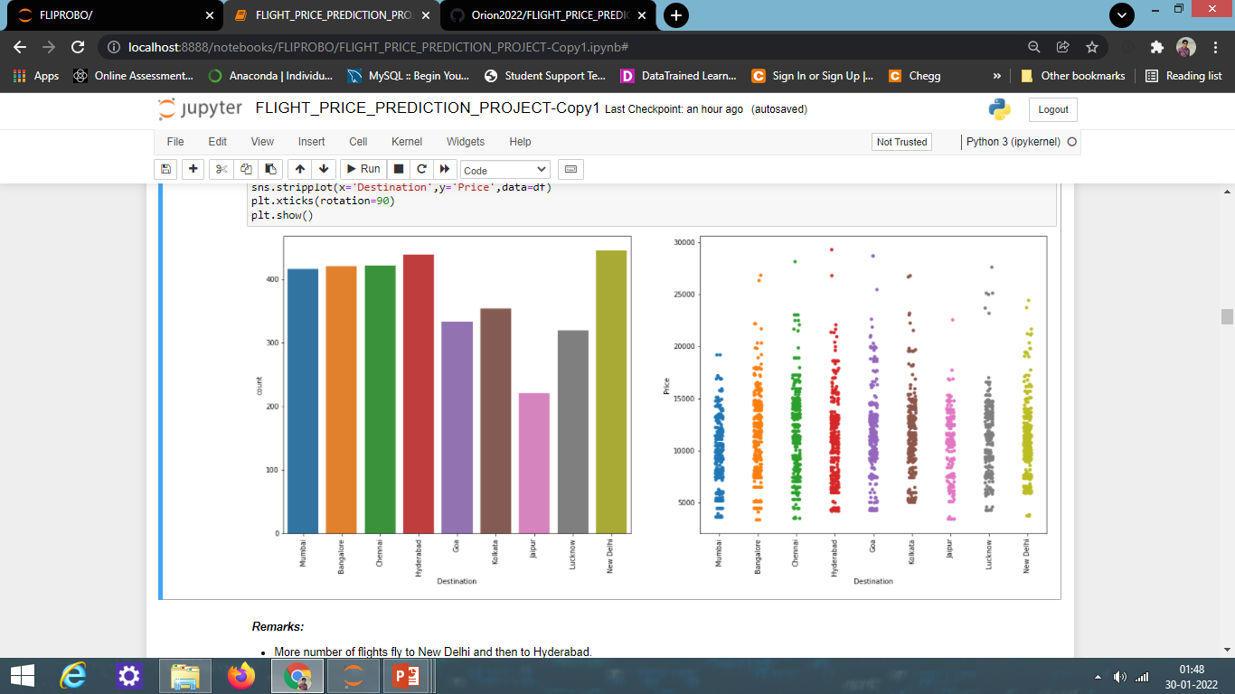
COUNT PLOTS
Observations:
More number of flights fly to New Delhi and then to Hyderabad.
The number of flights to Bangalore, Chennai and Mumbai is almost similar.
The number of flights flying to Jaipur is lowest as compared to the other locations.
Flight price is highest to travel to Hyderabad, then to Goa, Chennai and Lucknow.
To travel to Bangalore and Kolkata, the flight price is similar.
Prices are low for flights flying to Mumbai, and Jaipur.

Slide 13
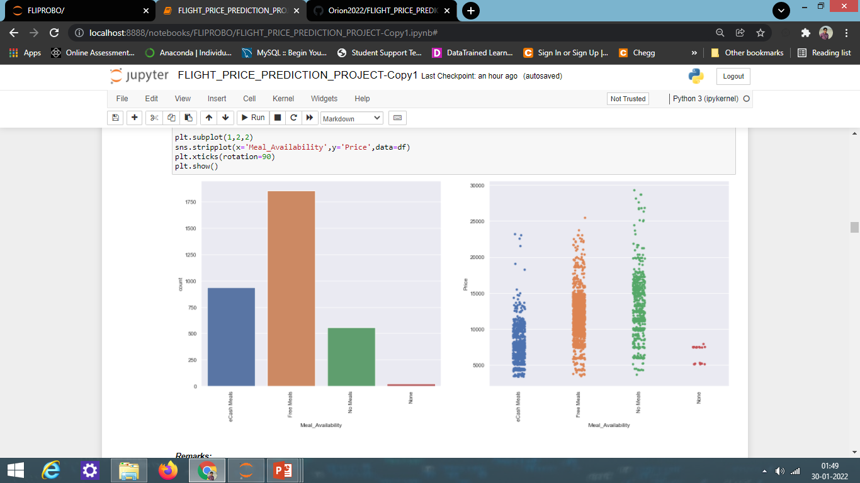
COUNT PLOTS
Observations:
From the above plot, we can see that more number of flights offering free meals which are probably for tickets that include those prices and meal services.
Next, we can see that flights are offering the eCash meals option that can be redeemed to purchase food during long journey flights, mostly with multiple stops.
Lastly, there are flights that are not offering any meals which may be because they are flying short distances and duration.
From the Meal_Availability vs Price plot, we can conclude that Flight prices is higher for flights offering no meals, which is followed by Flights offering free meals, and lastly flights offering eCash meals.

Slide 14
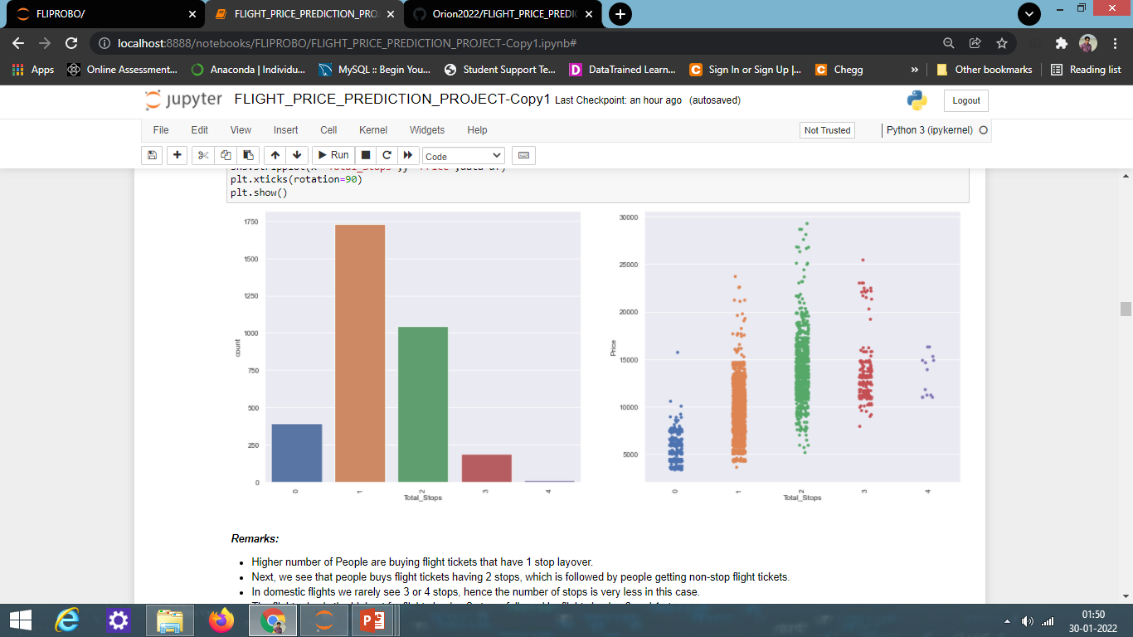
COUNT PLOTS
Observations:
Higher number of People are buying flight tickets that have 1 stop layover.
Next, we see that people buys flight tickets having 2 stops, which is followed by people getting non-stop flight tickets.
In domestic flights we rarely see 3 or 4 stops, hence the number of stops is very less in this case.
The flight price is the highest for flights having 2 stops, followed by flights having 3 and 1 stops.
The Non-stop flights tickets price is the least.

Slide 15
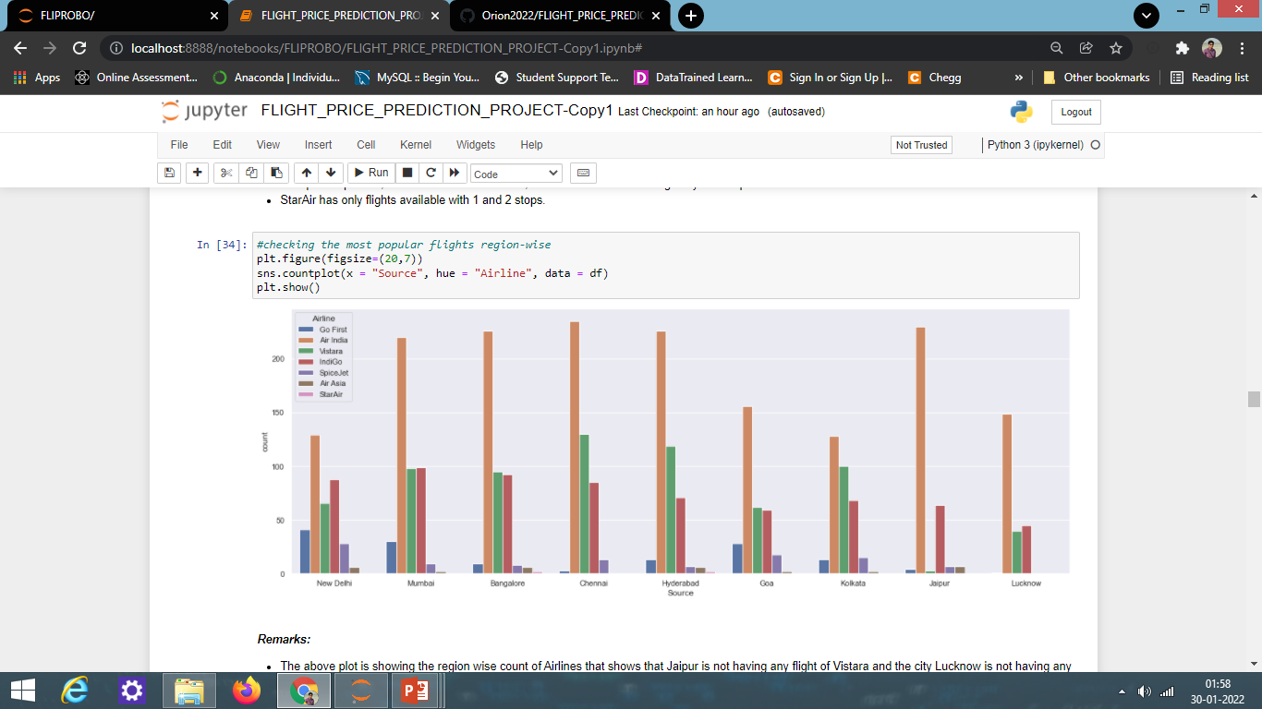
COUNT PLOT

Slide 16
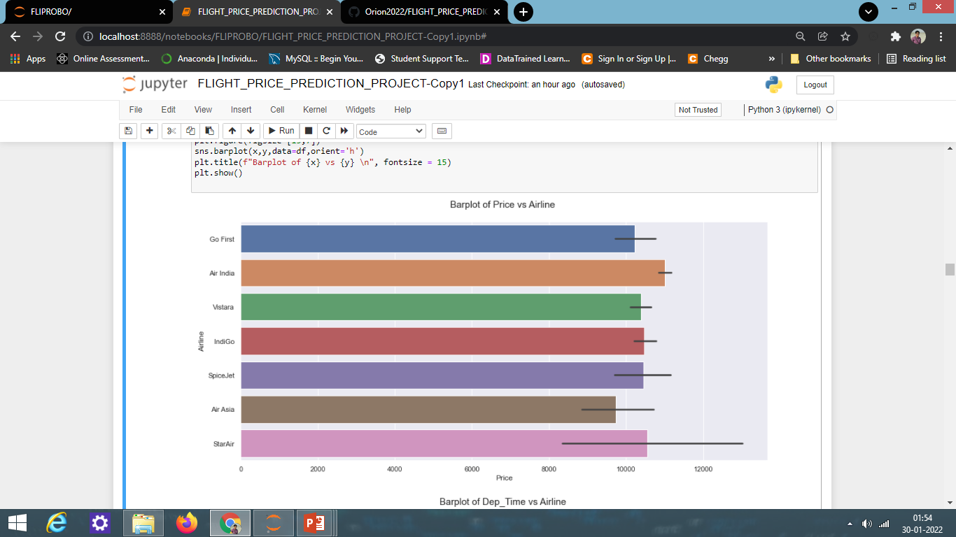
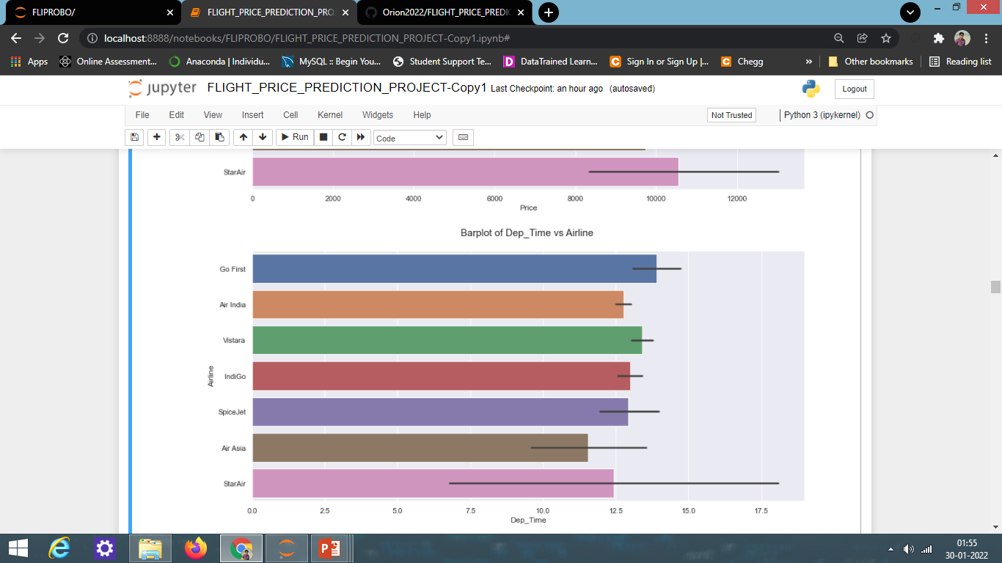
BAR PLOTS

Slide 17
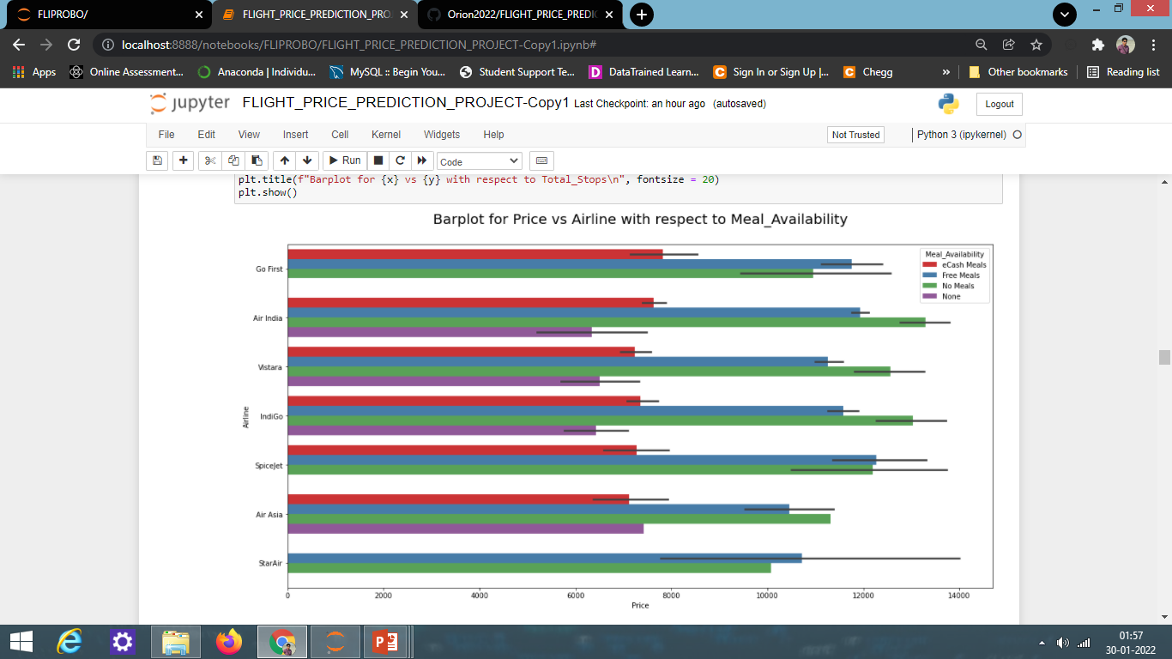
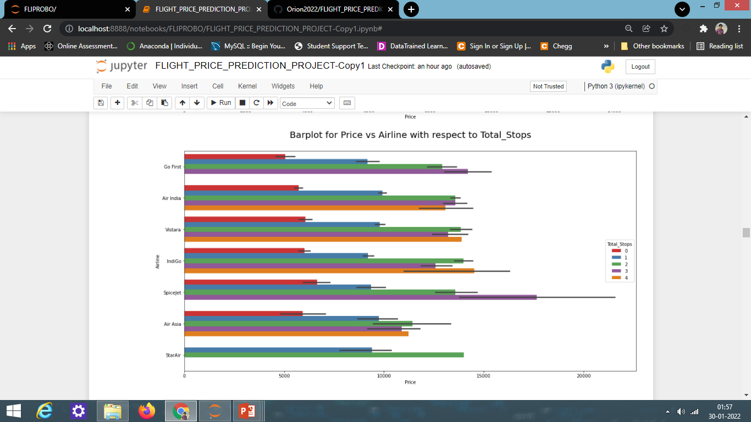
BAR PLOTS

Slide 18
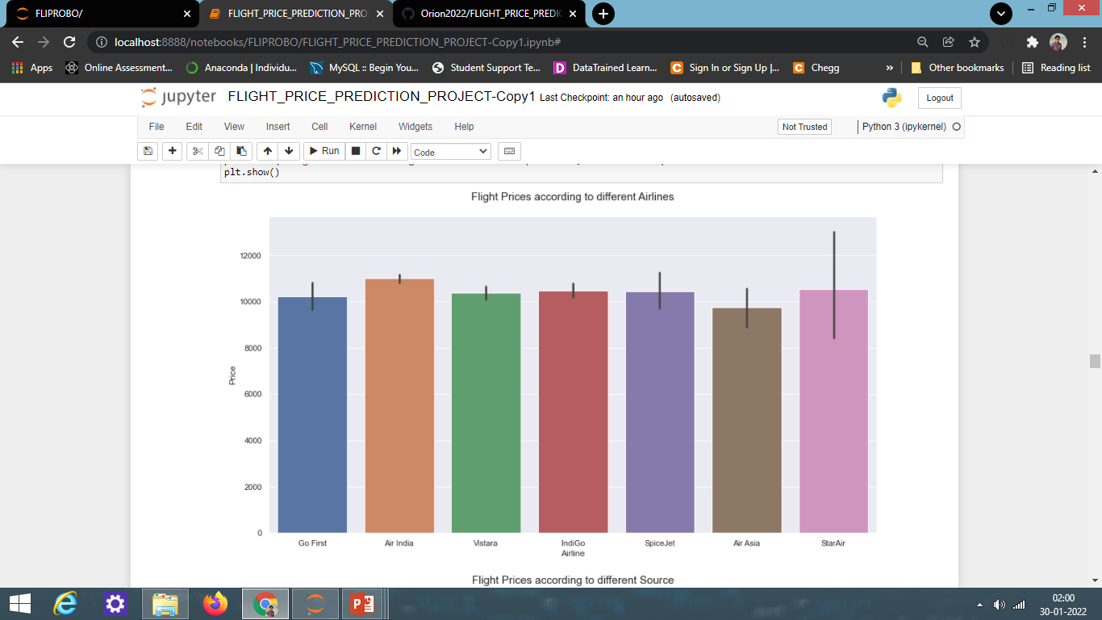
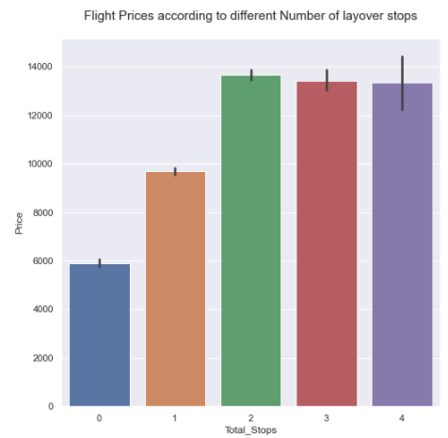
BAR PLOTS

Slide 19
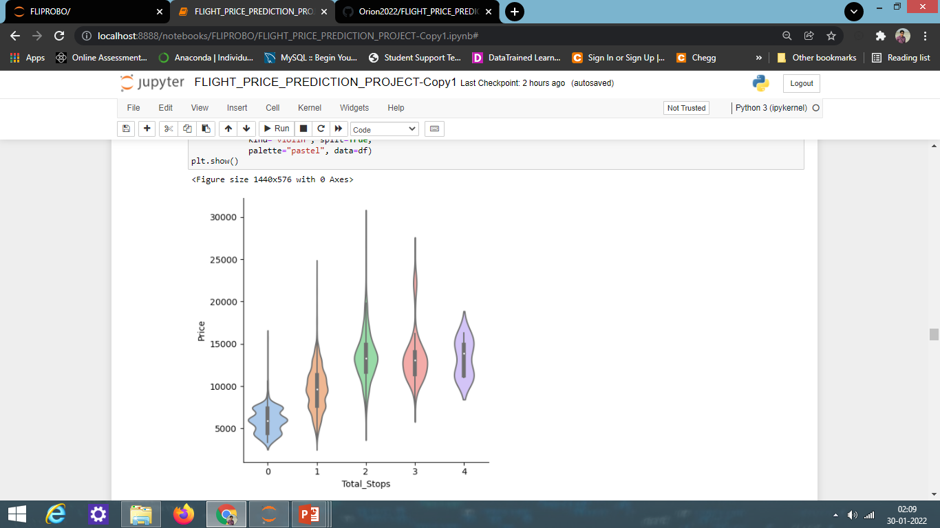
VIOLIN PLOT

Slide 20
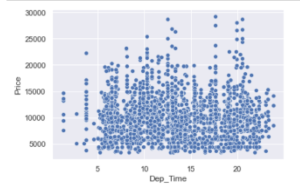
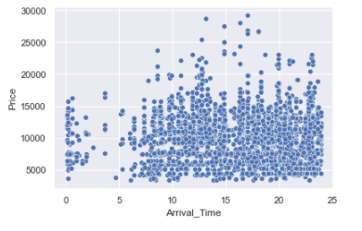
SCATTER PLOTS

Slide 21
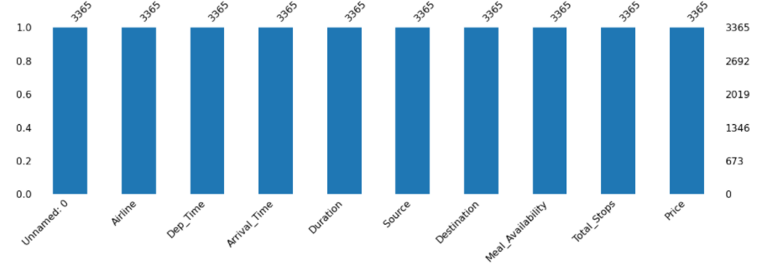
MISSING VALUES

Slide 22
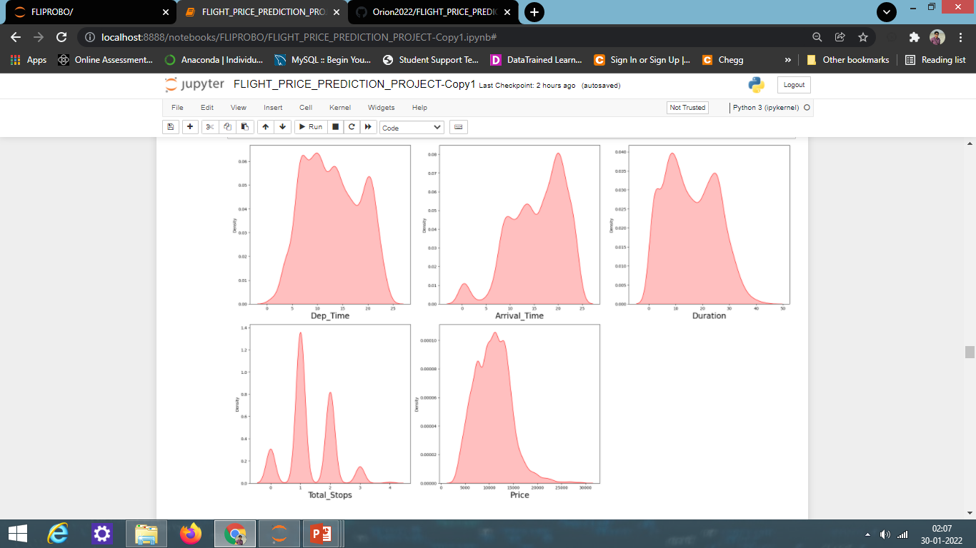
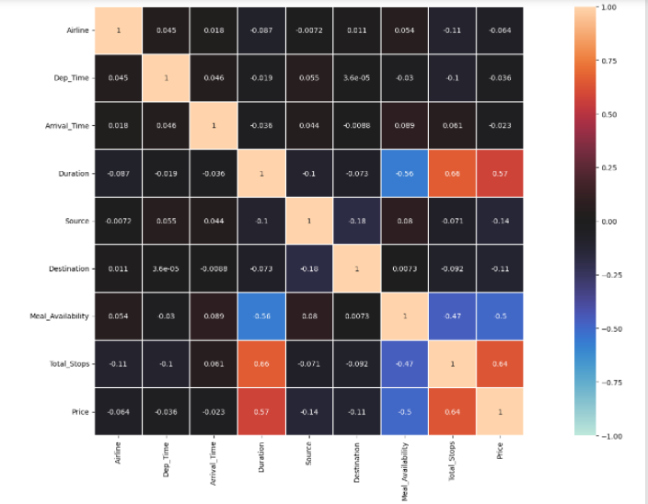
DISTRIBUTION PLOT AND HEATMAP

Slide 23
MODEL DEVELOPMENT ALGORITHMS
The complete list of algorithms that were used in training and testing the regression model are listed below:
▪ Linear Regression Model
▪ Ridge Regularization Model
▪ Lasso Regularization Model
▪ Decision Tree Regression Model
▪ Random Forest Regression Model
▪ Gradient Boosting Regression Model
▪ Ada Boost Regression Model
▪ Extra Trees Regression Model
XGB Regressor
LGBM Regressor

Slide 24
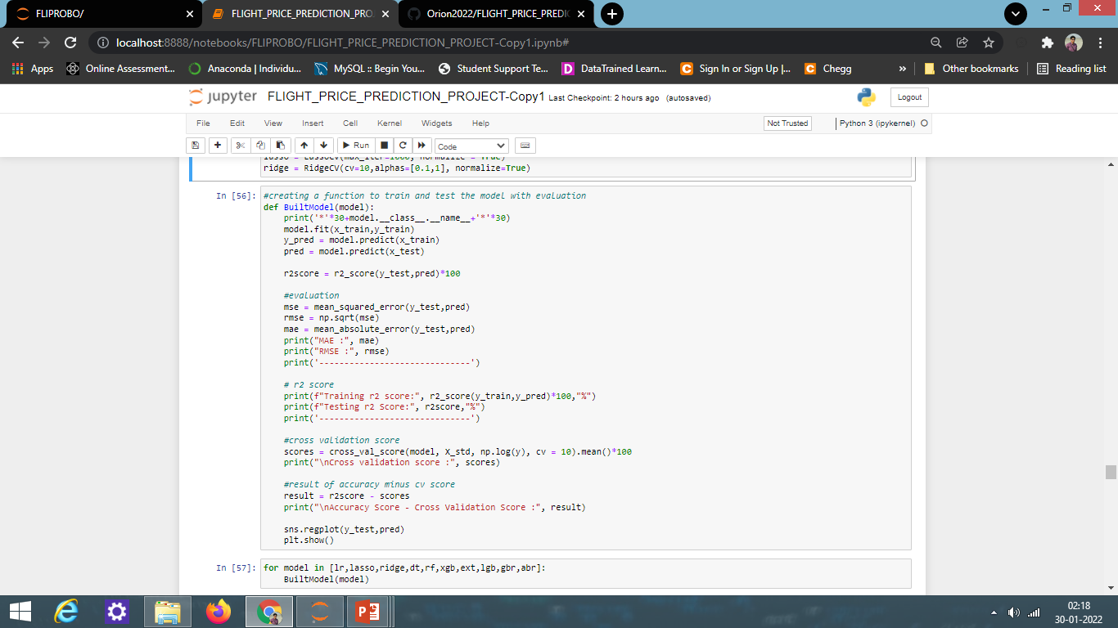
REGRESSION MODEL FUNCTION WITH EVALUATION METRICS

Slide 25
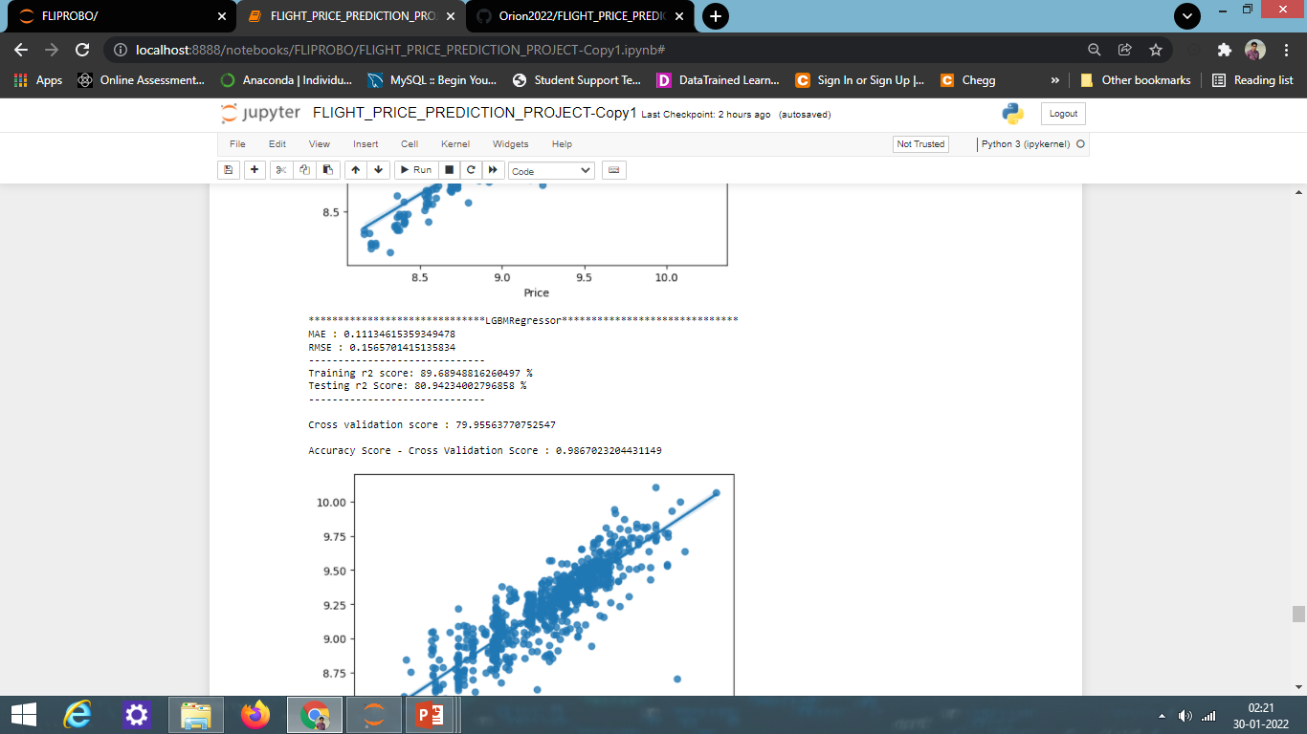
MODEL EVALUATION

Slide 26
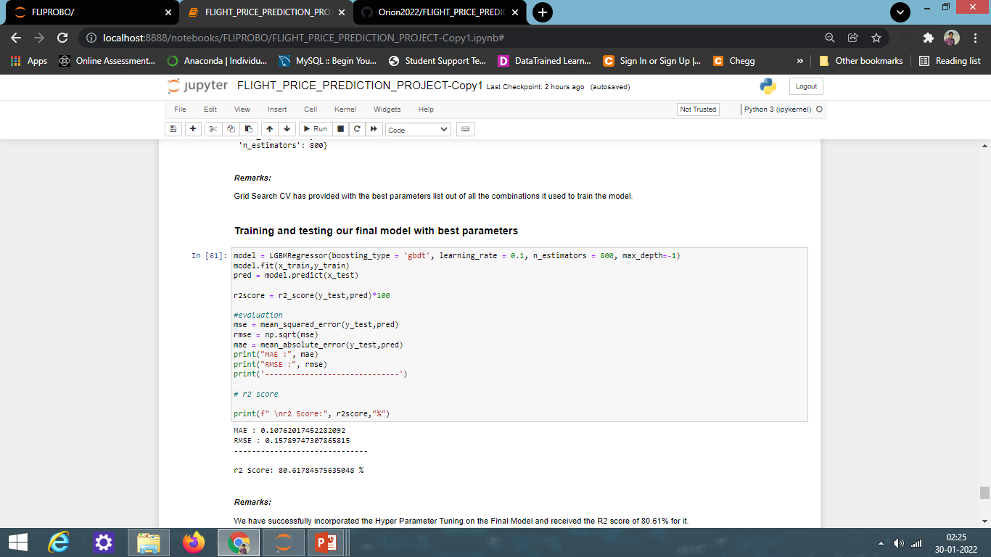
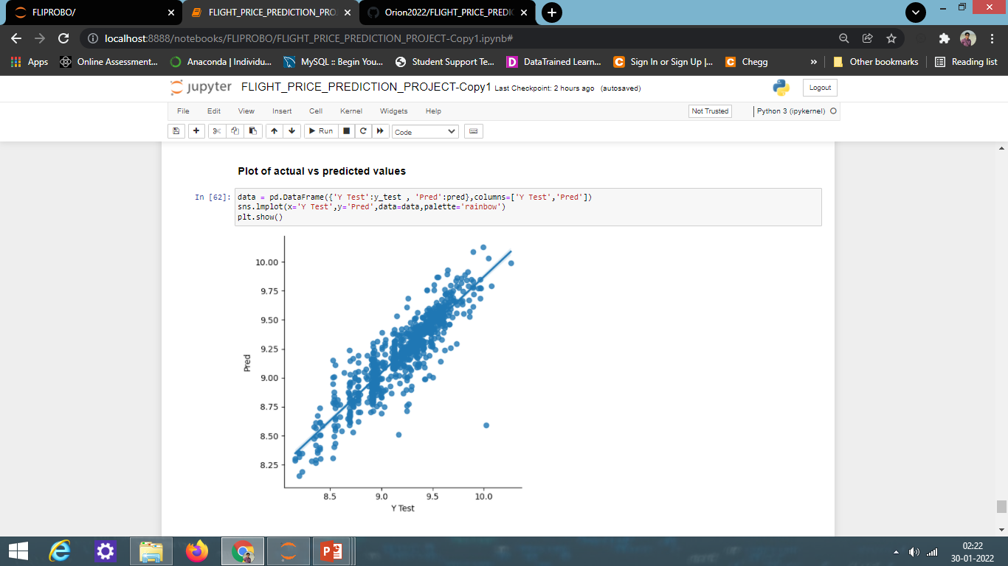
RESULT OF FINAL MODEL EVALUATION:

Slide 27
EVALUATION AND HYPER PARAMETER TUNING
The key metrics used in evaluation were:
R2 score
Cross Validation Score
MAE
MSE
RMSE
We tried to find out the best parameters list to increase our accuracy scores by using Hyperparameter Tuning. In order to achieve a higher score we used the Grid Search CV method with 5 folds.

Slide 28
Conclusion
Key Findings and Conclusions of the Study
From the model performance comparison, it is clear that LGBMRegressor performs well with R2 score of 80.61% and lowest difference between accuracy_score and cross_val_score, hence I selected LGBMRegressor as our final model.
In this project we have scraped the flight data from airline webpage “yatra.com”.
Features like flight duration, number of stops during the journey and the availability of meals are playing major role in predicting the prices of the flights.
It would help customers to predict future flight prices and plan the journey accordingly because it is difficult for airlines to maintain prices since it changes dynamically due to different conditions. Hence by using Machine Learning techniques we can solve this problem.
The above research will help our client to study the latest flight price market and with the help of the model built he can easily predict the price ranges of the flight, and also will helps him to understand based on what factors the fight price is decided.

Slide 29
CONCLUSION
Learning Outcomes of the Study in respect of Data Science
Visualization part helped to understand the data as it provides graphical representation of huge data.
It assisted to understand the feature importance, outliers or skewness detection and to compare the independent-dependent features.
Data cleaning is the most important part of model building and therefore before model building, I made sure the data is cleaned.
I have generated multiple regression machine learning models to get the best model wherein I found LGBMRegressor Model being the best based on the metrics I have used.
I ensured that at least I get a decent prediction confidence percentage.

Slide 30
CONCLUSION
Limitations of this work and Scope for Future Work
Some algorithms are facing over-fitting problem which may be because of lesser number of features in our dataset.
We can get a better r2 score by fetching some more features by web scraping which may help to reduce the over fitting problem in our models.
Limitation of the study is that in the volatile changing market we have taken the data, to be more precise we have taken the data at the time of pandemic and recent data, so when the pandemic ends the market correction might happen slowly.
Therefore based on that again the deciding factors of it may change and we have shortlisted and taken these data from the important cities across India.
If the customer is from the different country our model might fail to predict the accuracy price of that flight.

Slide 31
THANK YOU

