Slide 1


DEPARTMENT OF COMPUTER SCIENCE AND ENGINEERING
CGI1354 – BUILDING RAG BASED SOLUTIONS
END SEMESTER PRACTICAL EXAMINATION - APRIL/MAY - 2026
Batch No. : 08
Date : 08-05-2026
Session : FN

Slide 2
ACADEMIC RESEARCH ASSISTANT USING
VECTOR SEARCH AND RAG
Guide Name:
Mrs.S.Gayathri,M.E.,
Assistant Professor
Department of CSE
Team Members:
GODFREY T R (2303811710421047)
GRISH NARAYANAN S (2303811710421048)
HARI PRAKASH A (2303811710421049)

Slide 3
INTRODUCTION
1. ScholarAI (Advanced Research Assistant System) is a production-grade RAG platform for academic and institutional research.
2. It bridges the gap between static PDF document libraries and interactive, AI-powered queryable ecosystems.
3. The system utilizes a modular, microservices-oriented architecture for independent scaling of ML engines and UI.
4. It leverages advanced technologies like FastAPI, React, ChromaDB, and high-performance LLMs (Groq and Gemini).

Slide 4
OBJECTIVE OF THE PROJECT
1. Transform academic literature processing, analysis, and synthesis for researchers and institutions.
2. Integrate state-of-the-art LLMs with high-performance vector search for dynamic knowledge discovery.
3. Reduce hallucination risks in AI responses by grounding insights in specific, verifiable document libraries.
4. Centralize institutional knowledge to enable cross-departmental discovery and preserve research continuity.

Slide 5
EXISTING SYSTEM
1. Traditional keyword-based search engines (e.g., Google Scholar) fail to bridge terminological divergence in research papers.
2. Static document management requires manual reading and extraction of methodologies from lengthy, complex PDFs.
3. Information retrieval is often limited to exact keyword matches, frequently missing semantically identical concepts.
4. Insights remain "trapped" in individual documents with no efficient mechanism for performing cross-document synthesis.

Slide 6
PROBLEM IDENTIFICAITON
1. Information Overload: The volume of academic literature doubles every few years, making manual currency maintenance impossible.
2. Semantic Retrieval Gap: Keyword-based engines fail to connect related terms like "Deep Learning" and "Neural Networks."
3. High Cognitive Burden: Extracting key methodologies and findings from 30+ page papers consumes excessive researcher time.
4. Knowledge Fragmentation: Inability to identify connections, contradictions, and trajectories across disparate academic publications.

Slide 7
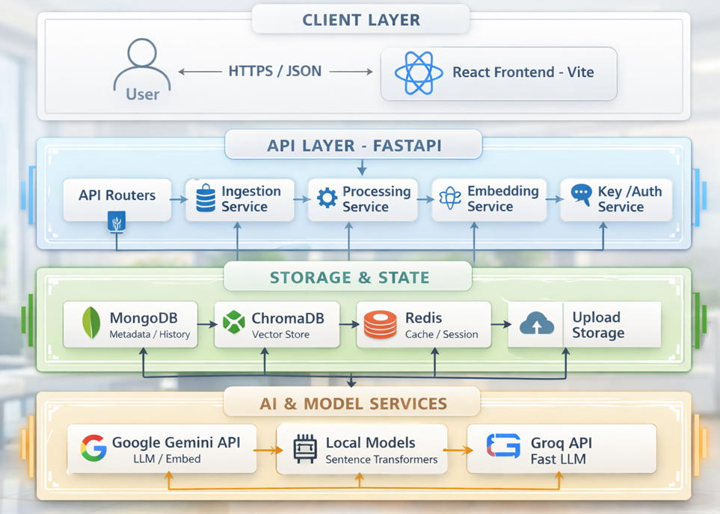
PROPOSED SYSTEM ARCHITECTURE

Slide 8
SOFTWARE AND HARDWARE REQUIREMENTS
Hardware | Software
1. Processor: Intel i5 or higher | 1. Frontend: React 19, TypeScript, Tailwind CSS
2. RAM: Minimum 8 GB | 2. Backend: FastAPI, Python, MongoDB
3. Storage: 256 GB SSD or higher | 3. AI Models: Gemini, GPT-4, Claude, Llama 3.1
4. Camera: High-resolution digital camera / smartphone | 4. Deployment: Nginx, Docker, Netlify
5. Internet: Stable connection for data transfer | 5. IDE: VS Code (Windows x64)

Slide 9
MODULES
Document Upload & Processing
Semantic Search Module
AI Analysis & Summarization
Chat & Conversational AI
Paper Comparison Module
Dashboard & Analytics

Slide 10
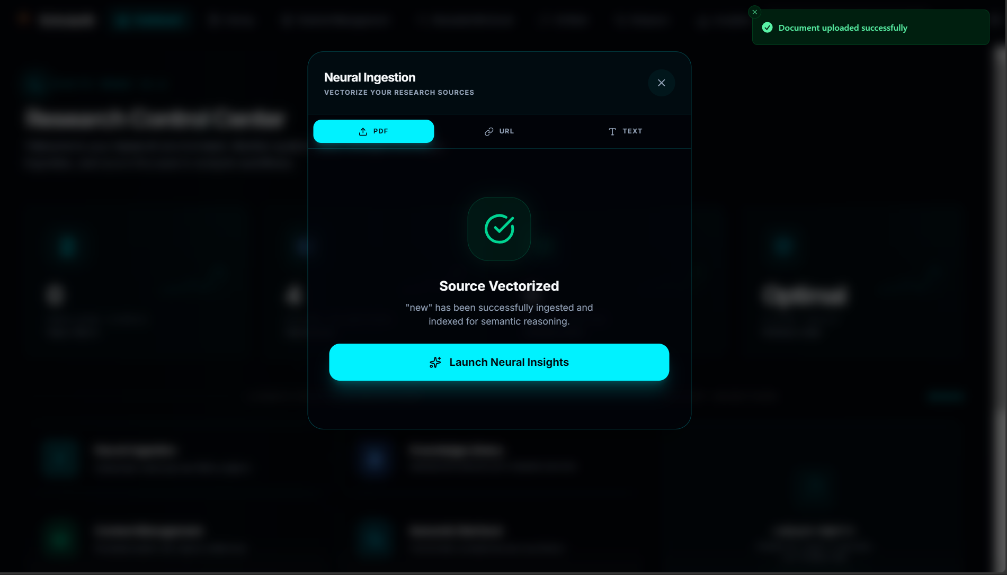
DOCUMENT UPLOAD & PROCESSING
The Document Management Module is responsible for handling the upload, storage, and organization of research papers.
Users can upload PDF documents, and the system stores them securely along with basic metadata such as title, authors, and publication details.
It also maintains user-specific libraries, allowing users to manage and access their research papers efficiently within a centralized platform.

Slide 11
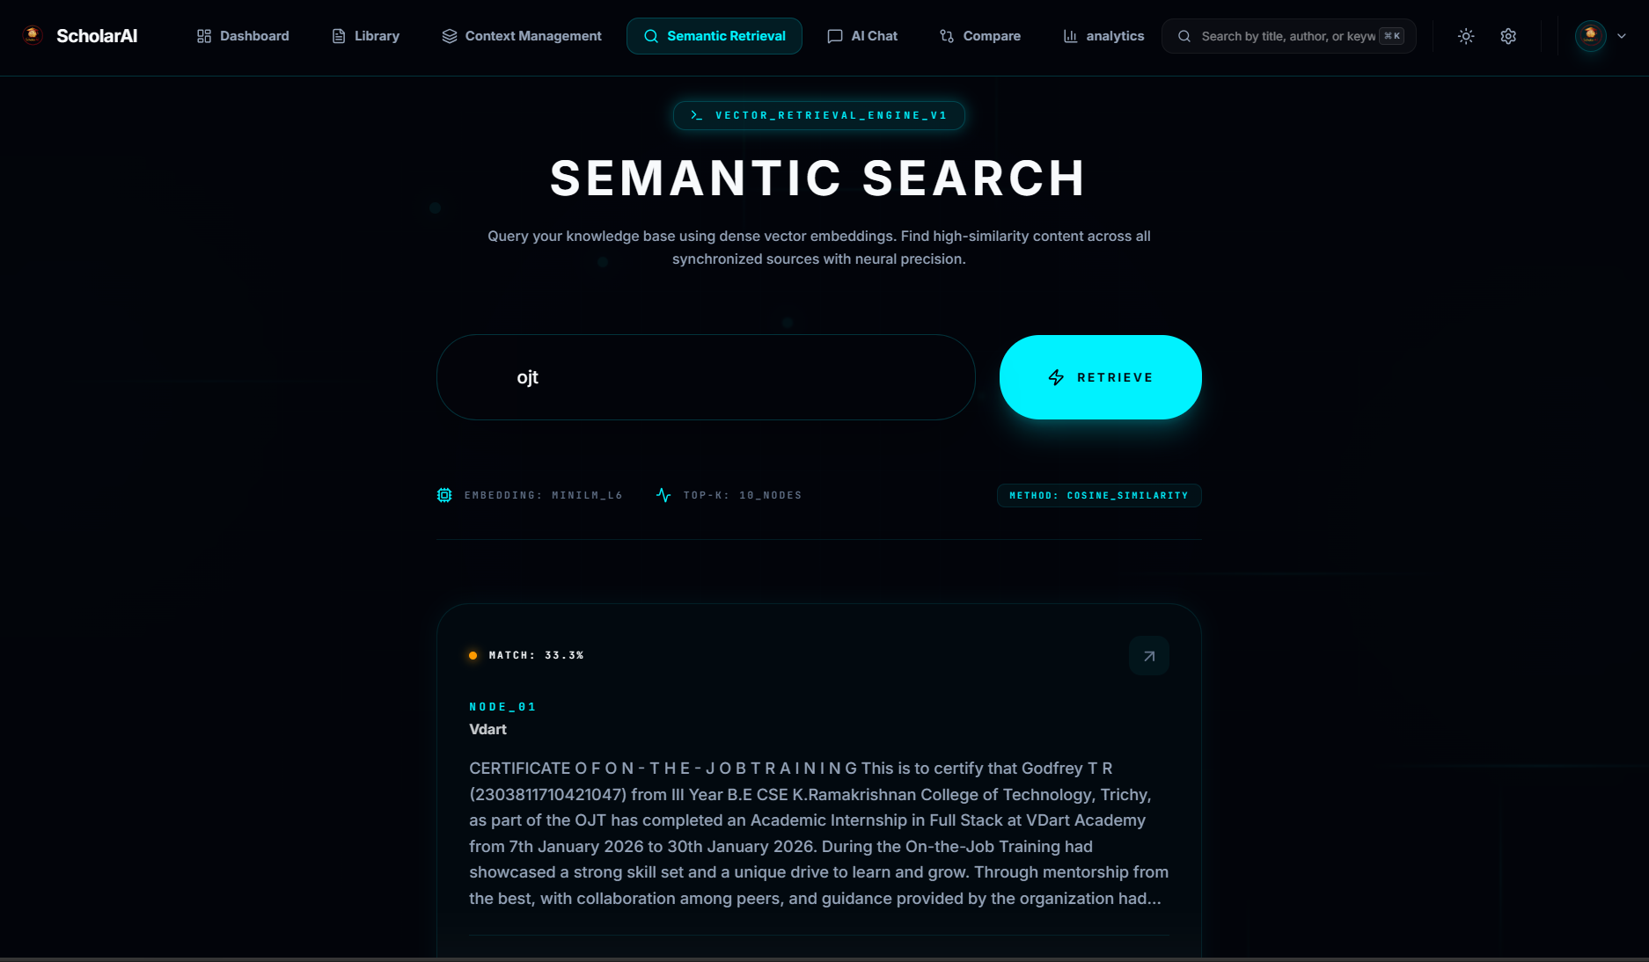
SEMANTIC SEARCH MODULE
Query embedding generation
Vector database search
Semantic similarity ranking
Relevant paper retrieval

Slide 12
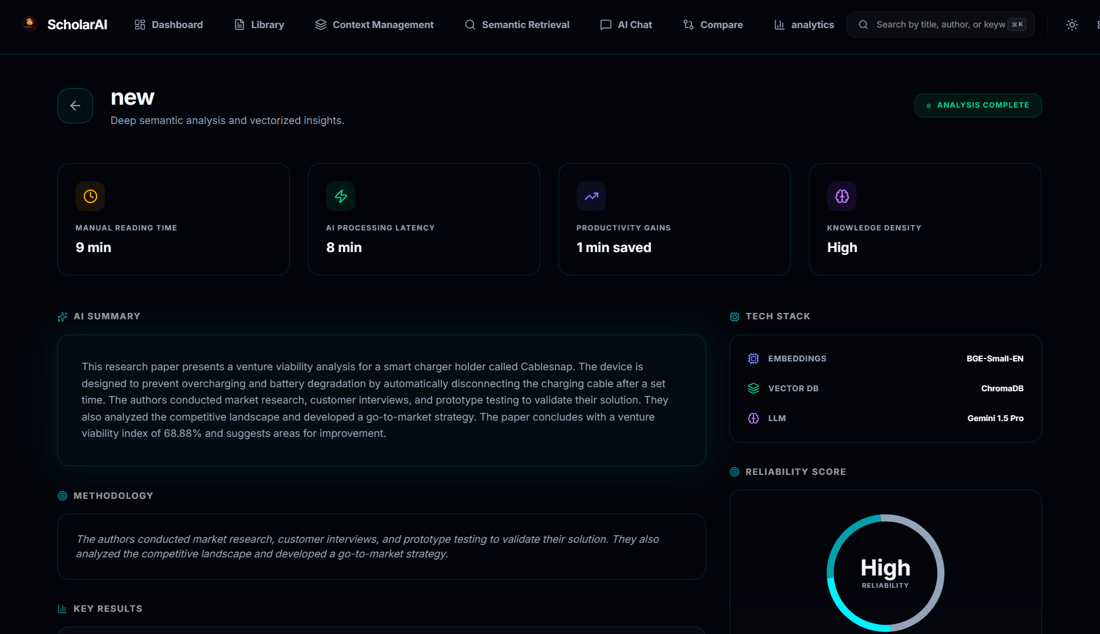
AI ANALYSIS & SUMMARIZATION
Automatic document summarization
Key concept extraction
Methodology identification
Research insights generation

Slide 13
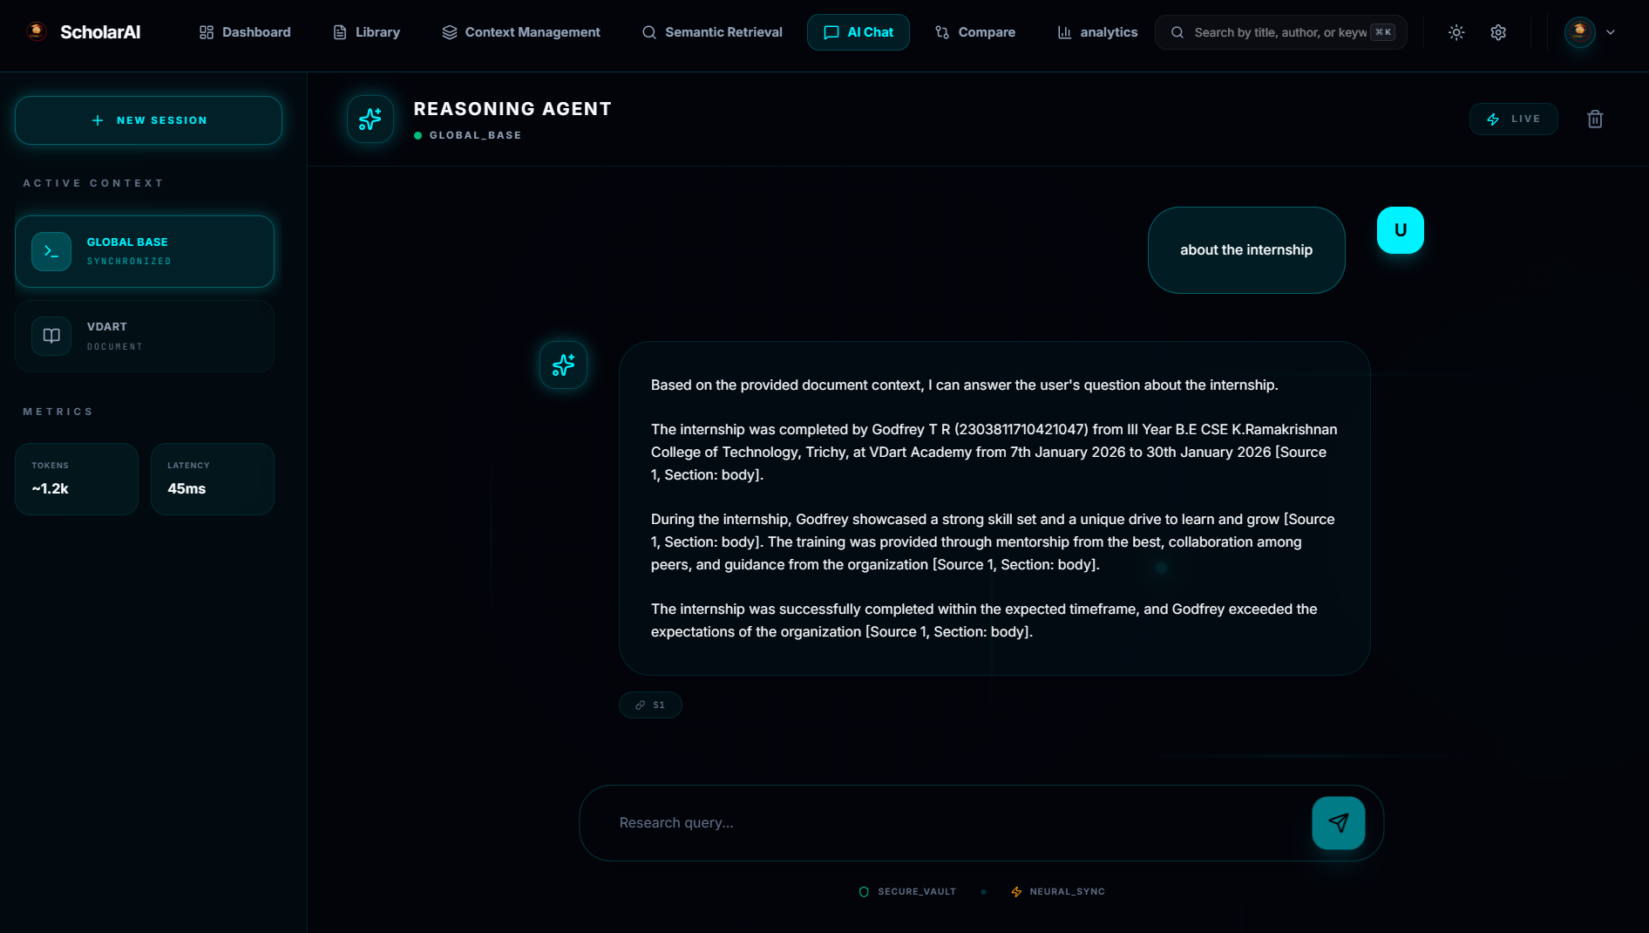
CHAT & CONVERSATIONAL AI
Context-based question answering
Relevant document retrieval
LLM-powered response generation
Citation-supported answers

Slide 14
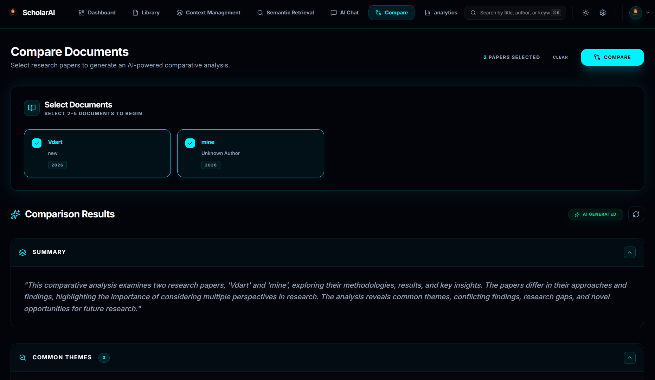
PAPER COMPARISON MODULE
Multi-document data extraction
Similarity and difference analysis
AI-based comparative insights
Structured comparison report generation

Slide 15
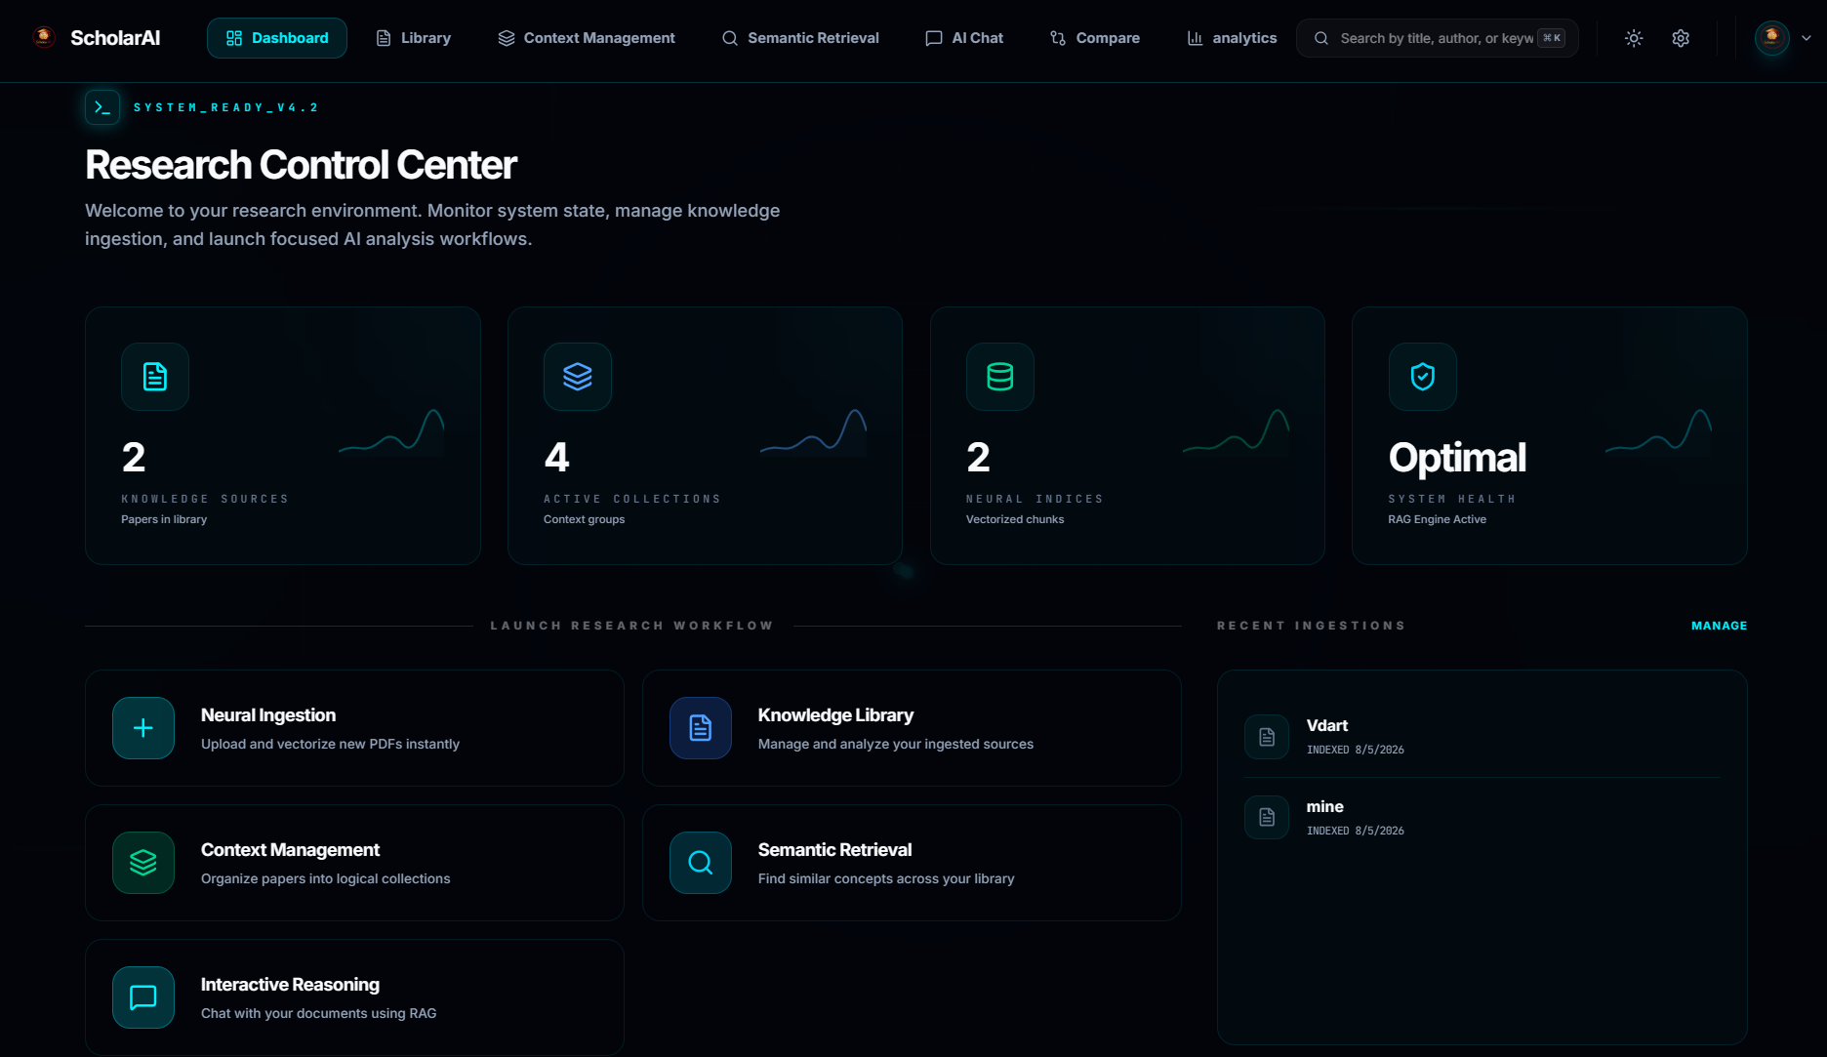
DASHBOARD & ANALYTICS
Research activity visualization
Document library management
Usage statistics tracking
Insights and history overview

Slide 16
CONCLUSION
1. ScholarAI successfully demonstrates the power of grounding LLMs in local libraries to drastically reduce research time.
2. The platform provides a robust, scalable architecture suitable for both individual scholars and large research institutions.
3. It effectively addresses the challenges of information overload and semantic discovery in modern academic literature.
4. By prioritizing data sovereignty and verifiable citations, it builds a trustworthy environment for AI-assisted synthesis.

Slide 17
FUTURE ENHANCEMENTS
1. Authentication & Persistent Storage: Transition from ephemeral sessions to JWT/OAuth-based persistent user accounts and team libraries.
2. Research Network Visualization: Implement concept graph visualizations like PowerBI dashbords to map citations and intellectual trajectories across papers.
3. Native Mobile Integration: Development of dedicated iOS and Android applications to enable field research accessibility.
4. Third-Party Integration: Automated synchronization with academic reference managers like Zotero, Mendeley, and external databases.

