Slide 1


CGB1221 DATABASE MANAGEMENT SYSTEMS PROJECT REVIEW
Department of Computer Science and Engineering
Academic Year: 2024 – 2025 (Even Semester)
Register Number : 2303811710421047
Name : GODFREY T R
Year : II
Semester : IV
Section : A
Date : 02/06/2025
Guided By : S.Uma Mageshwari.M.E.,

Slide 2
Title of the Project
HOSTEL MANAGEMENT SYSTEM

Slide 3
Abstract
The Hostel Management System is a desktop application built with Python's Tkinter and MySQL, designed to simplify and digitize hostel administration. It features role-based access for wardens and hostellers, enabling functions like attendance tracking, outpass requests, and user management.
Wardens can view attendance summaries, approve outpass requests, and filter hosteller data by various criteria. Hostellers can mark attendance, submit and track outpass requests, and review their attendance history.
The system ensures secure login and registration, supports real-time database operations, and promotes efficient communication between hostel staff and residents. With its user-friendly interface and modular design, this project offers a practical solution for managing hostels in academic institutions.

Slide 4
Introduction
The Hostel Management System is a desktop-based application designed to streamline and digitize the various processes involved in the administration of a student hostel.
This project leverages Python for its core functionality, utilizing the Tkinter library to build an interactive graphical user interface and MySQL to handle the backend database operations.
The system was developed to address the inefficiencies of traditional paper-based hostel management, offering a modern and intuitive platform for both students and wardens to manage daily hostel-related tasks.

Slide 5
Database - Concepts Used
SQL & MySQL used to manage hostel data (students, attendance, outpass).
Tables are normalized to reduce redundancy.Primary & Foreign Keys maintain data relationships.
DDL & DML used for creating and managing data (e.g., CREATE, INSERT, SELECT, UPDATE).
Joins used to fetch related data across tables.Security with parameterized queries and role-based access (student/warden).
Transactions ensure reliable data operations using ACID properties.

Slide 6
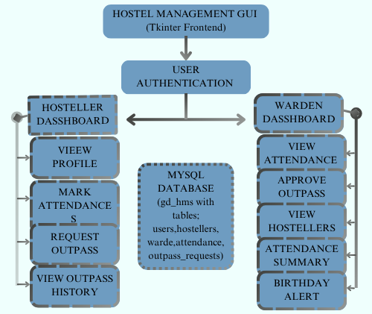
Proposed Architecture

Slide 7
Proposed Architecture - Description
The proposed Hostel Management System is a role-based software solution designed to digitize and streamline the administrative operations of a student hostel. Developed using Python's Tkinter library for the front-end and MySQL for the backend database, the system provides a user-friendly and efficient interface for managing hostellers, tracking attendance, and processing outpass requests.
Hostellers can register through a detailed form that captures personal, academic, and contact details. Once registered, they can log in to manage their attendance by marking themselves as present, absent, or on leave using an interactive calendar-based interface.

Slide 8
Proposed Architecture - Description (Cont..)
Wardens, on the other hand, have administrative privileges allowing them to view attendance records, approve or reject outpass requests, and access a filtered list of hostellers based on department, year, or hostel name. The system also features birthday alerts, notifying wardens of hostellers who have birthdays on the current day, adding a personalized touch to student management.
Overall, the system replaces traditional paper-based records with a centralized digital platform that enhances efficiency, accuracy, and accessibility. It minimizes manual effort, reduces the chances of errors, and improves communication between students and wardens.

Slide 9
List of Modules
USER LOGIN MODULE
STUDENT DASHBOARD MODULE
WARDEN DASHBOARD MODULE
OUTPASS APPROVAL MODULE
ATTENDANCE/CHECK-IN MODULE

Slide 10
Module Description
1. User Login Module: Allows secure login using username and password. Based on the role (warden or hosteller), it opens the appropriate dashboard. Users can register if they don’t have an account and switch between light/dark themes. Invalid logins show an error message.
2. Warden Dashboard Module: Displays a personalized greeting and calendar with events, holidays, and birthdays. Warden can access student attendance, manage outpass requests, and view/filter hosteller details. Key actions open in separate windows for better task management.
3. Outpass Approval Module: Integrated with the warden dashboard to handle student outpass requests. Shows a table with request details. Warden can approve/reject with remarks. Requests can be filtered and sorted, and decisions are updated in the database with student notifications.

Slide 11
Module Description (Cont..)
4. Student Dashboard Module: Provides hostellers with tools to manage personal info, mark attendance, request outpasses, and view request history. Offers a simple interface with logout option and keeps students informed through notifications.
5. Attendance/Check-In Module: Lets students mark daily attendance and view attendance records. Integrated with the student dashboard, it also supports outpass requests and shows request history with approval status and remarks. Notifications alert students about updates and announcements.

Slide 12
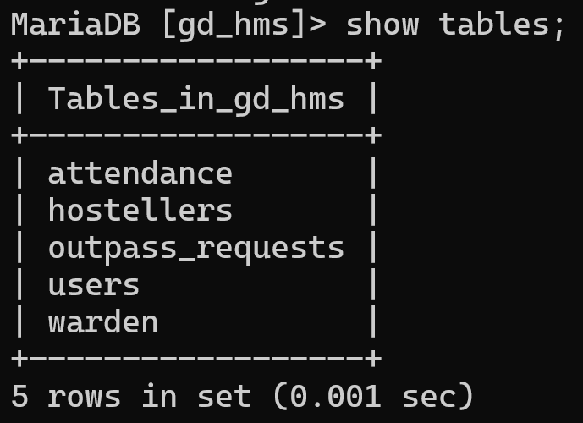
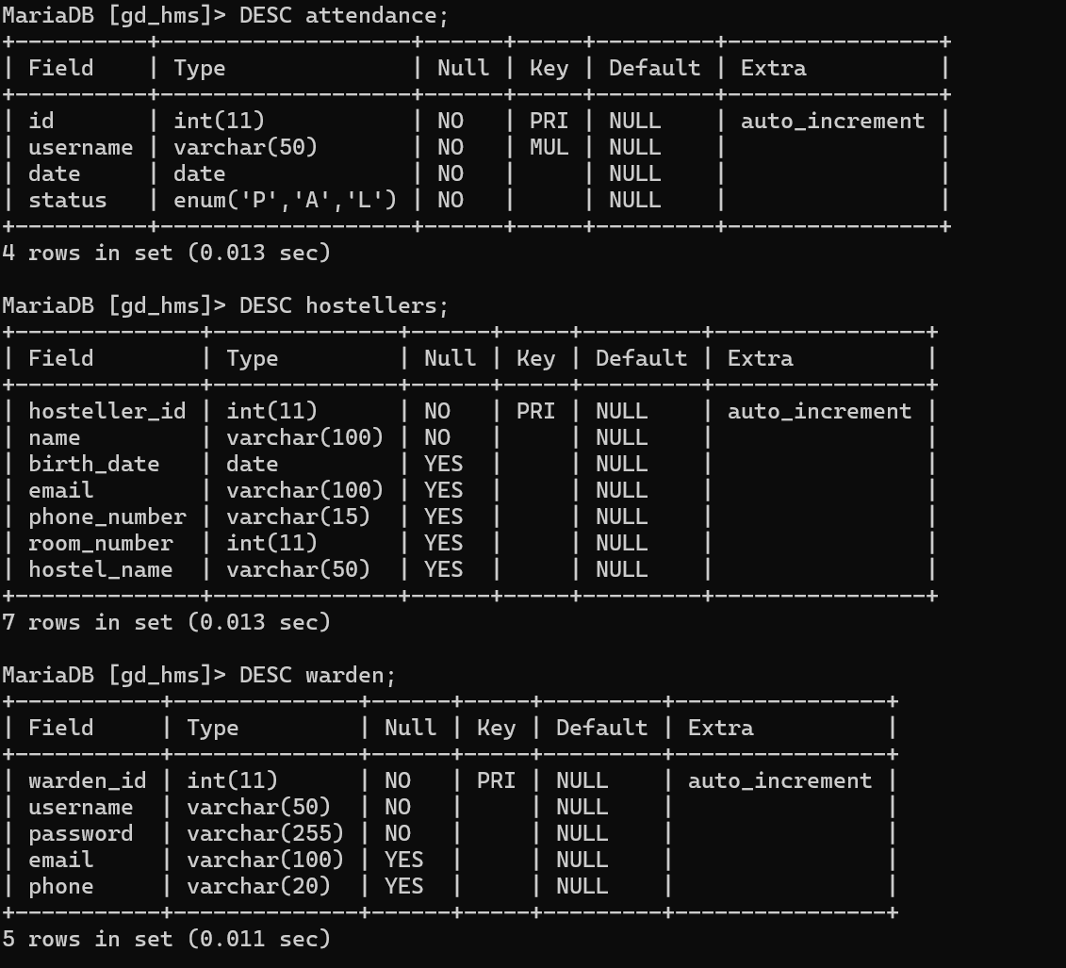
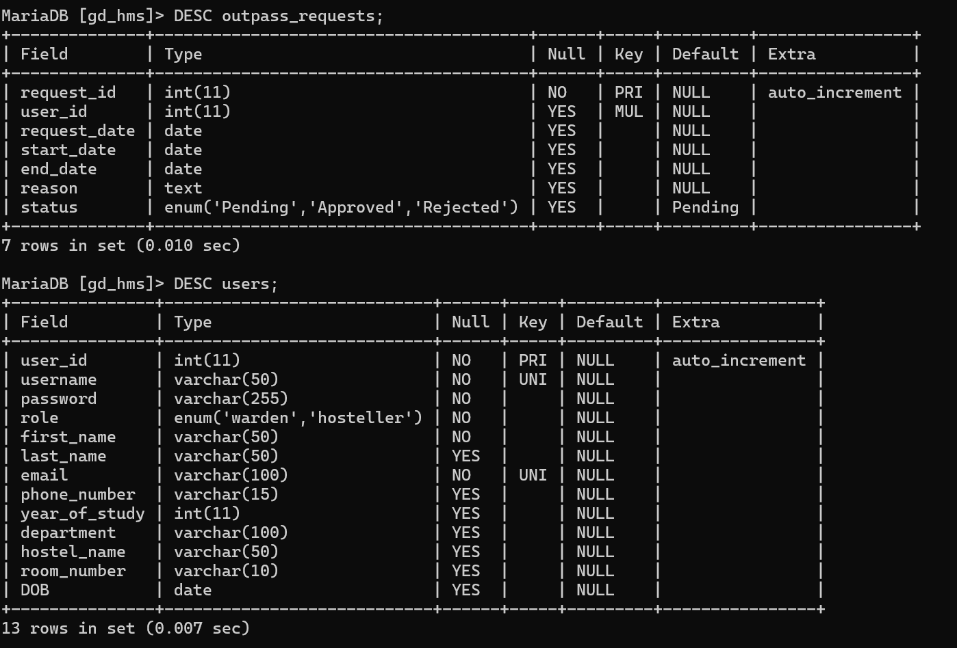
Results and Discussion

Slide 13
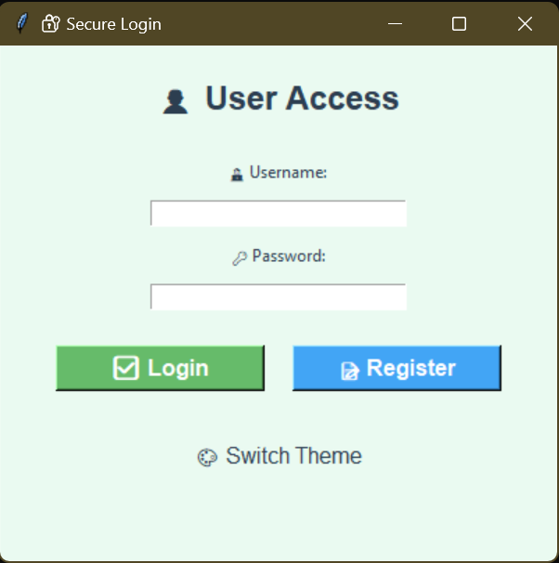
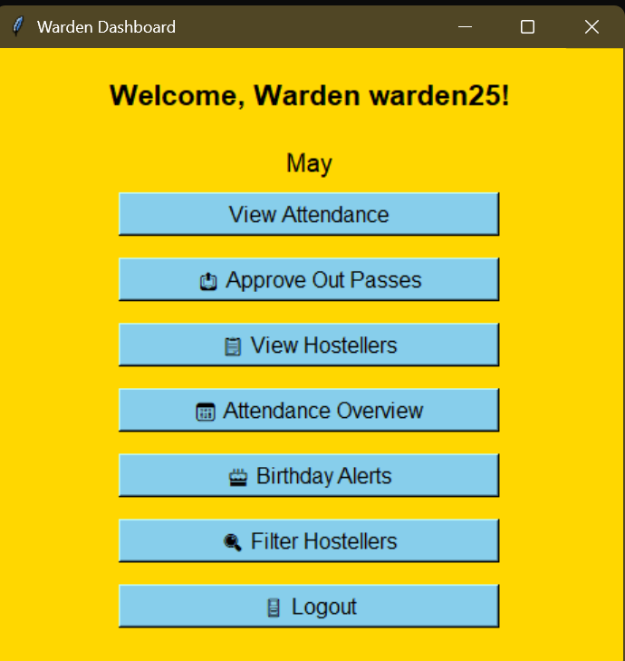
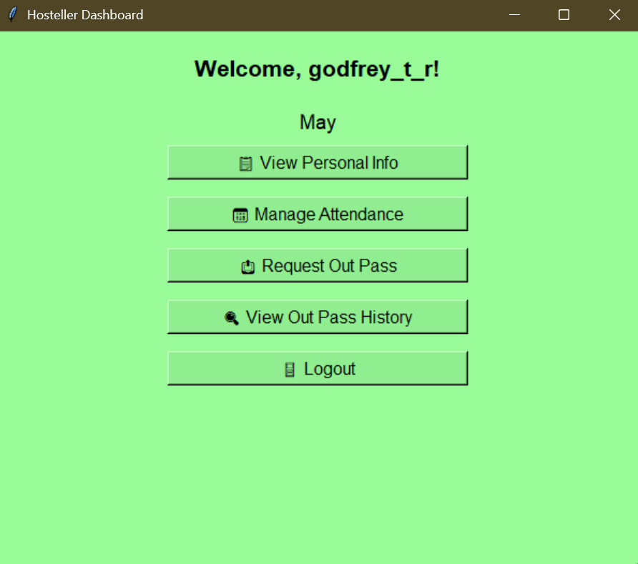
Results and Discussion (Cont..)

Slide 14
Conclusion
In this project, a hostel management system has been designed and developed with the aim of improving efficiency, reducing manual efforts, and providing a seamless experience for both wardens and students. The system incorporates key modules such as the user login module, warden dashboard, outpass approval system, student dashboard, and attendance management. Through these modules, the system ensures that the daily operations of hostel life, including attendance tracking and outpass management, are streamlined and automated.
The system has successfully addressed the primary challenges of hostel management by enabling real-time updates, easy access to records, and the ability to handle requests with efficiency. By using a simple yet effective user interface, the system facilitates smooth communication between wardens and students, and ensures that all operations are executed in a timely and organized manner.

Slide 15
Thank You
ANY QUERIES???

