Slide 1


K.RAMAKRISHNAN COLLEGE OF TECHNOLOGY (AUTONOMOUS), TRICHY.
SMART LMS: AI-Enhanced Learning Management System
GUIDED BY
Mrs. A. DHIVYA BHARATHI, M.E., (Ph.D.,)
PRESENTED BY
GIRIJESH R (2303811710421046)
GODFREY T R (2303811710421047)
GRISH NARAYANAN S(2303811710421048)
HARIHAR R (2303811710421051)

Slide 2
INTRODUCTION
Smart LMS is an adaptive online learning platform.
It overcomes static, one-size-fits-all learning methods.
The system supports Admins, Instructors, and Students.
Students get AI-personalized content and TTS support.
It uses generative AI and real-time features for better learning.

Slide 3
EXISTING SYSTEM
Existing LMS platforms mainly function as file repositories.
Instructors upload PDFs, PPTs, and videos for students to download.
Learning remains linear with no adaptiveness or personalization.
Students study offline and return only for static quizzes.
Interaction is minimal, and feedback is slow or manual.

Slide 4
PROPOSED SYSTEM
Smart LMS introduces an AI-powered transformation layer.
Content is dynamically generated using the Gemini API.
Quizzes adapt to the lesson content in real time.
The system provides instant interactive feedback.
Offline mode supports learning even without the server.

Slide 5
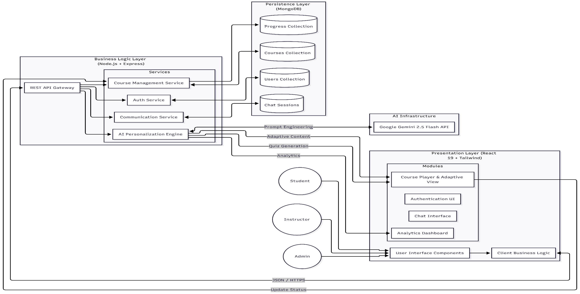
PROPOSED SYSTEM

Slide 6
MODULES OF THE PROJECT
Authentication & User Management Module.
Course Management & Delivery Module.
AI Adaptation & Personalization Engine.
Intelligent Assessment & Feedback Module.
Immersive Reader (Text-to-Speech) Module.
Real-time Communication & Query Module.
Admin Dashboard & Analytics Module.

Slide 7
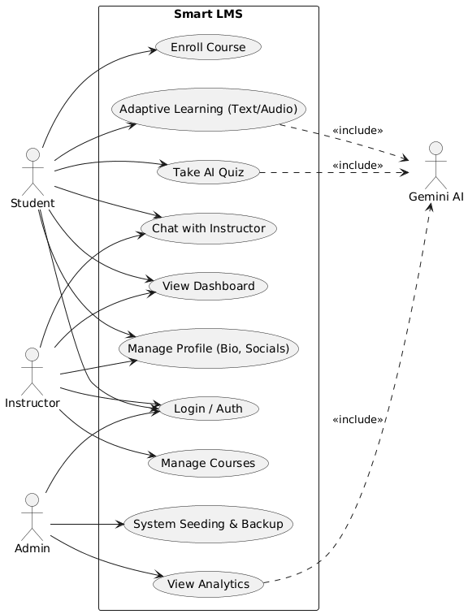
USE CASE DIAGRAM

Slide 8
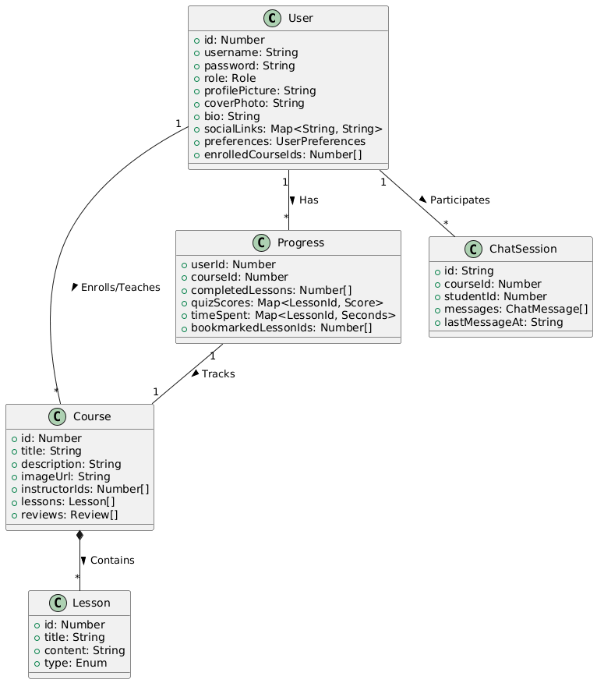
CLASS DIAGRAM

Slide 9
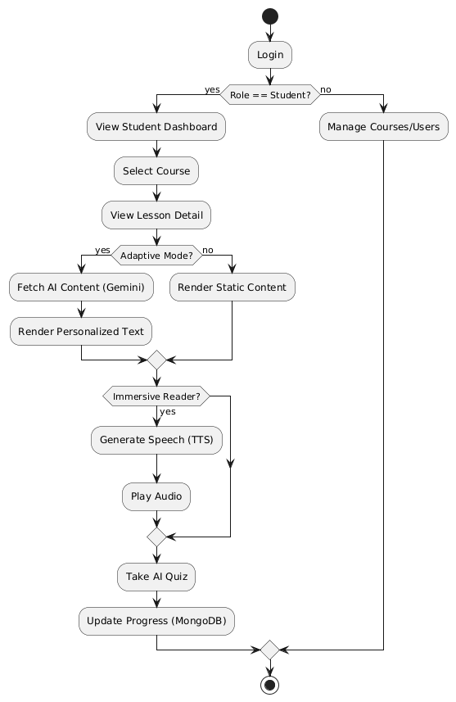
ACTIVITY DIAGRAM

Slide 10
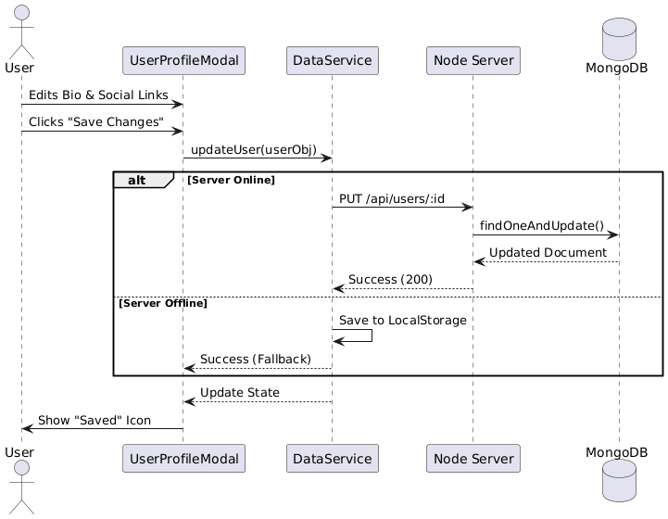
SEQUENCE DIAGRAM

Slide 11
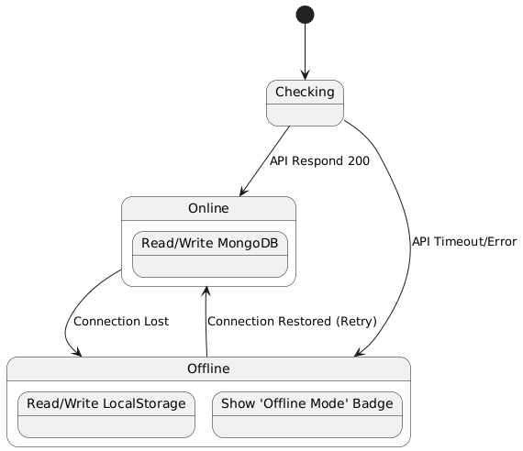
STATE MACHINE DIAGRAM

Slide 12
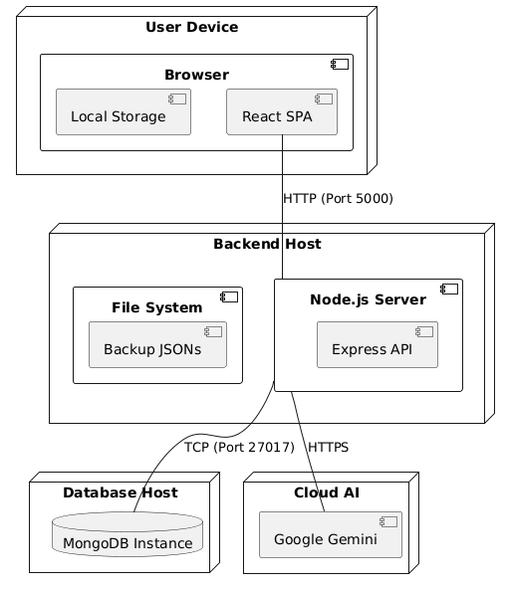
DEPLOYMENT DIAGRAM

Slide 13
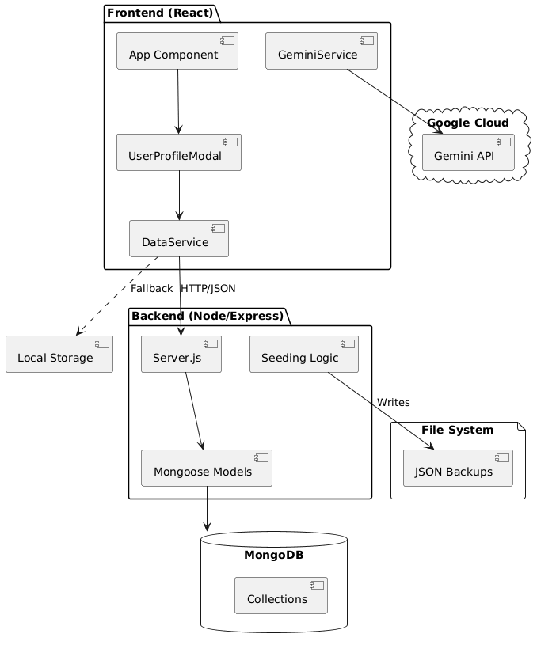
COMPONENT DIAGRAM

Slide 14
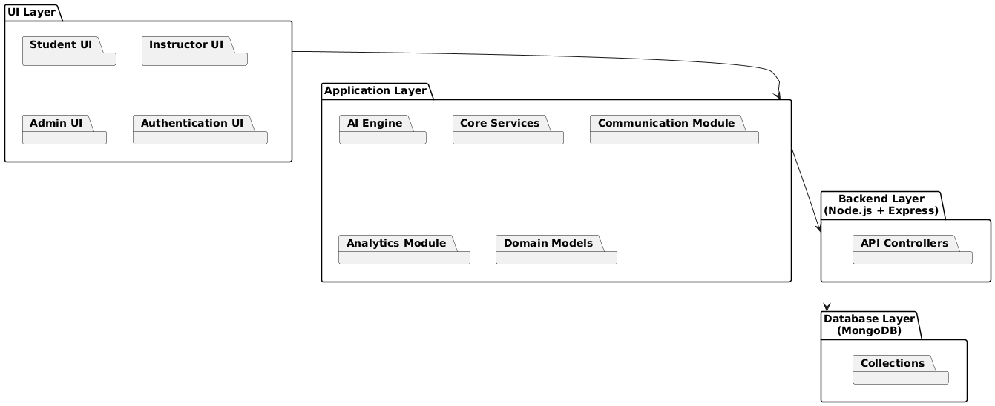
PACKAGE DIAGRAM

Slide 15
CONCLUSION
Smart LMS proves that Generative AI can deliver scalable, personalized learning by adapting content, generating intelligent assessments, and enhancing engagement.
Built on the MERN stack with Gemini integration, it overcomes the limitations of traditional LMS platforms and provides a modern, efficient, and adaptive learning experience.

Slide 16
THANK YOU !

