Slide 1
VoltGuard
電池狀態與交接
真實資料原型
Team 1023 / LadyBanana
01
Notes:
Team identity comes from the supplied brief: Team 1023 / LadyBanana, HKBU. Confirm official display names before submission. Observation and handover prototype. No claim of fire prediction, safety certification, customer deployment or actual AI API testing.
Sources (checked 2026-10-03):

Slide 2
香港電動車
184,000
輛
2026.08 約 19.9% 車輛
02
Notes:
EPD states approximately 184,000 EVs and about 19.9% of all vehicles at end-August 2026. This is a stock figure, not an accident rate. Updated from the unverified 75,000+ number in the guidance. Growing adoption motivates studying understandable condition information. It does not prove that EVs ignite more often than other vehicles.
Sources (checked 2026-10-03):
https://www.epd.gov.hk/epd/tc_chi/environmentinhk/air/promotion_ev/promotion_ev.html

Slide 3
安全風險
鋰電池消防設施要求
消防處 3/2025
場地適用性須專業覆核
03
Notes:
FSD Circular 3/2025 identifies lithium-ion battery fire hazards in battery rooms and electrical charging facilities and changes requirements for specified building-plan submissions. This is a facility document, not a universal EV temperature limit. Applicability to a specific site needs qualified review. No unverified Laguna City incident, accident count or guaranteed advance warning is used.
Sources (checked 2026-10-03):
https://www.hkfsd.gov.hk/eng/source/circular/2025_03_eng_20250905_192346.pdf

Slide 4
GenAI 與傳統 ML
規則
量測判定
GenAI
雙語交接
ML
需標註樣本
04
Notes:
OEM BMS, vehicle warnings, charging-management systems and building fire systems serve different purposes. VoltGuard explores cross-role interpretation and handover without replacing them. We have not benchmarked proprietary products or established zero parking-facility visibility. Deterministic rules evaluate measurements. GenAI can explain evidence in two languages and reference curated sources. An ML fire predictor would need representative labeled incident/non-incident data, validated performance, calibration and OEM-specific testing. None has been supplied. This prototype contains no trained fire-prediction model.
Sources (checked 2026-10-03):
https://developers.openai.com/api/docs/models/gpt-4o
https://www.nasa.gov/intelligent-systems-division/discovery-and-systems-health/pcoe/pcoe-data-set-repository/

Slide 5
兩層架構
量測
規則判定
人員覆核
AI 解讀
05
Notes:
Tier 1 uses shared deterministic prototype rules. Tier 2 is an optional GPT-4o text-and-image evidence explanation endpoint. A human authorizes cloud transfer and reviews the output. Tier 2 cannot mutate measured values, thresholds, event status or the current rule decision. If unavailable, Tier 1 and source guidance still work. This is implemented locally, not a cloud AI deployment.
Sources (checked 2026-10-03):
https://developers.openai.com/api/docs/models/gpt-4o

Slide 6
真實資料與規則
0
熱異常
3
容量維護
末次循環
06
Notes:
636 measured discharge cycles: B0005, B0006, B0007 each 168, B0018 132. Chart values are final measured capacity divided by the first measured capacity in that cell, from bundled fleet-summary.json. This operational capacity ratio is not an OEM SOH estimate or a safety probability. Four latest cycles cross zero thermal rules and three capacity-review rules. Thermal thresholds 60/80 C and rise 1/2 C per second are unvalidated prototype choices, not FSD criteria. Capacity review under 75% and watch under 90% are workflow choices. Dataset is historical laboratory cycling, not thermal-runaway incidents.
Sources (checked 2026-10-03):
https://www.nasa.gov/intelligent-systems-division/discovery-and-systems-health/pcoe/pcoe-data-set-repository/

Slide 7
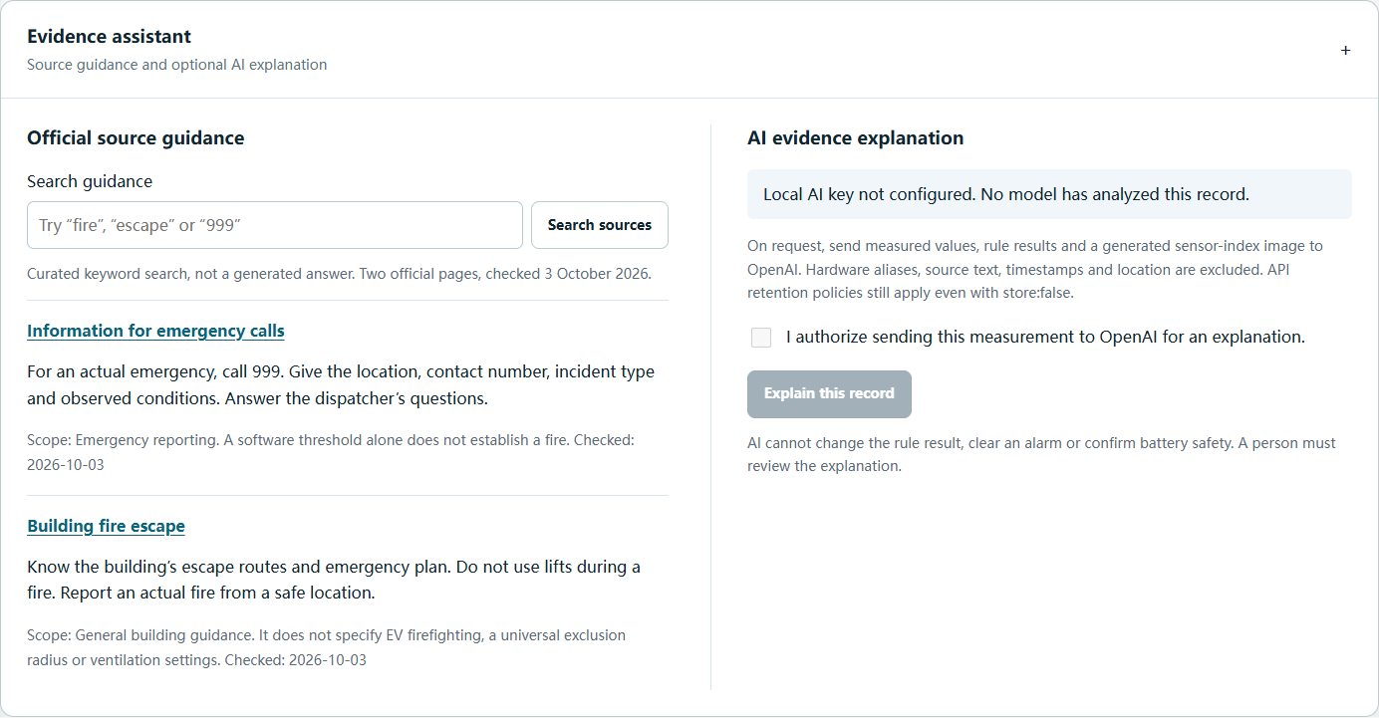
證據助理
現場演示 1
密鑰未配置
07
Notes:
LIVE DEMO 1, 30 seconds: enter Operations, expand Evidence assistant, search 999 and show the official link and scope. The screenshot is from the actual local service with no API key. It contains no fabricated AI output. The local route uses Responses API, GPT-4o, strict JSON schema, a server-generated measured sensor-index PNG, explicit consent, stripped identifiers, store:false, 30-second bounded in-memory cache, timeout and response guards. Curated keyword retrieval of two FSD pages is not vector search and is not itself GenAI. Provider access/latency/quality still require a real key and real live validation. Model refusal or rejected output preserves deterministic rules.
Sources (checked 2026-10-03):
https://www.hkfsd.gov.hk/eng/fire_ambulance_services/fire_information.html
https://developers.openai.com/api/docs/models/gpt-4o

Slide 8
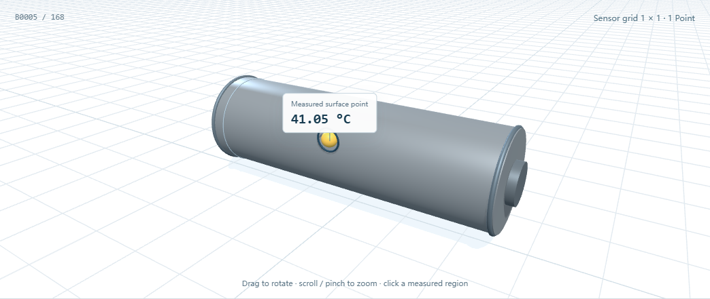
3D 實測溫度
現場演示 2
灰色區域未量測
08
Notes:
LIVE DEMO 2, 35 seconds: rotate the cylinder, select the actual hottest displayed sample, then show the missing/gray regions. NASA provides one measured surface-temperature channel for an independent cell. Its physical position is unknown. The cylinder is an illustrative model, not OEM geometry. Only the marker carries a real temperature; the gray shell is unmeasured. No inferred thermal field, no manufactured hotspots, no spatial interpolation. A real pack heatmap needs actual multi-sensor data and verified geometry. Screenshot captures the real application with genuine NASA data.
Sources (checked 2026-10-03):
https://www.nasa.gov/intelligent-systems-division/discovery-and-systems-health/pcoe/pcoe-data-set-repository/

Slide 9
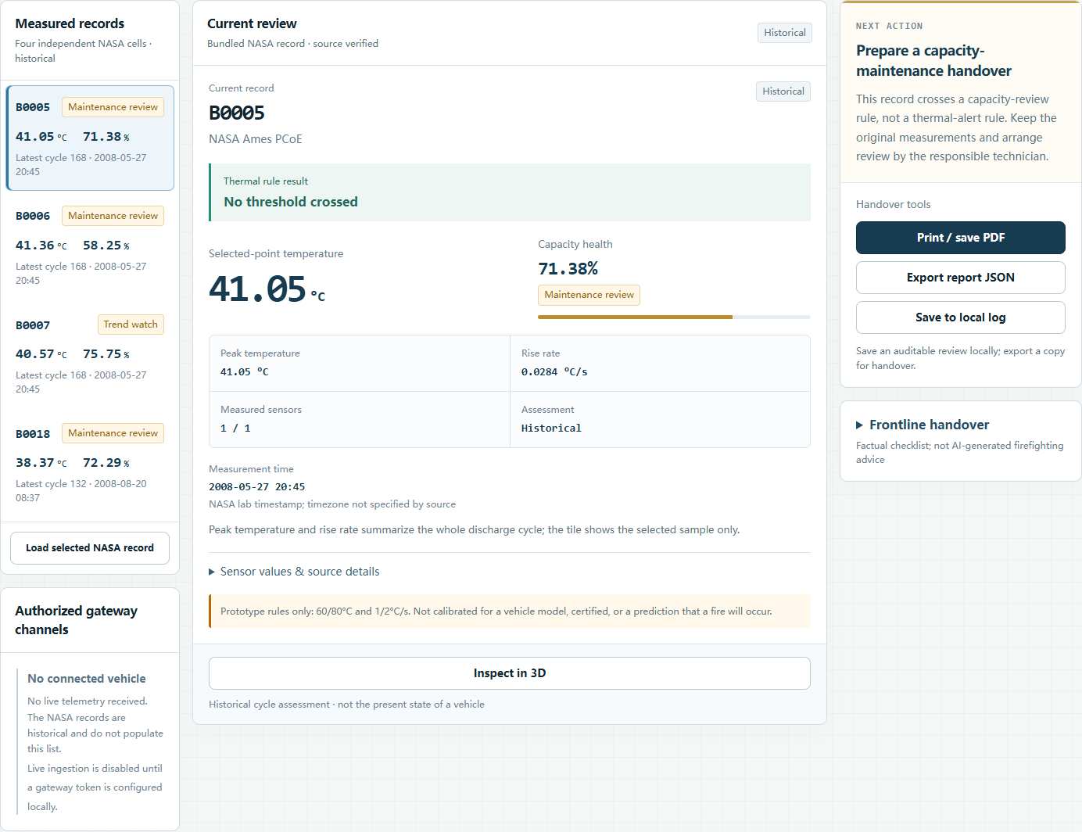
現場交接
現場演示 3
原始證據可匯出
09
Notes:
LIVE DEMO 3, 35 seconds: hand over the chosen measured sample, verify temperature/time/source, export JSON and enter Frontline view. Local mode can save capacity-review events and show acknowledgment/closure history. Public mode has no durable cloud event database. Processing history has real action timestamps but no authenticated operator identity or cryptographic tamper protection. Imported reports cannot inject AI conclusions or audit actions. The screenshot uses real B0005 laboratory measurements, not a fire incident.
Sources (checked 2026-10-03):
https://www.nasa.gov/intelligent-systems-division/discovery-and-systems-health/pcoe/pcoe-data-set-repository/

Slide 10
客戶與商業假設
車隊／場地營運者
B2B 訂閱假設
價格與需求待訪談
10
Notes:
Proposed paying clients: fleet operators and facility operators. Intended daily users: trained frontline staff, managers and drivers through future authorized vehicle integration. Hypothesis: B2B subscription/service integration for readable evidence and handover. No price, revenue, contract, customer count or pilot commitment has been validated. Interviews and authorized data-access discussions precede commercialization. No replacement of OEM BMS or certified fire protection. Accessibility barriers include device access, training and connectivity. Frontline view, large touch targets, optional speech and cached historical records address part of this workflow.
Sources (checked 2026-10-03):

Slide 11
成效驗證
交接時間
判讀錯誤
真人測試待安排
11
Notes:
Desired benefit is quicker, clearer evidence review and handover. No measured lives-saved, fire-rate reduction, deployment count or 500-site coverage claim. Proposed pilot measures: task completion, interpretation mistakes, source-checking behavior and time to prepare a handover. Compare with the operator’s baseline process. Automated QA is not usability testing. Obtain participant consent and avoid collecting plates, VINs or personal location data. At least two real participants, an administrator and a trained frontline role, remain to be recruited. Results should show n, actual task times, errors and unresolved confusion, not invented satisfaction scores.
Sources (checked 2026-10-03):

Slide 12
技術與資料流
SQLite
量測
規則
AI 待接入
交接
12
Notes:
Local Node HTTP service, shared browser/server rule module, SQLite review history, receive-only WebSocket for authorized gateway records, browser Three.js model and 2D fallback. GPT-4o optional local endpoint sends sanitized evidence plus a generated sensor-index image over HTTPS on explicit consent. Public hosting is static with no cloud backend or API key. Live ingestion needs an authorized gateway and accurate timestamps. Driving, parked and charging states are accepted by the contract; no OEM/CAN/OBD adapter is claimed. Diagram distinguishes implemented local components from the AI provider connection still awaiting validation.
Sources (checked 2026-10-03):
https://developers.openai.com/api/docs/models/gpt-4o

Slide 13
資料私隱
明確同意
最少量測資料
正式合規仍須評估
13
Notes:
Only selected measurement values, deterministic labels and a generated sensor-index image go to OpenAI when an operator explicitly consents. The payload excludes alias, free-text source, timestamp and location. Import normalization whitelists fields. Local persisted asset aliases are hashed, which is pseudonymization, not proof of anonymization. API credentials remain server-side. store:false does not guarantee zero provider retention; applicable account retention policies still apply. PCPD guidance supports risk assessment, human oversight, transparency and minimum necessary data. No PDPO compliance certification or legal opinion is claimed. Multi-user authentication, retention policy, security review and production controls remain future prerequisites.
Sources (checked 2026-10-03):
https://www.pcpd.org.hk/english/news_events/media_statements/press_20240611.html
https://developers.openai.com/api/docs/guides/your-data

Slide 14
驗證路線圖
6 個月
授權車輛試點
1 年
驗證營運流程
3 年
按證據擴展
14
Notes:
Proposed milestones, contingent on data access, team capacity and domain review. Near-term: configure a real API key, validate measured explanations and perform participant tests. Six months: seek an authorized multi-sensor vehicle/gateway pilot and OEM-specific calibration. One year: evaluate operating/security costs and a validated fleet workflow. Three years: consider broader deployment only after independent safety/security review and evidence of demand. These are planning horizons, not commitments, completed deployments or assured coverage. The official event site lists Final Pitch Day 24 October 2026. The guide’s 18 October submission date and scoring/WorkBuddy criteria remain team instructions pending confirmation with organizers.
Sources (checked 2026-10-03):
https://www.hack4sdg.com/

Slide 15
團隊與協作
Team 1023
LadyBanana / HKBU
成員與分工待確認
15
Notes:
The supplied project brief identifies Team 1023 / LadyBanana, HKBU. No member names or confirmed responsibilities were provided. Suggested ownership areas: domain/safety, data/integration, product/engineering, user validation and pitch. Confirm assignments before submission. A portable voltguard-evidence-review skill is packaged with measured-data constraints, provenance review, bilingual explanation and failure boundaries. It has not been installed or used in WorkBuddy. Actual WorkBuddy collaboration screenshots and participation evidence must come from real sessions, not Codex screenshots relabeled as WorkBuddy. Do not claim that the award evidence is complete.
Sources (checked 2026-10-03):

Slide 16
Q&A
量測證據，清楚交接
謝謝
16
Notes:
A working measured-data prototype and a verifiable handover workflow. Main asks: authorized vehicle data access, qualified safety/OEM review and real user validation. No claim of guaranteed prevention. The companion Q&A document answers twenty likely questions. Open the public website or local service for the three bounded demos, with screenshots as genuine-data fallback.
Sources (checked 2026-10-03):

