Slide 1
Final Handoff
Monitor Lizard
Team 33: Creighton DeVal, Soumya Gade, Matthew Leonard, Orion Qin, Rose Zendels
Notes:
Creighton

Slide 2

Introduction to Presentation
Review of the requirements
Demo
Documents
Testing
Next Steps
Notes:
Creighton

Slide 3
Goals & Requirements
Monitoring professional deployments
Display data
Alert users about anomalies
Web applications
Extensible
Learning
Notes:
Creighton

Slide 4
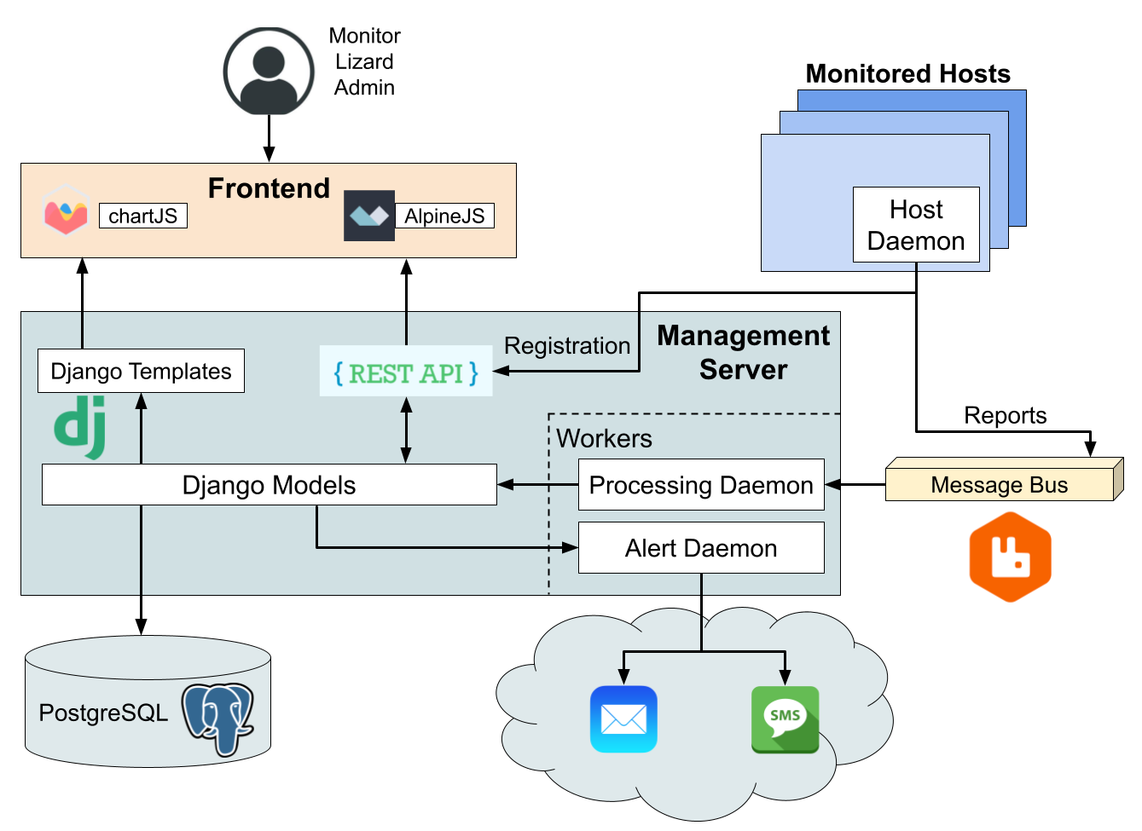
Overall System Design
Notes:
Matthew

Slide 5
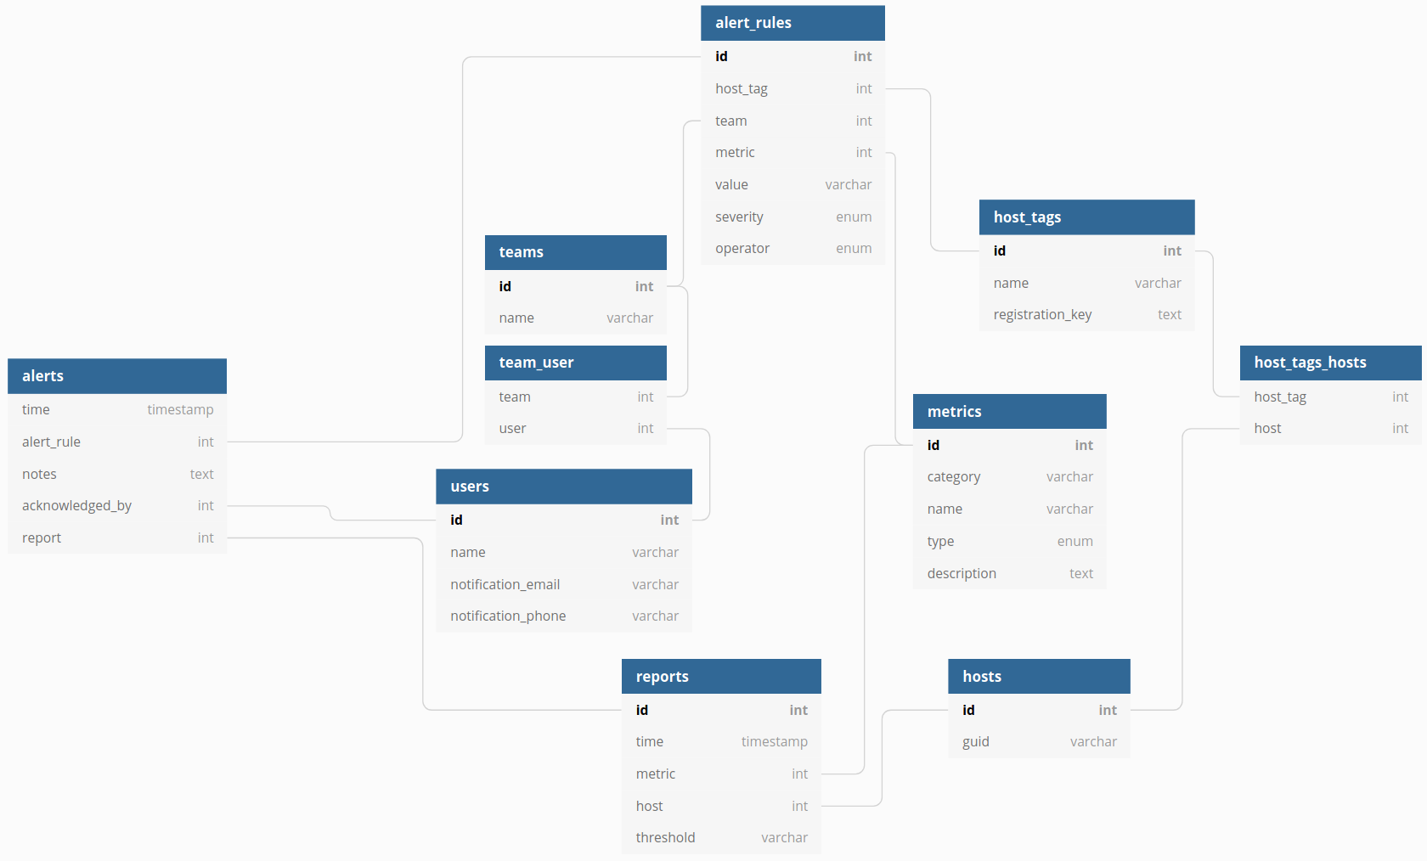
LLD, Database
Notes:
Matthew

Slide 6
Demo
User Guide Overview
Making an Alert
Watch Alert Trigger
Notes:
Rose, Soumya

Slide 7
Documents
Installation Guide Overview
Developer Guide Overview
Notes:
Matthew

Slide 8
Future Steps
Alert Acknowledgement
Tag Configuration
Search
Anomaly Detection
Reporting Rollups
Host Names
Pagination
Sorting
Data responsive
Web sockets
SMS
Tabs
Notes:
Orion

