Slide 1

PCD Lanjut – Pertemuan 2 Gray-Level Co-occurrence Matrix (GLCM)
P r a j a n t o W a h y u A d i
prajanto@dsn.dinus.ac.id
+6285 641 73 00 22

Slide 2
Rencana Kegiatan Perkuliahan Semester
# | Pokok Bahasan
1 | Pengujian Kualitas Citra
2 | Gray-Level Co-occurrence Matrix (GLCM)
3 | Principal Component Analysis (PCA)
4 | Fuzzy C-Mean (FCM)
5 | K-Nearest Neighbor (KNN)
6 | Jaringan Syaraf Tiruan (JST)
7 | *Responsi*
Ujian Tengah Semester
# | Pokok Bahasan
8 | Modulus Function (MF) pada domain Integer Wavelet Transform (IWT)
9 | Chinese Remainder Theorem (CRT) pada domain IWT
10 11 | Kompresi Lossy
12 13 | Kompresi Loseless
14 | *Presentasi Tugas Besar*
Ujian Akhir Semester

Slide 3
Content
1
GLCM
2
Contrast
3
Correlation
4
5
Energy
Homogeneity
6
Hasil Ekstraksi Fitur GLCM

Slide 4
1. GLCM
P r a j a n t o W a h y u A d i
prajanto@dsn.dinus.ac.id
+6285 641 73 00 22

Slide 5
GLCM
GLCM adalah sebuah teknik untuk mendapatkan nilai statistik orde ke-2 dengan menghitung probabilitas hubungan kedekatan antara dua buah piksel pada jarak (d) dan sudut (θ) tertentu (Rahmanti, 2017).

Slide 6
GLCM
Nilai θ yang banyak adalah 0⁰, 45⁰, 90⁰, dan 135⁰

Slide 7
GLCM
Contoh:
Diketahui sebuah citra 3-bit sebagai berikut:
bentuklah GLCM dengan jarak 1 dan θ = 0⁰ ([0 1]) !
3 | 5 | 7
2 | 4 | 1
6 | 3 | 5

Slide 8
GLCM
Contoh:
Membentuk GLCM [0 1]:
3 | 5 | 7
2 | 4 | 1
6 | 3 | 5
_{i} ^{j} | 0 | 1 | 2 | 3 | 4 | 5 | 6 | 7
0 | 0 | 0 | 0 | 0 | 0 | 0 | 0 | 0
1 | 0 | 0 | 0 | 0 | 0 | 0 | 0 | 0
2 | 0 | 0 | 0 | 0 | 1 | 0 | 0 | 0
3 | 0 | 0 | 0 | 0 | 0 | 2 | 0 | 0
4 | 0 | 1 | 0 | 0 | 0 | 0 | 0 | 0
5 | 0 | 0 | 0 | 0 | 0 | 0 | 0 | 1
6 | 0 | 0 | 0 | 1 | 0 | 0 | 0 | 0
7 | 0 | 0 | 0 | 0 | 0 | 0 | 0 | 0

Slide 9
GLCM
Contoh:
Membentuk GLCM [0 1]:
Setelah Normalisasi =
3 | 5 | 7
2 | 4 | 1
6 | 3 | 5
_{i} ^{j} | 0 | 1 | 2 | 3 | 4 | 5 | 6 | 7
0 | 0 | 0 | 0 | 0 | 0 | 0 | 0 | 0
1 | 0 | 0 | 0 | 0 | 0 | 0 | 0 | 0
2 | 0 | 0 | 0 | 0 | ¹/₆ | 0 | 0 | 0
3 | 0 | 0 | 0 | 0 | 0 | ²/₆ | 0 | 0
4 | 0 | ¹/₆ | 0 | 0 | 0 | 0 | 0 | 0
5 | 0 | 0 | 0 | 0 | 0 | 0 | 0 | ¹/₆
6 | 0 | 0 | 0 | ¹/₆ | 0 | 0 | 0 | 0
7 | 0 | 0 | 0 | 0 | 0 | 0 | 0 | 0

Slide 10
GLCM
Ekstraksi fitur (feature extraction) tekstur GLCM menghasilkan beberapa fitur, antara lain:
Contrast
Correlation
Energy
Homogeneity

Slide 11
2. Contrast
P r a j a n t o W a h y u A d i
prajanto@dsn.dinus.ac.id
+6285 641 73 00 22

Slide 12
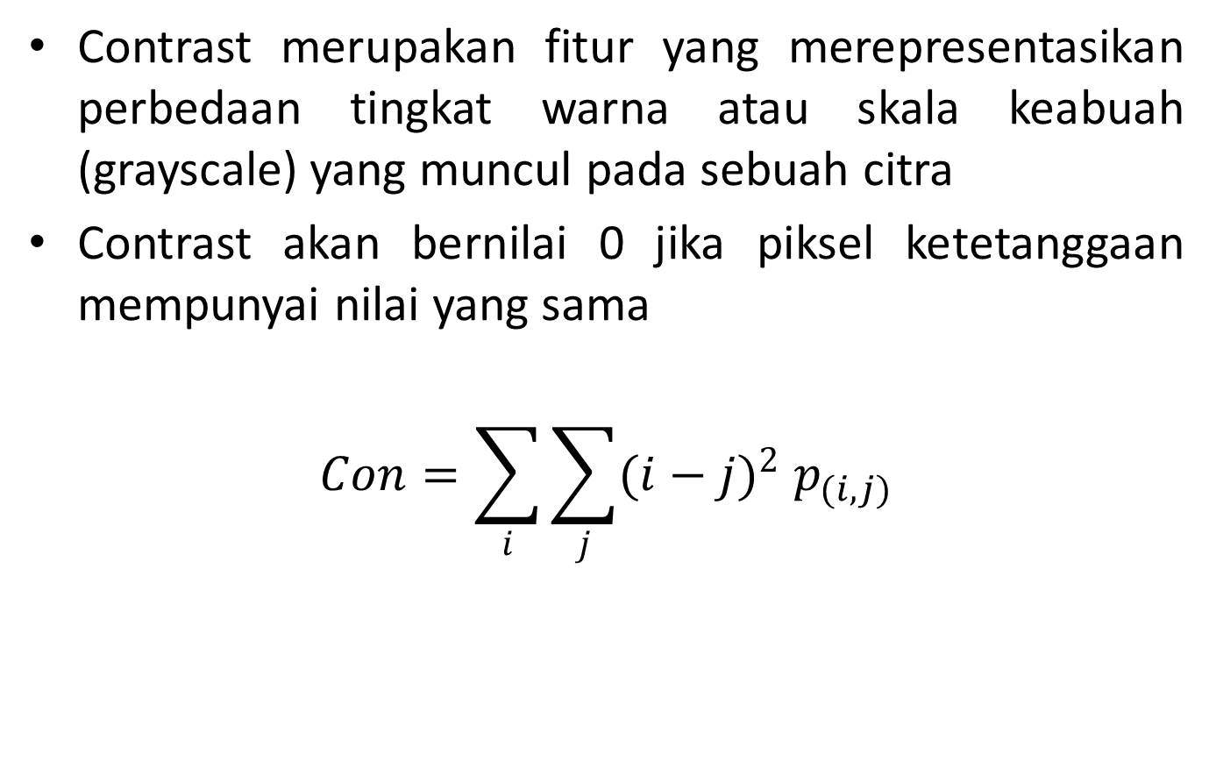
Contrast
Contrast merupakan fitur yang merepresentasikan perbedaan tingkat warna atau skala keabuah (grayscale) yang muncul pada sebuah citra
Contrast akan bernilai 0 jika piksel ketetanggaan mempunyai nilai yang sama
$$Con=\sum_{i}{\sum_{j}{{(i−j)}^{2} p_{(i,j)}}}$$

Slide 13
Contrast
Contoh:
Hitunglah Contrast dari GLCM berikut:
_{i} ^{j} | 0 | 1 | 2 | 3 | 4 | 5 | 6 | 7
0 | 0 | 0 | 0 | 0 | 0 | 0 | 0 | 0
1 | 0 | 0 | 0 | 0 | 0 | 0 | 0 | 0
2 | 0 | 0 | 0 | 0 | ¹/₆ | 0 | 0 | 0
3 | 0 | 0 | 0 | 0 | 0 | ²/₆ | 0 | 0
4 | 0 | ¹/₆ | 0 | 0 | 0 | 0 | 0 | 0
5 | 0 | 0 | 0 | 0 | 0 | 0 | 0 | ¹/₆
6 | 0 | 0 | 0 | ¹/₆ | 0 | 0 | 0 | 0
7 | 0 | 0 | 0 | 0 | 0 | 0 | 0 | 0

Slide 14
Contrast
Contoh:
Hitunglah Contrast dari GLCM berikut:
_{i} ^{j} | 0 | 1 | 2 | 3 | 4 | 5 | 6 | 7
0 | 0 | 0 | 0 | 0 | 0 | 0 | 0 | 0
1 | 0 | 0 | 0 | 0 | 0 | 0 | 0 | 0
2 | 0 | 0 | 0 | 0 | ¹/₆ | 0 | 0 | 0
3 | 0 | 0 | 0 | 0 | 0 | ²/₆ | 0 | 0
4 | 0 | ¹/₆ | 0 | 0 | 0 | 0 | 0 | 0
5 | 0 | 0 | 0 | 0 | 0 | 0 | 0 | ¹/₆
6 | 0 | 0 | 0 | ¹/₆ | 0 | 0 | 0 | 0
7 | 0 | 0 | 0 | 0 | 0 | 0 | 0 | 0

Slide 15
Contrast
Contoh:
Hitunglah Contrast dari GLCM berikut:
_{i} ^{j} | 0 | 1 | 2 | 3 | 4 | 5 | 6 | 7
0 | 0 | 0 | 0 | 0 | 0 | 0 | 0 | 0
1 | 0 | 0 | 0 | 0 | 0 | 0 | 0 | 0
2 | 0 | 0 | 0 | 0 | ¹/₆ | 0 | 0 | 0
3 | 0 | 0 | 0 | 0 | 0 | ²/₆ | 0 | 0
4 | 0 | ¹/₆ | 0 | 0 | 0 | 0 | 0 | 0
5 | 0 | 0 | 0 | 0 | 0 | 0 | 0 | ¹/₆
6 | 0 | 0 | 0 | ¹/₆ | 0 | 0 | 0 | 0
7 | 0 | 0 | 0 | 0 | 0 | 0 | 0 | 0

Slide 16
Contrast
Contoh:
Hitunglah Contrast dari GLCM berikut:
_{i} ^{j} | 0 | 1 | 2 | 3 | 4 | 5 | 6 | 7
0 | 0 | 0 | 0 | 0 | 0 | 0 | 0 | 0
1 | 0 | 0 | 0 | 0 | 0 | 0 | 0 | 0
2 | 0 | 0 | 0 | 0 | ¹/₆ | 0 | 0 | 0
3 | 0 | 0 | 0 | 0 | 0 | ²/₆ | 0 | 0
4 | 0 | ¹/₆ | 0 | 0 | 0 | 0 | 0 | 0
5 | 0 | 0 | 0 | 0 | 0 | 0 | 0 | ¹/₆
6 | 0 | 0 | 0 | ¹/₆ | 0 | 0 | 0 | 0
7 | 0 | 0 | 0 | 0 | 0 | 0 | 0 | 0

Slide 17
Contrast
Contoh:
Hitunglah Contrast dari GLCM berikut:
_{i} ^{j} | 0 | 1 | 2 | 3 | 4 | 5 | 6 | 7
0 | 0 | 0 | 0 | 0 | 0 | 0 | 0 | 0
1 | 0 | 0 | 0 | 0 | 0 | 0 | 0 | 0
2 | 0 | 0 | 0 | 0 | ¹/₆ | 0 | 0 | 0
3 | 0 | 0 | 0 | 0 | 0 | ²/₆ | 0 | 0
4 | 0 | ¹/₆ | 0 | 0 | 0 | 0 | 0 | 0
5 | 0 | 0 | 0 | 0 | 0 | 0 | 0 | ¹/₆
6 | 0 | 0 | 0 | ¹/₆ | 0 | 0 | 0 | 0
7 | 0 | 0 | 0 | 0 | 0 | 0 | 0 | 0

Slide 18
Contrast
Contoh:
Hitunglah Contrast dari GLCM berikut:
_{i} ^{j} | 0 | 1 | 2 | 3 | 4 | 5 | 6 | 7
0 | 0 | 0 | 0 | 0 | 0 | 0 | 0 | 0
1 | 0 | 0 | 0 | 0 | 0 | 0 | 0 | 0
2 | 0 | 0 | 0 | 0 | ¹/₆ | 0 | 0 | 0
3 | 0 | 0 | 0 | 0 | 0 | ²/₆ | 0 | 0
4 | 0 | ¹/₆ | 0 | 0 | 0 | 0 | 0 | 0
5 | 0 | 0 | 0 | 0 | 0 | 0 | 0 | ¹/₆
6 | 0 | 0 | 0 | ¹/₆ | 0 | 0 | 0 | 0
7 | 0 | 0 | 0 | 0 | 0 | 0 | 0 | 0

Slide 19
Contrast
Contoh:
Hitunglah Contrast dari GLCM berikut:
_{i} ^{j} | 0 | 1 | 2 | 3 | 4 | 5 | 6 | 7
0 | 0 | 0 | 0 | 0 | 0 | 0 | 0 | 0
1 | 0 | 0 | 0 | 0 | 0 | 0 | 0 | 0
2 | 0 | 0 | 0 | 0 | ¹/₆ | 0 | 0 | 0
3 | 0 | 0 | 0 | 0 | 0 | ²/₆ | 0 | 0
4 | 0 | ¹/₆ | 0 | 0 | 0 | 0 | 0 | 0
5 | 0 | 0 | 0 | 0 | 0 | 0 | 0 | ¹/₆
6 | 0 | 0 | 0 | ¹/₆ | 0 | 0 | 0 | 0
7 | 0 | 0 | 0 | 0 | 0 | 0 | 0 | 0

Slide 20
3. Correlation
P r a j a n t o W a h y u A d i
prajanto@dsn.dinus.ac.id
+6285 641 73 00 22

Slide 21
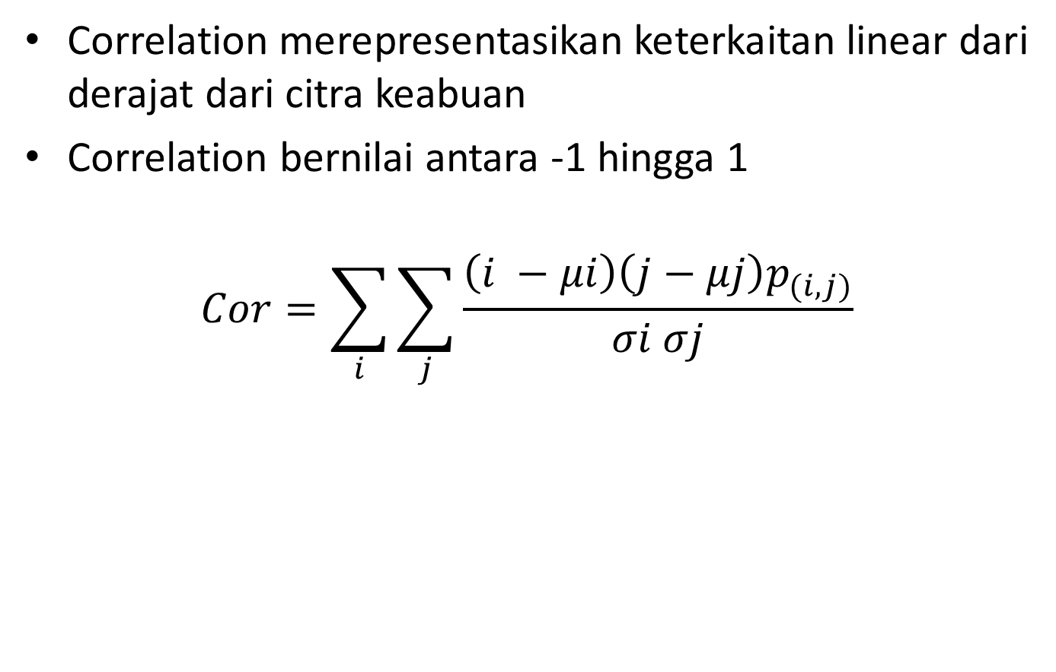
Correlation
Correlation merepresentasikan keterkaitan linear dari derajat dari citra keabuan
Correlation bernilai antara -1 hingga 1
$$Cor=\sum_{i}{\sum_{j}{\frac{\left(i −μi\right)\left(j−μj\right)p_{(i,j)}}{σi σj}}}$$

Slide 22

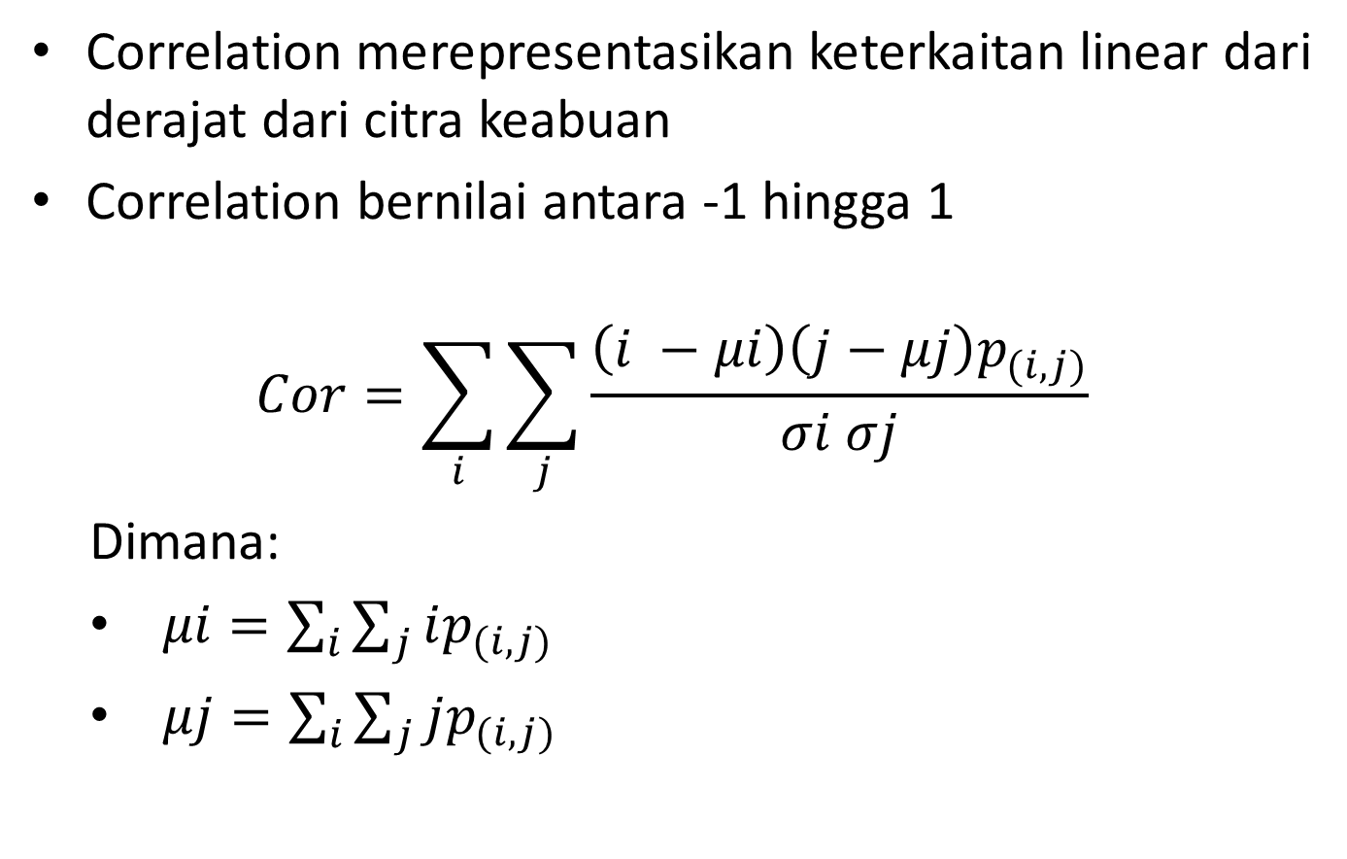
Correlation
Correlation merepresentasikan keterkaitan linear dari derajat dari citra keabuan
Correlation bernilai antara -1 hingga 1
$$Cor=\sum_{i}{\sum_{j}{\frac{\left(i −μi\right)\left(j−μj\right)p_{(i,j)}}{σi σj}}}$$
Dimana:
$μi=\sum_{i}{\sum_{j}{ip_{(i,j)}}}$
$μj=\sum_{i}{\sum_{j}{jp_{(i,j)}}}$
$σi=\sqrt{\sum_{i}{\sum_{j}{{(i−μi)}^{2}p_{(i,j)}}}}$
$σj=\sqrt{\sum_{i}{\sum_{j}{{(j−μi)}^{2}p_{(i,j)}}}}$

Slide 23
Correlation
Contoh:
Hitunglah Correlation dari GLCM berikut:
_{i} ^{j} | 0 | 1 | 2 | 3 | 4 | 5 | 6 | 7
0 | 0 | 0 | 0 | 0 | 0 | 0 | 0 | 0
1 | 0 | 0 | 0 | 0 | 0 | 0 | 0 | 0
2 | 0 | 0 | 0 | 0 | ¹/₆ | 0 | 0 | 0
3 | 0 | 0 | 0 | 0 | 0 | ²/₆ | 0 | 0
4 | 0 | ¹/₆ | 0 | 0 | 0 | 0 | 0 | 0
5 | 0 | 0 | 0 | 0 | 0 | 0 | 0 | ¹/₆
6 | 0 | 0 | 0 | ¹/₆ | 0 | 0 | 0 | 0
7 | 0 | 0 | 0 | 0 | 0 | 0 | 0 | 0

Slide 24

Correlation
Contoh:
Menghitung $μi$:
_{i} ^{j} | 0 | 1 | 2 | 3 | 4 | 5 | 6 | 7
0 | 0 | 0 | 0 | 0 | 0 | 0 | 0 | 0
1 | 0 | 0 | 0 | 0 | 0 | 0 | 0 | 0
2 | 0 | 0 | 0 | 0 | ¹/₆ | 0 | 0 | 0
3 | 0 | 0 | 0 | 0 | 0 | ²/₆ | 0 | 0
4 | 0 | ¹/₆ | 0 | 0 | 0 | 0 | 0 | 0
5 | 0 | 0 | 0 | 0 | 0 | 0 | 0 | ¹/₆
6 | 0 | 0 | 0 | ¹/₆ | 0 | 0 | 0 | 0
7 | 0 | 0 | 0 | 0 | 0 | 0 | 0 | 0

Slide 25

Correlation
Contoh:
Menghitung $μj$:
_{i} ^{j} | 0 | 1 | 2 | 3 | 4 | 5 | 6 | 7
0 | 0 | 0 | 0 | 0 | 0 | 0 | 0 | 0
1 | 0 | 0 | 0 | 0 | 0 | 0 | 0 | 0
2 | 0 | 0 | 0 | 0 | ¹/₆ | 0 | 0 | 0
3 | 0 | 0 | 0 | 0 | 0 | ²/₆ | 0 | 0
4 | 0 | ¹/₆ | 0 | 0 | 0 | 0 | 0 | 0
5 | 0 | 0 | 0 | 0 | 0 | 0 | 0 | ¹/₆
6 | 0 | 0 | 0 | ¹/₆ | 0 | 0 | 0 | 0
7 | 0 | 0 | 0 | 0 | 0 | 0 | 0 | 0

Slide 26

Correlation
Contoh:
Menghitung $σi$:
_{i} ^{j} | 0 | 1 | 2 | 3 | 4 | 5 | 6 | 7
0 | 0 | 0 | 0 | 0 | 0 | 0 | 0 | 0
1 | 0 | 0 | 0 | 0 | 0 | 0 | 0 | 0
2 | 0 | 0 | 0 | 0 | ¹/₆ | 0 | 0 | 0
3 | 0 | 0 | 0 | 0 | 0 | ²/₆ | 0 | 0
4 | 0 | ¹/₆ | 0 | 0 | 0 | 0 | 0 | 0
5 | 0 | 0 | 0 | 0 | 0 | 0 | 0 | ¹/₆
6 | 0 | 0 | 0 | ¹/₆ | 0 | 0 | 0 | 0
7 | 0 | 0 | 0 | 0 | 0 | 0 | 0 | 0

Slide 27
Correlation
Contoh:
Menghitung $σi$:
_{i} ^{j} | 0 | 1 | 2 | 3 | 4 | 5 | 6 | 7
0 | 0 | 0 | 0 | 0 | 0 | 0 | 0 | 0
1 | 0 | 0 | 0 | 0 | 0 | 0 | 0 | 0
2 | 0 | 0 | 0 | 0 | ¹/₆ | 0 | 0 | 0
3 | 0 | 0 | 0 | 0 | 0 | ²/₆ | 0 | 0
4 | 0 | ¹/₆ | 0 | 0 | 0 | 0 | 0 | 0
5 | 0 | 0 | 0 | 0 | 0 | 0 | 0 | ¹/₆
6 | 0 | 0 | 0 | ¹/₆ | 0 | 0 | 0 | 0
7 | 0 | 0 | 0 | 0 | 0 | 0 | 0 | 0

Slide 28
Correlation
Contoh:
Menghitung $σi$:
_{i} ^{j} | 0 | 1 | 2 | 3 | 4 | 5 | 6 | 7
0 | 0 | 0 | 0 | 0 | 0 | 0 | 0 | 0
1 | 0 | 0 | 0 | 0 | 0 | 0 | 0 | 0
2 | 0 | 0 | 0 | 0 | ¹/₆ | 0 | 0 | 0
3 | 0 | 0 | 0 | 0 | 0 | ²/₆ | 0 | 0
4 | 0 | ¹/₆ | 0 | 0 | 0 | 0 | 0 | 0
5 | 0 | 0 | 0 | 0 | 0 | 0 | 0 | ¹/₆
6 | 0 | 0 | 0 | ¹/₆ | 0 | 0 | 0 | 0
7 | 0 | 0 | 0 | 0 | 0 | 0 | 0 | 0

Slide 29
Correlation
Contoh:
Menghitung $σi$:
_{i} ^{j} | 0 | 1 | 2 | 3 | 4 | 5 | 6 | 7
0 | 0 | 0 | 0 | 0 | 0 | 0 | 0 | 0
1 | 0 | 0 | 0 | 0 | 0 | 0 | 0 | 0
2 | 0 | 0 | 0 | 0 | ¹/₆ | 0 | 0 | 0
3 | 0 | 0 | 0 | 0 | 0 | ²/₆ | 0 | 0
4 | 0 | ¹/₆ | 0 | 0 | 0 | 0 | 0 | 0
5 | 0 | 0 | 0 | 0 | 0 | 0 | 0 | ¹/₆
6 | 0 | 0 | 0 | ¹/₆ | 0 | 0 | 0 | 0
7 | 0 | 0 | 0 | 0 | 0 | 0 | 0 | 0

Slide 30
Correlation
Contoh:
Menghitung $σi$:
_{i} ^{j} | 0 | 1 | 2 | 3 | 4 | 5 | 6 | 7
0 | 0 | 0 | 0 | 0 | 0 | 0 | 0 | 0
1 | 0 | 0 | 0 | 0 | 0 | 0 | 0 | 0
2 | 0 | 0 | 0 | 0 | ¹/₆ | 0 | 0 | 0
3 | 0 | 0 | 0 | 0 | 0 | ²/₆ | 0 | 0
4 | 0 | ¹/₆ | 0 | 0 | 0 | 0 | 0 | 0
5 | 0 | 0 | 0 | 0 | 0 | 0 | 0 | ¹/₆
6 | 0 | 0 | 0 | ¹/₆ | 0 | 0 | 0 | 0
7 | 0 | 0 | 0 | 0 | 0 | 0 | 0 | 0

Slide 31
Correlation
Contoh:
Menghitung $σi$:
_{i} ^{j} | 0 | 1 | 2 | 3 | 4 | 5 | 6 | 7
0 | 0 | 0 | 0 | 0 | 0 | 0 | 0 | 0
1 | 0 | 0 | 0 | 0 | 0 | 0 | 0 | 0
2 | 0 | 0 | 0 | 0 | ¹/₆ | 0 | 0 | 0
3 | 0 | 0 | 0 | 0 | 0 | ²/₆ | 0 | 0
4 | 0 | ¹/₆ | 0 | 0 | 0 | 0 | 0 | 0
5 | 0 | 0 | 0 | 0 | 0 | 0 | 0 | ¹/₆
6 | 0 | 0 | 0 | ¹/₆ | 0 | 0 | 0 | 0
7 | 0 | 0 | 0 | 0 | 0 | 0 | 0 | 0

Slide 32

Correlation
Contoh:
Menghitung $σj$:
_{i} ^{j} | 0 | 1 | 2 | 3 | 4 | 5 | 6 | 7
0 | 0 | 0 | 0 | 0 | 0 | 0 | 0 | 0
1 | 0 | 0 | 0 | 0 | 0 | 0 | 0 | 0
2 | 0 | 0 | 0 | 0 | ¹/₆ | 0 | 0 | 0
3 | 0 | 0 | 0 | 0 | 0 | ²/₆ | 0 | 0
4 | 0 | ¹/₆ | 0 | 0 | 0 | 0 | 0 | 0
5 | 0 | 0 | 0 | 0 | 0 | 0 | 0 | ¹/₆
6 | 0 | 0 | 0 | ¹/₆ | 0 | 0 | 0 | 0
7 | 0 | 0 | 0 | 0 | 0 | 0 | 0 | 0

Slide 33
Correlation
Contoh:
Menghitung $σj$:
_{i} ^{j} | 0 | 1 | 2 | 3 | 4 | 5 | 6 | 7
0 | 0 | 0 | 0 | 0 | 0 | 0 | 0 | 0
1 | 0 | 0 | 0 | 0 | 0 | 0 | 0 | 0
2 | 0 | 0 | 0 | 0 | ¹/₆ | 0 | 0 | 0
3 | 0 | 0 | 0 | 0 | 0 | ²/₆ | 0 | 0
4 | 0 | ¹/₆ | 0 | 0 | 0 | 0 | 0 | 0
5 | 0 | 0 | 0 | 0 | 0 | 0 | 0 | ¹/₆
6 | 0 | 0 | 0 | ¹/₆ | 0 | 0 | 0 | 0
7 | 0 | 0 | 0 | 0 | 0 | 0 | 0 | 0

Slide 34
Correlation
Contoh:
Menghitung $σj$:
_{i} ^{j} | 0 | 1 | 2 | 3 | 4 | 5 | 6 | 7
0 | 0 | 0 | 0 | 0 | 0 | 0 | 0 | 0
1 | 0 | 0 | 0 | 0 | 0 | 0 | 0 | 0
2 | 0 | 0 | 0 | 0 | ¹/₆ | 0 | 0 | 0
3 | 0 | 0 | 0 | 0 | 0 | ²/₆ | 0 | 0
4 | 0 | ¹/₆ | 0 | 0 | 0 | 0 | 0 | 0
5 | 0 | 0 | 0 | 0 | 0 | 0 | 0 | ¹/₆
6 | 0 | 0 | 0 | ¹/₆ | 0 | 0 | 0 | 0
7 | 0 | 0 | 0 | 0 | 0 | 0 | 0 | 0

Slide 35
Correlation
Contoh:
Menghitung $σj$:
_{i} ^{j} | 0 | 1 | 2 | 3 | 4 | 5 | 6 | 7
0 | 0 | 0 | 0 | 0 | 0 | 0 | 0 | 0
1 | 0 | 0 | 0 | 0 | 0 | 0 | 0 | 0
2 | 0 | 0 | 0 | 0 | ¹/₆ | 0 | 0 | 0
3 | 0 | 0 | 0 | 0 | 0 | ²/₆ | 0 | 0
4 | 0 | ¹/₆ | 0 | 0 | 0 | 0 | 0 | 0
5 | 0 | 0 | 0 | 0 | 0 | 0 | 0 | ¹/₆
6 | 0 | 0 | 0 | ¹/₆ | 0 | 0 | 0 | 0
7 | 0 | 0 | 0 | 0 | 0 | 0 | 0 | 0

Slide 36
Correlation
Contoh:
Menghitung $σj$:
_{i} ^{j} | 0 | 1 | 2 | 3 | 4 | 5 | 6 | 7
0 | 0 | 0 | 0 | 0 | 0 | 0 | 0 | 0
1 | 0 | 0 | 0 | 0 | 0 | 0 | 0 | 0
2 | 0 | 0 | 0 | 0 | ¹/₆ | 0 | 0 | 0
3 | 0 | 0 | 0 | 0 | 0 | ²/₆ | 0 | 0
4 | 0 | ¹/₆ | 0 | 0 | 0 | 0 | 0 | 0
5 | 0 | 0 | 0 | 0 | 0 | 0 | 0 | ¹/₆
6 | 0 | 0 | 0 | ¹/₆ | 0 | 0 | 0 | 0
7 | 0 | 0 | 0 | 0 | 0 | 0 | 0 | 0

Slide 37
Correlation
Contoh:
Menghitung $σj$:
_{i} ^{j} | 0 | 1 | 2 | 3 | 4 | 5 | 6 | 7
0 | 0 | 0 | 0 | 0 | 0 | 0 | 0 | 0
1 | 0 | 0 | 0 | 0 | 0 | 0 | 0 | 0
2 | 0 | 0 | 0 | 0 | ¹/₆ | 0 | 0 | 0
3 | 0 | 0 | 0 | 0 | 0 | ²/₆ | 0 | 0
4 | 0 | ¹/₆ | 0 | 0 | 0 | 0 | 0 | 0
5 | 0 | 0 | 0 | 0 | 0 | 0 | 0 | ¹/₆
6 | 0 | 0 | 0 | ¹/₆ | 0 | 0 | 0 | 0
7 | 0 | 0 | 0 | 0 | 0 | 0 | 0 | 0

Slide 38
Correlation
Contoh:
Menghitung Correlation:
_{i} ^{j} | 0 | 1 | 2 | 3 | 4 | 5 | 6 | 7
0 | 0 | 0 | 0 | 0 | 0 | 0 | 0 | 0
1 | 0 | 0 | 0 | 0 | 0 | 0 | 0 | 0
2 | 0 | 0 | 0 | 0 | ¹/₆ | 0 | 0 | 0
3 | 0 | 0 | 0 | 0 | 0 | ²/₆ | 0 | 0
4 | 0 | ¹/₆ | 0 | 0 | 0 | 0 | 0 | 0
5 | 0 | 0 | 0 | 0 | 0 | 0 | 0 | ¹/₆
6 | 0 | 0 | 0 | ¹/₆ | 0 | 0 | 0 | 0
7 | 0 | 0 | 0 | 0 | 0 | 0 | 0 | 0

Slide 39
Correlation
Contoh:
Menghitung Correlation:
_{i} ^{j} | 0 | 1 | 2 | 3 | 4 | 5 | 6 | 7
0 | 0 | 0 | 0 | 0 | 0 | 0 | 0 | 0
1 | 0 | 0 | 0 | 0 | 0 | 0 | 0 | 0
2 | 0 | 0 | 0 | 0 | ¹/₆ | 0 | 0 | 0
3 | 0 | 0 | 0 | 0 | 0 | ²/₆ | 0 | 0
4 | 0 | ¹/₆ | 0 | 0 | 0 | 0 | 0 | 0
5 | 0 | 0 | 0 | 0 | 0 | 0 | 0 | ¹/₆
6 | 0 | 0 | 0 | ¹/₆ | 0 | 0 | 0 | 0
7 | 0 | 0 | 0 | 0 | 0 | 0 | 0 | 0

Slide 40
Correlation
Contoh:
Menghitung Correlation:
_{i} ^{j} | 0 | 1 | 2 | 3 | 4 | 5 | 6 | 7
0 | 0 | 0 | 0 | 0 | 0 | 0 | 0 | 0
1 | 0 | 0 | 0 | 0 | 0 | 0 | 0 | 0
2 | 0 | 0 | 0 | 0 | ¹/₆ | 0 | 0 | 0
3 | 0 | 0 | 0 | 0 | 0 | ²/₆ | 0 | 0
4 | 0 | ¹/₆ | 0 | 0 | 0 | 0 | 0 | 0
5 | 0 | 0 | 0 | 0 | 0 | 0 | 0 | ¹/₆
6 | 0 | 0 | 0 | ¹/₆ | 0 | 0 | 0 | 0
7 | 0 | 0 | 0 | 0 | 0 | 0 | 0 | 0

Slide 41
Correlation
Contoh:
Menghitung Correlation:
_{i} ^{j} | 0 | 1 | 2 | 3 | 4 | 5 | 6 | 7
0 | 0 | 0 | 0 | 0 | 0 | 0 | 0 | 0
1 | 0 | 0 | 0 | 0 | 0 | 0 | 0 | 0
2 | 0 | 0 | 0 | 0 | ¹/₆ | 0 | 0 | 0
3 | 0 | 0 | 0 | 0 | 0 | ²/₆ | 0 | 0
4 | 0 | ¹/₆ | 0 | 0 | 0 | 0 | 0 | 0
5 | 0 | 0 | 0 | 0 | 0 | 0 | 0 | ¹/₆
6 | 0 | 0 | 0 | ¹/₆ | 0 | 0 | 0 | 0
7 | 0 | 0 | 0 | 0 | 0 | 0 | 0 | 0

Slide 42
Correlation
Contoh:
Menghitung Correlation:
_{i} ^{j} | 0 | 1 | 2 | 3 | 4 | 5 | 6 | 7
0 | 0 | 0 | 0 | 0 | 0 | 0 | 0 | 0
1 | 0 | 0 | 0 | 0 | 0 | 0 | 0 | 0
2 | 0 | 0 | 0 | 0 | ¹/₆ | 0 | 0 | 0
3 | 0 | 0 | 0 | 0 | 0 | ²/₆ | 0 | 0
4 | 0 | ¹/₆ | 0 | 0 | 0 | 0 | 0 | 0
5 | 0 | 0 | 0 | 0 | 0 | 0 | 0 | ¹/₆
6 | 0 | 0 | 0 | ¹/₆ | 0 | 0 | 0 | 0
7 | 0 | 0 | 0 | 0 | 0 | 0 | 0 | 0

Slide 43
Correlation
Contoh:
Menghitung Correlation:
_{i} ^{j} | 0 | 1 | 2 | 3 | 4 | 5 | 6 | 7
0 | 0 | 0 | 0 | 0 | 0 | 0 | 0 | 0
1 | 0 | 0 | 0 | 0 | 0 | 0 | 0 | 0
2 | 0 | 0 | 0 | 0 | ¹/₆ | 0 | 0 | 0
3 | 0 | 0 | 0 | 0 | 0 | ²/₆ | 0 | 0
4 | 0 | ¹/₆ | 0 | 0 | 0 | 0 | 0 | 0
5 | 0 | 0 | 0 | 0 | 0 | 0 | 0 | ¹/₆
6 | 0 | 0 | 0 | ¹/₆ | 0 | 0 | 0 | 0
7 | 0 | 0 | 0 | 0 | 0 | 0 | 0 | 0

Slide 44
4. Energy
P r a j a n t o W a h y u A d i
prajanto@dsn.dinus.ac.id
+6285 641 73 00 22

Slide 45
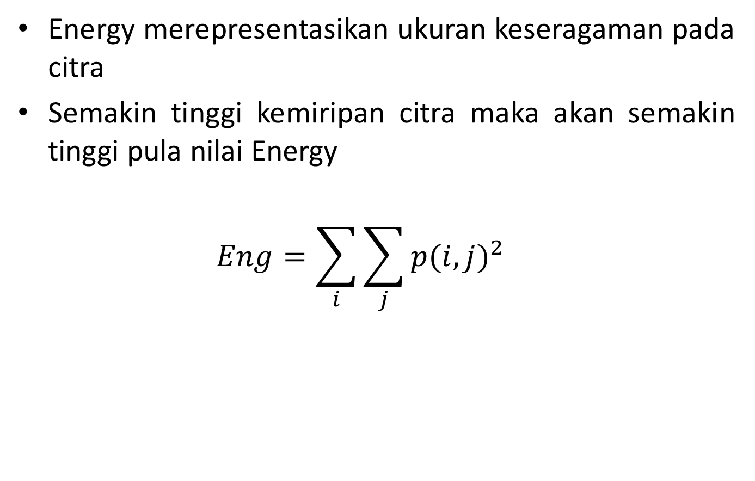
Energy
Energy merepresentasikan ukuran keseragaman pada citra
Semakin tinggi kemiripan citra maka akan semakin tinggi pula nilai Energy
$$Eng=\sum_{i}{\sum_{j}{{p(i,j)}^{2}}}$$

Slide 46
Energy
Contoh:
Hitunglah Energy dari GLCM berikut:
_{i} ^{j} | 0 | 1 | 2 | 3 | 4 | 5 | 6 | 7
0 | 0 | 0 | 0 | 0 | 0 | 0 | 0 | 0
1 | 0 | 0 | 0 | 0 | 0 | 0 | 0 | 0
2 | 0 | 0 | 0 | 0 | ¹/₆ | 0 | 0 | 0
3 | 0 | 0 | 0 | 0 | 0 | ²/₆ | 0 | 0
4 | 0 | ¹/₆ | 0 | 0 | 0 | 0 | 0 | 0
5 | 0 | 0 | 0 | 0 | 0 | 0 | 0 | ¹/₆
6 | 0 | 0 | 0 | ¹/₆ | 0 | 0 | 0 | 0
7 | 0 | 0 | 0 | 0 | 0 | 0 | 0 | 0

Slide 47
Energy
Contoh:
Hitunglah Energy dari GLCM berikut:
_{i} ^{j} | 0 | 1 | 2 | 3 | 4 | 5 | 6 | 7
0 | 0 | 0 | 0 | 0 | 0 | 0 | 0 | 0
1 | 0 | 0 | 0 | 0 | 0 | 0 | 0 | 0
2 | 0 | 0 | 0 | 0 | ¹/₆ | 0 | 0 | 0
3 | 0 | 0 | 0 | 0 | 0 | ²/₆ | 0 | 0
4 | 0 | ¹/₆ | 0 | 0 | 0 | 0 | 0 | 0
5 | 0 | 0 | 0 | 0 | 0 | 0 | 0 | ¹/₆
6 | 0 | 0 | 0 | ¹/₆ | 0 | 0 | 0 | 0
7 | 0 | 0 | 0 | 0 | 0 | 0 | 0 | 0

Slide 48
5. Homogeneity
P r a j a n t o W a h y u A d i
prajanto@dsn.dinus.ac.id
+6285 641 73 00 22

Slide 49
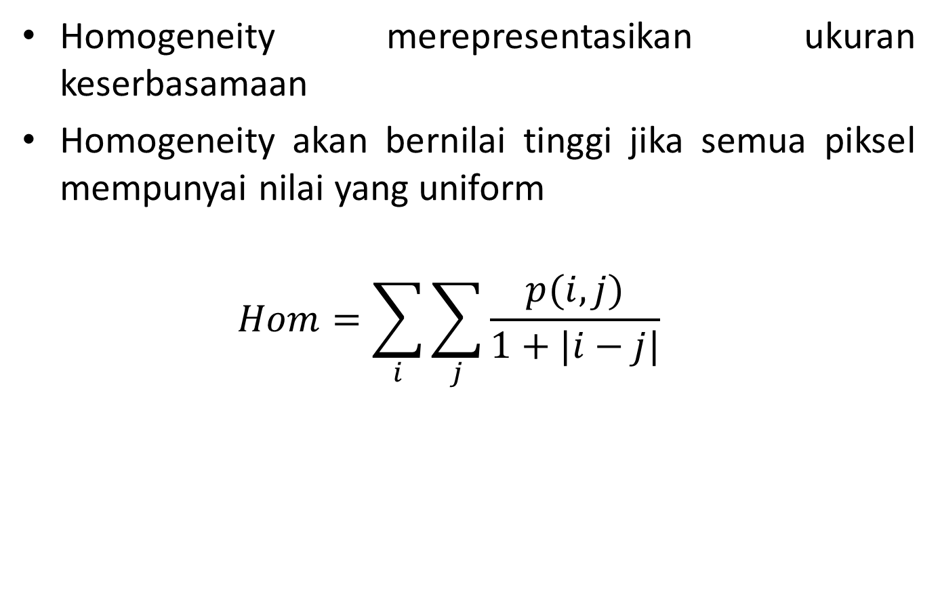
Homogeneity
Homogeneity merepresentasikan ukuran keserbasamaan
Homogeneity akan bernilai tinggi jika semua piksel mempunyai nilai yang uniform
$$Hom=\sum_{i}{\sum_{j}{\frac{p(i,j)}{1+|i−j|}}}$$

Slide 50
Homogeneity
Contoh:
Hitunglah Homogeneity dari GLCM berikut:
_{i} ^{j} | 0 | 1 | 2 | 3 | 4 | 5 | 6 | 7
0 | 0 | 0 | 0 | 0 | 0 | 0 | 0 | 0
1 | 0 | 0 | 0 | 0 | 0 | 0 | 0 | 0
2 | 0 | 0 | 0 | 0 | ¹/₆ | 0 | 0 | 0
3 | 0 | 0 | 0 | 0 | 0 | ²/₆ | 0 | 0
4 | 0 | ¹/₆ | 0 | 0 | 0 | 0 | 0 | 0
5 | 0 | 0 | 0 | 0 | 0 | 0 | 0 | ¹/₆
6 | 0 | 0 | 0 | ¹/₆ | 0 | 0 | 0 | 0
7 | 0 | 0 | 0 | 0 | 0 | 0 | 0 | 0

Slide 51
Homogeneity
Contoh:
Hitunglah Homogeneity dari GLCM berikut:
_{i} ^{j} | 0 | 1 | 2 | 3 | 4 | 5 | 6 | 7
0 | 0 | 0 | 0 | 0 | 0 | 0 | 0 | 0
1 | 0 | 0 | 0 | 0 | 0 | 0 | 0 | 0
2 | 0 | 0 | 0 | 0 | ¹/₆ | 0 | 0 | 0
3 | 0 | 0 | 0 | 0 | 0 | ²/₆ | 0 | 0
4 | 0 | ¹/₆ | 0 | 0 | 0 | 0 | 0 | 0
5 | 0 | 0 | 0 | 0 | 0 | 0 | 0 | ¹/₆
6 | 0 | 0 | 0 | ¹/₆ | 0 | 0 | 0 | 0
7 | 0 | 0 | 0 | 0 | 0 | 0 | 0 | 0

Slide 52
Homogeneity
Contoh:
Hitunglah Homogeneity dari GLCM berikut:
_{i} ^{j} | 0 | 1 | 2 | 3 | 4 | 5 | 6 | 7
0 | 0 | 0 | 0 | 0 | 0 | 0 | 0 | 0
1 | 0 | 0 | 0 | 0 | 0 | 0 | 0 | 0
2 | 0 | 0 | 0 | 0 | ¹/₆ | 0 | 0 | 0
3 | 0 | 0 | 0 | 0 | 0 | ²/₆ | 0 | 0
4 | 0 | ¹/₆ | 0 | 0 | 0 | 0 | 0 | 0
5 | 0 | 0 | 0 | 0 | 0 | 0 | 0 | ¹/₆
6 | 0 | 0 | 0 | ¹/₆ | 0 | 0 | 0 | 0
7 | 0 | 0 | 0 | 0 | 0 | 0 | 0 | 0

Slide 53
Homogeneity
Contoh:
Hitunglah Homogeneity dari GLCM berikut:
_{i} ^{j} | 0 | 1 | 2 | 3 | 4 | 5 | 6 | 7
0 | 0 | 0 | 0 | 0 | 0 | 0 | 0 | 0
1 | 0 | 0 | 0 | 0 | 0 | 0 | 0 | 0
2 | 0 | 0 | 0 | 0 | ¹/₆ | 0 | 0 | 0
3 | 0 | 0 | 0 | 0 | 0 | ²/₆ | 0 | 0
4 | 0 | ¹/₆ | 0 | 0 | 0 | 0 | 0 | 0
5 | 0 | 0 | 0 | 0 | 0 | 0 | 0 | ¹/₆
6 | 0 | 0 | 0 | ¹/₆ | 0 | 0 | 0 | 0
7 | 0 | 0 | 0 | 0 | 0 | 0 | 0 | 0

Slide 54
Homogeneity
Contoh:
Hitunglah Homogeneity dari GLCM berikut:
_{i} ^{j} | 0 | 1 | 2 | 3 | 4 | 5 | 6 | 7
0 | 0 | 0 | 0 | 0 | 0 | 0 | 0 | 0
1 | 0 | 0 | 0 | 0 | 0 | 0 | 0 | 0
2 | 0 | 0 | 0 | 0 | ¹/₆ | 0 | 0 | 0
3 | 0 | 0 | 0 | 0 | 0 | ²/₆ | 0 | 0
4 | 0 | ¹/₆ | 0 | 0 | 0 | 0 | 0 | 0
5 | 0 | 0 | 0 | 0 | 0 | 0 | 0 | ¹/₆
6 | 0 | 0 | 0 | ¹/₆ | 0 | 0 | 0 | 0
7 | 0 | 0 | 0 | 0 | 0 | 0 | 0 | 0

Slide 55
Homogeneity
Contoh:
Hitunglah Homogeneity dari GLCM berikut:
_{i} ^{j} | 0 | 1 | 2 | 3 | 4 | 5 | 6 | 7
0 | 0 | 0 | 0 | 0 | 0 | 0 | 0 | 0
1 | 0 | 0 | 0 | 0 | 0 | 0 | 0 | 0
2 | 0 | 0 | 0 | 0 | ¹/₆ | 0 | 0 | 0
3 | 0 | 0 | 0 | 0 | 0 | ²/₆ | 0 | 0
4 | 0 | ¹/₆ | 0 | 0 | 0 | 0 | 0 | 0
5 | 0 | 0 | 0 | 0 | 0 | 0 | 0 | ¹/₆
6 | 0 | 0 | 0 | ¹/₆ | 0 | 0 | 0 | 0
7 | 0 | 0 | 0 | 0 | 0 | 0 | 0 | 0

Slide 56
Homogeneity
Contoh:
Hitunglah Homogeneity dari GLCM berikut:
_{i} ^{j} | 0 | 1 | 2 | 3 | 4 | 5 | 6 | 7
0 | 0 | 0 | 0 | 0 | 0 | 0 | 0 | 0
1 | 0 | 0 | 0 | 0 | 0 | 0 | 0 | 0
2 | 0 | 0 | 0 | 0 | ¹/₆ | 0 | 0 | 0
3 | 0 | 0 | 0 | 0 | 0 | ²/₆ | 0 | 0
4 | 0 | ¹/₆ | 0 | 0 | 0 | 0 | 0 | 0
5 | 0 | 0 | 0 | 0 | 0 | 0 | 0 | ¹/₆
6 | 0 | 0 | 0 | ¹/₆ | 0 | 0 | 0 | 0
7 | 0 | 0 | 0 | 0 | 0 | 0 | 0 | 0

Slide 57
6. Hasil Ekstraksi Fitur GLCM
P r a j a n t o W a h y u A d i
prajanto@dsn.dinus.ac.id
+6285 641 73 00 22

Slide 58
Hasil Ekstraksi Fitur GLCM
Hasil ekstraksi fitur GLCM:
Contrast : 5,667
Correlation : -0,056
Energy : 0,222
Homogeneity : 0,306
3 | 5 | 7
2 | 4 | 1
6 | 3 | 5
_{i} ^{j} | 0 | 1 | 2 | 3 | 4 | 5 | 6 | 7
0 | 0 | 0 | 0 | 0 | 0 | 0 | 0 | 0
1 | 0 | 0 | 0 | 0 | 0 | 0 | 0 | 0
2 | 0 | 0 | 0 | 0 | ¹/₆ | 0 | 0 | 0
3 | 0 | 0 | 0 | 0 | 0 | ²/₆ | 0 | 0
4 | 0 | ¹/₆ | 0 | 0 | 0 | 0 | 0 | 0
5 | 0 | 0 | 0 | 0 | 0 | 0 | 0 | ¹/₆
6 | 0 | 0 | 0 | ¹/₆ | 0 | 0 | 0 | 0
7 | 0 | 0 | 0 | 0 | 0 | 0 | 0 | 0

Slide 59
Hasil Ekstraksi Fitur GLCM
Hasil ekstraksi fitur GLCM:
Contrast : 5,667
Correlation : -0,056
Energy : 0,222
Homogeneity : 0,306
Fitur-fitur tersebut selanjutnya dapat digunakan dalam proses klasifikasi atau identifikasi citra dengan algoritma klasifikasi seperti KNN, ANN/JST, dsb.
Untuk hasil ekstraksi fitur yang terlalu besar/banyak, dapat dilakukan proses seleksi fitur (feature selection) dengan algoritma seperti PCA.

Slide 60
Sekian
TERIMA KASIH

