Slide 1
Synthetic Clinical Notes Generation
Niharika Shrivastava | 3/08/23

Slide 2
Outline
Problem Statement
Objective
Setup
Dataset
LLM
Implementation
De-Novo Generation
0-Shot
Few-Shot
Paraphrasing
0-Shot
Chained Prompts
Few-Shot
Evaluation
Utility Metrics
Privacy Metrics
De-Novo Analysis
Paraphrasing Analysis
Conclusion
Next Steps

Slide 3
Problem Statement
SECTION 1

Slide 4
Problem
Objective
Need for alternative sources of non-sensitive medical data.
Multiple downstream NLP tasks.
Distribute for increased research.
Use LLMs to generate synthetic medical notes and evaluate its utility and privacy risks.
Tons of medical unstructured data:
Diagnostic reports, discharge summaries and prescriptions
Contains ~80% information
Accessibility to real medical records constrained by 2 main factors:
Limited availability of labelled data.
Privacy concerns.

Slide 5
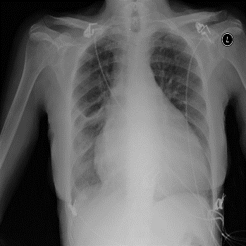
Tasks
Paraphrasing (Text-to-text)
Utility metrics
BLEU
ROUGE-L
BERT
Predictive Capability
Feature importance
Real clinical note
Synthetic clinical note
Prompt: Write a clinical note of a patient with a neurological condition
De novo text generation
Synthetic clinical note
Privacy metrics
BLEU
ROUGE-L
Image-to-text
Image captioning
Radiology report
“A chest X-ray of a patient with cardiomegaly”
Model training for diverse use-cases
Document classification
Entity recognition
Summarization

Slide 6
Setup
SECTION 2

Slide 7
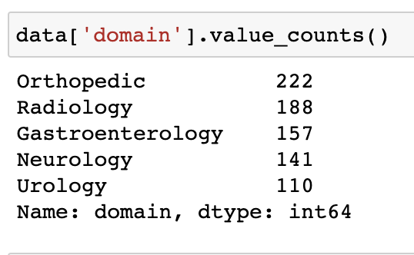
Setup: Kaggle Public Dataset
1222 reports, 5 domains: Link
All experiments with Orthopedic (unless otherwise mentioned.)
Example of a Radiology report
<B>CT HEAD WITHOUT CONTRAST, CT FACIAL BONES WITHOUT CONTRAST, AND CT CERVICAL SPINE WITHOUT CONTRAST</B>
<B>REASON FOR EXAM: </B> Motor vehicle collision.
<B>CT HEAD</B>
<B>TECHNIQUE: </B> Noncontrast axial CT images of the head were obtained without contrast.
<B>FINDINGS: </B> There is no acute intracranial hemorrhage, mass effect, midline shift, or extra-axial fluid collection. The ventricles and cortical sulci are normal in shape and configuration. The gray/white matter junctions are well preserved. No calvarial fracture is seen.
<B>IMPRESSION: </B>Negative for acute intracranial disease.
<B>CT FACIAL BONES WITHOUT CONTRAST</B>
<B>TECHNIQUE: </B>Noncontrast axial CT images of the facial bones were obtained with coronal reconstructions.
<B>FINDINGS:</B> There is no facial bone fracture. The maxilla and mandible are intact. The visualized paranasal sinuses are clear. The temporomandibular joints are intact. The nasal bone is intact. The orbits are intact. The extra-ocular muscles and orbital nerves are normal. The orbital globes are normal.
<B>IMPRESSION: </B> No evidence for a facial bone fracture.
<B>CT CERVICAL SPINE WITHOUT CONTRAST</B>
<B>TECHNIQUE: </B> Noncontrast axial CT images of the cervical spine were obtained with sagittal and coronal reconstructions.
<B>FINDINGS: </B> There is a normal lordosis of the cervical spine, no fracture or subluxation is seen. The vertebral body heights are normal. The intervertebral disk spaces are well preserved. The atlanto-dens interval is normal. No abnormal anterior cervical soft tissue swelling is seen. There is no spinal compression deformity.
<B>IMPRESSION: </B> Negative for a facial bone fracture.

Slide 8
Setup: Orthopedic Reports
222 reports
3 main categories.
Format 3 used across domains
Format 1: (66) | Format 2: (34) | Format 3: (122)
Procedure in detail | CC History Assessment Lab Results Impression Evaluation/Treatment Plan | Preoperative diagnosis Postoperative diagnosis Procedure performed History Procedure Inter-operative Findings Anesthesia Tourniquet Time Post operative plan

Slide 9
Setup: WizardVicunaLM 13B
13 billion parameters: Link
Wizard's dataset + ChatGPT's conversation extension + Vicuna's tuning method
WizardLM extends a single problem more in-depth.
VicunaLM overcomes the limitations of single-turn conversations by introducing multi-round conversations.
Trained with 8 A100 GPUs for 35 hours.
Maximum Token Window = Input context tokens (PROMPT) + Generated tokens (OUTPUT) = 2048
Temperature: 0.5
0 - 0.3 → Output is fairly close to the actual distribution.
0.3 - 0.7 → Output is factual, slightly diverse yet relevant.
0.7 - 1 → Output is creative, hallucinates, unpredictable.
Quantization: 4-bit precision
Reducing the precision of the model’s parameters.
Smaller in size, consume less power, trained faster.
AutoGPTQ: Link
Inference on free version of colab (T4 GPU)!

Slide 10
Implementation
SECTION 3

Slide 11
Implementation
Prompt-Engineering
De Novo
Text Generation
Text-to-Text
Generation
0-Shot
Prompt
Few-Shot
Prompt
0-shot
Prompt
Few-Shot
Prompt
Chained Prompt
(with partial context)

Slide 12
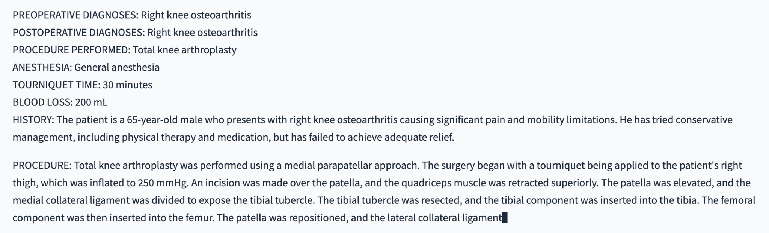
DeNovo: 0-Shot Prompt Template
"""You are an assistant to an orthopaedic doctor. Your task is to generate a synthetic clinical report.
Use the following format. Use "None" for a section if not applicable:
PREOPERATIVE DIAGNOSES: <clinical diagnosis before operation>
POSTOPERATIVE DIAGNOSES: <clinical diagnosis after the operation>
PROCEDURE PERFORMED: <short title of the operation performed>
ANESTHESIA: <medication used>
TOURNIQUET TIME: <time in minutes>
BLOOD LOSS: <estimated blood loss during operation>
HISTORY: <medical history of the patient>
PROCEDURE: <procedural detail of the operation performed in atleast 100 words>
INTEROPERATIVE FINDINGS: <gross findings during operation>
DISPOSITION: <post-operative plan for the patient>"""
PRO: Gives a coherent orthopaedic report.
CON: Restricted to a specific format!

Slide 13
DeNovo: Few-Shot Prompt Template
"""Below are examples of clinical reports delimited by triple backticks for a given domain. Your task is to generate a similar synthetic clinical report for a domain.
Domain: {domain} Report: ```{report}```
Domain: {domain} Report: ```{report}```
Domain: {domain} Report: ```{report}```
Domain: {domain} Report: ```{report}```
Domain: {query} Report:"""
Variations
Give examples of all domains.
Give examples of 1 domain with varied formats.
Give examples with varied lengths.
Longer prompts:
Enriched context
Shorter/truncated output.
EXPERT EXAMPLES
QUERY

Slide 14
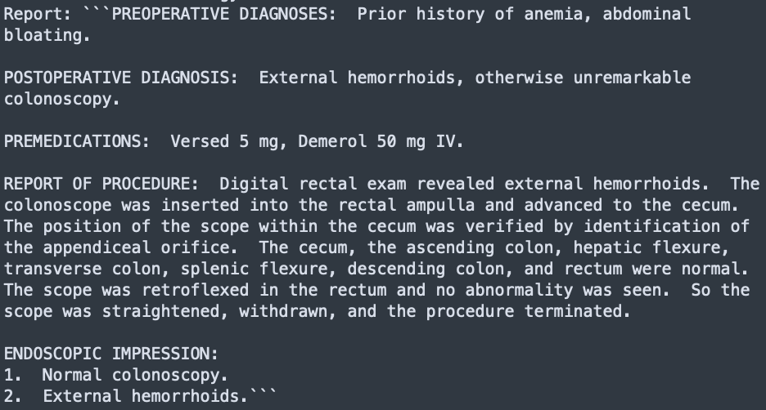
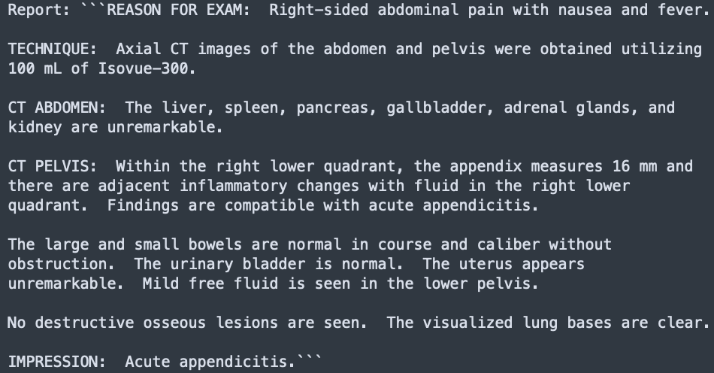
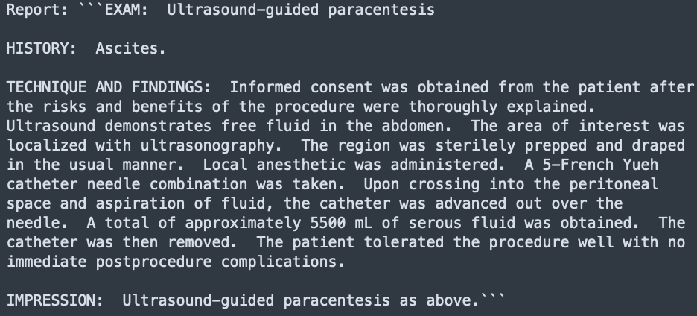
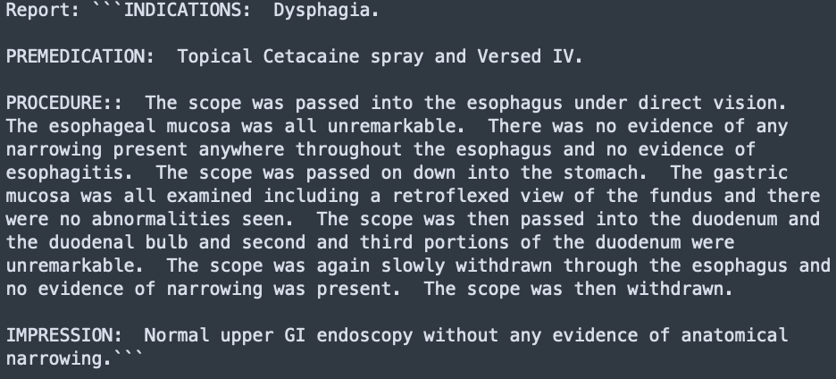
DeNovo: Few-Shot Prompt

Slide 15
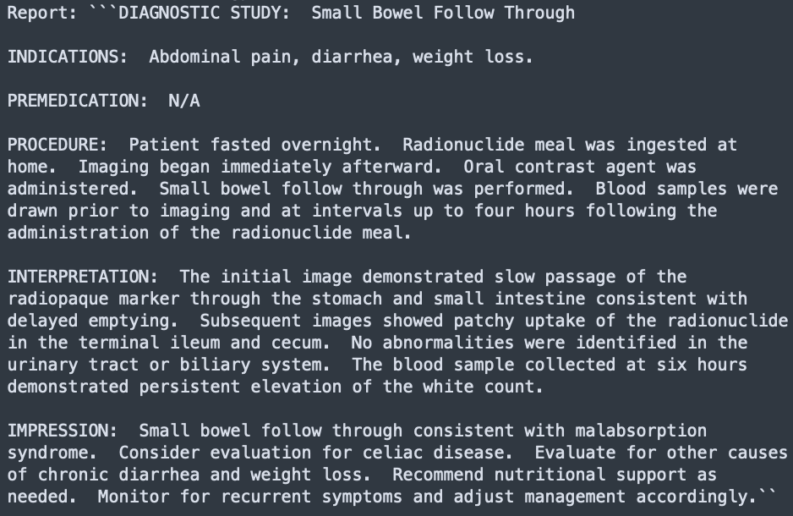
DeNovo: Few-Shot Prompt
PROS:
Coherent report for query domain.
Diverse yet relevant format.
Length is similar to expert examples.
CONS:
Input token window is huge for longer examples.
Long prompts can confuse LLM if not engineered properly.

Slide 16
Implementation
Prompt-Engineering
De Novo
Text Generation
Text-to-Text
Generation
Few-Shot
Prompt
Few-Shot
Prompt
0-Shot
Prompt
0-shot
Prompt
Chained Prompt
(with partial context)

Slide 17
Paraphrase: 0-Shot Prompt Template
"""Given below is a clinical report delimited by triple backticks. Your task is to rephrase each section of this report to generate a similar clinical report. Use the same outline as the given report. Given Report: ```{report}``` New Report:"""
EXTRACT FORMAT FROM REPORT
FULL REAL REPORT

Slide 18
Paraphrase: 0-Shot Prompt
REAL
SYNTHETIC
PREOPERATIVE DIAGNOSES:
1. Painful enlarged navicula, right foot.
2. Osteochondroma of right fifth metatarsal.
POSTOPERATIVE DIAGNOSES:
1. Painful enlarged navicula, right foot.
2. Osteochondroma of right fifth metatarsal.
PROCEDURE PERFORMED:
1. Partial tarsectomy navicula, right foot.
2. Partial metatarsectomy, right foot.
HISTORY: This 41-year-old Caucasian female who presents to ABCD General Hospital with the above chief complaint. The patient states that she has extreme pain over the navicular bone with shoe gear as well as history of multiple osteochondromas of unknown origin. She states that she has been diagnosed with hereditary osteochondromas. She has had previous dissection of osteochondromas in the past and currently has not been diagnosed in her feet as well as spine and back. The patient desires surgical treatment at this time.
PROCEDURE: <<3 paras long>>...
CLINICAL REPORT
Patient:
A 41-year-old Caucasian female presented to ABCD General Hospital with a chief complaint of painful enlargement of the navicula, right foot, along with a history of multiple osteochondromas of unknown origin. She has been diagnosed with hereditary osteochondromas and has had previous dissection of osteochondromas in the past, which includes the spine and back as well as the feet. The patient desires surgical treatment at this time.
Diagnoses:
Preoperative Diagnoses:
1. Painful enlarged navicula, right foot.
2. Osteochondroma of right fifth metatarsal.
Postoperative Diagnoses:
1. Painful enlarged navicula, right foot.
2. Osteochondroma of right fifth metatarsal.
Procedure Performed:
The patient underwent partial tarsectomy of the navicula, right foot, along with partial metatarsectomy of the right foot. The procedure was performed under sedation by the Department of Anesthesia. The patient's ankle was instilled with Webril, and a blood pressure cuff was applied. The patient was then administered a mixture of 1% lidocaine plain and 0.5% Marcaine plain via a diamond block type fashion around the navicular bone as well as the fifth metatarsal. The foot was then elevated and exsanguinated with an Esmarch bandage. The pneumatic ankle tourniquet was then inflated to 250 mmHg, and the foot was lowered and the operating table. The sterile stockinet was reflected and the foot was cleansed with wet and dry sponge. Attention was then directed to the navicular region on the right foot.

Slide 19
Paraphrase: 0-Shot Prompt
PROS:
Coherent report.
CONS:
Large parts of the report are copied as-is (no-rephrasing).
Detailed procedures are summarized to extremely short 1 paragraph procedures.
LLM loses focus / gets confused wrt the task.
Long real reports take major portion of limited token window.
Either causes code exception
Generates shorter / prematurely-cut reports.

Slide 20
Paraphrase: Chained Prompt Template
PROMPT_1 = """You are given a clinical report delimited within triple backticks. Your task is to output the detailed procedure in at most 200 words.
Report: ```’’’{report}```’’’ Procedure in detail:"""
PROMPT_2 = """Write a synthetic clinical report based on the context delimited with triple backticks.
Use the following format. Use "None" for a section if not applicable: PREOPERATIVE DIAGNOSES: <clinical diagnosis before operation> POSTOPERATIVE DIAGNOSES: <clinical diagnosis after the operation> PROCEDURE PERFORMED: <short title of the operation performed> ANESTHESIA: <medication used> TOURNIQUET TIME: <time in minutes> BLOOD LOSS: <estimated blood loss during operation> HISTORY: <medical history of the patient> PROCEDURE: <procedural detail of the operation performed in at least 100 words> INTEROPERATIVE FINDINGS: <gross findings during operation> DISPOSITION: <post-operative plan for the patient>
Context: ```’’’{context}```’’’ Report:"""
Real Report
Prompt 1
Detailed Procedure
Prompt 2
Synthetic Report

Slide 21
Paraphrase: Chained Prompt
REAL
SYNTHETIC
PREOPERATIVE DIAGNOSIS: Ganglion of the left wrist.
POSTOPERATIVE DIAGNOSIS: Ganglion of the left wrist.
OPERATION: Excision of ganglion.
ANESTHESIA: General.
ESTIMATED BLOOD LOSS: Less than 5 mL.
OPERATION: After a successful anesthetic, the patient was positioned on the operating table. A tourniquet applied to the upper arm. The extremity was prepped in a usual manner for a surgical procedure and draped off. The superficial vessels were exsanguinated with an elastic wrap and the tourniquet was then inflated to the usual arm pressure. A curved incision was made over the presenting ganglion over the dorsal aspect of the wrist. By blunt and sharp dissection, it was dissected out from underneath the extensor tendons and the stalk appeared to arise from the distal radiocapitellar joint and the dorsal capsule was excised along with the ganglion and the specimen was removed and submitted. The small superficial vessels were electrocoagulated and instilled after closing the skin with 4-0 Prolene, into the area was approximately 6 to 7 mL of 0.25 Marcaine with epinephrine. A Jackson-Pratt drain was inserted and then after the tourniquet was released, it was kept deflated until at least 5 to 10 minutes had passed and then it was activated and then removed in the recovery room. The dressings applied to the hand were that of Xeroform, 4x4s, ABD, Kerlix, and elastic wrap over a volar fiberglass splint. The tourniquet was released. Circulation returned to the fingers. The patient then was allowed to awaken and left the operating room in good condition.
PREOPERATIVE DIAGNOSES: Ganglion of the left wrist
POSTOPERATIVE DIAGNOSES: Same
PROCEDURE PERFORMED: Excision of the ganglion
ANESTHESIA: General anesthesia
TOURNIQUET TIME: Not mentioned
BLOOD LOSS: Less than 5 mL
HISTORY: None
PROCEDURE: The patient presented with a swelling on their left wrist which was diagnosed as a ganglion. The decision to perform surgery was taken after discussing the risks and benefits with the patient. The surgery involved making an incision over the presenting ganglion and dissecting out the ganglion from underneath the extensor tendons. The stalk was found to arise from the distal radiocapitellar joint and the dorsal capsule was excised along with the ganglion. The specimen was sent for testing.
INTEROPERATIVE FINDINGS: The ganglion was found to be located deep within the tissue and was easily accessible through the incision. The extensor tendons were found to be intact.
DISPOSITION: The patient was advised to follow up with the surgeon in two weeks to check for any signs of recurrence or complications. They were given pain medication and instructed to keep their hand elevated to reduce swelling.

Slide 22
Paraphrase: Chained Prompt
PROS:
Coherent report.
Major parts of the procedure are summarized based on extraction.
Generates other valid sections on its own.
Chain can be extended in the future.
Avoids all context in 1 prompt.
Greater token window for generation!
CONS:
If one link of the chain fails, rest of the chain may not work as expected.
Extremely long procedure causing exception / LLM confusion.
Unstructured report doesn’t have a clear procedure.
2nd link is format-dependent.

Slide 23
Paraphrase: Few-Shot Prompt Template
"""Below are examples of synthetic clinical reports rephrased based on original reports. Both the reports are delimited by <>. Your task is to generate a similar synthetic clinical report for a given report."""
Original: <{original}> Rephrased: <{rephrased}>
Original: <{original}> Rephrased: <{rephrased}>
Original: <{original}> Rephrased: <{rephrased}>
Original: <{original}> Rephrased: <{rephrased}>
Original: <{query}> Rephrased:"""
Real Report
Human / Better LLM (ChatGPT)
Expert Rephrase
Prompt
Synthetic Report

Slide 24
Paraphrase: Few-Shot Prompt
REAL
SYNTHETIC
PROCEDURES PERFORMED: C5-C6 anterior cervical discectomy, allograft fusion, and anterior plating.
ESTIMATED BLOOD LOSS: 10 mL.
CLINICAL NOTE: This is a 57-year-old gentleman with refractory neck pain with single-level degeneration of the cervical spine and there was also some arm pain. We decided go ahead with anterior cervical discectomy at C5-C6 and fusion. The risks of lack of pain relief, paralysis, hoarse voice, nerve injuries, and infection were explained and the patient agreed to proceed.
DESCRIPTION OF PROCEDURE: The patient was brought to the operating room where a general endotracheal anesthesia was induced without complication. The patient was placed in the slightly extended position with the neck and the head was restrained in a doughnut and the occiput was restrained by the doughnut. He had tape placed over the shoulders during intraoperative x-rays and his elbows were well padded. The tape was placed and his arms were well padded. He was prepped and draped in a sterile fashion. A linear incision was fashioned at the cricothyroid level from near the midline to over the sternocleidomastoid muscle. We separated the platysma from the subcutaneous tissue and then opened the platysma along the medial border of the sternocleidomastoid muscle. We then dissected sharply medial to carotid artery, which we palpated to the prevertebral region. We placed Caspar retractors for medial and lateral exposure over the C5-C6 disc space, which we confirmed with the lateral cervical spine x-ray including 18-gauge needle in the disc space. We then marked the disc space. We then drilled off ventral osteophyte as well as osteophyte creating concavity within the disc space. We then under magnification removed all the disc material, we could possibly see down to bleeding bone and both the endplates. We took down posterior longitudinal ligament as well. We incised the 6-mm cornerstone bone. We placed a 6-mm parallel medium bone nicely into the disc space. We then sized a 23-mm plate. We inserted the screws nicely above and below. We tightened down the lock-nuts. We irrigated the wound. We assured hemostasis using bone wax prior to placing the plate. We then assured hemostasis once again. We reapproximated the platysma using 3-0 Vicryl in a simple interrupted fashion. The subcutaneous level was closed using 3-0 Vicryl in a simple buried fashion. The skin was closed with 3-0 Monocryl in a running subcuticular stitch. Steri-Strips were applied. Dry sterile dressing with Telfa was applied over this. We obtained an intraoperative x-ray to confirm the proper level and good position of both plates and screw construct on the lateral x-ray and the patient was transferred to the recovery room, moving all four extremities with stable vital signs. I was present as a primary surgeon throughout the entire case.
<PROCEDURES PERFORMED: Cervical vertebrae (C5-C6) anterior discectomy, allograft fusion, and anterior plating.
ESTIMATED BLOOD LOSS: 10mL
CLINICAL NOTE: The patient, aged 57 years, has been experiencing refractory neck pain due to single-level degeneration of the cervical spine, along with arm pain. After discussing the risks and benefits of the surgery, the patient agreed to undergo anterior cervical discectomy at C5-C6 levels, fusion, and anterior plating.
DESCRIPTION OF PROCEDURE: The patient was put under general endotracheal anesthesia, and the procedure was conducted in the operating room. The patient's neck was extended slightly, and the head was secured in place with a doughnut. Elbow pads were used to protect the patient's arms. The patient was prepped and draped in a sterile manner. An incision was made at the level of the cricoid cartilage, extending from the midline to the sternocleidomastoid muscle. The platysma was separated from the subcutaneous tissue, and then opened along the medial border of the sternocleidomastoid muscle. Retractors were used to expose the C5-C6 disc space, which was confirmed with a lateral cervical spine x-ray. The disc was removed, and the endplates were exposed. A 6-mm cornerstone bone was placed into the disc space, and a 23-mm plate was used to fix the screws. Hemostasis was ensured using bone wax before applying the plate. The wound was irrigated, and the plate was tightened. The platysma was reconstructed using 3-0 Vicryl suture, and the subcutaneous layer was closed using 3-0 Vicryl suture in a buried fashion. The skin was closed using 3-0 Monocryl suture in a running subcuticular stitch. Steri-Strips were applied, and a dry sterile dressing with Telfa was placed over the wound. An intraoperative x-ray was taken to confirm the proper level and position of the plates and screw construct. The patient was transferred to the recovery room, with stable vital signs and full mobility of all four extremities. The primary surgeon was present throughout the entire procedure.</

Slide 25
Paraphrase: Few-Shot Prompt
PROS:
Coherent report.
Format is intact.
Fewer parts of the report are copied as-is.
CONS:
Prompt induces big limitation on LLM token window.
Lesser examples provided.
Premature stopping of report regeneration.
Long prompts can confuse LLM if not engineered properly.

Slide 26
Evaluation
SECTION 4

Slide 27
Evaluation: Utility Metrics
Rouge-L | Similarity of the longest common subsequence b/w candidate and reference. | Syntactical matching. | Higher value better. | Useful for summarizing / paraphrasing tasks.
Bleu | Product of length penalty and mean n-gram overlap. |  |  | Useful for machine translation tasks.
BERT | Cosine similarity b/w embeddings of candidate and reference. | Semantic matching. |  | Useful for most NLP tasks.
Feature Importance | Top-10 TF-IDF features correlated to a domain. |  |  | Trained SVM, MLP, LR using TF-IDF encodings for domain classification task.

Slide 28
Evaluation: Privacy Metrics
Rouge-L | Similarity of the longest common subsequence b/w candidate and reference. | Syntactical matching. | Lower value better. | Extremely large score means parts of real report were copied as-is, thereby potentially leaking original private data. Poor LLM generation performance.
Bleu | Product of length penalty and mean n-gram overlap.

Slide 29
Evaluation: Paraphrase
Syntactic metrics for 0-shot have the highest scores since the LLM blindly copy-pasted the original report.
Chained has high downstream task utility.
Real reports → 738
Synthetic reports → ~220 (orthopedic)
Train on real reports, test on synthetic reports.
All paraphrased reports (candidates) have a corresponding real report (reference).
Utility Metrics
 | ROUGE-L | BERT | BLEU | Accuracy
0-shot | 0.56 | 0.91 | 0.27 | 0.84
1-shot | 0.44 | 0.88 | 0.1 | 0.88
few-shot | 0.45 | 0.89 | 0.09 | 0.83
chained | 0.36 | 0.85 | 0.08 | 0.93
Train | - | - | - | 0.85

Slide 30
Evaluation: Paraphrase
Real reports → 738
Synthetic reports → ~220 (orthopedic)
Train on real reports, test on synthetic reports.
All paraphrased reports (candidates) have a corresponding real report (reference).
Chained reports preserve privacy the most by inherently obfuscating PII.
Privacy Metrics
 | ROUGE-L | BLEU
0-shot | 0.56 | 0.27
1-shot | 0.44 | 0.1
few-shot | 0.45 | 0.09
chained | 0.36 | 0.08

Slide 31
Evaluation: De Novo
Real reports → 738
Synthetic reports → 1000 (uniform).
Rouge-L, Bleu, Bert cannot be calculated since no ground truth.
Train on real, test on synthetic
Train on synthetic, test on real
 | Training accuracy | Test accuracy | AUC
LR | 0.832 | 0.62 | 0.88
SVC | 0.847 | 0.63 | -
MLP | 0.83 | 0.62 | 0.88
 | Training accuracy | Test accuracy | AUC
LR | 0.866 | 0.55 | 0.89
SVC | 0.90 | 0.51 | -
MLP | 0.88 | 0.54 | 0.87
AUC is high, domains are nicely distinguishable.
Model overfits. Different distributions?
AUC is high, domains are nicely distinguishable.
Model overfits worse than before.
Real reports are slightly more general.
Real reports → better quality.

Slide 32
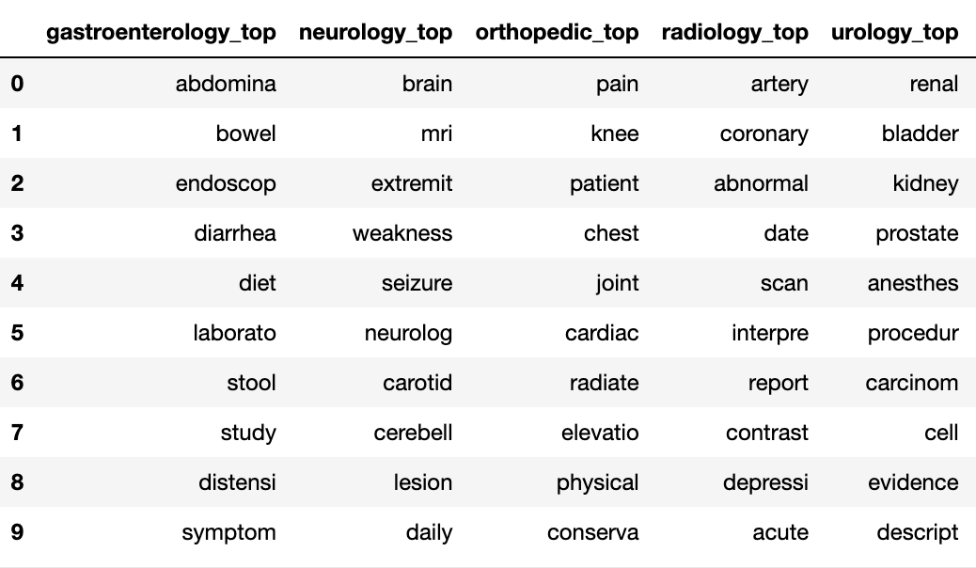
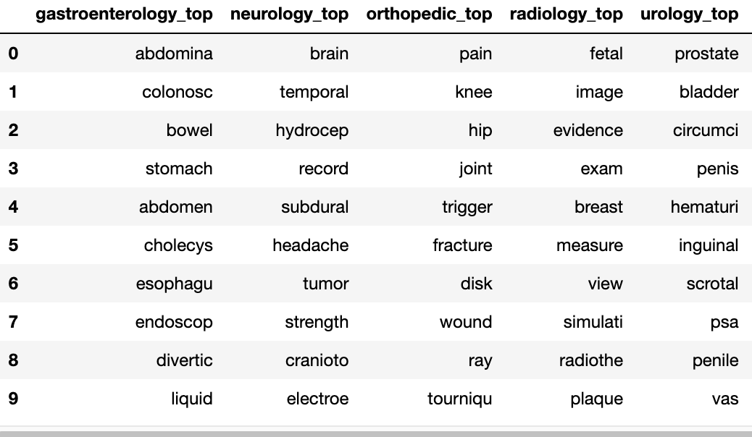
Evaluation: De Novo (Feature Importance)
SYNTHETIC
REAL
% similarity:
Per domain = [30, 10, 30, 0, 20]
Average = 18%
Radiology is hard to predict.
% relevance:
Per domain = [70, 90, 60, 70, 50]
Average = 68%
Generated reports possibly have different distribution, but still useful.

Slide 33
Conclusion
SECTION 5

Slide 34
Conclusion
Few-shot prompting is best for de-novo text generation.
Chained prompts are best for paraphrasing.
Generated reports is a mix of:
Noisy reports,
Reports from real reports distribution,
Reports from a separate distribution
Generation highly dependent on model type and prompt structure.

Slide 35
Future Steps
SECTION 6

Slide 36
Future Steps: Fine-tuning using QLoRA
Quantized Config
Model Tokenizer
Load quantized model
Tokenize reports
Apply LoRA on model
Create a custom Pytorch Dataset
Will need better GPU though!
Train

Slide 37
Future Steps: Fine-tuning using QLoRA
Larger distribution of data learnt.
Greater alignment.
Easier prompts.
LLM will turn few-shot into 0-shot capabilities.
Greater token windows available for prompt/generation.
Same prompts can be used.
Future Steps: Misc.
Explore latest open source LLMs.
Test on real private data.

Slide 38
End of Presentation
THANK YOU

