Slide 1
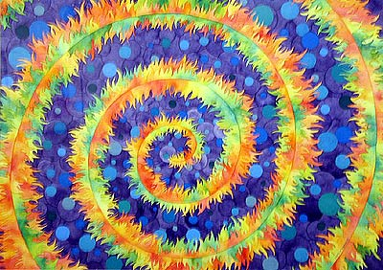
Archimedean Spiral
By
Levi Basist
And Owen Lutje

Slide 2

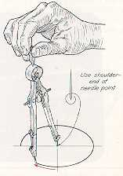
History of the Archimedean Spiral
The Archimedean spiral was created by, you guessed it, Archimedes. He created his spiral in the third century B.C. by fooling around with a compass. He pulled the legs of a compass out at a steady rate while he rotated the compass clockwise. What he discovered was a spiral that moved out at the same magnitude to which he turned the compass and kept a constant distant between each revolution of the spiral.

Slide 3
Ancient Spiral Uses
The Archimedean spiral was used as a better way of determining the area of a circle. The spiral improved an ancient Greek method of calculating the area of a circle by measuring the circumference with limited tools. The spiral allowed better measurement of a circle’s circumference and thus its area. However, this spiral was soon proved inadequate when Archimedes went on to determine a more accurate value of Pi that created an easier way of measuring the area of a circle.

Slide 4
What is the Archimedean Spiral?
The Archimedean Spiral is defined as the set of spirals defined by the polar equation r=a*θ^{(1/n)}
The Archimedes’ spiral, among others, is a variation of the Archimedean spiral set.
Spiral Name | n-value
Archimedes’ Spiral | 1
Hyperbolic Spiral | -1
Fermat’s Spiral | 2
Lituus | -2

Slide 5
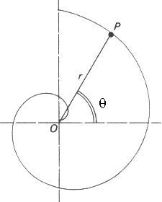
General Polar Form

Slide 6
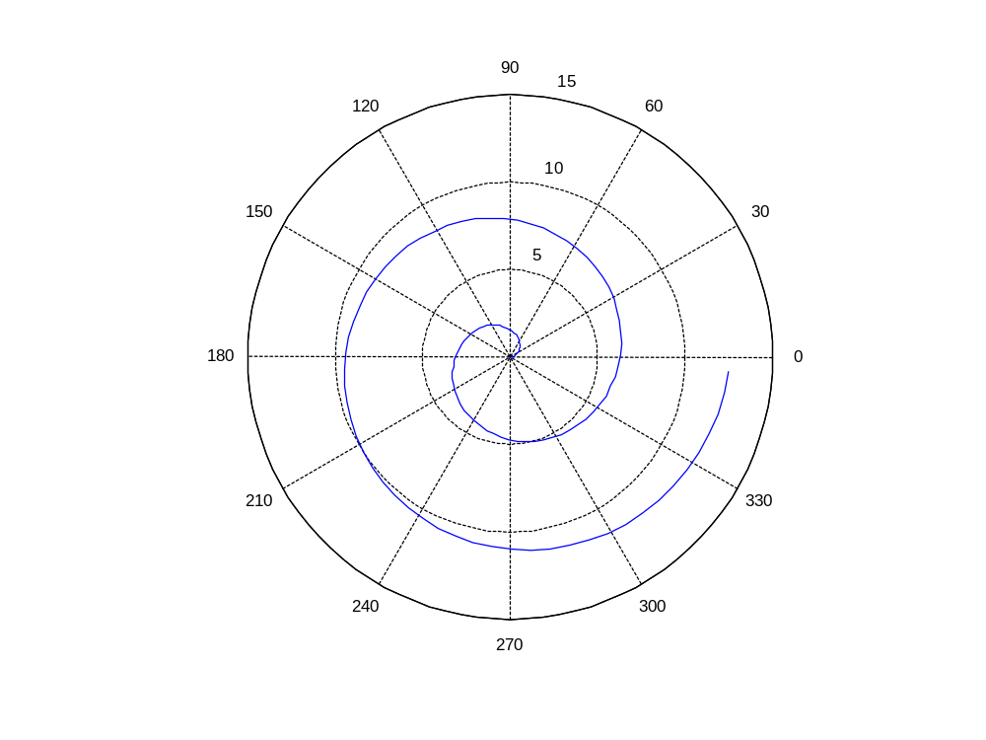
Archimedes’ Spiral
Equation: r=a*θ^{(1/1)}

Slide 7
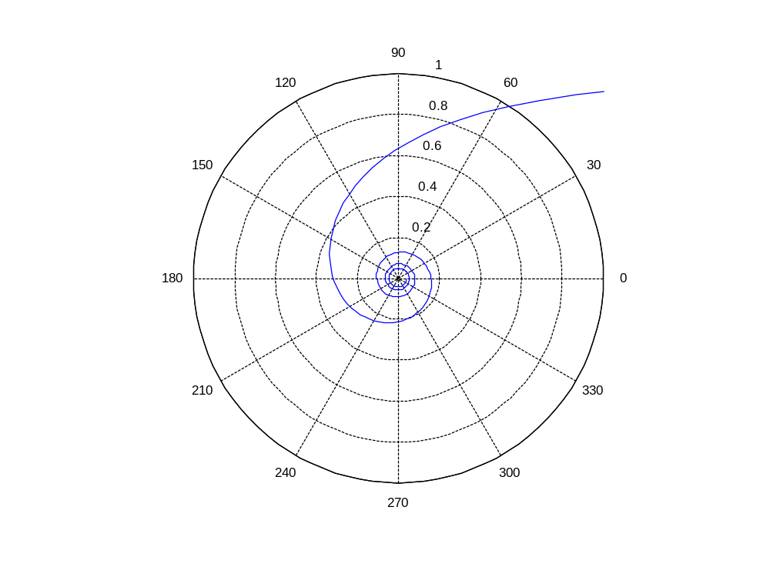
Hyperbolic Spiral
Equation: r=a*θ^{(1/-1)}

Slide 8
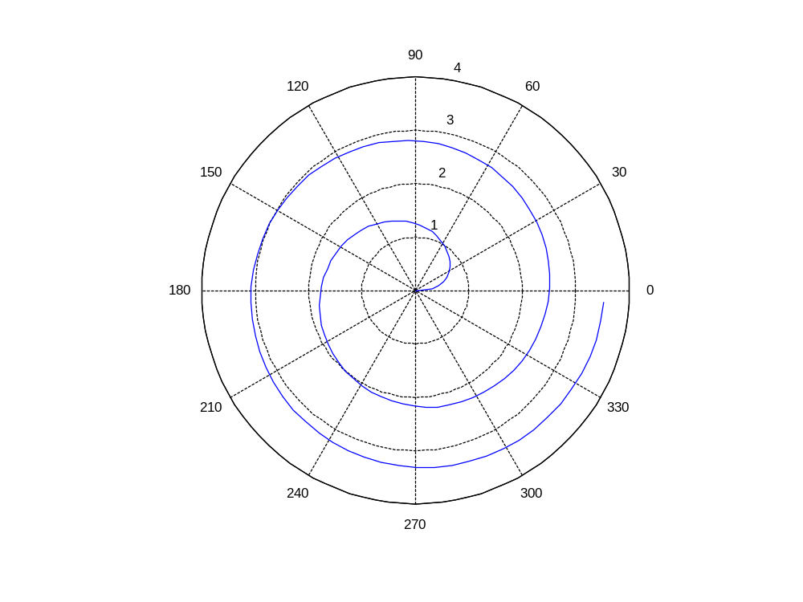
Fermat’s Spiral
Equation: r=a*θ^{(1/2)}

Slide 9
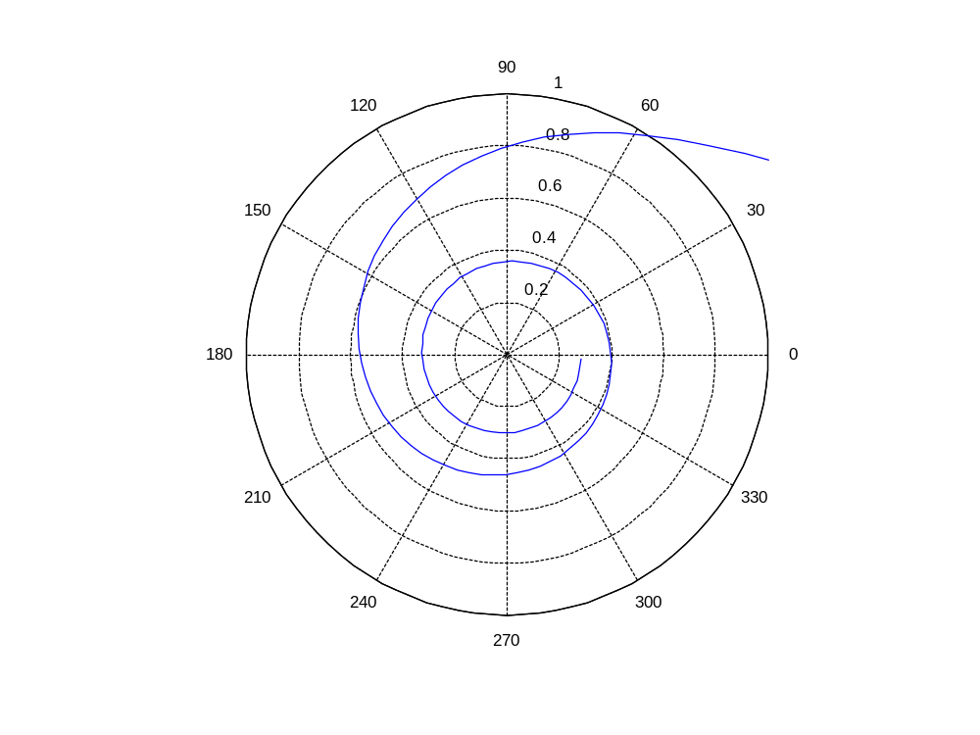
Lituus Spiral
Equation: r=a*θ^{(1/-2)}

Slide 10
Parameterization of Archimedes’ Spiral
Start with the equation of the spiral r=a*(θ).
Then use the Pythagorean Theorem.
x²+y²=r² (r= radius of a circle)
We will also use …
y=r*sin(θ)
x=r*cos(θ)

Slide 11
Now back to the equation:
First square r=a*(θ)
r²=a²*(θ)²
Then replace r and solve for y:
x²+y²=a²*(θ)²
y² = a² *(θ)² –x²
y²=a²*(θ)²-r²*cos(θ)²
y=sqrt(a²*θ²-r²*cos(θ)²)
Once again replace r and solve:
y=sqrt(a²*θ²-(a*θ)²*cos(θ)²) since [r=a*θ]
y=sqrt(a²*θ²*(1-cos(θ)²))
y=sqrt(a²*θ²*sin(θ)²)
y= |a*θ*sin(θ)|

Slide 12
now solve for x:
x²+y²=a²*(θ)²
x² = a² *(θ)² –y²
x²=a²*(θ)²-r²*sin(θ)²
x=sqrt(a²*θ²-r²*sin(θ)²)
Replace r and solve:
x=sqrt(a²*θ²-(a*θ)²*sin(θ)²) since [r=a*θ]
x=sqrt(a²*θ²*(1-sin(θ)²))
x=sqrt(a²*θ2*cos(θ)²)
x= |a*θ*cos(θ)|

Slide 13
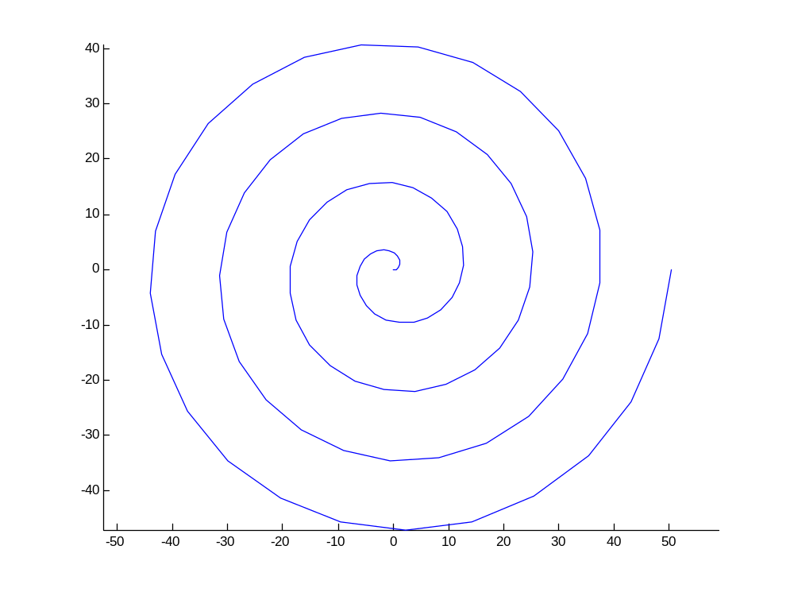
Parameterized Graph

Slide 14
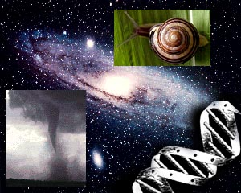
Real Life Spirals
The spiral of Archimedes (derived from the Archimedean spiral) can be found throughout nature and industry.

Slide 15
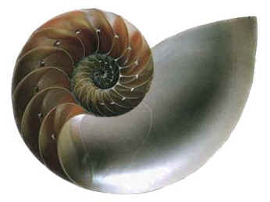
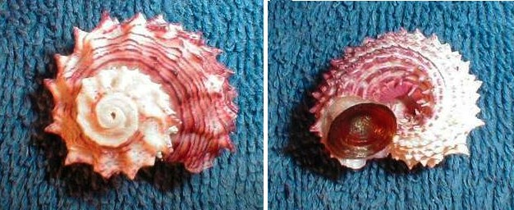
Spirals Found in Nature
Seen here are the shells of a chambered nautilus and other sea shells with equiangular spirals

Slide 16
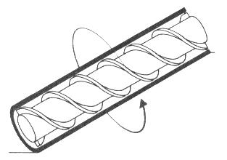
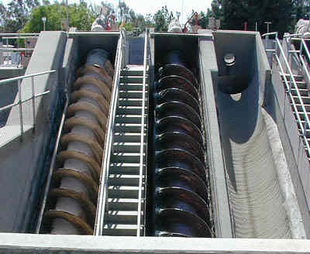
Industrial Uses
This is Archimedes Screw, a device used for raising water. The lower screw is capable of pumping an average of 8 million gallons of water per day.

Slide 17
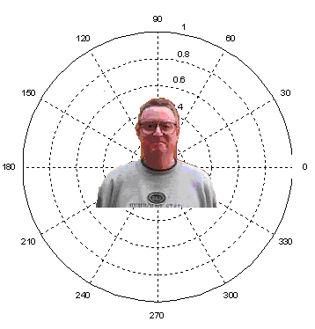
And finally…
The Spiral of Dave
Have a great summer everybody!
The End!

