Slide 1
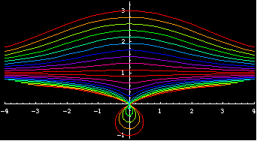
The Conchoid of Nicomedes

Slide 2
Definition
con·choid ˈkɒŋ kɔɪd/ [kong-koid]
–noun
a plane curve such that if a straight line is drawn from a certain fixed point, called the pole of the curve, to the curve, the part of the line intersected between the curve and its asymptote is always equal to a fixed distance.
Equation: r = a ± k sec(θ).

Slide 3
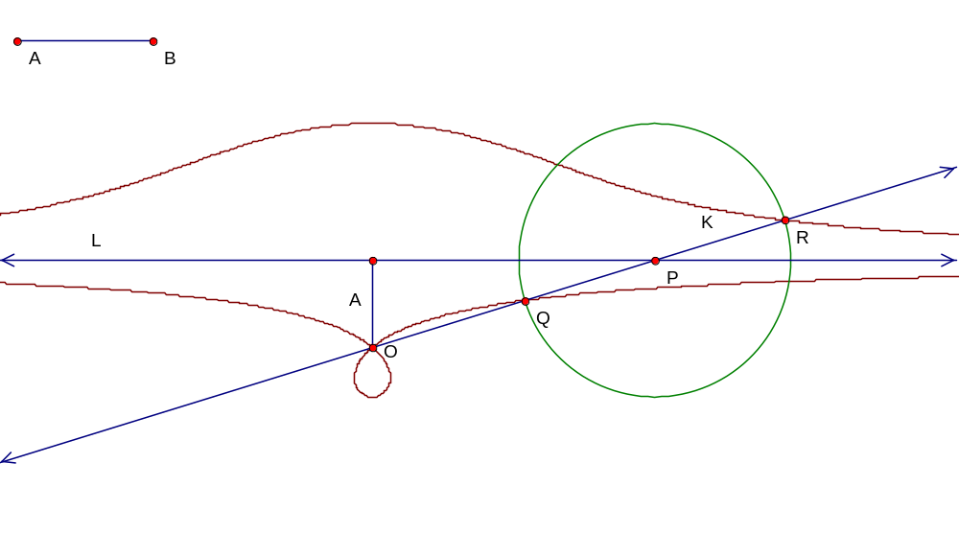
What does that mean?
The conchoid is defined as the locus of points Q and R as the point P moves along the line L with respect to the pole O. As the radius of the circle K is always fixed, to get different results, the distance between L and the pole, A, can be varied. The ratio of A to K is what determines what the curve will look like.

Slide 4
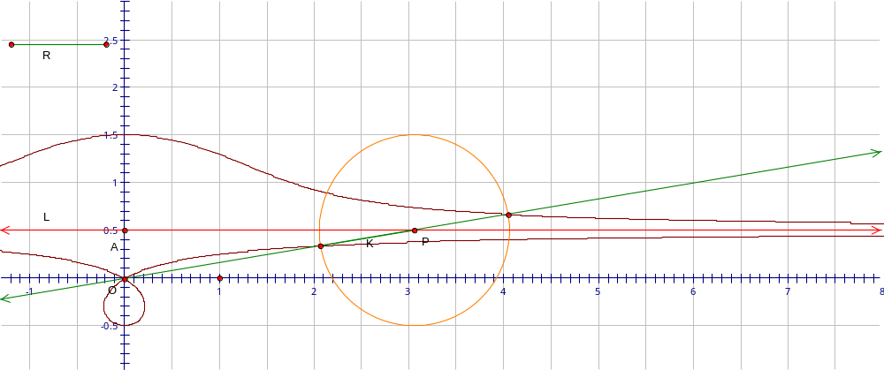
With A/K <1
Note: When A/K < 1, the bottom locus forms a loop at the pole

Slide 5
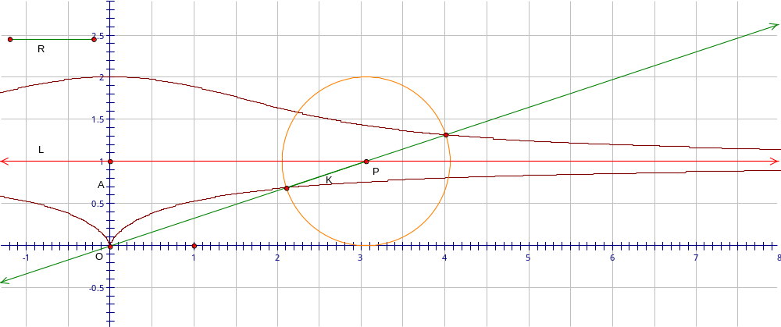
A/K = 1
Note: There is no loop once A/K reaches 1

Slide 6
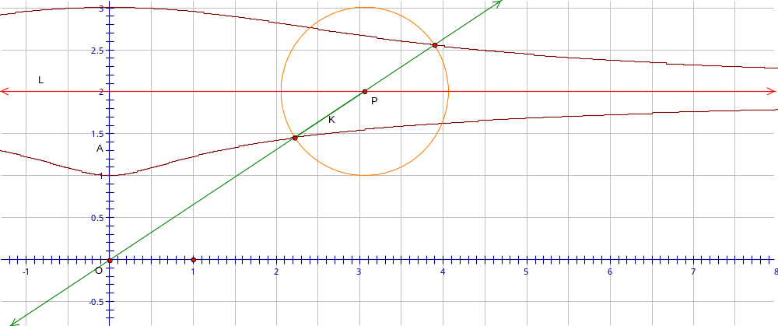
A/K > 1
Note: As A/K increases, the loci get straighter,

Slide 7
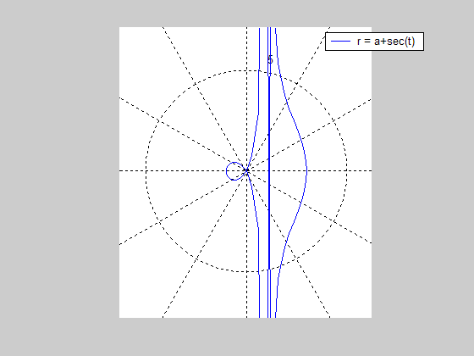
Conchoid in Polar Form
(complete with asymptote…)

Slide 8
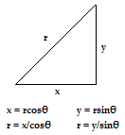
Parameterization of the Conchoid
Given our polar equation:
r = a + k*sec (θ)
We can simply sub in x/cosθ or y/sinθ for r using the physics geek’s triangle.

Slide 9
Parameterization (cont.)
Solving for x with the substitution:
r = a + k*secθ (r = x/cosθ)
x/cosθ = a + k/cosθ (secθ = 1/cosθ)
x = a*cosθ + k
Solving for y with the substitution:
r = a + k/cosθ (r = y/sinθ)
y/sinθ = a + k/cosθ
y = a*sinθ + k*tanθ

Slide 10
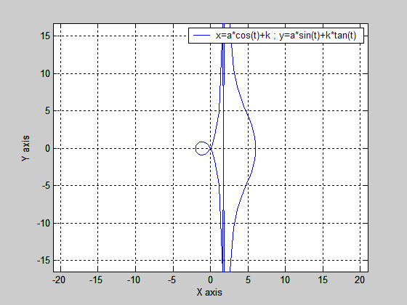
Conchoid in Parametric Form

Slide 11
History
The name conchoid is derived from Greek meaning “shell”, as in the word conch. The curve is also known as cochloid. The Conchoid of Nicomedes was conceived by the Greek mathematician, Nicomedes (surprised?). His primary purpose in making this curve was to solve the angle trisection problem. But it also could be used to solve the problem of doubling the cube.

Slide 12
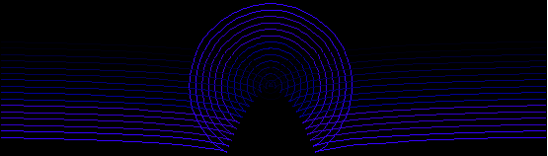
References
Xah: Special Place Curves
http://www.xahlee.org/SpecialPlaneCurves_dir/ConchoidOfNicomedes_dir/conchoidOfNicomedes.html
Conchoid
http://en.wikipedia.org/wiki/Conchoid
Adam Heberly - The Conchoid of Nicomedes
http://online.redwoods.cc.ca.us/instruct/darnold/CalcProj/Fall98/AdamH/Conchoid_Nicomedes_Finalb.htm

