Slide 1
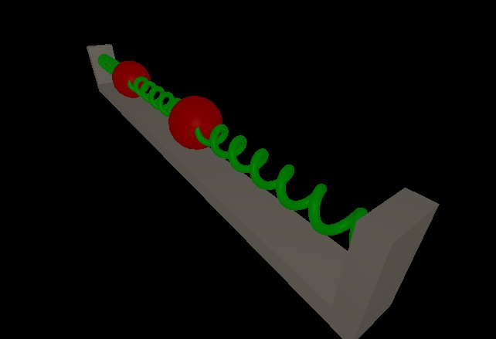
Coupled Oscillators
By: Alex Gagen
and Sean Larson

Slide 2

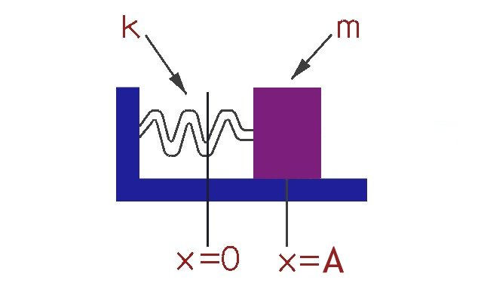
Single Oscillator
Spring and Mass System

Slide 3
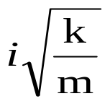
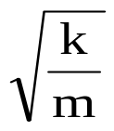
Finding the General Solution
(Damping is Ignored)
Using Newton's Second Law on the mass:
mx” + kx = 0, where m and k > 0
We guess the solution:
x= e^{λt} x’=λe^{λt} x”= λ²e^{λt}
Solving for the Eigenvalues:
λ = ± Let ω = , the natural frequency
This gives us: λ = ± iω

Slide 4
Euler's Formula gives:
x= e^{iωt}
= cos(ωt) + isin(ωt)
Both the imaginary and the real parts are solutions.
x =c₁cos(ωt)+c₂sin(ωt)
↓
= Acos(ωt-φ)
Where A is the amplitude, ω is the natural frequency and phi is the phase shift.

Slide 5
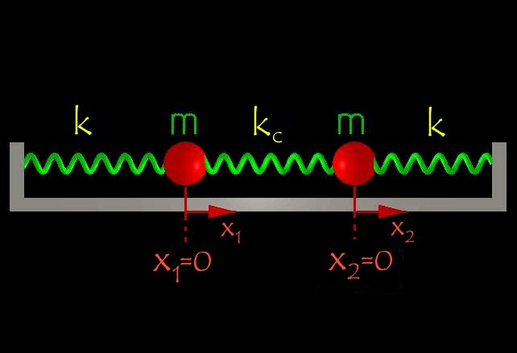
Coupled Oscillators:
Coordinate System

Slide 6
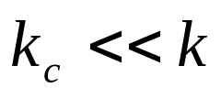
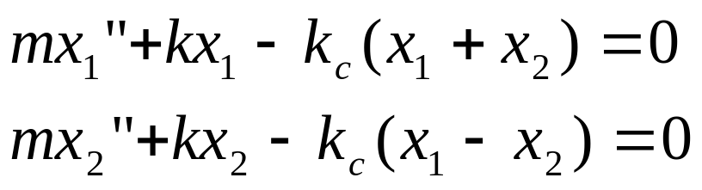
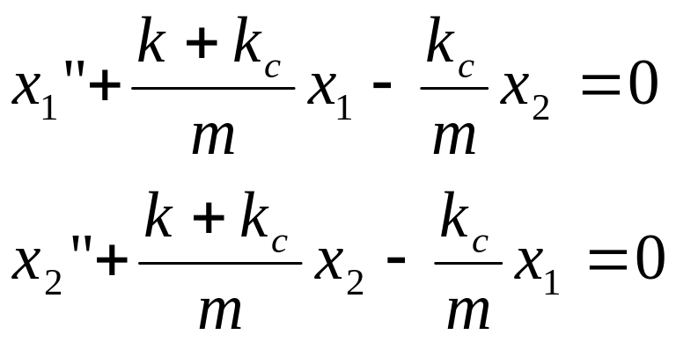
Derivation
Of the General solution
Newton’s 2nd Law:
Coupling terms
(1)
(2)

Slide 7
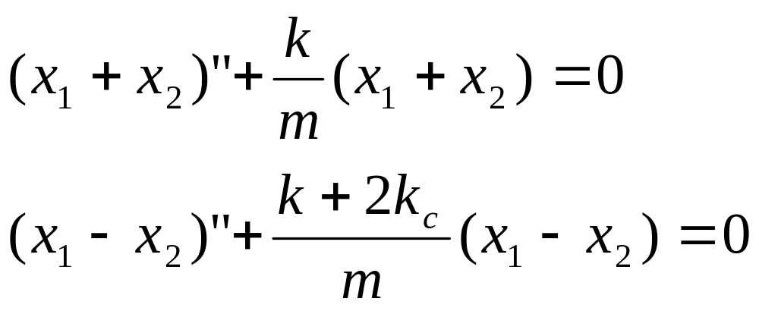
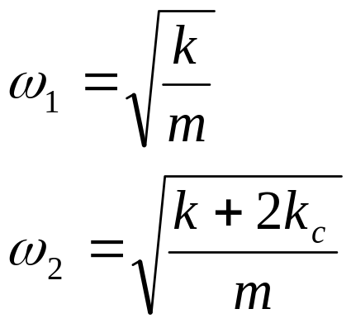
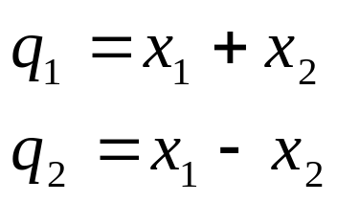
Normalize
Add (1) and (2):
Subtract (2) from (1):
Let
Normal Coordinates and Frequencies

Slide 8
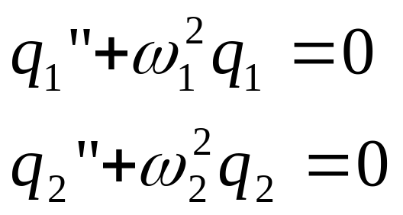
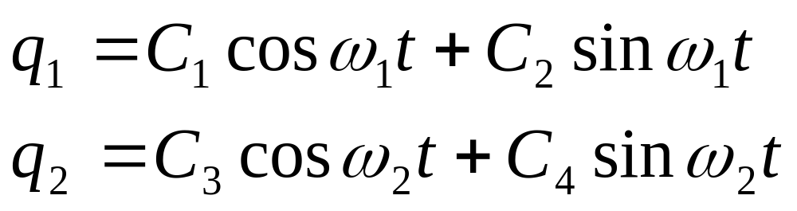
With those variables substituted in:
Neither Equation is Coupled!
Both Equations match the form of the uncoupled oscillator. Therefore:

Slide 9
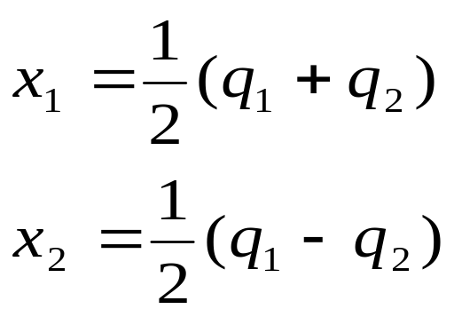
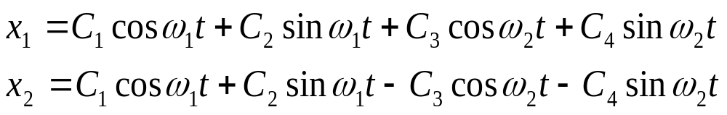
The General Solution
Knowing that:
We do some substitution and achieve...

Slide 10
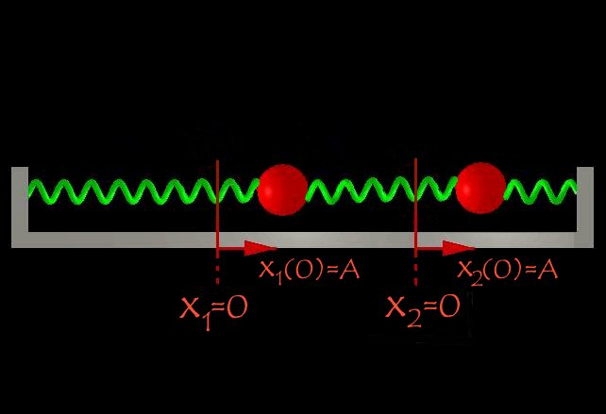
Symmetric Mode:
x₁(0) = A
x₂(0) = A
x₁’(0) = 0
x₂’(0) = 0

Slide 11
Derivation….
x₁(0) =C₁ + C₃ = A
x₂(0) = C₁ - C₃ = A
x₁’(0) = C₂ω₁+ C₄ ω₂ = 0
x₂’(0) = C₂ω₁ - C₄ ω₂ = 0
C₁ = A
C₂ = C₃ = C₄ = 0

Slide 12
The General Solution

Slide 13
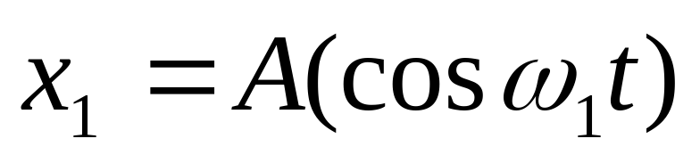
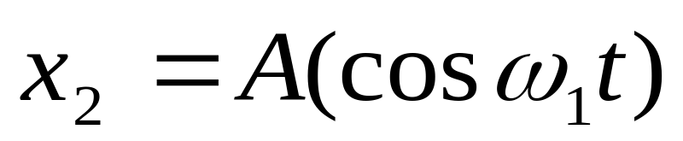
Our Solution Is...

Slide 14
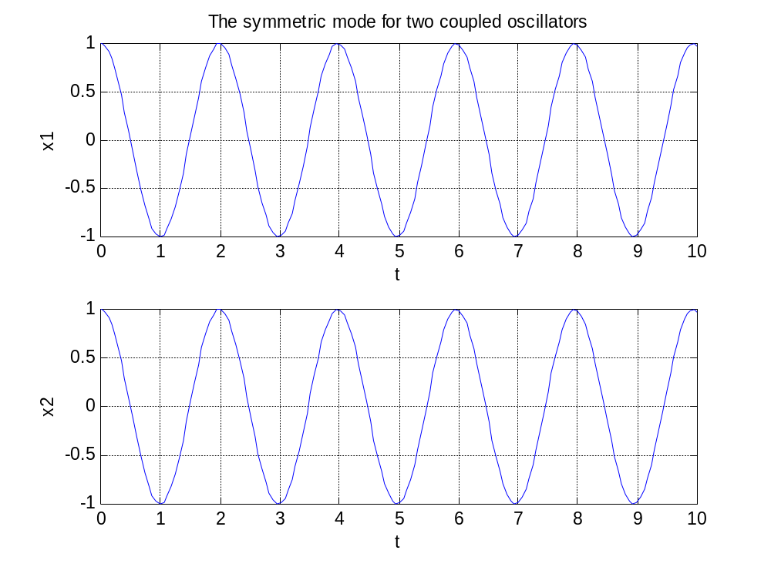

Slide 15
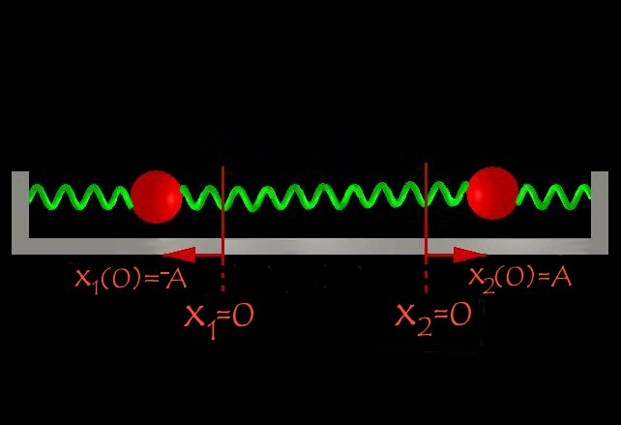
Non-symmetric Mode:
x₁(0) = -A
x₂(0) = A
x₁’(0) = 0
x₂’(0) = 0

Slide 16


Derivation….
x₁(0) =C₁ + C₃ = -A
x₂(0) = C₁ - C₃ = A
x₁’(0) = C₂ω₁+ C₄ ω₂ = 0
x₂’(0) = C₂ω₁ - C₄ ω₂ = 0
C₃ = -A
C₁ = C₂ = C₄ = 0
Are solution is:

Slide 17
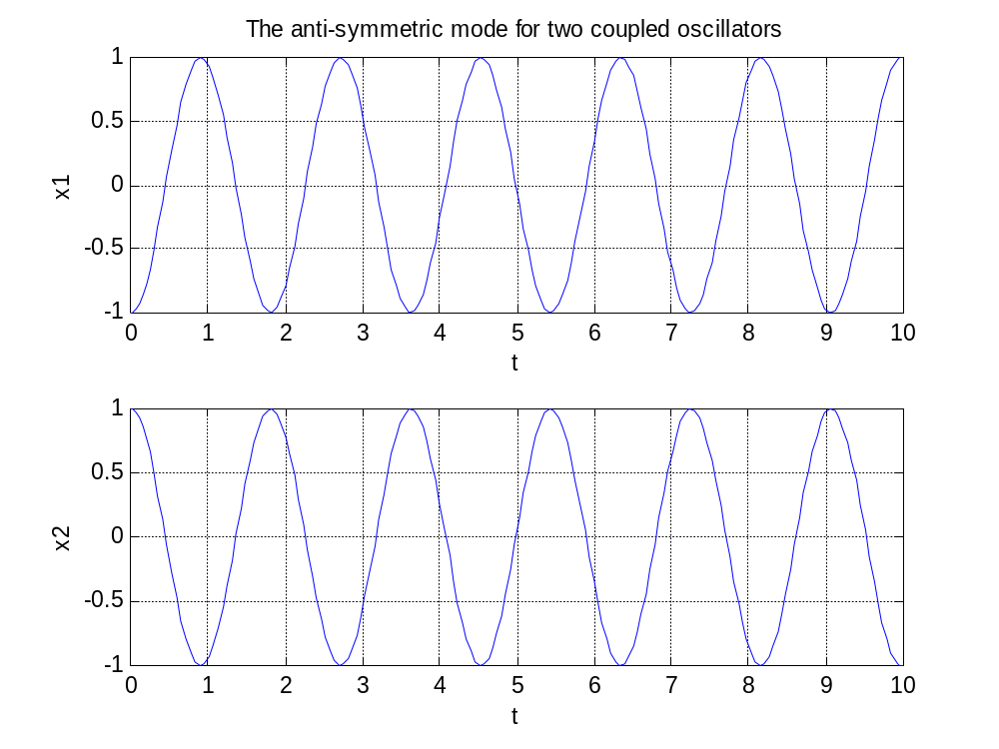

Slide 18
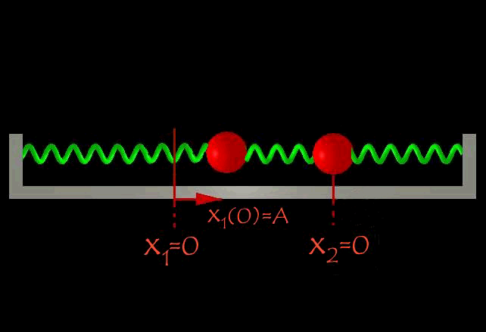
General Case:
x₁(0) = A
x₂(0) = 0
x₁’(0) = 0
x₂’(0) = 0

Slide 19
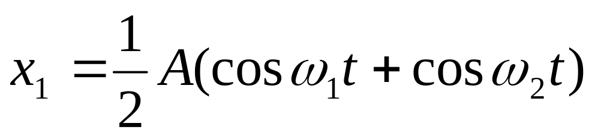
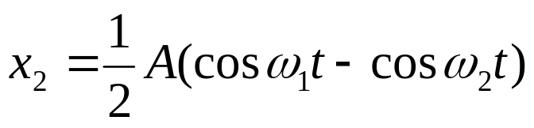
x₁(0) =C₁ + C₃ = A
x₂(0) = C₁ - C₃ = 0
x₁’(0) = C₂ω₁+ C₄ ω₂ = 0
x₂’(0) = C₂ω₁ - C₄ ω₂ = 0
C₁ = C₃ = (1/2)A
C₂ = C₄ = 0
The Solution becomes:

Slide 20
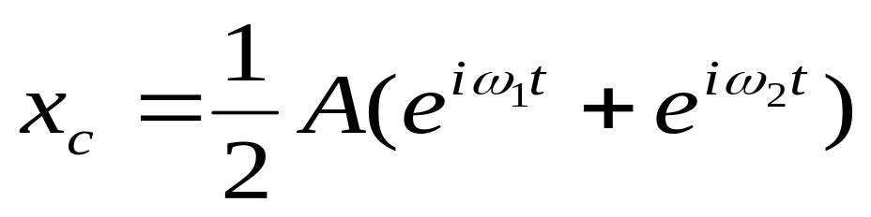
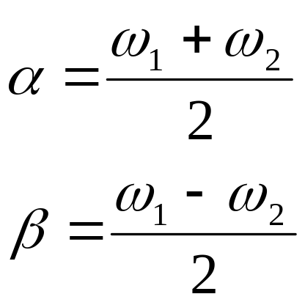
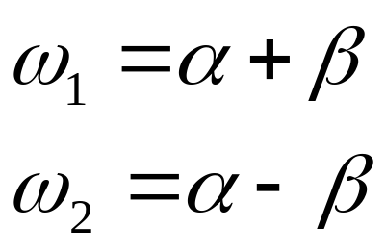

Slide 21
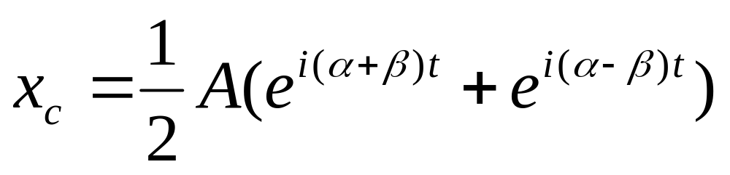
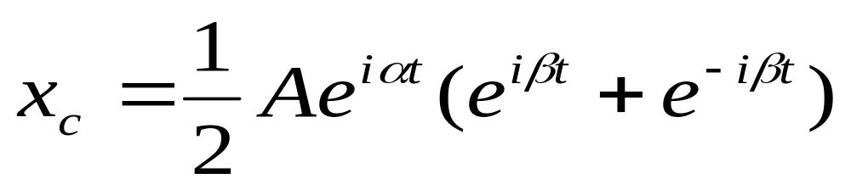
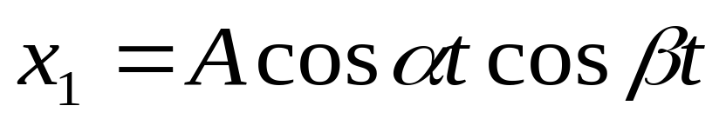
Using Euler’s Formula:
Remember that x₁= Re(x_{c})

Slide 22
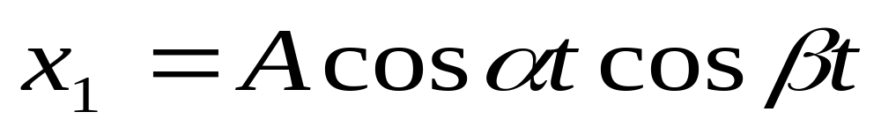
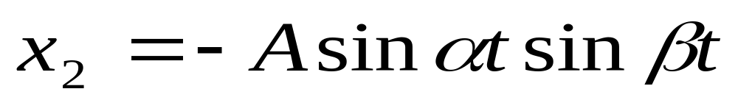
Rapid
Slow
In a similar manner x₂ is found to be:

Slide 23
