Slide 1

The Force of a Falling Chain
By
Gina Giacone and Linda Lindsley

Slide 2

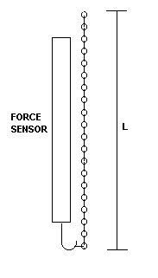
The Set-up:
“A very flexible uniform chain of length L and mass M is suspended from one end so that it hangs vertically,” the other end is hooked on a force sensor, though it exerts no force at the beginning.

Slide 3

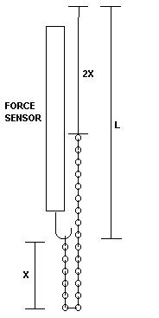
The Problem:
To calculate the force that the chain exerts on the sensor as it falls to a position hanging from the hook of the sensor

Slide 4

The force exerted by the chain on the sensor is a combination of two forces:
The impulse force(momentum) of each link as it is stopped by the link above it (F₁), and
the weight force of the links already hanging from the hook(F₂).
The total force (F_{T}) exerted on the sensor is:
F_{T} = F₁ + F₂

Slide 5

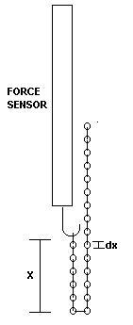
The chain itself is made up of links that are individual mass elements (dm), which are associated with their length increments (dx).

Slide 6

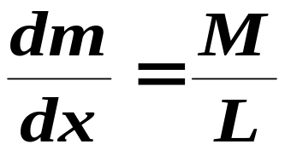
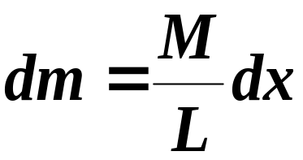
These individual masses and lengths are related to the mass and length of the entire chain by:
Rearranging this we get:

Slide 7
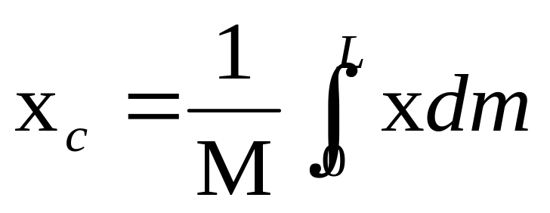
Center of Mass:

Slide 8

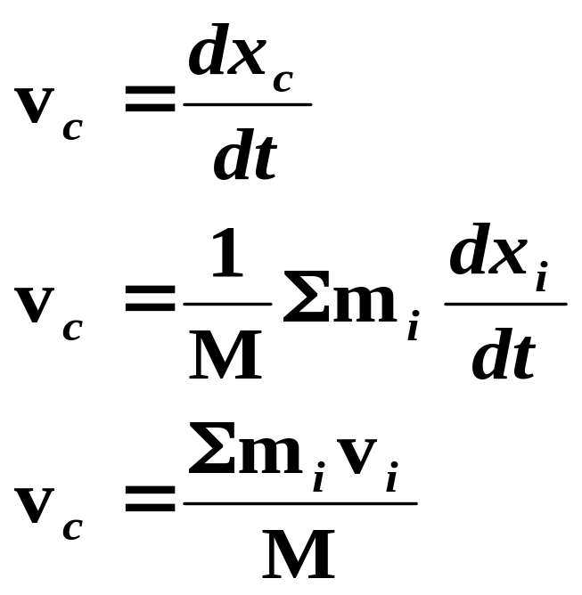
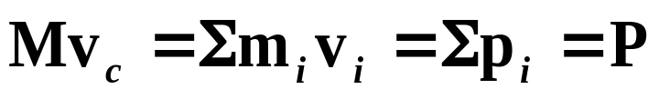
Velocity of the center of mass:
Rearranging the equation:

Slide 9
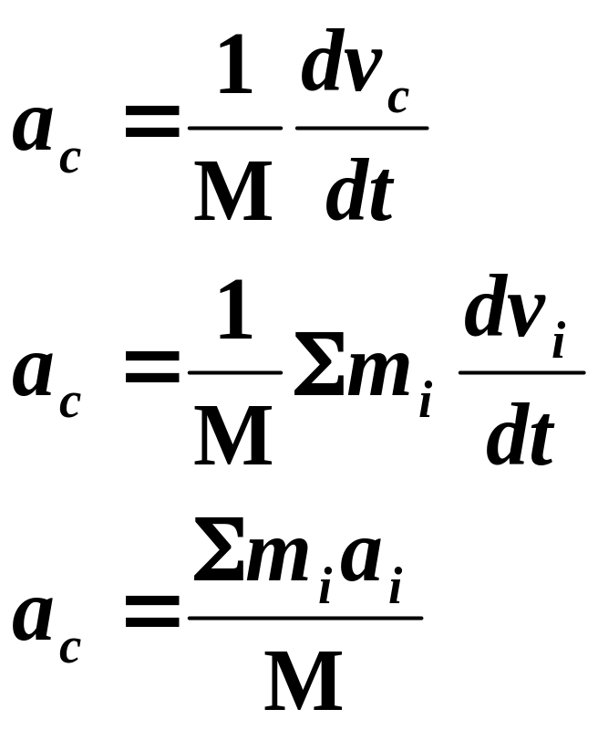
The acceleration of the center of mass is:

Slide 10

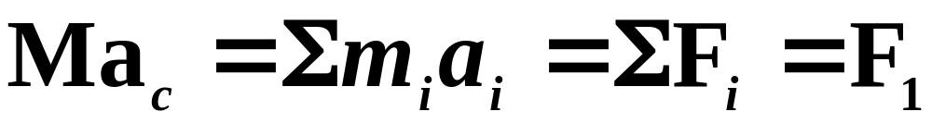
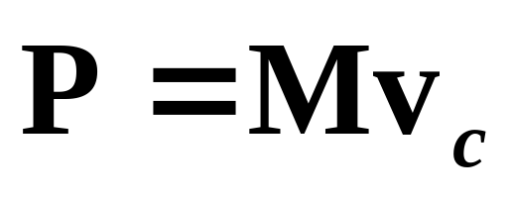
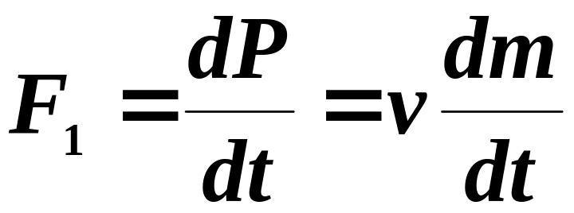
Rearranging this equation we arrive at:
Previously defined is:
So we have a more basic form of Newton’s Second Law:

Slide 11
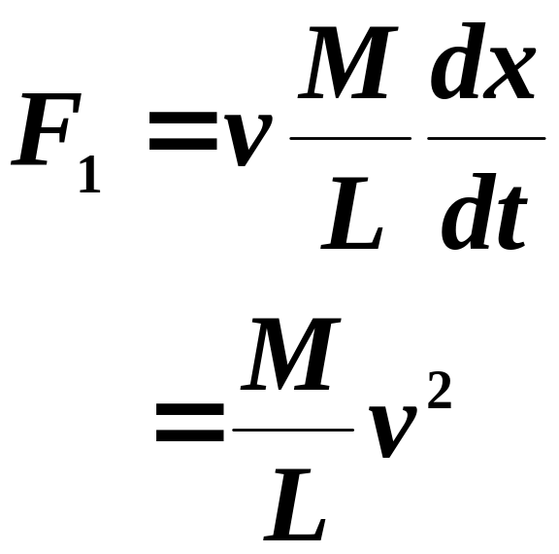
Substituting dm into the previous force equation:

Slide 12
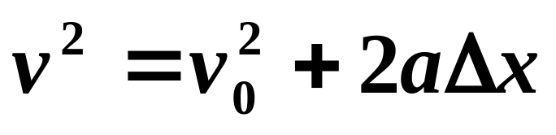
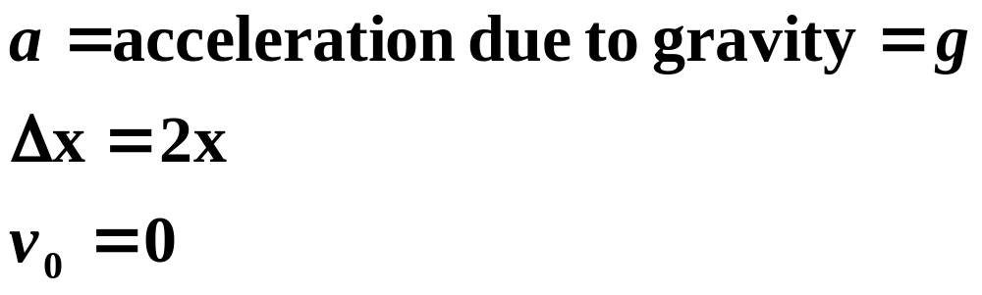
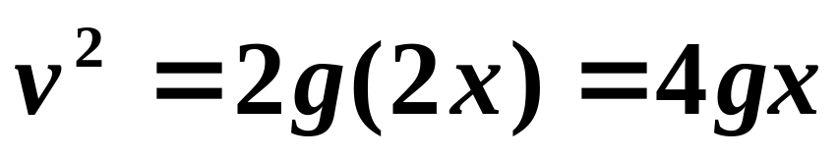
Using Newton’s Second Law:
Where,
Then,

Slide 13

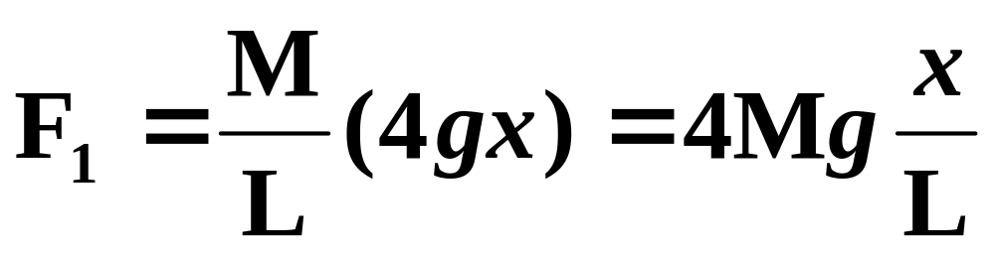
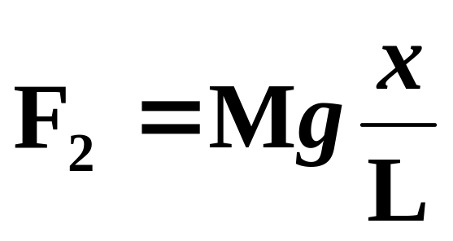
Substituting this into the previous equation,
In addition to the force of the falling link, the chain already hanging on the sensor exerts a force equal to its weight force,

Slide 14
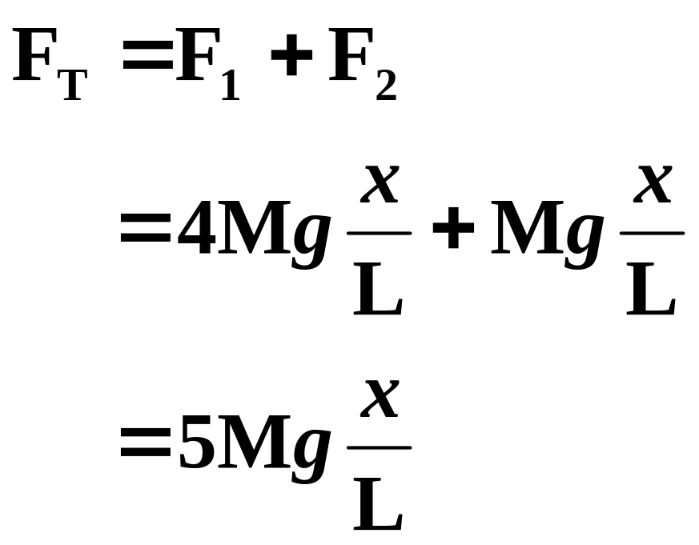
So, the total instantaneous force exerted on the sensor as the final link falls is,

Slide 15
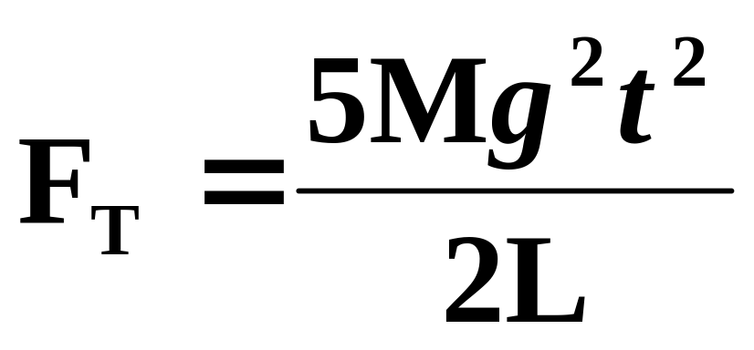
Since the sensor measures only force versus time, a substitution of x=0.5gt² is made,

Slide 16

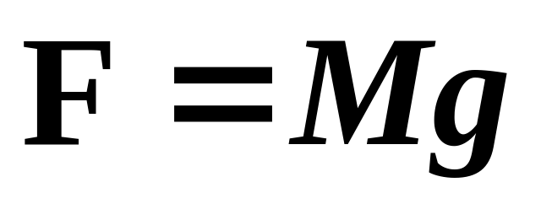
As the final link comes to rest:

Slide 17
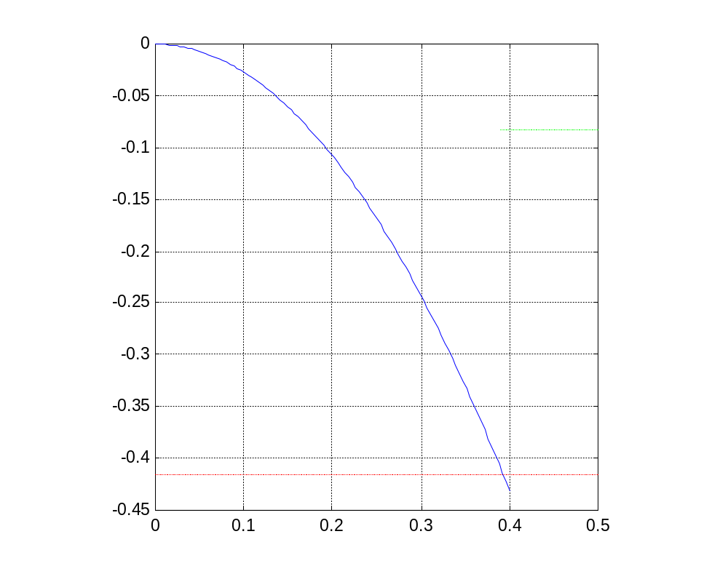
Graph of Theoretical Values:
____ Falling Force
____ Weight Force
____ Maximum Force

Slide 18
Experimental Data:
Length: 0.7645 m
Mass: 0.008479 Kg
Weight: 0.0832 N
Five times the weight force:
0.4159 N

