Slide 1
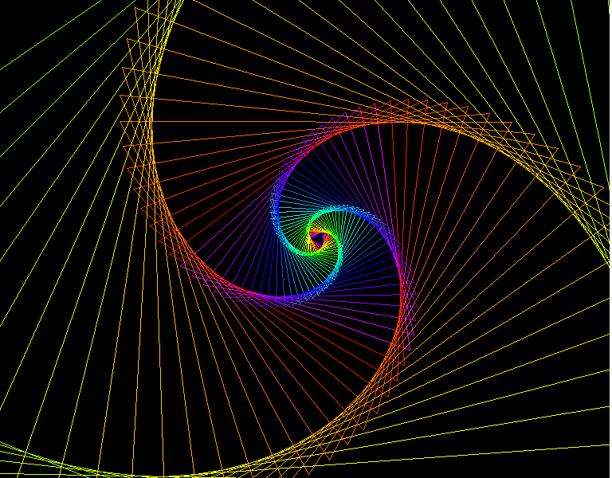
Logarithmic Spiral
  By:
  Graham Steinke
  &
  Stephanie Kline

Slide 2
History of the Logarithmic Spiral
  The Logarithmic curve was first described by Descartes in 1638, when it was called an equiangular spiral. He found out the formula for the equiangular spiral in the 17th century. It was later studied by Bernoulli, who was so fascinated by the curve that he asked that it be engraved on his head stone. But the carver put an Archimedes spiral by accident.

Slide 3
Archimedes v. Logarithmic Spirals
The difference between an Archimedes Spiral and a Logarithmic spiral is that the distance between each turn in a Logarithmic spiral is based upon a geometric progression instead of staying constant.

Slide 4
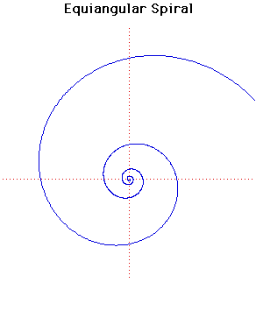
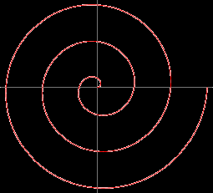
Archimedes v. Logarithmic

Slide 5
WTF is an equiangular spiral?
  An Equiangular spiral is defined by the polar equation:
  r =e^{Θcot(α)}
  where r is the distance from the origin, and alpha is the rotation, and theta is the angle from the x-axis

Slide 6
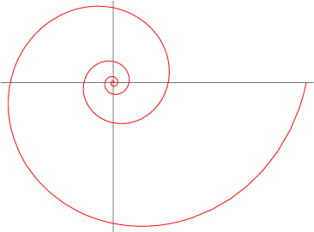
General Polar Form

Slide 7
Parameterization of a logarithmic spiral
  Start with the equation for a logarithmic spiral in polar form:
  r = e^{Θcot(α)}
  then we will use the equation of a circle:
  x² + y² = r²
  we will also be using x = rcos(Θ) & y = rsin(Θ)

Slide 8
Solving for X . . .
  r = e^{Θcot(α)} //square both sides
  r² = e^{2Θcot(α)} //plug in x² + y² for r²
  x² + y² = e^{2Θcot(α)} //subtract y² from both sides
  x² = e^{2Θcot(α)} – y² //plug in rsinΘ for y
  x² = e^{2Θcot(α)} – r²sin²Θ //plug in e^{Θcot(α)} for r
  x² = e^{2Θcot(α)} – e^{2Θcot(α)}sin²Θ //factor e^{2Θcot(α)} out
  x² = e^{2Θcot(α)}(1-sin²Θ) //1-sin²Θ = cos²Θ
  x² = e^{2Θcot(α)}cos²Θ //square root of both sides
  x = e^{Θcot(α)}cosΘ

Slide 9
Solving for Y . . .
  r = e^{Θcot(α)} //square both sides
  r² = e^{2Θcot(α)} //plug in x² + y² for r²
  x² + y² = e^{2Θcot(α)} //subtract x² from both sides
  y² = e^{2Θcot(α)} – x² //plug in rcosΘ for x
  y² = e^{2Θcot(α)} – r²cos²Θ //plug in e^{Θcot(α)} for r
  y² = e^{2Θcot(α)} – e^{2Θcot(α)}cos²Θ //factor e^{2Θcot(α)} out
  y² = e^{2Θcot(α)}(1-cos²Θ) //1-cos²Θ = sin²Θ
  y² = e^{2Θcot(α)}sin²Θ //square root of both sides
  x = e^{Θcot(α)}sinΘ

Slide 10
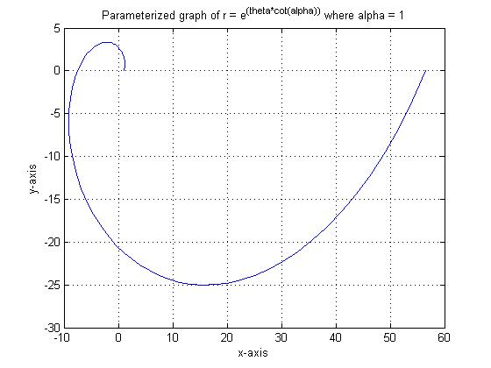
Parameterized Graph

Slide 11
Logarithmic Spirals in something other than a math book
  The logarithmic spiral is found in nature in the spiral of a nautilus shell, low pressure systems, the draining of water, and the pattern of sunflowers.

Slide 12
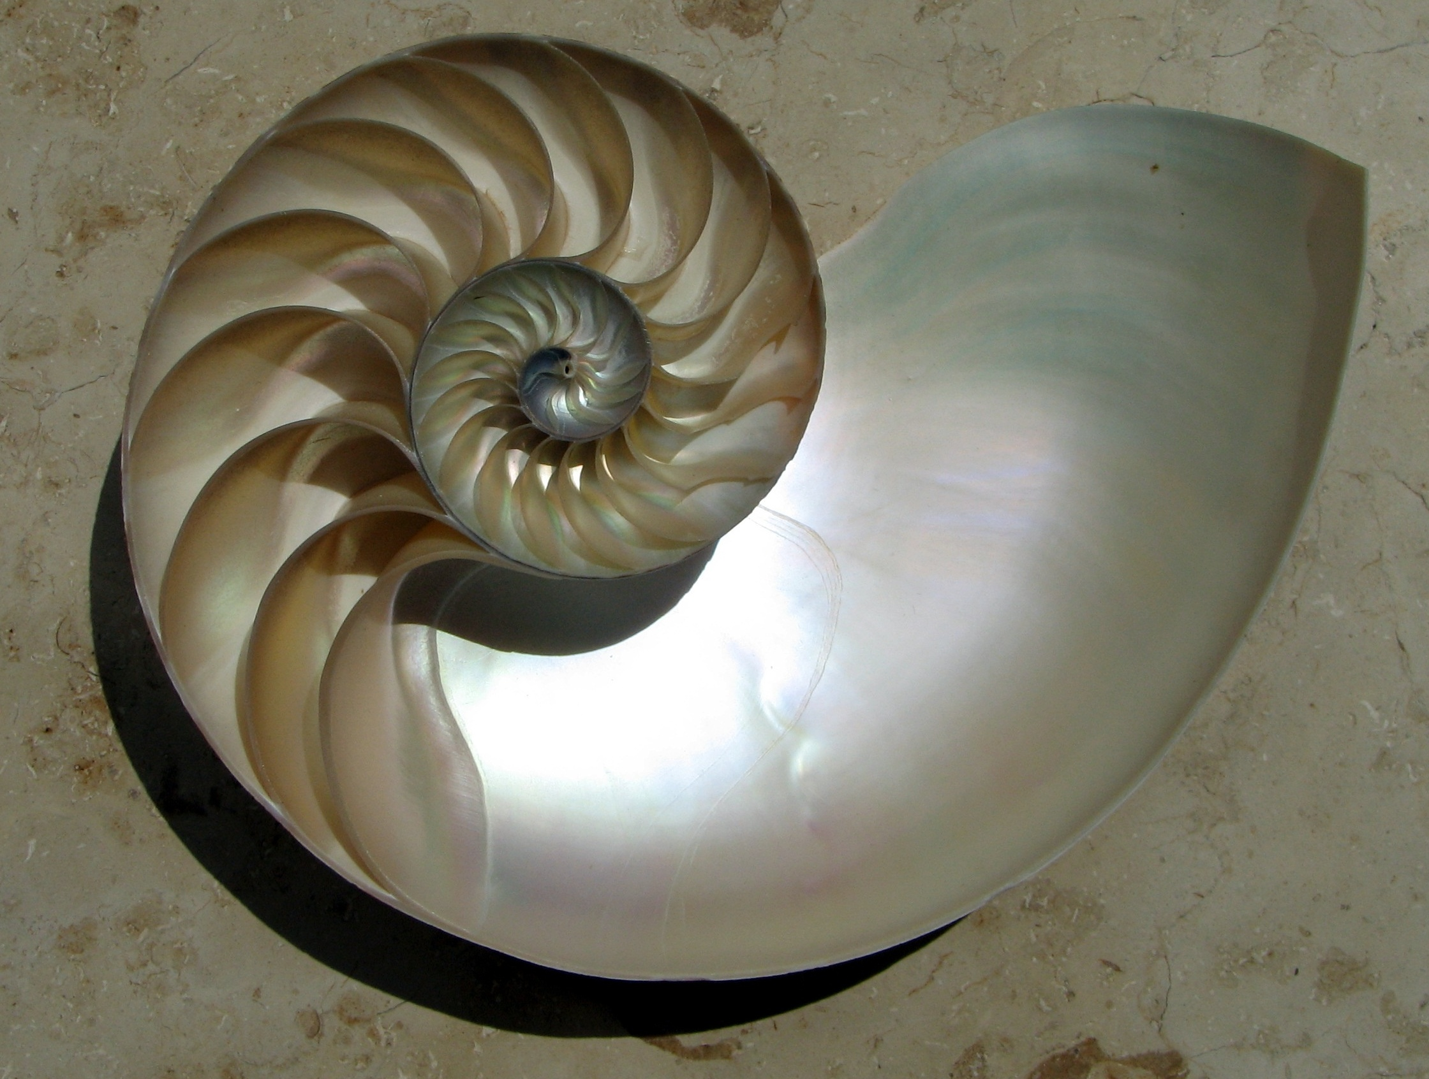
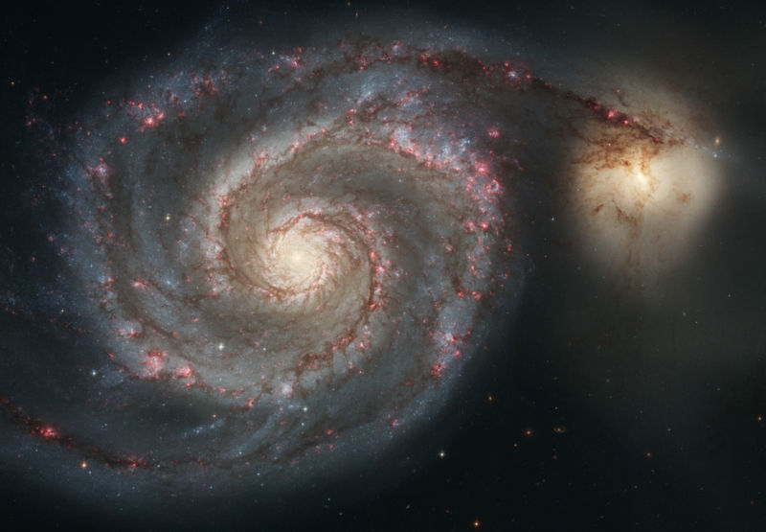

IN NATURE . . .

Slide 13
HAVE A GOOD SUMMER
  THE END!!!

