Slide 1
Graphical MATLAB
Lesson 1: Programming a GUI
Husam Aldahiyat

Slide 2
Functions
Each function has inputs and outputs
For our GUI, we need a function with no inputs or outputs
This is because the function only calls the GUI

Slide 3
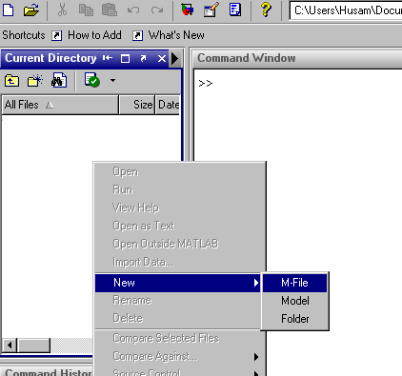
Creating an m File

Slide 4
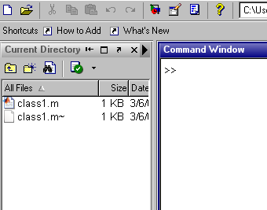
Naming the m File
Be sure the m file has the same name as the function

Slide 5
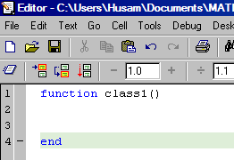
Creating the Function
Make sure the function name is the same as the m file’s.
No input
No output

Slide 6
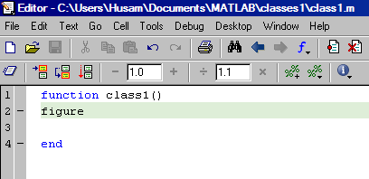
Figure Command
Creates a FIGURE with default properties

Slide 7
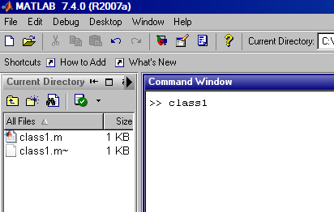
Running the Code
To run the code, do one of the following:
1. Calling it in the main window

Slide 8
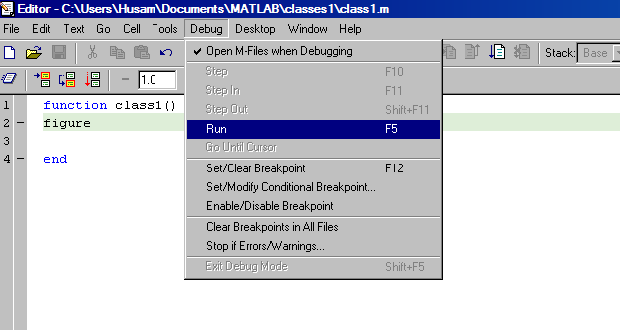
Cont.
2. Go to Debug->Run in editor window

Slide 9
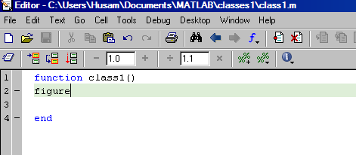
Cont.
Use the shortcut F5 from editor window

Slide 10
Setting Figure Properties
Figures have properties and property values.
Syntax for setting figure properties is:
figure('PropertyName',propertyvalue,…)

Slide 11
Some Figure Properties
PropertyName | PropertyValue | Example
‘name’ | string | ‘Example’
‘MenuBar’ | ‘none’ {‘figure’} | ‘none’
‘NumberTitle’ | {‘on’} ‘off’ | ‘on’
‘color’ | [R, G, B] | [0.5, 0.9, 0.7]
‘units’ | {‘pixels’} ‘normalized’ ‘inches’ ‘centimeters’ ‘points’ ‘characters’ | ‘inches’
‘position’ | [x, y, w, l] | [2, 3, 2, 1]

Slide 12
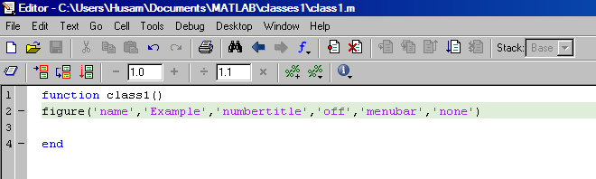
Setting Figure Properties

Slide 13
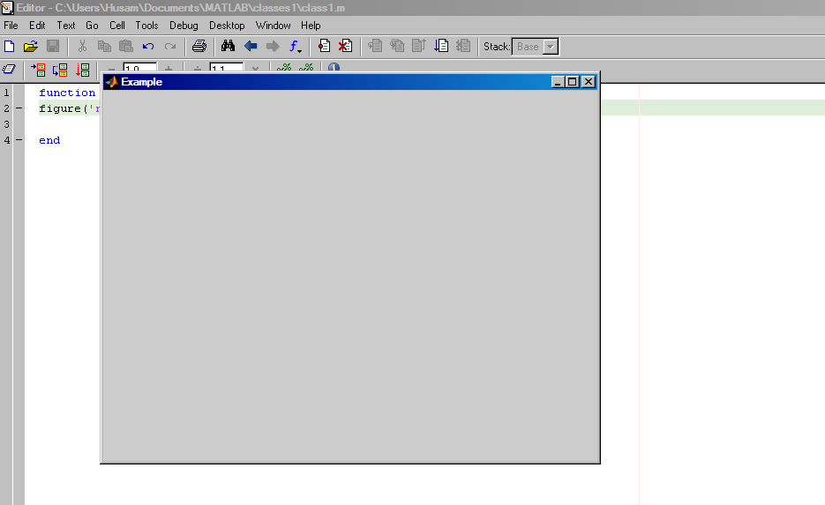
Running the Function

Slide 14
Figure Property: Color
The figure property ‘color’ takes the vector value [R, G, B], where each vector element takes a value in the range [0, 1].
Examples:
[0, 1, 0] = GREEN
[1, 1, 0] = YELLOW
[1, 1, 1] = WHITE
[0.5 0.5 0.5] = GRAY
[0.5 0.2 0.75] = PURPLE

Slide 15
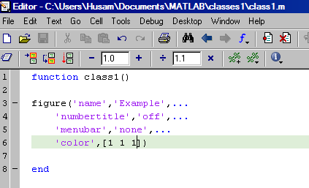
Using “…”
Makes for better readability

Slide 16
Figure Property: Position
Takes the vector value [x, y, w, l]
Each element is a value in the units specified by the figure property ‘units’
x- Distance from left side of the screen
y- Distance from bottom side of the screen
w- Width of figure (horizontally)
l- Length of figure (vertically)

Slide 17
Figure Property: Units
Safest bet is to use the property value ‘normalized’.
With ‘normalized’ chosen, each element is relative to the screen and takes the value in the range of [0, 1].
Bottom left side of the screen is [0, 0].
Upper right side of the screen is [1, 1].

Slide 18
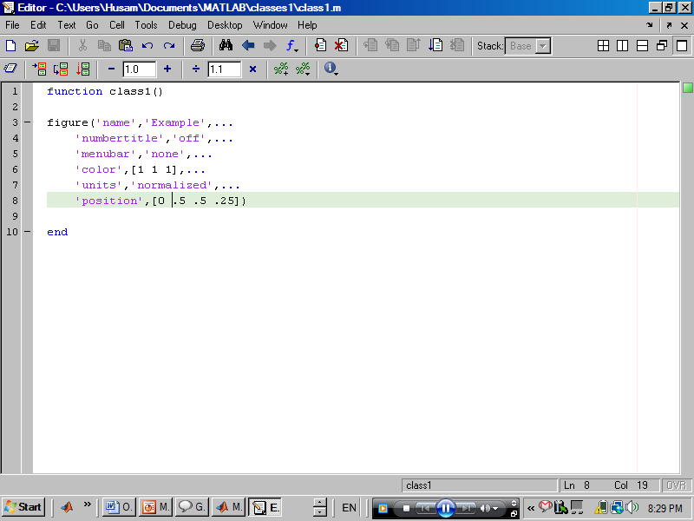
Applying More Properties

Slide 19
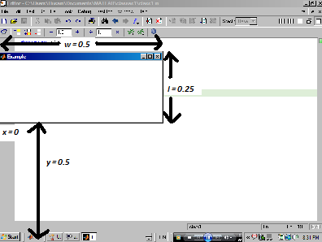
Result

Slide 20
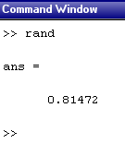
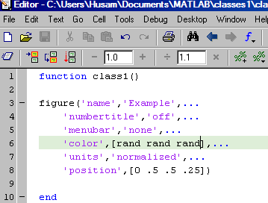
RAND function
Creates a random number in the range [0, 1].
Can be used in [R, G, B] vector
To create a randomly coloured
FIGURE.

Slide 21
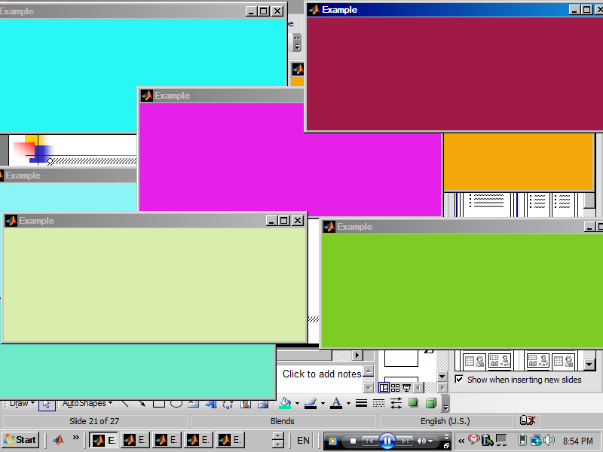
Result

Slide 22
UICONTROL Command
Very important command.
Creates edit boxes, text boxes, pushbuttons, sliders, popup menus and more.
Syntax:
Uicontrol(‘propertyName’,propertyvalue)

Slide 23
UICONTROL Property: ‘Style’
‘style’ property specifies the UICONTROL type and can have one of the following as its value:
pushbutton, togglebutton, radiobutton, checkbox, edit, text, slider, frame, listbox, popupmenu.

Slide 24
UICONTROL Property: Position
‘position’ behaves similarly to the FIGURE property, only here the position is taken relative to the figure window. Likewise, ‘units’ is treated in the same vein.
For example, the point [0, 0] lies on the lower left corner of the figure on which the UICONTROL is laid upon.

Slide 25
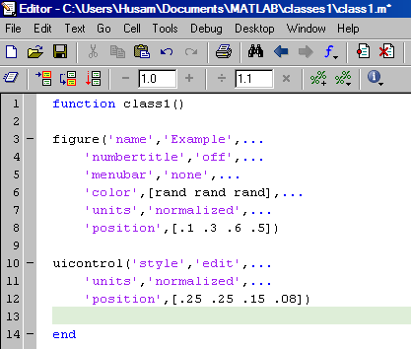
Example

Slide 26
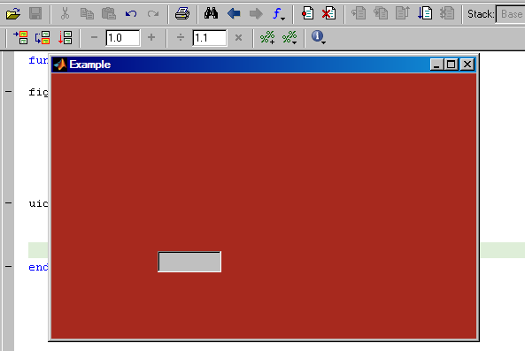
Result

Slide 27
Important UICONTROL Properties
PropertyName | PropertyValue | Example | Explanation
‘string’ | string | ‘Enter Number’ | Writes string in UICONTROL
‘foregroundcolor’ | [R, G, B] | [0, 0, 0] | Font colour
‘backgroundcolor’ | [R, G, B] | [1, 1, 1] | UICONTROL colour
‘visible’ | {‘on’} ‘off’ | ‘off’ | Sets UICONTROL to visible/invisible
‘callback’ | String or function handle | @myfunc1 | Execute specified function on UICONTROL interaction

Slide 28
Creating Another UICONTROL
Let’s create another UICONTROL, namely a text box.
Notice how the (y) element of position is slightly higher than that of the our edit box.

Slide 29
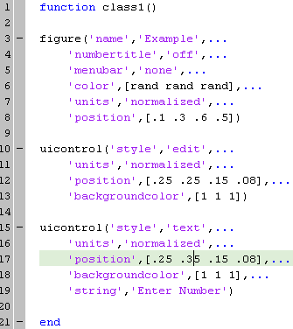

Slide 30
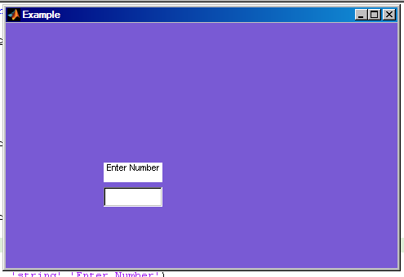
Result

Slide 31
Problem
Notice how the background colour of the text box is distracting
It would be better if the ‘backgroundcolor’ property was set to the same as that of the FIGURE.
However, the FIGURE has a random colour combination, so what is the solution?
We need to use the command GET.

Slide 32
GET Command
Along with the command SET, essential commands for GUI building
Syntax:
get(handle,’propertName’)

Slide 33
Giving Handles to Objects
We need to give handles for objects so we could reference them later.
Not all objects need handles; only those which will be referenced later.
Nearly anything can be given a handle.

Slide 34
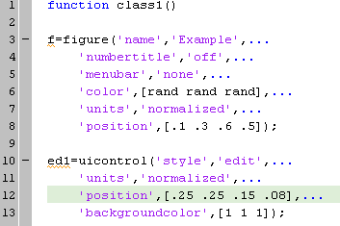
Examples

Slide 35
Using GET
Now that you’ve given something a handle, you can obtain its properties for later use, as shown.
First, get the colour of the created FIGURE (with handle “f”)

Slide 36
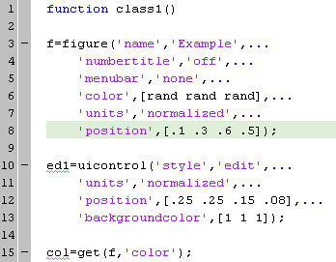
Cont.

Slide 37
Cont.
Now that the FIGURE colour is known and stored in the variable “col”, we can use this value as background colour for our text box UICONTROL.

Slide 38
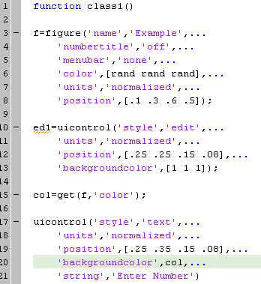

Slide 39
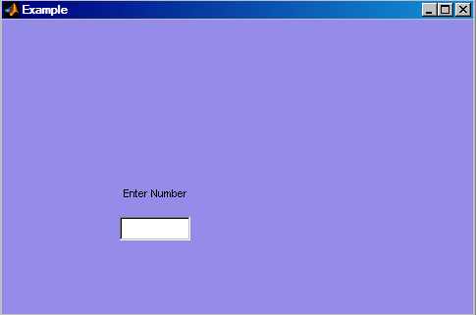
Result

Slide 40
Using the SET Command
Gives pre-existing objects new values for properties.
Syntax:
set(handle,’propertyName’,propertyvalue)

Slide 41
Example
Change background colour of text box from white to that of the current figure (random).

Slide 42
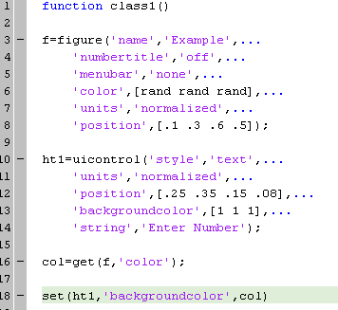

Slide 43
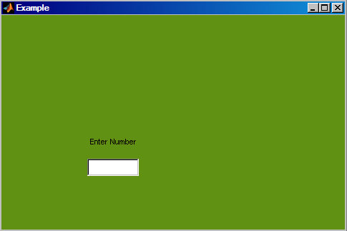
Result
Same as before.

Slide 44
Problem
FIGURE colour is given a random choice.
What if resulting random combination produces a figure that is too dark?
How can we create a random combination for the FIGURE colour, yet maintain that it’s still random?

Slide 45
More on RGB Vectors
Each element in the [R, G, B] vector controls the intensity of its corresponding value (red/green/blue).
This means for high values in the vector we get brighter colours.
Thus it is possible to make sure colour combination produces a bright colour if its elements are rather large.

Slide 46
Cont.
So if we somehow control the RAND command into giving values for a higher range, we would make sure that each time a colour combination is produced, it is on the lighter side.
For this we use
rand*0.5+0.5
Instead of
rand
Which gives us values in the range [0.5 1].

Slide 47
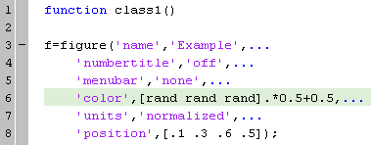
Example

Slide 48
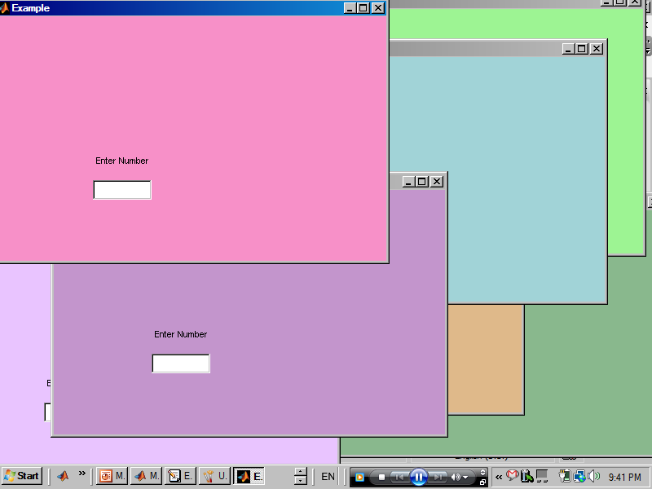
Result

Slide 49
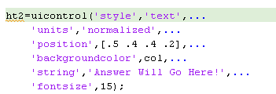
Creating Another Text Box
Let us create another text box and give it its own handle.

Slide 50
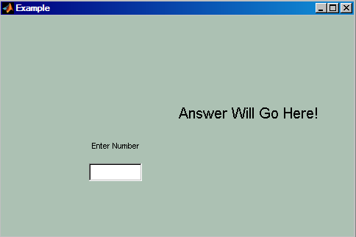
Result

Slide 51
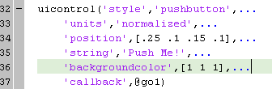
Creating a Pushbutton
Creating a pushbutton has the same syntax as other UICONTROLs.

Slide 52
Pushbutton Callback
Notice how the recently created pushbutton has the ‘callback’ propertyname with the propertyvalue “@go1”.
This means that whenever the user interacts with the UICONTROL (in our case push the pushbutton), we will execute the function “go1”.

Slide 53
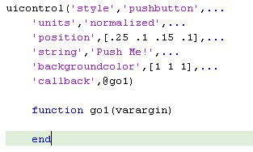
Creating the Callback Function

Slide 54
Programming the GUI
We want to put lines of code inside the callback function. That way, whenever the user clicks the pushbutton, something happens.
What happens is the number in the edit box is obtained, an operation is performed on it, then the result is to be displayed on the text box on the right.

Slide 55
Cont.
First we want to obtain the value found in the edit box.
To do this, we need to get the ‘string’ value of the edit box.
However, the value found here is in character format. To convert it into a numerical value, we use the command STR2NUM.

Slide 56
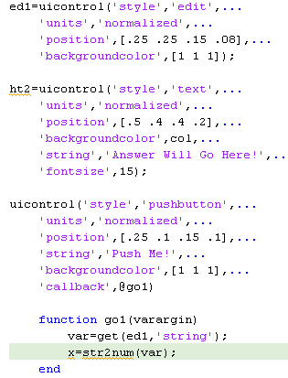
Example

Slide 57
Notes
The input to the function “go1” is the phrase “varargin”, which stand for variable arguments input.
This is due to the fact that the function has no inputs to it.
The command STR2DOUBLE can be used instead of STR2NUM for scalar values.

Slide 58
Programming the Pushbutton
After obtaining the number in the edit box, we will want to perform an operation on it, say square it.
After the operation is done, the result should be placed in the text box with handle “ht2”.
Remember: the numeric value should be converted to character format before being set as string. The command NUM2STR will be used for this purpose.
The command SET will be used to display the answer.

Slide 59
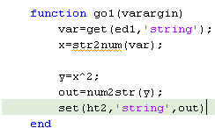
Example

Slide 60
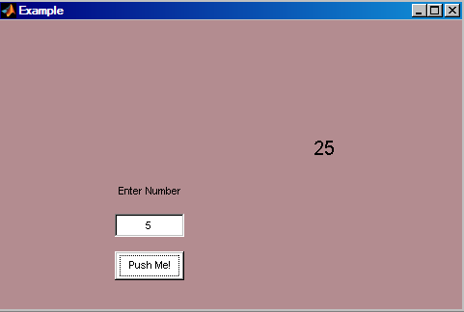
Result

Slide 61
Creating a Popupmenu
A popupmenu is a UICONTROL which gives the user a list of possibilities which they can choose from.
The defining properties of the popupmenu are the properties ‘string’ and ‘value’.

Slide 62
Popupmenu Property: ‘String’
The ‘string’ property contains a cell matrix with each row containing the string of one value (option).
Cell matrices automatically stack strings of different lengths together.

Slide 63

Example

Slide 64
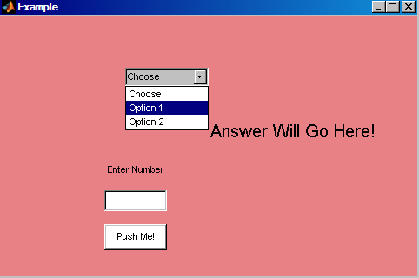
Result

Slide 65
Popupmenu Property: Value
The ‘value’ property is numeric and contains the row of string from the popupmenu which was chosen.
In our case, we want to edit our pushbutton callback into producing differing results based on the popupmenu options chosen.

Slide 66
Cont.
For this, we edit the popupmenu string and have the user chose between squaring and cubing the value in the edit box.
Thus when the pushbutton is pressed, the popupmenu value is checked and based on it, the operation performed will be different.

Slide 67
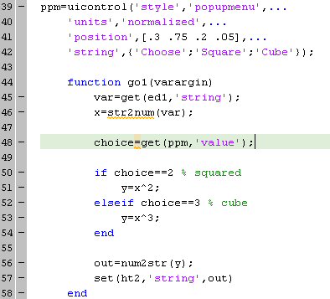
Example

Slide 68
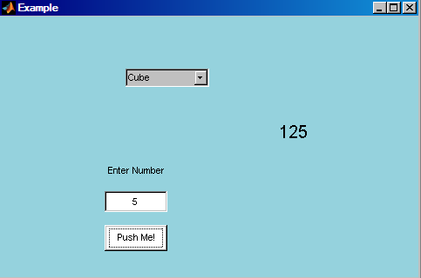
Result

Slide 69
Problem
Each time the pushbutton is pressed, the value in the text box updates depending on the chosen value from the popupmenu.
Say we want the answer to update every time the popupmenu is updated, what should we do?

Slide 70
Solution
We want the pushbutton callback to be executed whenever the popupmenu is interacted with.
This means we should give the popupmenu a callback function.
Let this be the same as the pushbutton callback function.
The result is the same callback, but this time being executed when the user either click the pushbutton, or updates the popupmenu.

Slide 71
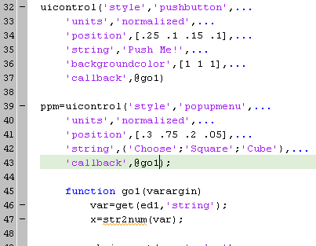
Example

Slide 72
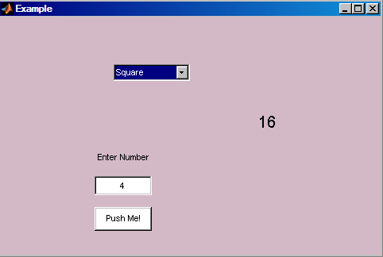
Result

Slide 73
Other UICONTROLs
There exists many other useful UICONTROL styles, but the most important ones have been covered.
Also to be covered are the listbox, the slider, the checkbox and the radiobutton.

Slide 74
Listbox UICONTROL
Its function is very similar to the popupmenu.
In fact it behaves exactly the same in regards to the properties ‘string’ and ‘value’.

Slide 75
Listbox Value
We want to create a listbox just as we did with the popupmenu.
Notice how the listbox needs to have a large value for its length.
In the “go1” callback, the value in the listbox is checked and an operation is performed accordingly.

Slide 76
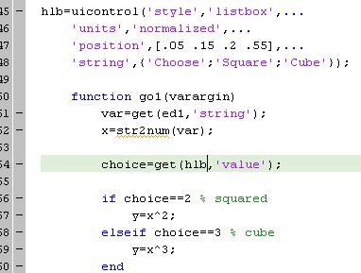
Example

Slide 77
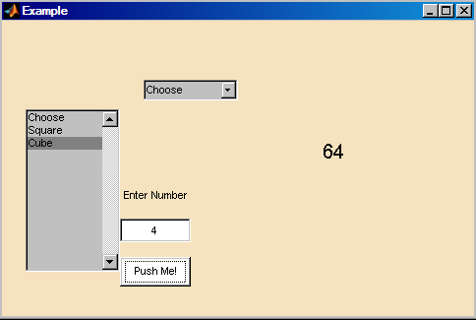
Result

Slide 78
Slider UICONTROL
Sliders can be used in many different ways.
Important slider properties include MIN, MAX, VALUE and SLIDERSTEP properties.

Slide 79
Slider Properties: MIN, MAX and SLIDERSTEP
MIN and MAX properties take the values of the minimum and maximum of the slider, respectively.
SLIDERSTEP is a two element vector that controls how much the slider VALUE changes with each click.

Slide 80
Slider Property: SLIDERSTEP
The first value of SLIDERSTEP controls how much the slider moves when one of the arrows on its far sides is clicked.
The second element governs the change of slider value when clicking on an empty space in the slider itself.
Both SLIDERSTEP element are scaled to the MIN to MAX scale, meaning they are to be in the range
[0, 1].

Slide 81
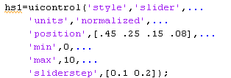
Example

Slide 82
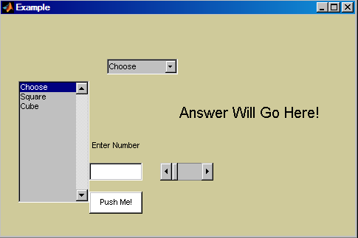
Result

Slide 83
Using the slider to its full potential
What we want to do is make the slider control the number to be inputted.
To do this, we give the slider a callback.
When interacting with the slider, its value will be placed in the edit box.
Then the operation specified by the listbox will be performed, and the answer will be displayed in the text box.

Slide 84
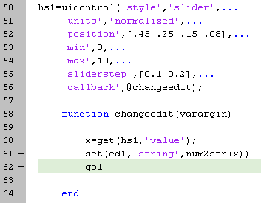
Example

Slide 85
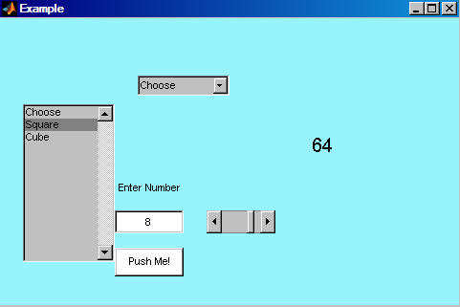
Result

Slide 86
Problem
What if we want the edit box to control the slider?

Slide 87
Solution
Just like any other UICONTROL, the edit box can be given a callback as well.
In the edit box callback, we change the value of the slider accordingly and then apply the main pushbutton callback “go1”.

Slide 88
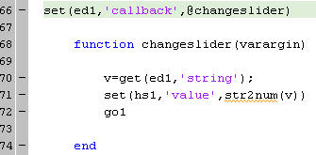
Example

Slide 89
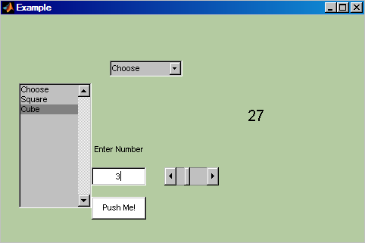
Result

Slide 90
Problem
Remember how we have set the MAX property of the SLIDER to 10?
Well what if this value is exceeded in the edit box, what should happen?

Slide 91
Solution
If the value to be set in the slider is higher than its MAX property or lower than it MIN property, then the SLIDER wouldn’t be created.
A solution to this problem is to create an error dialog box whenever this happens, and then proceed to reset the slider.

Slide 92
ERRORDLG Function
The function ERRORDLG produces an error dialog box with two input parameters.
The second input is the box title, while the first is the error message itself.
Syntax:
errordlg(title,message)

Slide 93
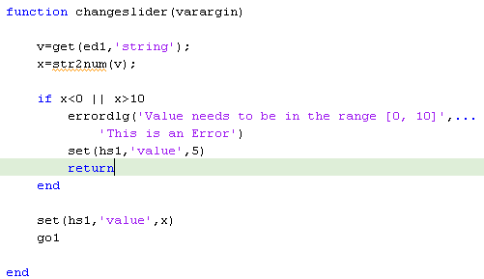
Example

Slide 94
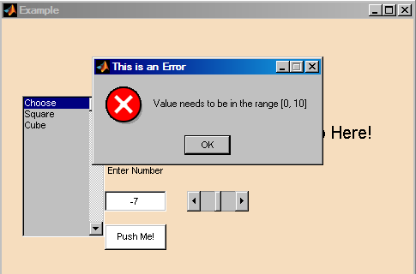
Result

Slide 95
Checkbox UICONTROL
The checkbox UICONTROL is similar to the listbox and popupmenu in which it has a defining VALUE property.
The value for each checkbox can either be “1” (i.e. checked) or “0”.
Another handy property is the ‘string’ property.

Slide 96
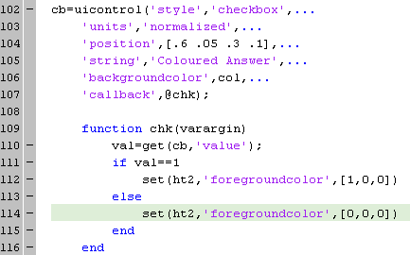
Example.

Slide 97

Result

Slide 98
Radiobutton UICONTROL
The radiobutton is very similar to the checkbox.
You can create a radiobutton group. That way, only one of the buttons in the group can be selected “on” (i.e. has the value of “1”)

Slide 99


Example

Slide 100

Result

