Slide 1

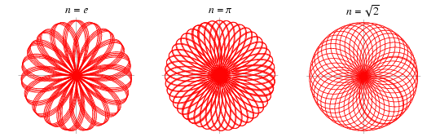
The Rose Curve
By Cailan Halliday
And
Sarah McCormick

Slide 2
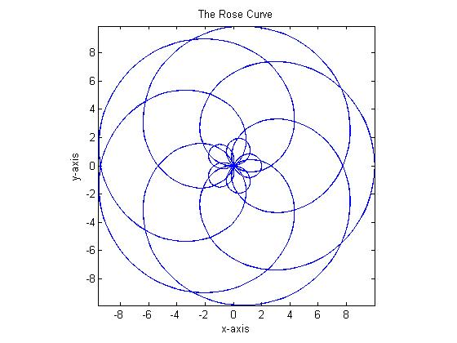
History
Guido Grandi named this
curve “rhodonea” or rose

Slide 3
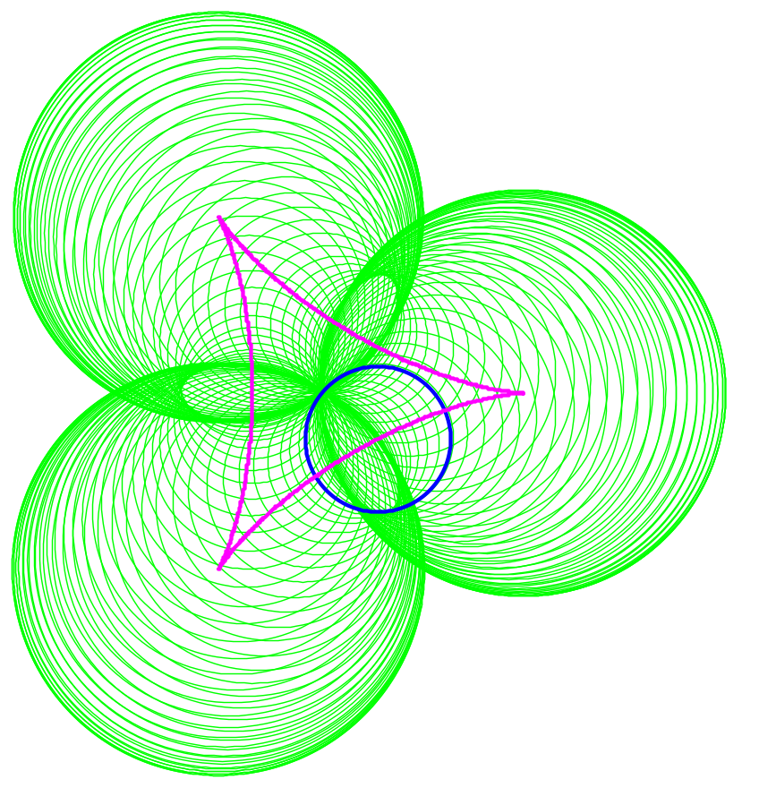
What is the Rose Curve?
The petal of any hypocycloid or epicycloid
What is a petal?

Slide 4
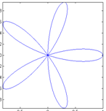
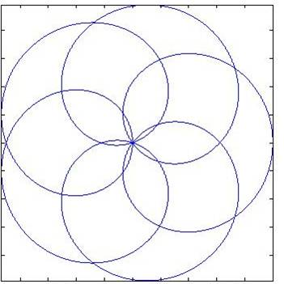
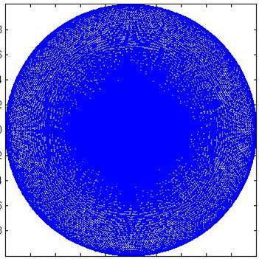
Period of the Rose Curve
r = cos(kθ)
Where k is a rational number
Or
r = cos(p/qθ)
Where p and q are integers
When p and q are both odd integers the period of the rose curve is π*q with p petals.
Otherwise the period is 2*π*q and has 2*p petals
If k is not a rational number (π, e, etc.) a solid disc will be drawn if θ is unbounded.

Slide 5
Parameterization of the rose curve
r = cos(p/q θ)
x = rcos(θ)
y = rsin(θ)
↓
x = cos(p/q θ)cos(θ)
y = cos(p/q θ)sin(θ)

Slide 6
Bibliography
Xah Lee, 1995-97 (5/8/06) http://xahlee.org/SpecialPlaneCurves_dir/specialPlaneCurves.html
Epitrochoids, Jan 1997 http://www-history.mcs.st-andrews.ac.uk/history/Curves.html
Roulette, rhodonea, 9 Aug 2005 (5/12/06) http://www.2dcurves.com/roulette/rouletter.html
Rose(mathematics), Wikipedia, 15 April 2006 (5/7/06) http://en.wikipedia.org/wiki/Rose_(mathematics)
Rose, Wolfram Research, Inc, 1999-2006 (5/7/06) http://mathworld.wolfram.com/Rose.html
Lockwood, E.H. 1967, A Book Of Curves, Cambridge University Press, New York

