Slide 1


Slide 2
The Double Pendulum
by
Franziska von Herrath
&
Scott Mandell

Slide 3
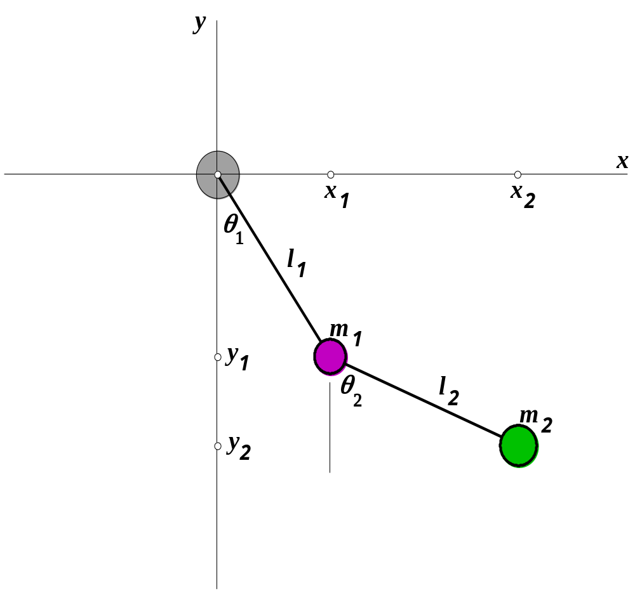
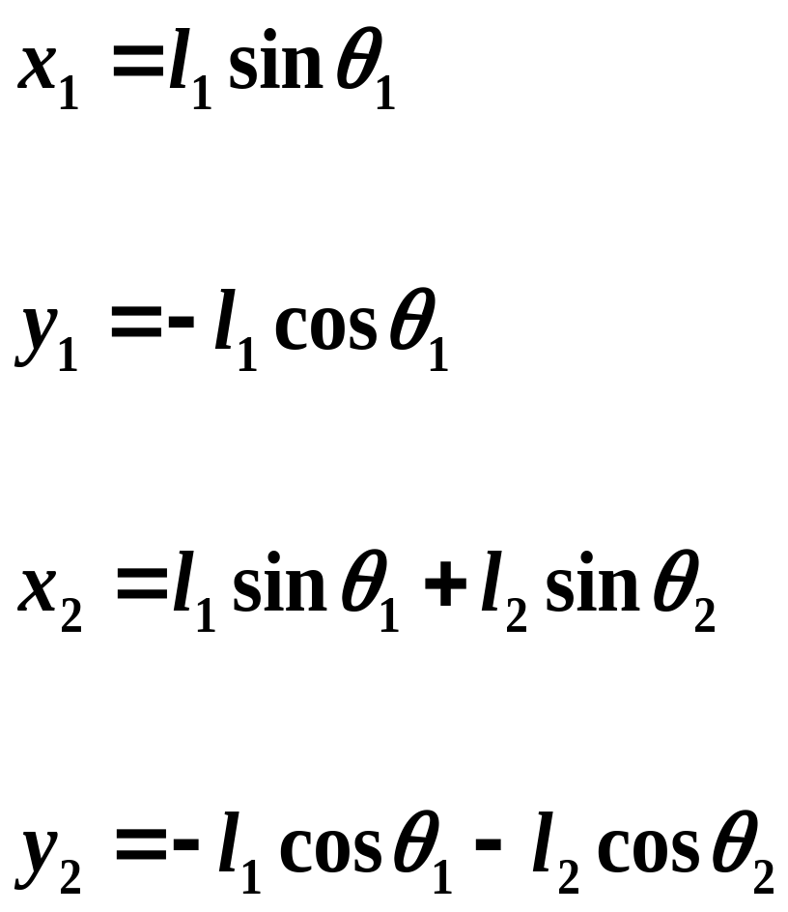

Slide 4
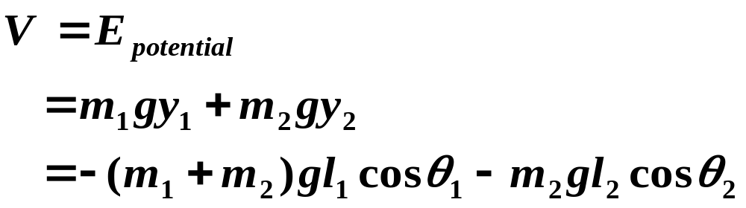
The potential energy of the system is found by combining the potential energy of each mass.

Slide 5
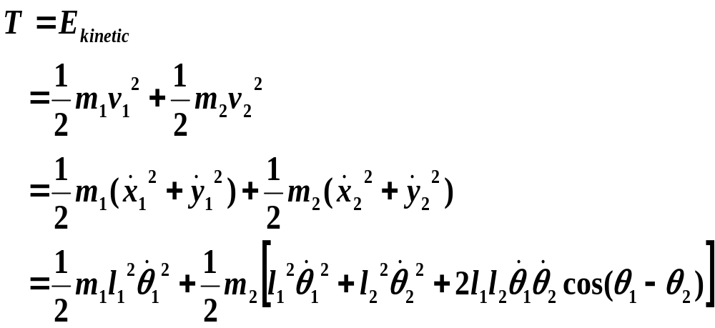
The kinetic energy of the system is found by combining the kinetic energy of each mass.

Slide 6
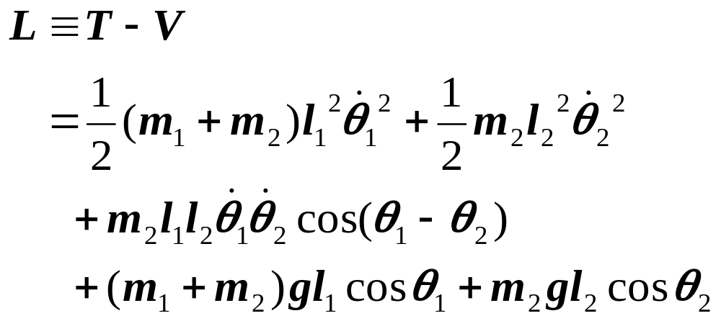
The Lagrangian of the system is:

Slide 7
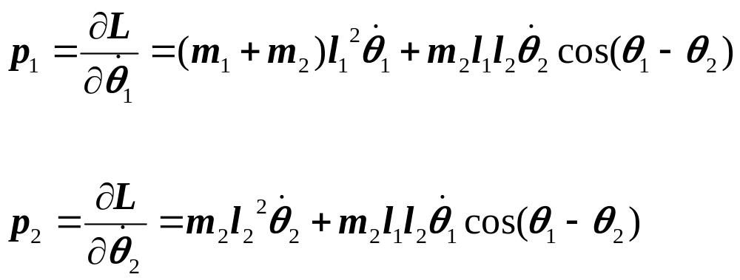
Equations for generalized momenta of each angle are found by taking the partial derivative of L with respect to the time derivative of the corresponding angle.

Slide 8
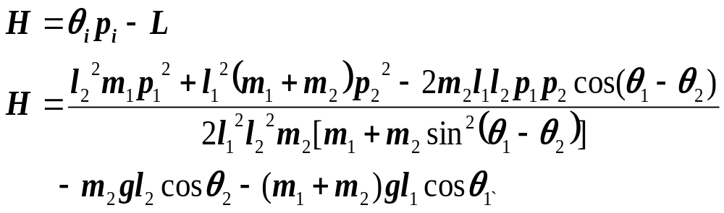
After solving p₁ and p₂ for θ’₁ and θ’₂ respectively and simplifying, the following Hamiltonian is obtained:

Slide 9
Since the Hamiltonian is a function of all the initial conditions, the equation can be separated into four first order non-linear differential equations by taking partial derivatives with respect to the appropriate variables.

Slide 10
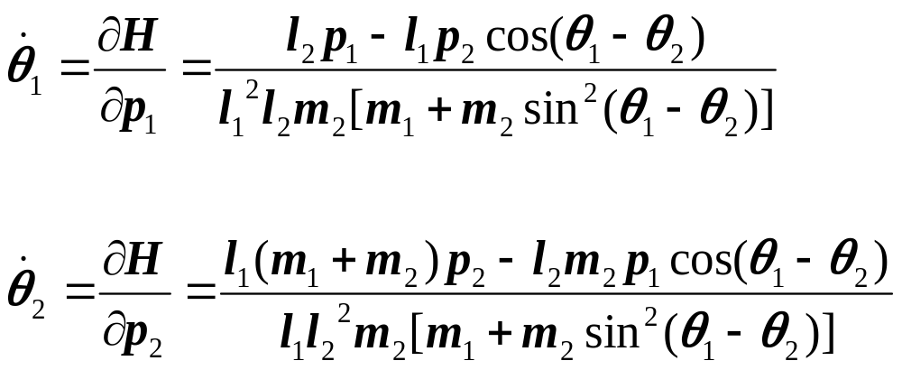

Slide 11
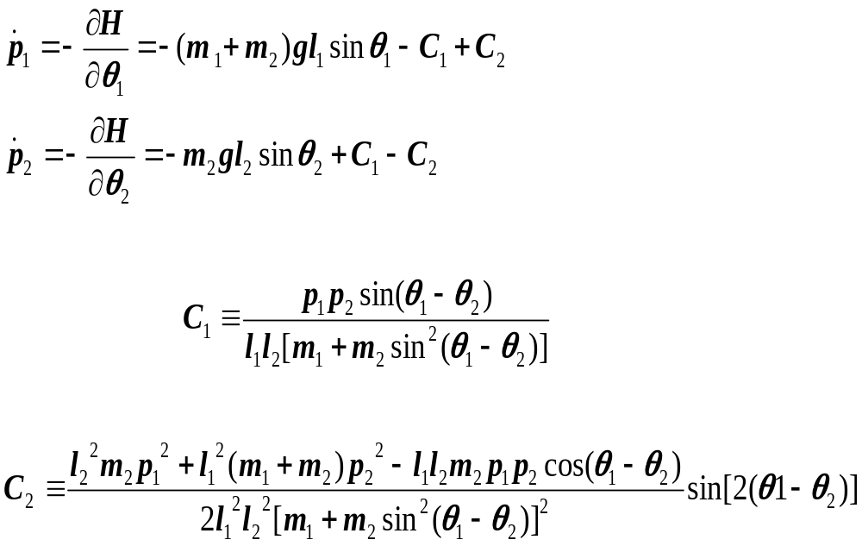

Slide 12
This system of four non-linear differential equations cannot be solved explicitly. Matlab’s ODE45 routine is used to get numerical solutions for θ₁ and θ₂, p_{1,} and p_{2.,}

Slide 13
Depending on the initial conditions, the double pendulum exhibits three types of motion:
Periodic
Quasiperiodic
Chaotic

Slide 14
At low energies, periodic motion dominates the system’s behavior. As the energy increases, the behavior becomes more chaotic. At high energies, the motion of the system is more ordered again. When the energy increases to infinity, periodic and quasiperiodic motion is observed.

Slide 15
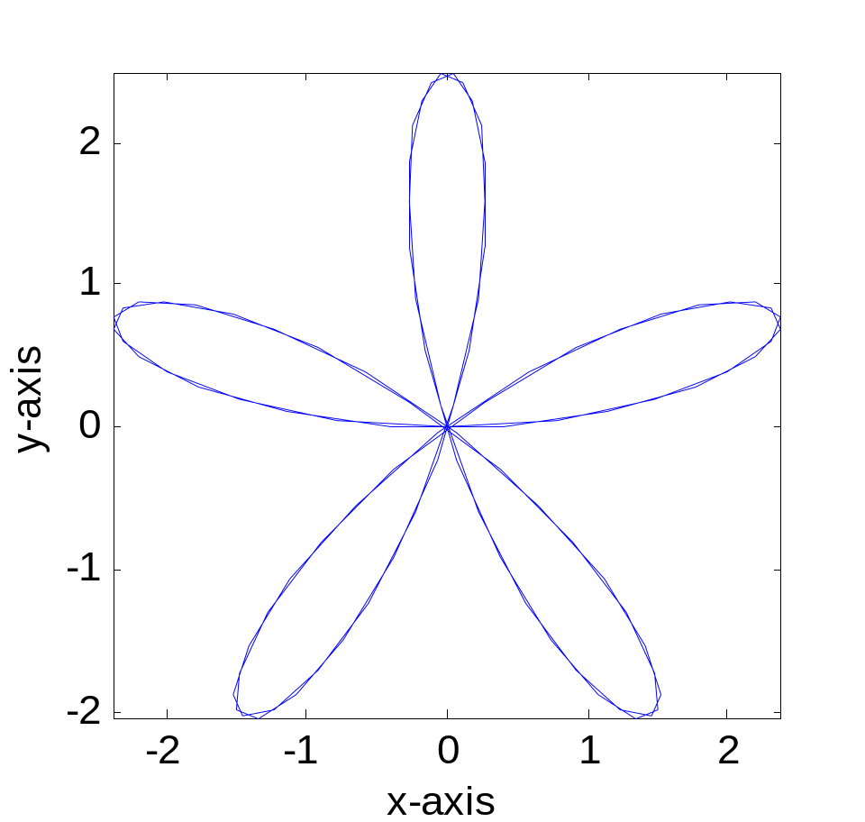
Periodic Motion
The system’s motion is cyclic.

Slide 16
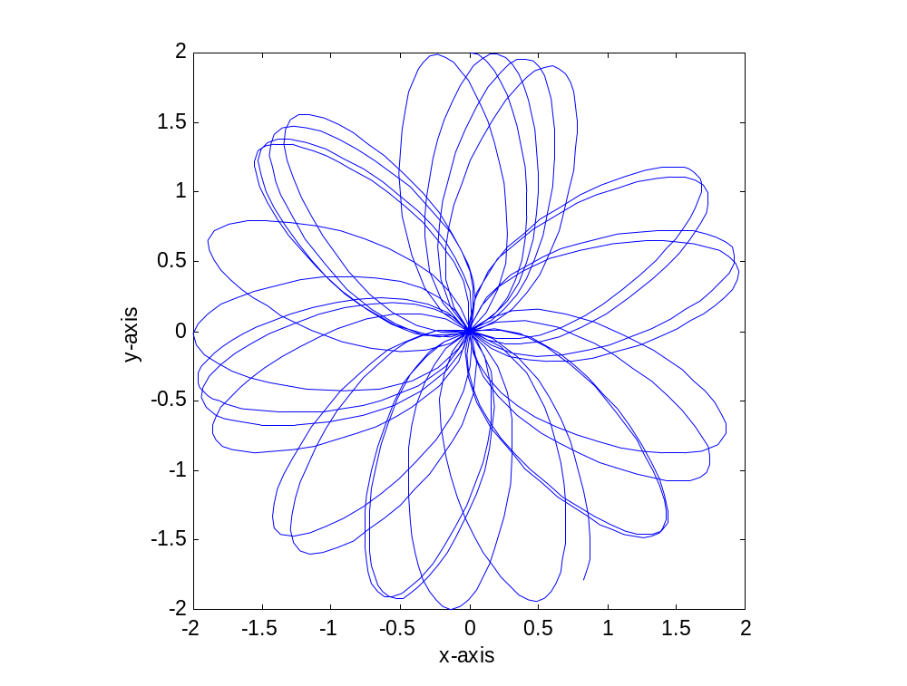
Quasiperiodic Motion
The system’s motion is almost periodic.

Slide 17
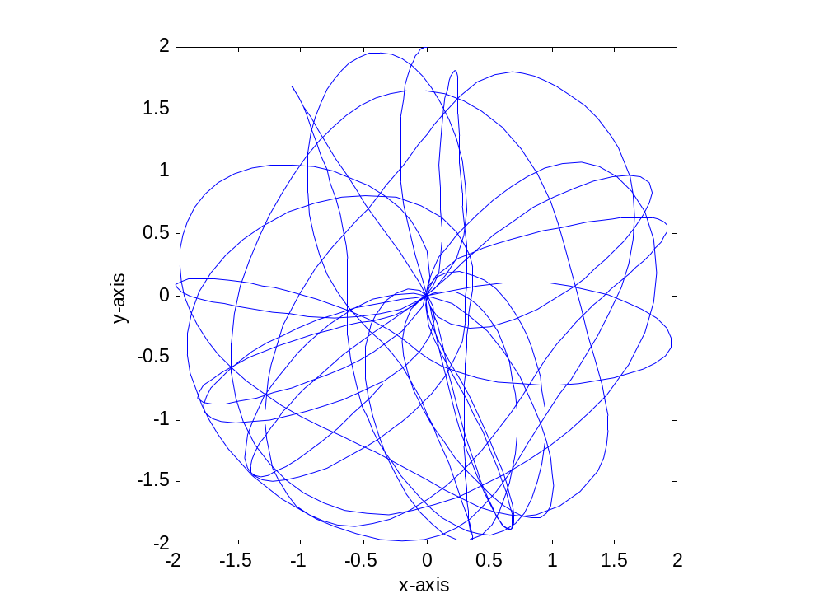
Chaotic Motion
The system’s motion is unpredictable and non-repetitive.

Slide 18
Chaotic Motion
Two systems with almost identical initial conditions show very different long term behavior.

