Slide 1
The Cardioid
By Stuart Blankenship
&
Hans Parshall

Slide 2

What does it mean?
Cardioid, coming from the Greek roots ‘cardi’ for ‘heart’ and ‘-oid’ for ‘resembling’, roughly translates to “heart-shaped.”

Slide 3
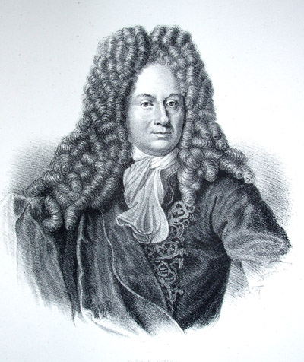
Who Was Involved?
Ole Christensen Rømer
17th century Danish astronomer
Made the first quantitative measurements of the speed of light
Studied the cardioid to find the best form of gear teeth

Slide 4
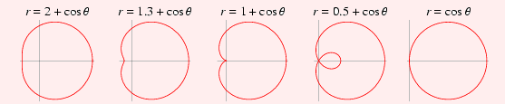
A Special Case Of…
The Limaçon

Slide 5
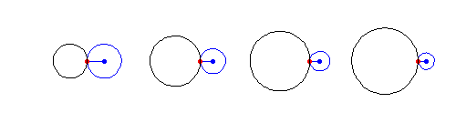
A Special Case Of…
The Epicycloid

Slide 6
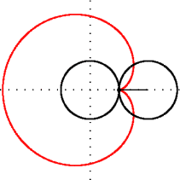
Parametric Equations
The parametric equations
x(t)=
2r(cost – (1/2)*cost)
y(t)=
2r(cost – (1/2)*cost)
create a cardioid similar to the one shown on the left.
r is the radius of each of the circles.

Slide 7
Other Properties
Polar Equation
r(θ)=
a(1-cosθ)
where a is the radius of one of the two circles in the previous slide
Area
(3/2)*pi*a
Length
8*a

Slide 8
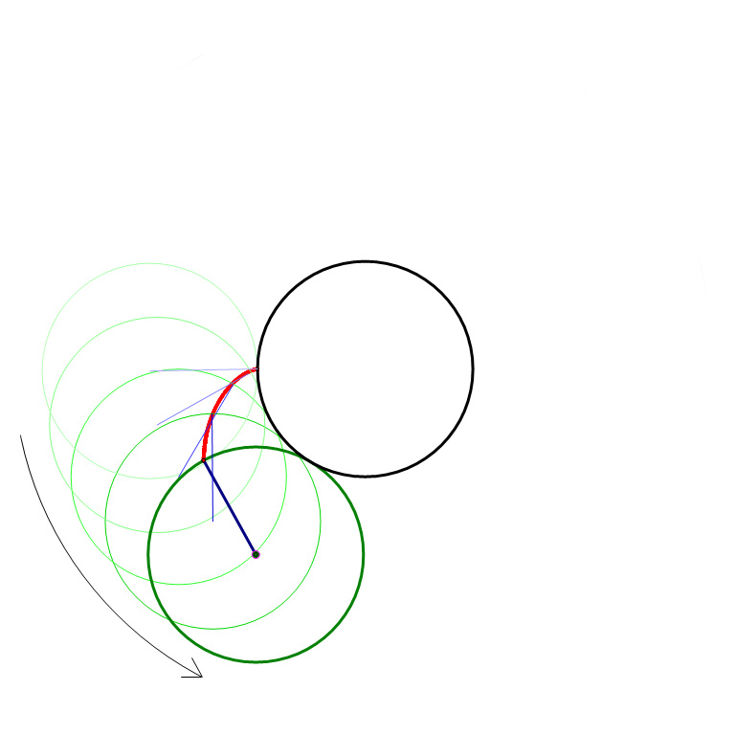
Trace of an Epicycloid

Slide 9
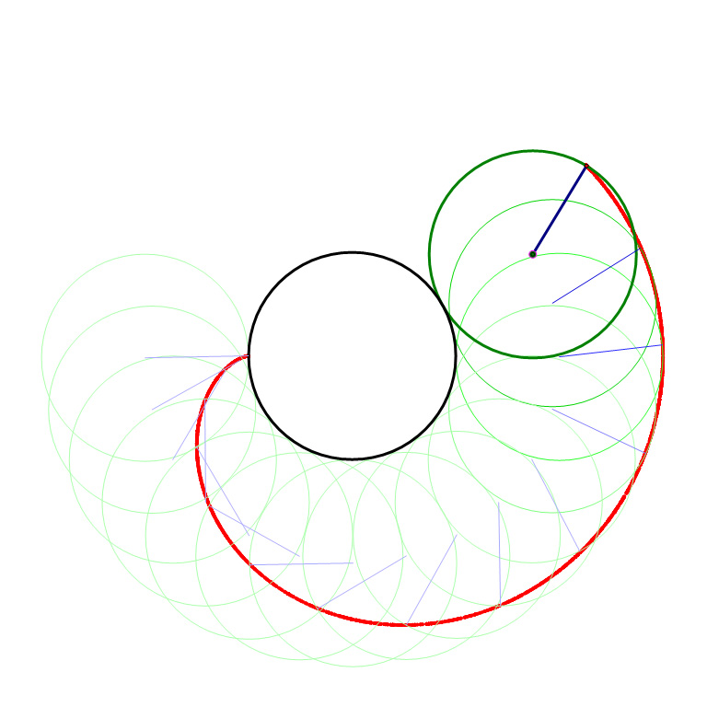
Trace of an Epicycloid

Slide 10
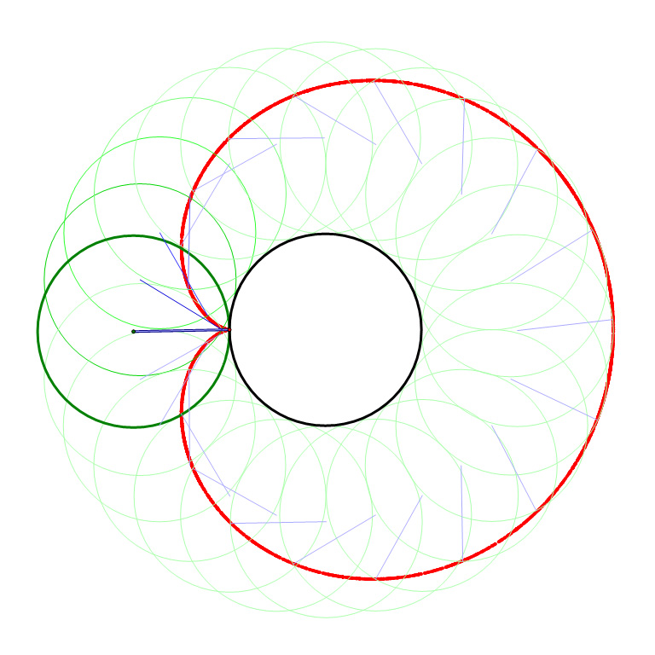
Trace of an Epicycloid

Slide 11
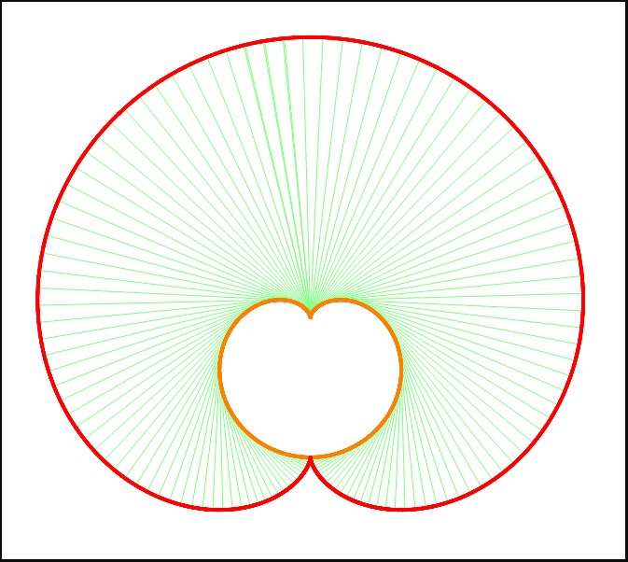
The Evolute
Cardioid
Evolute
Radius of the
Circle of Osculation

