Slide 1

Lead Levels in the Human Body
Math 55
Miyuki Shimokawa

Slide 2
CONTENTS
Introduction
Building the Model of the kinetics of lead
Identification of the Model
Case study

Slide 3
Introduction
Lead is closely related in many objects of everyday life: gasoline, water pipes, paint, & soil
Lead is harmful to human body if it is intake in large quantities.
Average intake of an adult person in a day is 200 ~ 500 µg of lead.
Symptoms such as headache and nervous disturbances.

Slide 4
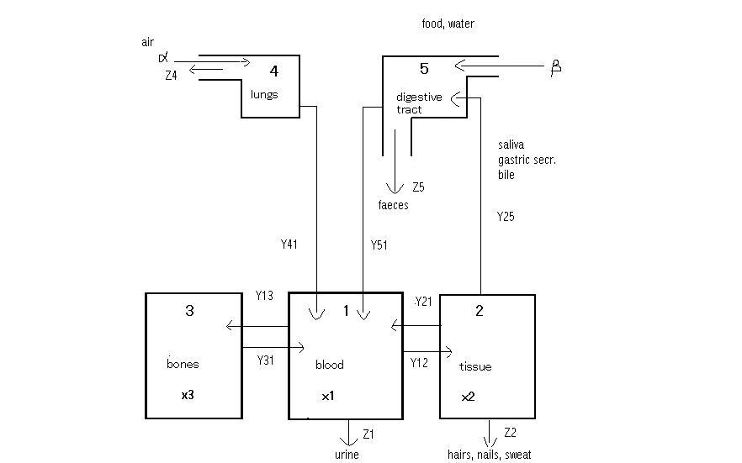
A three compartment model for the kinetics of lead

Slide 5
Building the model of kinetics of the lead
α: the daily input of lead into the lungs
β: the daily food & water intake in the digestive tract
Z(1): lead leave by urine from blood
Z(2): lead as hairs, nails, & sweat
Z(4): lead contained in the dust particles
Z(5): lead excreted out of body

Slide 6
Y2,5: lead contained in saliva, gastric secretion
Y4,1: the absorbed portion from lungs
Y4,1 = α - Z(4) = pα , p(0 < p < 1) (1)
Y5,1: absorbed portion of lead from the digestive tract
Y5,1 = q ( β + Y2,5 ) , q(0 < q < 1) (2)

Slide 7
Y2,1 , Y1,2: exchange of lead between blood & tissue
Y1,3 , Y3,1:exchange of lead between blood & bones

Slide 8
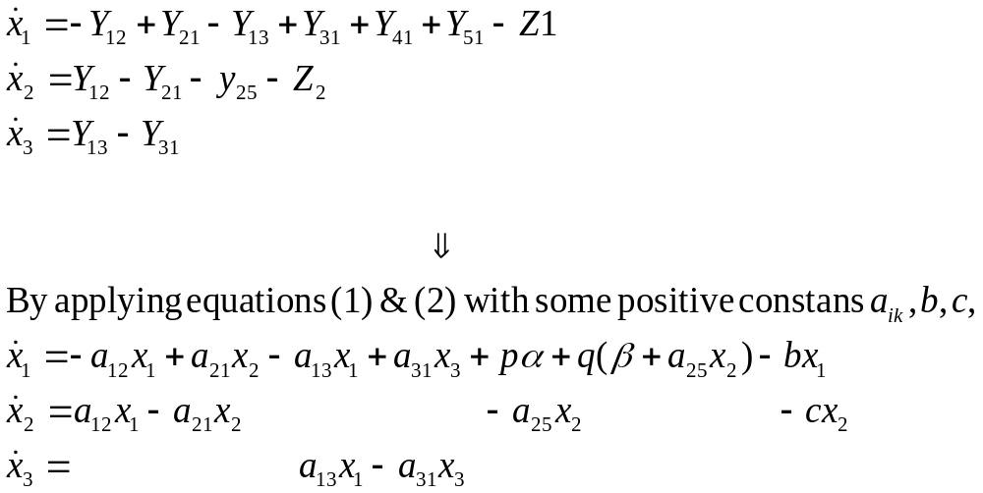
Differential Equation (1), (2)

Slide 9
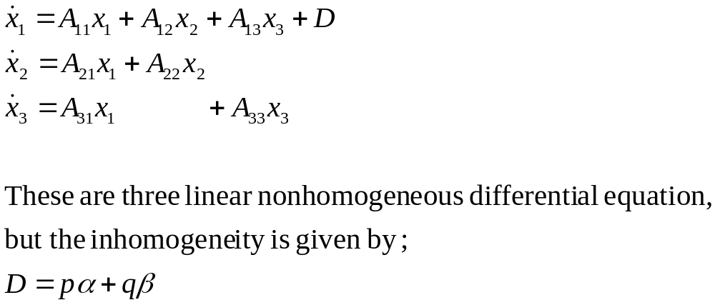
By combining terms,

Slide 10
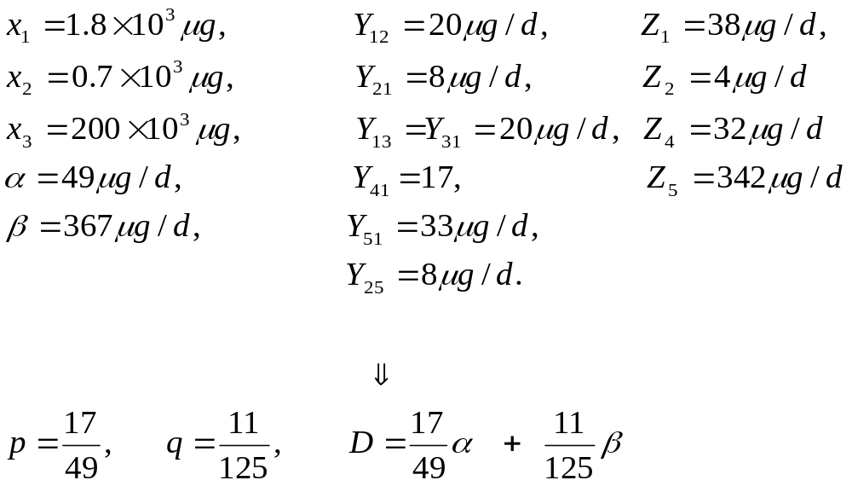
Identification of the Model

Slide 11
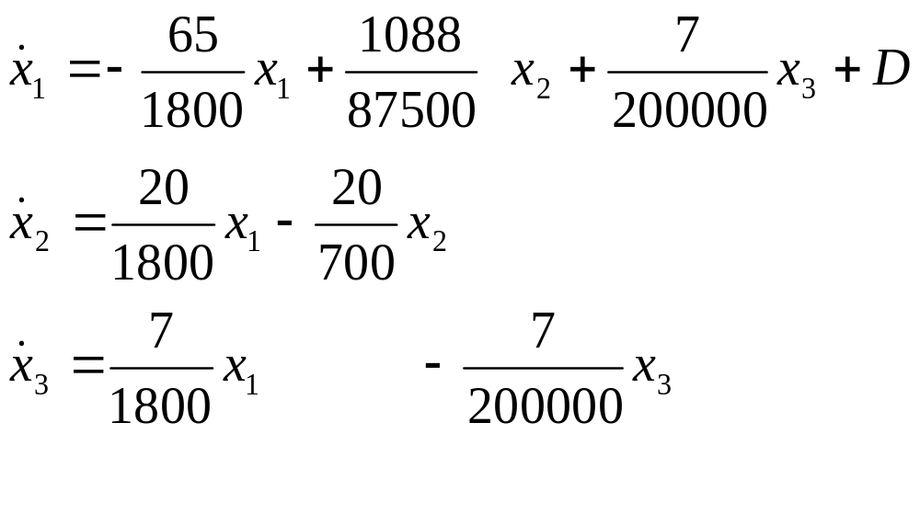
Differential Equation (3)

Slide 12
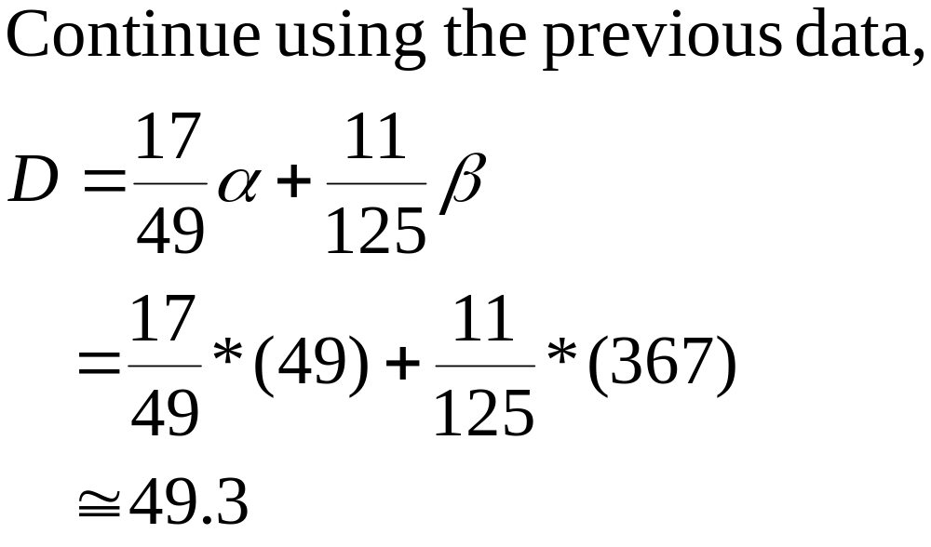
Case Study

Slide 13
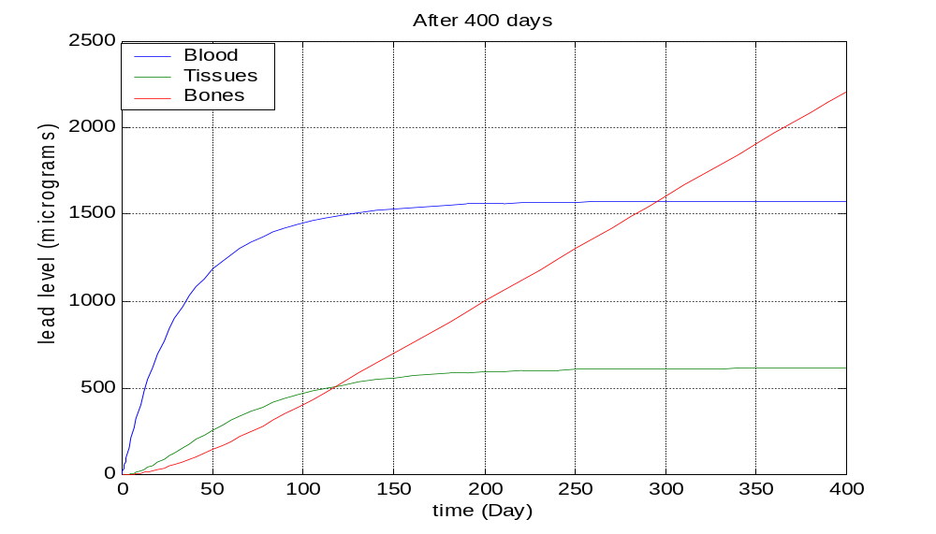
After 400 days,

Slide 14
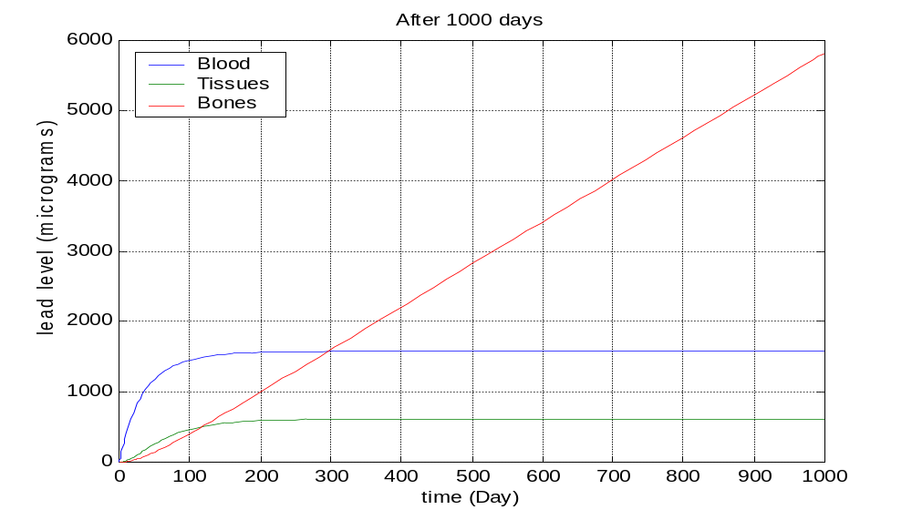
After 1000 days,

Slide 15
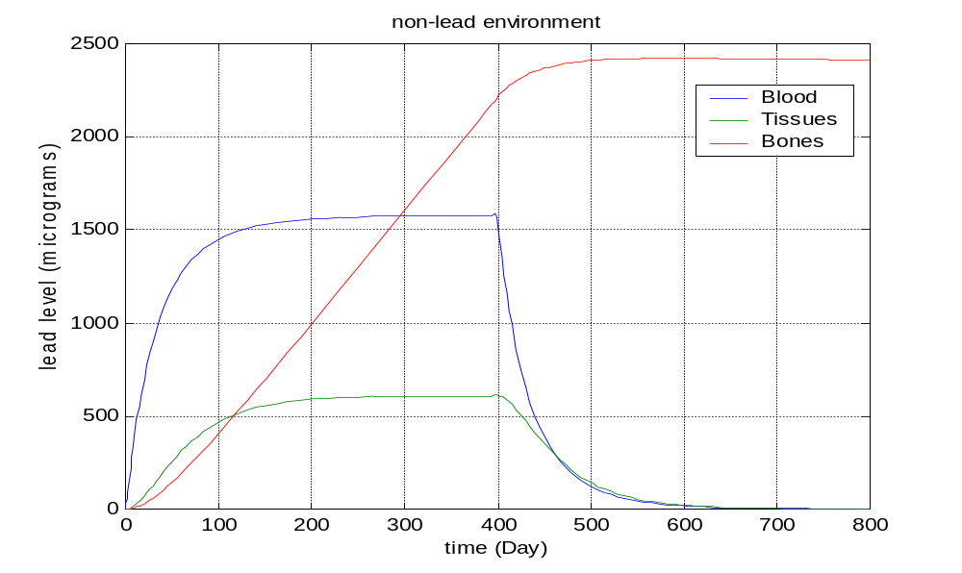
If get the lead out of the environment
D=49.3step(400-t)

Slide 16
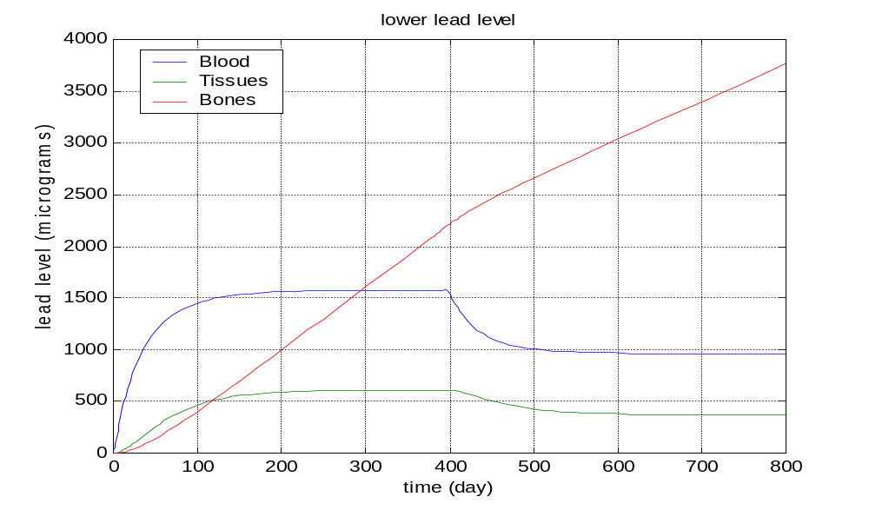
If reduce the lead of the environment
D=49.3step(400-t)+33step(t-400)

Slide 17
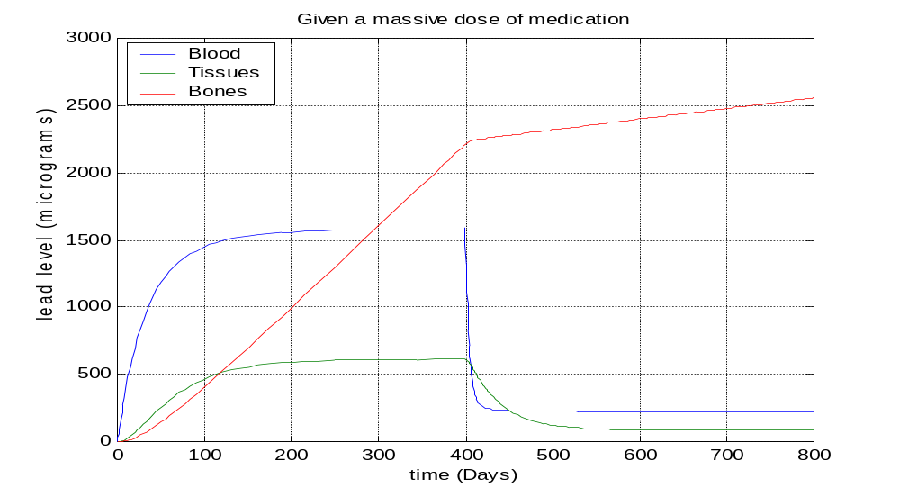
If given a massive dose of the medication
D=.0211step(400-t)+.211step(t-400)

Slide 18
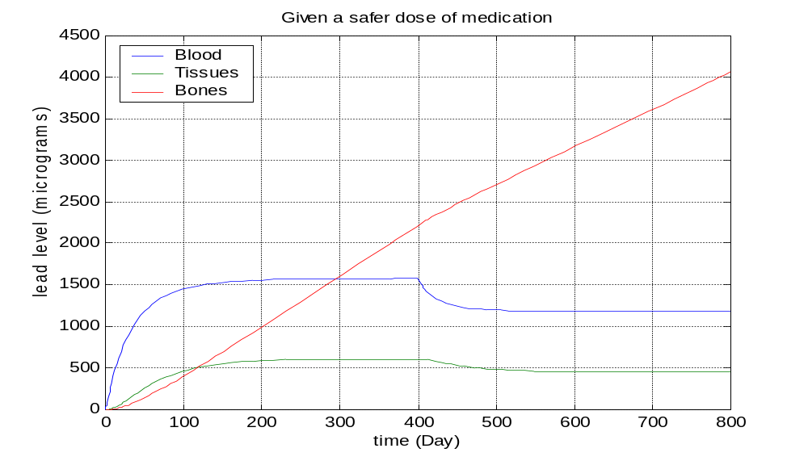
If given a safer dose of medication
D=.0211step(400-t)+.0316step(t-400)

Slide 19
Conclusion;
The equations remain in the linear relation.
The lead level is dependent on the intake rate D.
Also depends on step functions as forcing functions.

